Slide 1

Connect4
Stack, Connect, Win

Slide 2
Presented by
Nelema Jahan
ID:BFH2125032F
Year:2nd Term:1
Supervised by
Tasniya Ahmed
Assistant Professor
Institute of Information Technology
Noakhali Science and Technology University

Slide 3
Contents
Introduction
Objectives
Features
Interface
Key Skills Set
Challenges
Stakeholder
Conclusion

Slide 4



Introduction
Connect 4 is a two-player connection game in which the player first choose a color and then take turns dropping colored discs from the top into a seven-column, six-row vertically suspended grid. The pieces fall straight down , occupying the next available space within the column . The ultimate goal of the game is to be the first to form a horizontal , vertical, or diagonal line of four of one’s own discs.

Slide 5
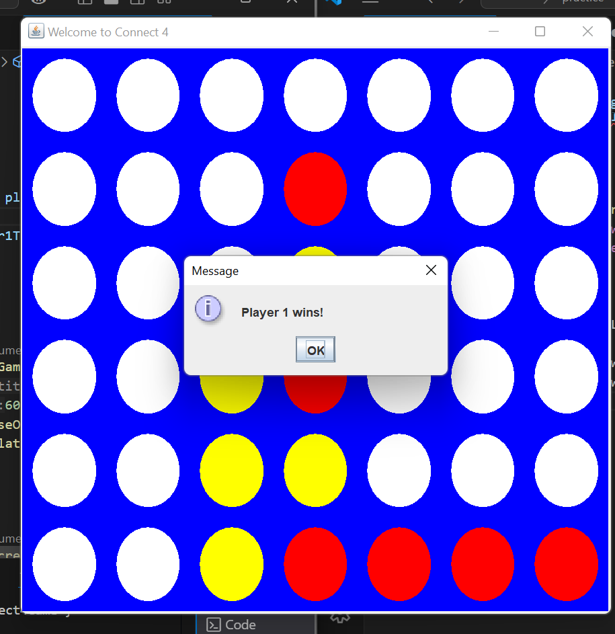
Objectives
1. Enhances Strategic Thinking
2. Improves Problem-Solving Skills
3. Boosts Cognitive Skills
4.Entertainment purpose

Slide 6
Feature
1
Game Board
2
Colored Dice
3
Player mode option

Slide 7
Interface
1
Welcome Message
2
Player mode message
3
Game Board

Slide 8
Key Skills Set
Knowledge of core OOP Principles
Java swing
Implementation of algorithm

Slide 9
Challenges
Implementation of algorithm
Logic building

Slide 10
Stakeholders
1
Computer Operator
2
Programmers
3
Student

Slide 11
This project aims to deliver a Connect 4 game using Java Swing, providing an enjoyable gaming experience.
Conclusion’

Slide 12
Thank you.

