Slide 1
Rapid Test Data Review Using Python Automation
Wandji Lionel Wilfried (PSS RF D RAD PTE TE4)
27.03.2026

Slide 2

Background
TE common work packages:
Test plan definition and test development
Production release and transfer to the production
Quality and reliability support
Hardware interface development
Characterization and correlation
Debug and failure analysis support
Test time optimization
Yield analysis and yield optimization
Limit setting and guard-banding
Documentation and change control
Cross-functional support with other stakeholders to close test-related issues
…
Meet the targets under time constraints while delivering highly qualitative TPs
Tight timeline (time-to-market) requiring concurrent releases (e.g. CTRX8188 FE Test-D1 & FE Test-D2 & BE Test-D)

Slide 3
Background
TE common work packages:
Test plan definition and test development
Production release and transfer to the production
Quality and reliability support
Hardware interface development
Characterization and correlation
Debug and failure analysis support
Test time optimization
Yield analysis and yield optimization
Limit setting and guard-banding
Documentation and change control
Cross-functional support with other stakeholders to close test-related issues
…
Verification runs and test data review necessary
Common approach for the test data review:
Load the data in Chronos or any other data visualization tool
Go through the fails pareto and review the failing tests
Review the (key parameter) tests one by one
→ Large datasets to review across FE, BE and Q insertions
From DPLL (57 tests) → TX (4535 tests) responsibility
→ Causing high effort and high workload at certain periods of the releases roadmap
→ Tedious, repeatitive and highly demanding task on top of other important tasks
In general an „unlikeable“ but necessary aspect of TP releases

Slide 4

Automated approach
TE common work packages:
Test plan definition and test development
Production release and transfer to the production
Quality and reliability support
Hardware interface development
Characterization and correlation
Debug and failure analysis support
Test time optimization
Yield analysis and yield optimization
Limit setting and guard-banding
Documentation and change control
Cross-functional support with other stakeholders to close test-related issues
…
Verification runs and test data review necessary
Common approach for the test data review:
Load the data in Chronos or any other data visualization tool
Go through the fails pareto and review the failing tests
Review the (key parameter) tests one by one
→ Large datasets to review across FE, BE and Q insertions
From DPLL (57 tests) → TX (4535 tests) responsibility
→ Causing high effort and high workload at certain periods of the releases roadmap
→ Tedious, repeatitive and highly demanding task on top of other important tasks
In general an „unlikeable“ but necessary aspect of TP releases
Let‘s automate this!

Slide 5
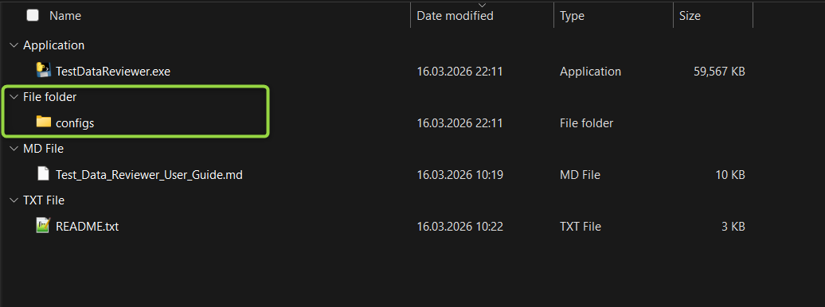
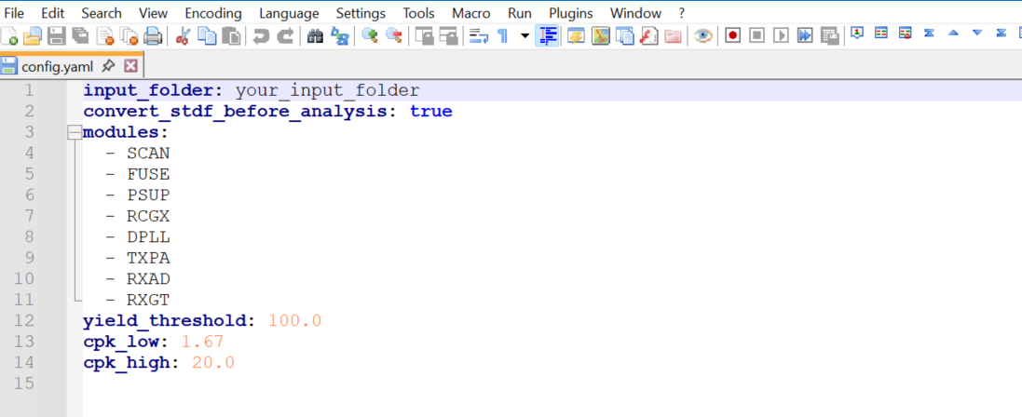
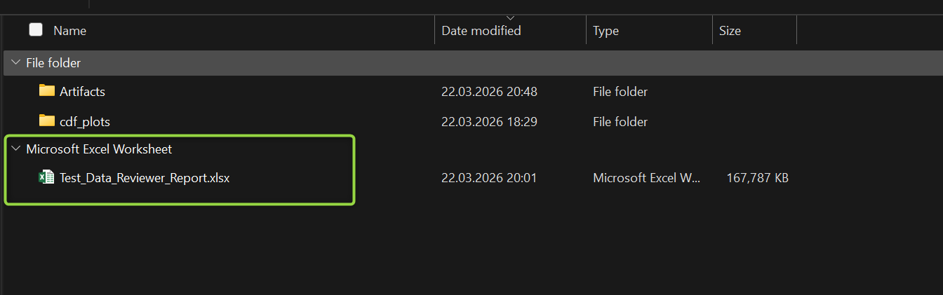

Automated solution
Download the zipped packaged TDR (test data reviewer) folder in Gitlab Test Data Reviewer Latest
After unzipping the TDR folder, it will look like as in the screenshot
Edit the YAML-config file available in the configs-folder with the following informations:
input_folder → where to locate the test raw data (all .std, .eff, .std.tar-gz or .csv extracted data will be processed individually)
modules → which modules to be considered for the review
The review report and artifacts will be generated in input_folder\Outputs
Remaining input parameters can be modified but it‘s not recommended
Open a Powershell-terminal in the TDR folder and run the command below as documented in the readme and markdown text files
.\TestDataReviewer.exe --config .\configs\config.yaml
After the script run completion, you can open the generated review report and start reviewing the tests of your defined modules, which are detected based on 7 key metrics as explained in the next slides

Slide 6
Key metrics
Yield
Detect all tests having at least 1 failing device
Cpk low
Detect all tests having a Cpk < 1.67
→ Test distributions close to the limits that might be passing but susceptible to generate yield losses in different testing setups
Cpk high
Detect all tests having a Cpk > 20
→ Tests having too wide limits, which degrade the coverage quality especially for non-monitoring tests
Site-to-site deltas
Multimodality
Detect all tests showing site-to-site offset behavior
Unique values
Skewness
Detect all tests (analog only) having fixed (< 10) test results
Detect all tests (analog only) having double or more distributions
Detect all tests having „tails“ in the distribution
→ Potential instrument quantization error, rounding or clipping errors, any other similar code issue ...
→ Most likely HW-related issue
→ Potential instrument settling issues, heating effects, intermittent contact or relay behavior, process variation, ... etc
→ Mixed populations due to site-to-site offsets, process variation, ... etc

Slide 7
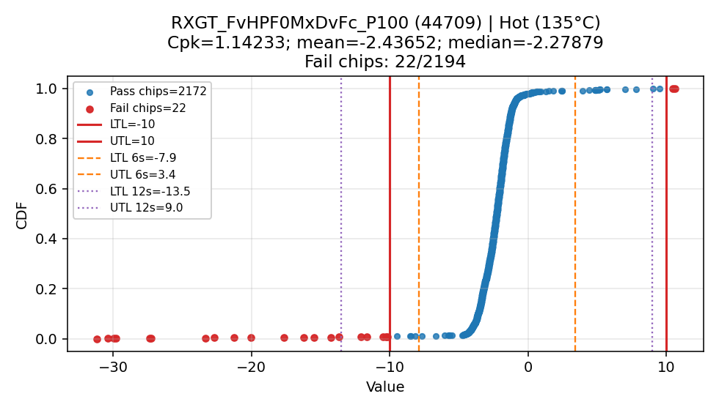
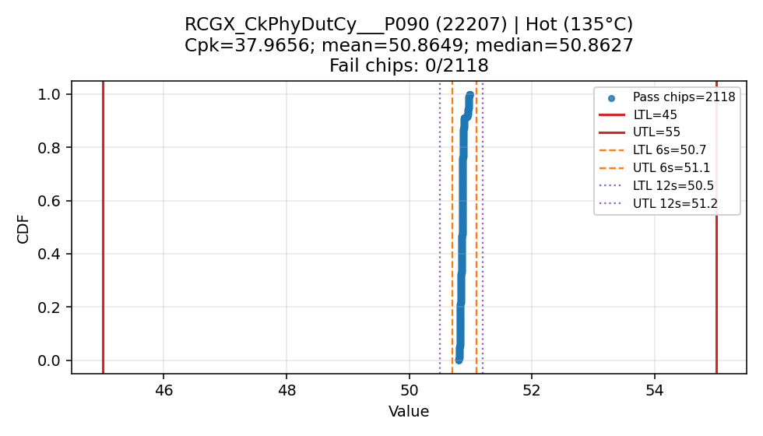
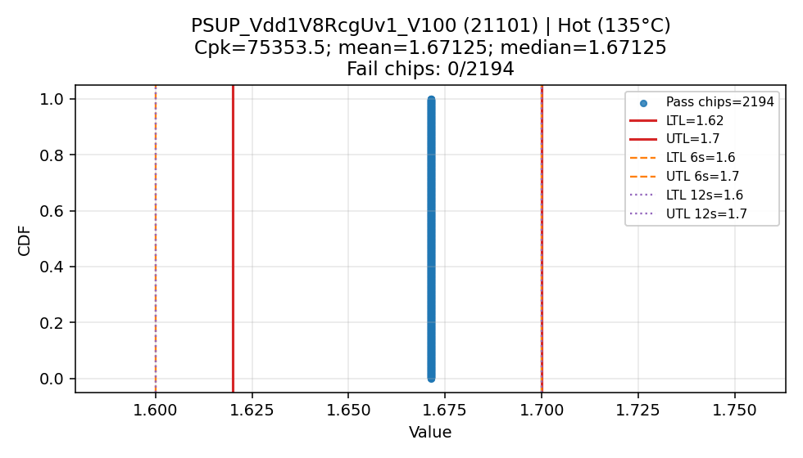
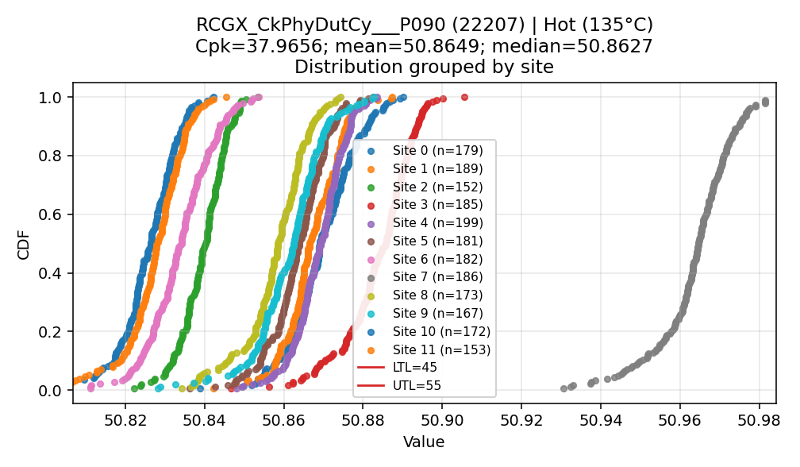
Key metrics Example with the CTRX8188 3FTCU151 W01, S1, Test-D34 data
Cpk low
Cpk high
Fails
Multimodality
Skewness
Site-to-site offset
Unique values

Slide 8

Demo session

Slide 9
Automated approach benefits
Consistency
Speed at scale
Better coverage
Repeatability and traceability
Built-in prioritization
The same limits, filters, metrics, and decision rules are applied every time, so results do not depend on who reviewed the data or how carefully they clicked through plots that day.
Large lots, many wafers, many test columns, and repeated daily runs can be processed in minutes instead of requiring long manual sessions.
An automated flow can check every selected test systematically, while manual review usually narrows attention to a subset of plots and can miss weaker but still important issues.
You can rerun the exact same configuration on new data or on historical data and get comparable outputs, which is much harder with manual interactive review.
Automatic tagging of yield loss, Cpk issues, site-to-site deltas, skewness, multimodality, fail counts, and fail coordinates helps focus engineering attention on the highest-value problems first.
Faster root-cause screening
Standardized deliverables
Easier trend comparison
Better integration into workflows
The same workbook structure, plots, summaries, and artifact names are produced every time, which makes team communication and handoff easier.
Once the logic is automated, it becomes straightforward to compare lots, wafers, temperatures, insertions, or releases using the same analysis basis.
Automatically surfacing fail coordinates, site patterns, wafer-map behavior, and suspect metrics shortens the path from raw data to engineering hypotheses.
An automated tool can be run in batch, from scripts, in CI, or by non-developers via an executable, which is much more practical than requiring everyone to drive a visualization tool manually.

Slide 10
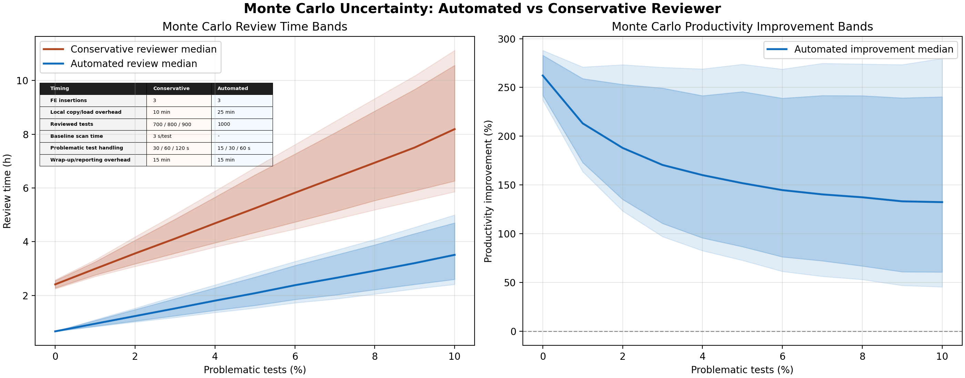
Automated approach benefits
From Monte-Carlo simulations, ~190% productivity improvement with:
automated approach (1.24h end-to-end review time, 2 tests missed) vs
conservative* manual review (3.57h end-to-end review time, 9 tests missed)
Assumptions:
KPI is “find the important problems with good technical coverage”
1 full wafer, 3 insertions to be reviewed separately
1000 tests to be reviewed
2% problematic tests → 20 tests/1000 have real issues
* conservative = using a data visualization tool while focussing on failing tests, Cpk issues and checking only key parameter tests one by one

Slide 11
Summary
The Test Data Reviewer has now been deployed to the team for operational use
The tool automates and standardizes large parts of the review workflow previously handled manually
Key benefits include consistency, reduced review time (higher productivity), improved repeatability, and better review coverage in test data analysis
The current solution already provides a solid baseline for further technical extension and user-driven improvement
The team now has a practical and reusable solution that supports faster and more structured decision-making
The tool is currently tailored for CTRX test data but can be extended to other product lines as well

Slide 12




Outlook
03/2026
08/2026 latest
Release
Enhancements
Maintenance
GUI migration
Sustaining phase
TDR tool has been rolled-out to the team
Code development towards the GUI migration
Additional features based on team‘s feedback
Bug fixes
Support to the team
Release the GUI version of the tool
Roll-out to the team
Additional features based on team‘s feedback
Bug fixes
Support to the team

Slide 13

Thanks for the attention.
Are there any questions?

