Slide 1
ATE ↔ CV Correlation Automation Report
Procedure, deliverables, and time benefit (generated from Python automation scripts)

Slide 2
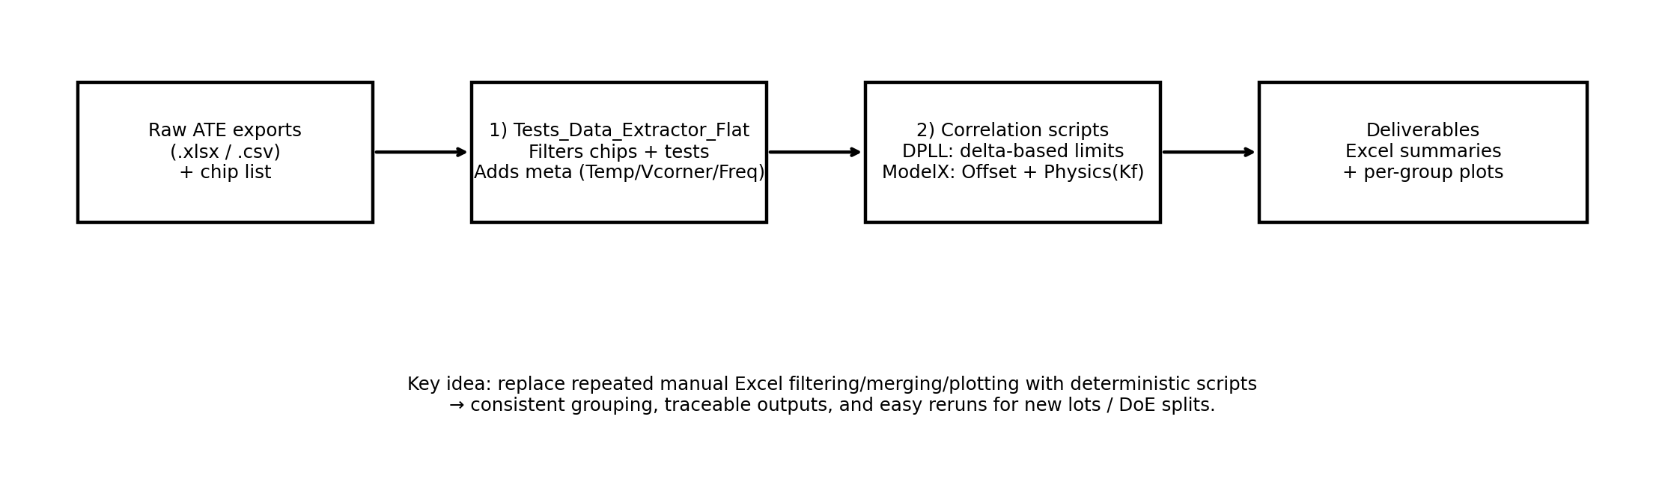
End-to-end automation pipeline
From raw ATE exports to correlated limits and plots

Slide 3
Correlation procedure (what the scripts actually do)
Extract ATE raw exports → normalize → filter to target chips/tests
Enrich metadata: Temperature from filename; Voltage corner + Frequency from Test Name
Merge CV/ATE rows by keys (Wafer/X/Y/DUT/Temp/Vcorner/Freq/Test#)
Group by test-case (TXLO: Test#…; TXPA: LUT value… + optional PA channel for LUT255)
Compute correlation + new limits and output: Excel summaries + per-group plots

Slide 4
Automation highlights vs manual workflow
Robust chip-list ingestion (CSV/XLSX; flexible headers; DoE split + DUT Nr preserved)
Test selection supports explicit IDs, ranges, and substrings
Batch-processing of all input files + automatic skip of temp/~$ files
Consistent, reproducible grouping and output naming (traceable plots per test-case)
Limit computation and guardbanding performed systematically (no copy/paste errors)

Slide 5
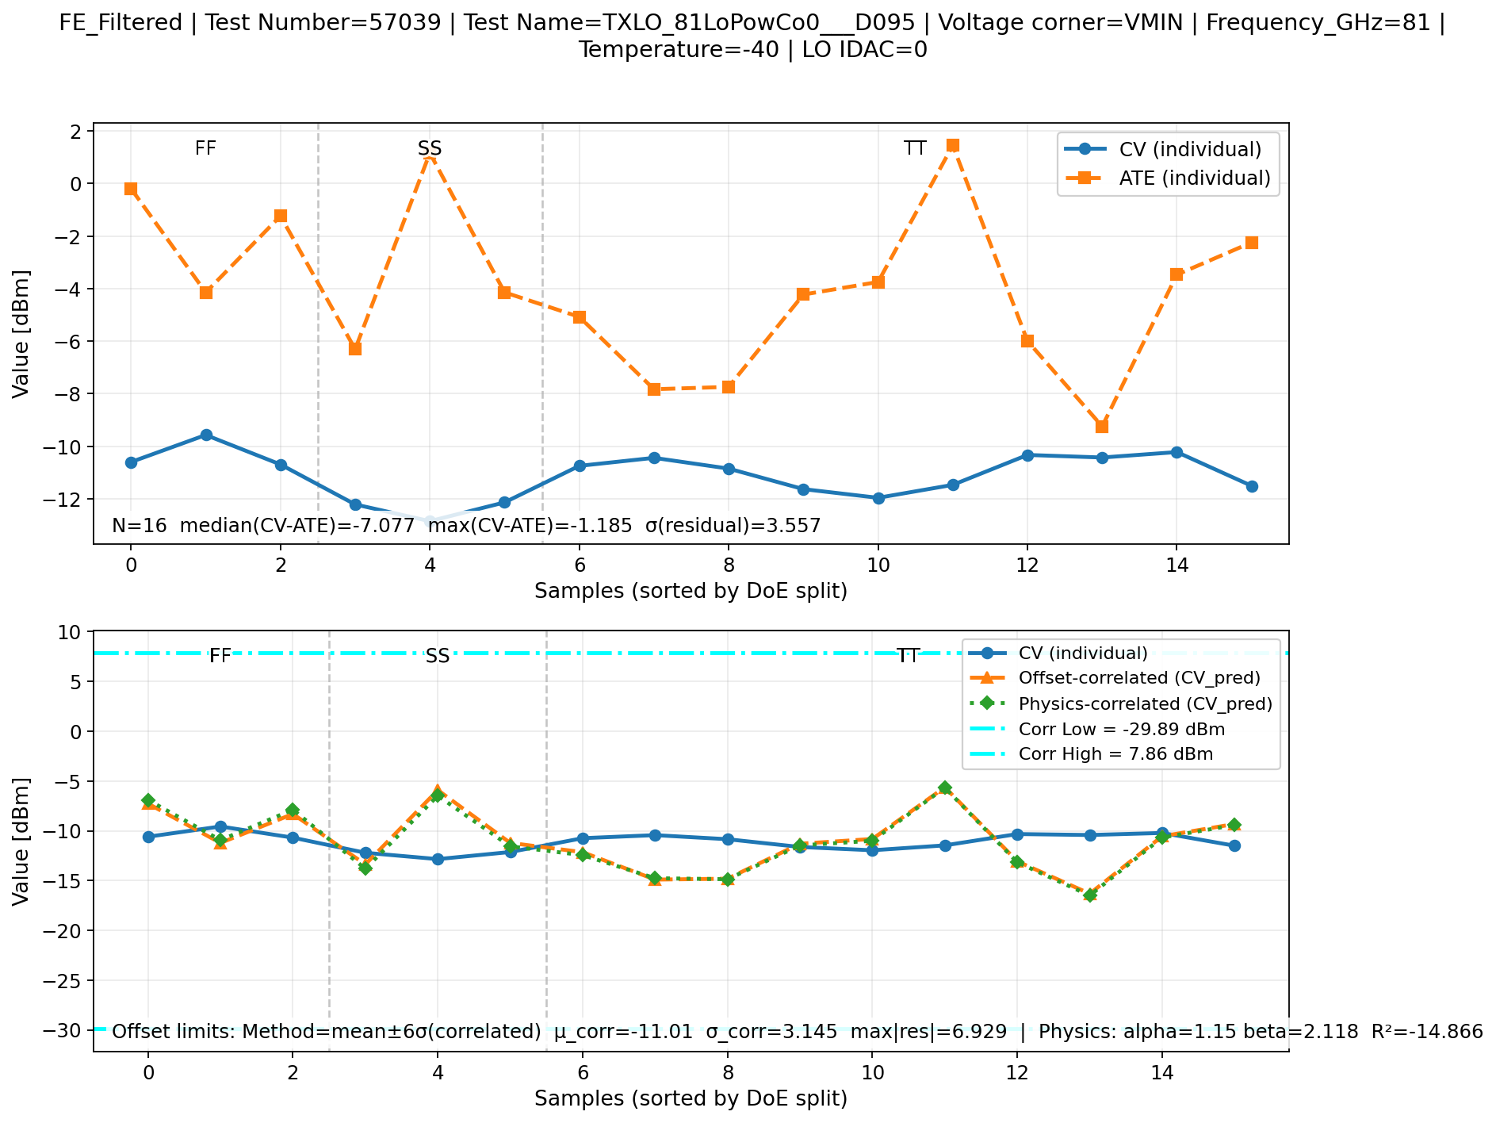
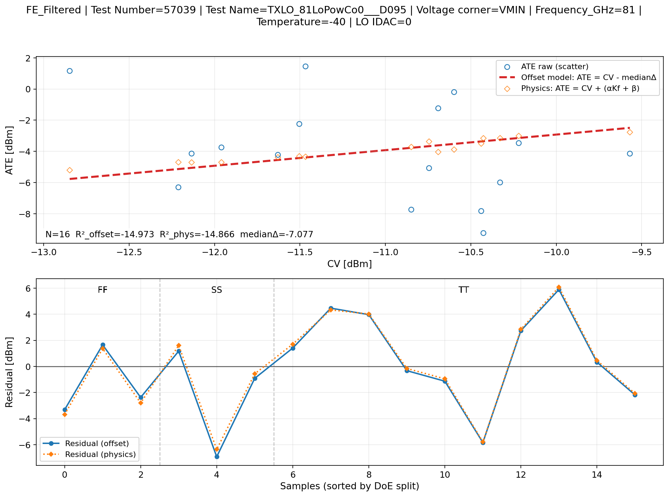
Example output: TXLO (series + models)
Series: CV vs ATE + correlated + limits
Models: regression view + residuals

Slide 6
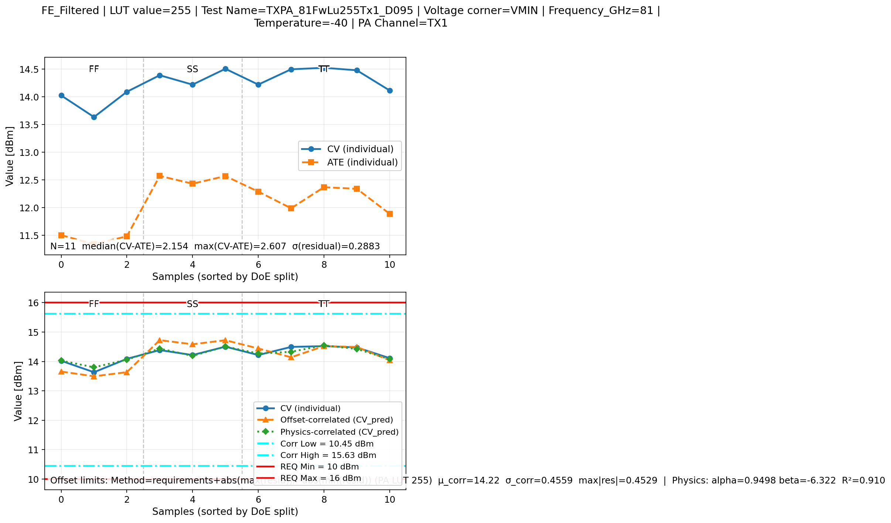
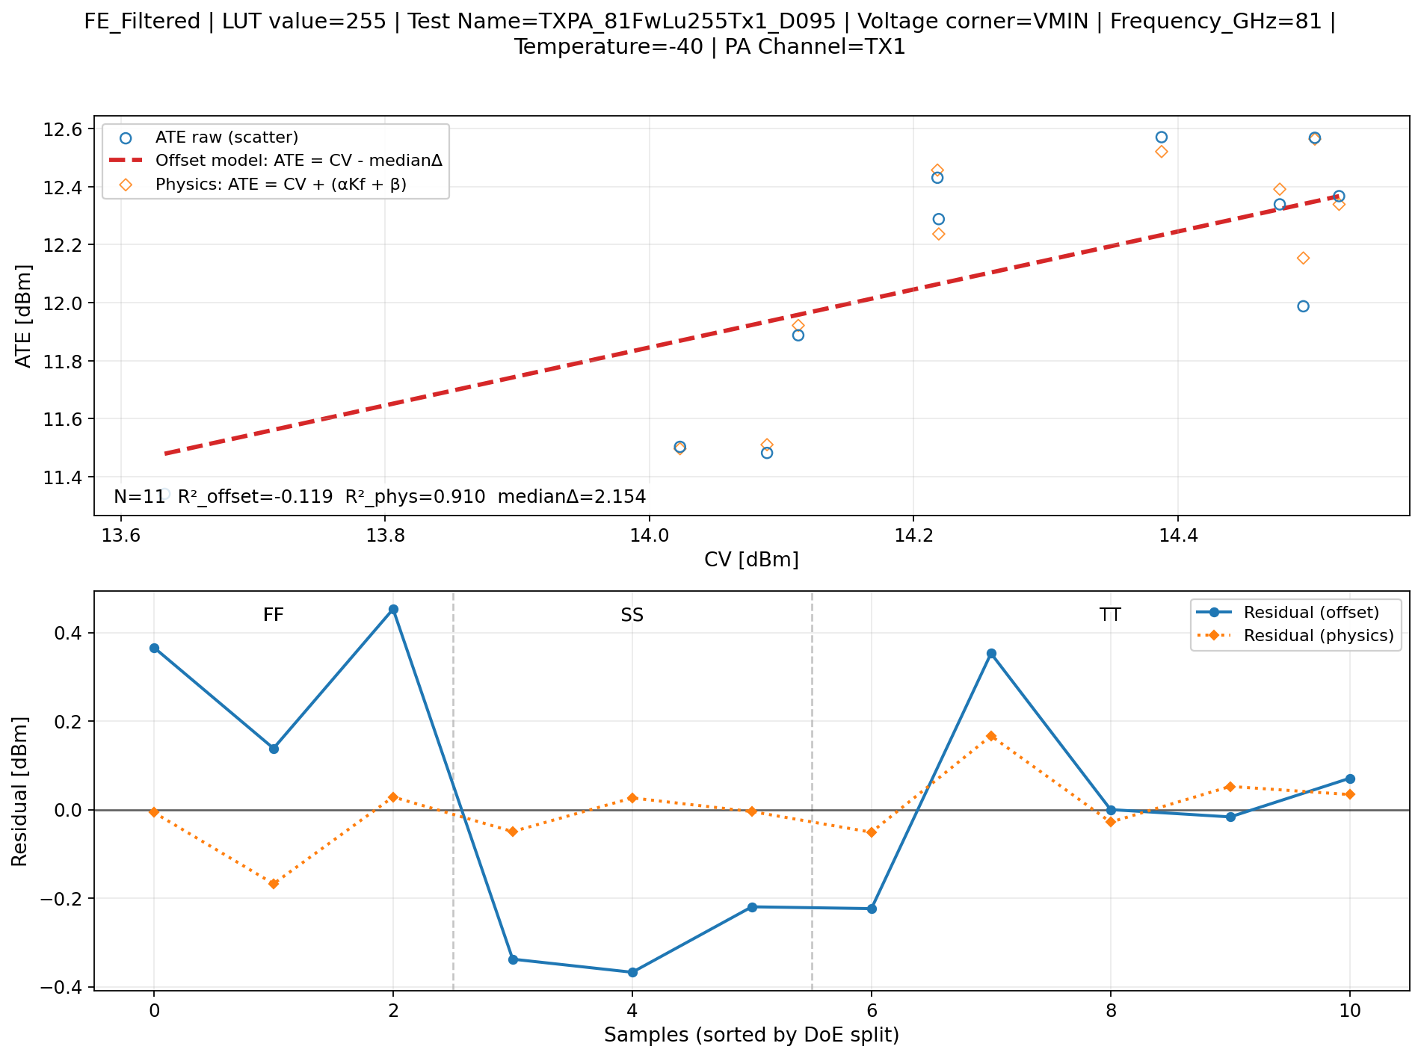
Example output: TXPA LUT255 (with requirements guardbanding)
Series: correlated distribution + requirement lines
Models: regression + residuals (offset/physics)

Slide 7
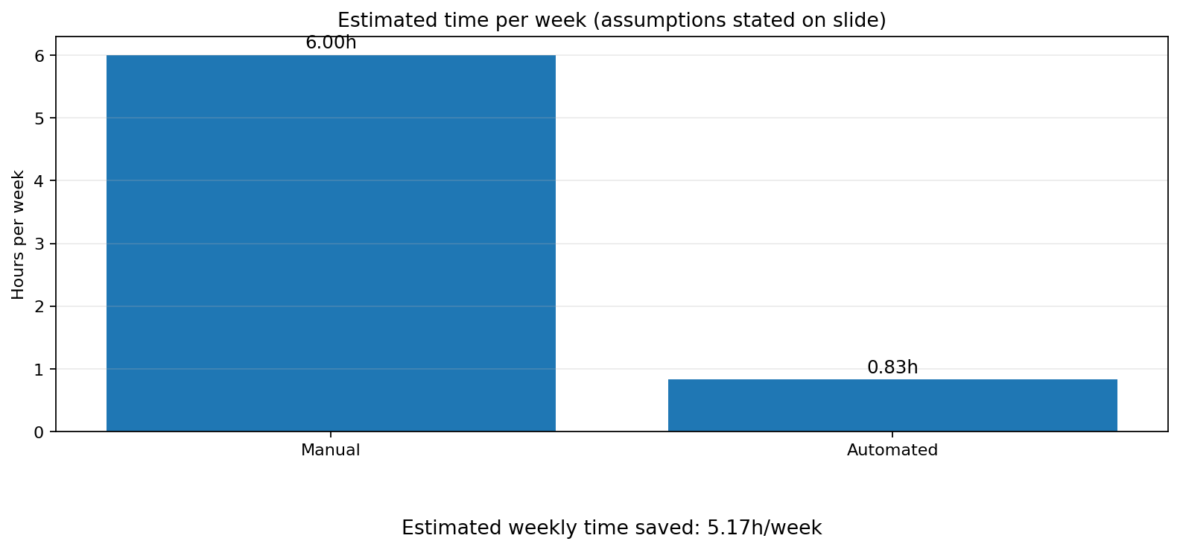
Time benefit estimate (automation impact)
Assumptions (edit to match reality):
Manual effort per iteration: 180 min
Automated effort per iteration: 25 min
Iterations per week: 2
Manual includes: Excel filtering/merging, plotting, copying results
Automated includes: editing config + running scripts + quick review

Slide 8
Outlook: suggested next automation steps
Central config file (YAML/JSON) + CLI wrapper to remove in-code edits
Single pipeline runner: Extract → Correlate → Package plots + summary
Add validation: missing columns, Kf merge coverage thresholds, inverted limit windows
Standardize outputs: versioned run folders + metadata (git hash, date, dataset tags)
Regression tests on small sample datasets to lock behavior

