Slide 1
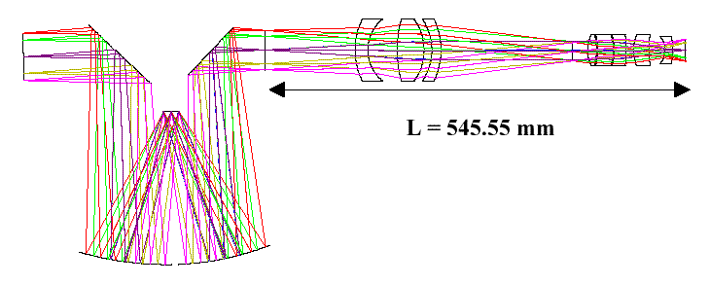
Optics Intro
Geometric Optics
Raytracing
Notes:
Geometrical Optics
Lecture 5

Slide 2
Reflection
UW ASTR 597
We describe the path of light as straight-line rays
  “geometrical optics” approach
Reflection off a flat surface follows a simple rule:
  angle in (incidence) equals angle out
  angles measured from surface “normal” (perpendicular)
surface normal
same
angle
exit ray
incident ray
Spring 2011
Notes:
Geometrical Optics
Lecture 5

Slide 3
Reflection, continued
UW ASTR 597
Also consistent with “principle of least time”
  If going from point A to point B, reflecting off a mirror, the path traveled is also the most expedient (shortest) route
A
shortest path;
equal angles
too long
B
Spring 2011
Notes:
Geometrical Optics
Lecture 5

Slide 4
Hall Mirror
UW ASTR 597
Useful to think in terms of images
“real” you
mirror only
needs to be half as
high as you are tall. Your
image will be twice as far from you
as the mirror.
“image” you
Spring 2011
Notes:
Geometrical Optics
Lecture 5

Slide 5
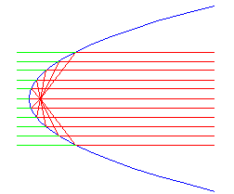
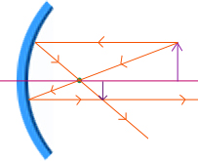
Curved mirrors
UW ASTR 597
What if the mirror isn’t flat?
  light still follows the same rules, with local surface normal
Parabolic mirrors have exact focus
  used in telescopes, backyard satellite dishes, etc.
  also forms virtual image
Spring 2011
Notes:
Geometrical Optics
Lecture 5

Slide 6
Refraction
UW ASTR 597
Light also goes through some things
  glass, water, eyeball, air
The presence of material slows light’s progress
  interactions with electrical properties of atoms
The “light slowing factor” is called the index of refraction
  glass has n = 1.52, meaning that light travels about 1.5 times slower in glass than in vacuum
  water has n = 1.33
  air has n = 1.00028
  vacuum is n = 1.00000 (speed of light at full capacity)
Spring 2011
Notes:
Geometrical Optics
Lecture 5

Slide 7
Refraction at a plane surface
UW ASTR 597
Light bends at interface between refractive indices
  bends more the larger the difference in refractive index
  can be effectively viewed as a “least time” behavior
    get from A to B faster if you spend less time in the slow medium
A
Snell’s Law:
n₁sinθ₁ = n₂sinθ₂
θ₁
n₁ = 1.0
n₂ = 1.5
θ₂
B
Spring 2011
Notes:
Geometrical Optics
Lecture 5

Slide 8
Driving Analogy
UW ASTR 597
Let’s say your house is 12 furlongs off the road in the middle of a huge field of dirt
  you can travel 5 furlongs per minute on the road, but only 3 furlongs per minute on the dirt
    this means “refractive index” of the dirt is 5/3 = 1.667
  Starting from point A, you want to find the quickest route:
    straight across (AD)—don’t mess with the road
    right-angle turnoff (ACD)—stay on road as long as possible
    angled turnoff (ABD)—compromise between the two
A
B
C
leg dist. Δt@5 Δt@3
AB 5 1 —
AC 16 3.2 —
AD 20 — 6.67
BD 15 — 5
CD 12 — 4
road
dirt
D (house)
AD: 6.67 minutes
ABD: 6.0 minutes: the optimal path is a “refracted” one
ACD: 7.2 minutes
Spring 2011
Note: both right triangles in figure are 3-4-5
Notes:
Geometrical Optics
Lecture 5

Slide 9
Total Internal Reflection
UW ASTR 597
At critical angle, refraction no longer occurs
  thereafter, you get total internal reflection
  n₂sinθ₂ = n₁sinθ₁ → θ_{crit} = sin⁻¹(n₁/n₂)
  for glass, the critical internal angle is 42°
  for water, it’s 49°
  a ray within the higher index medium cannot escape at shallower angles (look at sky from underwater…)
incoming ray hugs surface
n₁ = 1.0
n₂ = 1.5
42°
Spring 2011
Notes:
Geometrical Optics
Lecture 5

Slide 10

Refraction in Suburbia
UW ASTR 597
Think of refraction as a pair of wheels on an axle going from sidewalk onto grass
  wheel moves slower in grass, so the direction changes
Note that the wheels
move faster (bigger space)
on the sidewalk, slower
(closer) in the grass
Spring 2011
Notes:
Geometrical Optics
Lecture 5

Slide 11
Even gets Total Internal Reflection Right
UW ASTR 597
Moreover, this analogy is mathematically equivalent to the actual refraction phenomenon
  can recover Snell’s law: n₁sinθ₁ = n₂sinθ₂
Wheel that hits sidewalk starts to go faster,
which turns the axle, until the upper wheel
re-enters the grass and goes straight again
Spring 2011
Notes:
Geometrical Optics
Lecture 5

Slide 12
Reflections, Refractive offset
UW ASTR 597
Let’s consider a thick piece of glass (n = 1.5), and the light paths associated with it
  reflection fraction = [(n₁ – n₂)/(n₁ + n₂)]²
  using n₁ = 1.5, n₂ = 1.0 (air), R = (0.5/2.5)² = 0.04 = 4%
n₁ = 1.5
n₂ = 1.0
incoming ray
(100%)
image looks displaced
due to jog
96%
8% reflected in two
reflections (front & back)
4%
92% transmitted
4%
0.16%
Spring 2011
Notes:
Geometrical Optics
Lecture 5

Slide 13
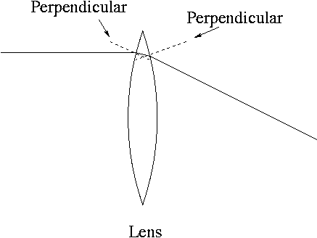
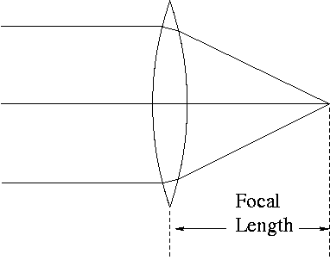
Let’s get focused…
UW ASTR 597
Just as with mirrors, curved lenses follow same rules as flat interfaces, using local surface normal
A lens, with front and back curved surfaces, bends
light twice, each diverting incoming ray towards
centerline.
Follows laws of refraction at each surface.
Parallel rays, coming, for instance from a specific
direction (like a distant bird) are focused by a convex
(positive) lens to a focal point.
Placing film at this point would record an image of
the distant bird at a very specific spot on the film.
Lenses map incoming angles into positions in the
focal plane.
Spring 2011
Notes:
Geometrical Optics
Lecture 5

Slide 14

Cameras, in brief
UW ASTR 597
object
pinhole
image at
film plane
In a pinhole camera, the hole is so small that light hitting any particular point
on the film plane must have come from a particular direction outside the camera
object
image at
film plane
lens
In a camera with a lens, the same applies: that a point on the film plane
more-or-less corresponds to a direction outside the camera. Lenses have
the important advantage of collecting more light than the pinhole admits
Spring 2011
Notes:
Geometrical Optics
Lecture 5

Slide 15
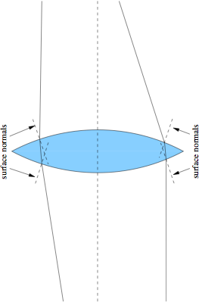
Positive Lenses
UW ASTR 597
Thicker in middle
Bend rays toward axis
Form real focus
Spring 2011
Notes:
Geometrical Optics
Lecture 5

Slide 16
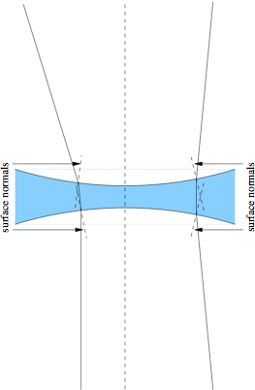
Negative Lenses
UW ASTR 597
Thinner in middle
Bend rays away from the axis
Form virtual focus
Spring 2011
Notes:
Geometrical Optics
Lecture 5

Slide 17
Raytracing made easier
UW ASTR 597
In principle, to trace a ray, one must calculate the intersection of each ray with the complex lens surface, compute the surface normal here, then propagate to the next surface
  computationally very cumbersome
We can make things easy on ourselves by making the following assumptions:
  all rays are in the plane (2-d)
  each lens is thin: height does not change across lens
  each lens has a focal length (real or virtual) that is the same in both directions
Spring 2011
Notes:
Geometrical Optics
Lecture 5

Slide 18
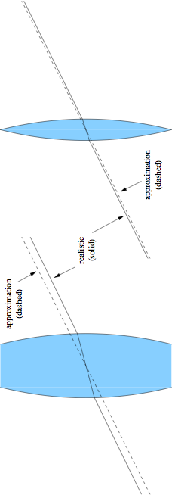
Thin Lens Benefits
UW ASTR 597
If the lens is thin, we can say that a ray through the lens center is undeflected
  real story not far from this, in fact: direction almost identical, just a jog
  the jog gets smaller as the lens gets thinner
Spring 2011
Notes:
Geometrical Optics
Lecture 5

Slide 19
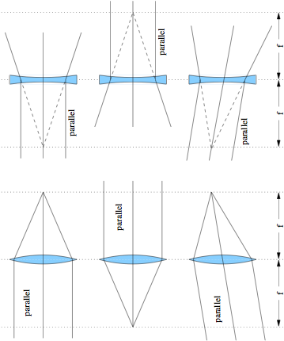
Using the focus condition
UW ASTR 597
real foci
virtual foci
s = ∞
s’ = f
s = ∞
s’ = −f
s = f
s’ = ∞
s = −f
s’ = ∞
s = ∞
s’ = f
s = ∞
s’ = −f
Spring 2011
Notes:
Geometrical Optics
Lecture 5

Slide 20
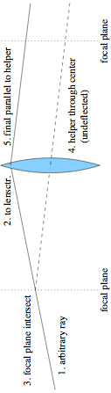
Tracing an arbitrary ray (positive lens)
UW ASTR 597
draw an arbitrary ray toward lens
stop ray at middle of lens
note intersection of ray with focal plane
from intersection, draw guiding (helper) ray straight through center of lens (thus undeflected)
original ray leaves lens parallel to helper
  why? because parallel rays on one side of lens meet each other at the focal plane on the other side
Spring 2011
Notes:
Geometrical Optics
Lecture 5

Slide 21
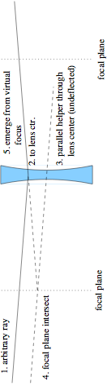
Tracing an arbitrary ray (negative lens)
UW ASTR 597
draw an arbitrary ray toward lens
stop ray at middle of lens
draw helper ray through lens center (thus undeflected) parallel to the incident ray
note intersection of helper with focal plane
emerging ray will appear to come from this (virtual) focal point
  why? parallel rays into a negative lens appear to diverge from the same virtual focus on the input side
Spring 2011
Notes:
Geometrical Optics
Lecture 5

Slide 22
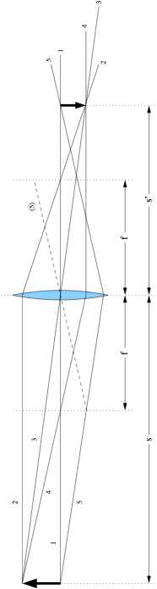
Image Formation
UW ASTR 597
Place arrow (object) on left, trace through image:
  1) along optical axis (no defl.); 2) parallel to axis, goes through far focus with optical axis ray; 3) through lens center; 4) through near-side focus, emerges parallel to optical axis; 5) arbitrary ray with helper
Note convergence at image position (smaller arrow)
  could run backwards just as well
Spring 2011
Notes:
Geometrical Optics
Lecture 5

Slide 23

Notes on Image Formation
UW ASTR 597
Note the following:
  image is inverted
  image size proportional to the associated s-value: ray 3 proves it
  both s and s’ are larger than f (s = 120; s’ = 80; f = 48)
Gaussian lens formula (simple form):
Spring 2011
Notes:
Geometrical Optics
Lecture 5

Slide 24
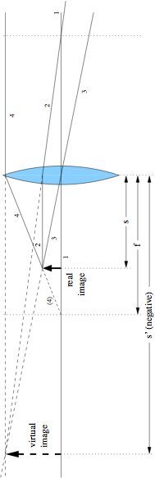
Virtual Images
UW ASTR 597
If the object is inside the focal length (s < f):
  a virtual (and larger) image is formed
  non-inverted
Ray numbers are same procedure as previous
This time s’ is negative:
  s = 40; f = 60; s’ = −120
  negative image distances indicate virtual images
Spring 2011
Notes:
Geometrical Optics
Lecture 5

Slide 25

The lens-maker’s formula
UW ASTR 597
We saw the Gaussian lens formula before:
  f is positive for positive lenses, negative for negative lenses
  s is positive on left, s’ is positive on right
But in terms of the surface properties:
  R₁ is for the left surface (pos. if center of curvature to right)
  R₂ is for right surface (pos. if center of curvature to right)
  bi-convex (as in prev. examples) has R₁ > 0; R₂ < 0
  n is the refractive index of the material (assume in air/vac)
Spring 2011
Notes:
Geometrical Optics
Lecture 5

Slide 26
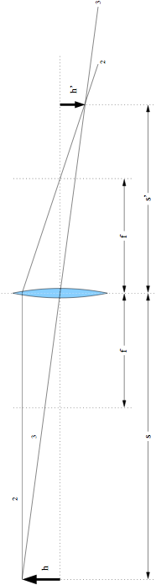
Deriving Gaussian Formula from Rays
UW ASTR 597
Object has height, h; image height = h’
tangent of ray 3 angle is −h/s, so h’ = −h(s’/s)
ray 2 angle is −h/f, so h’ = (−h/f)×(s’ − f)
set the two expressions for h’ equal, and divide by hs’
  the result will pop out
can do the same trick using virtual images too
Spring 2011
Notes:
Geometrical Optics
Lecture 5

Slide 27
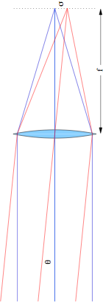
Lenses map directions into displacements
UW ASTR 597
Two objects at infinity an angle θ apart produce distinct spots separated by σ
  following geometry, σ = f·tanθ ≈ f·θ for small θ
    hint: look at central rays
  so lens turns angle (θ) into displacement (σ)
Spring 2011
Notes:
Geometrical Optics
Lecture 5

Slide 28
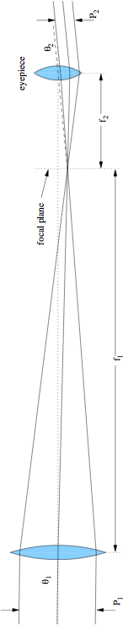
Telescope
UW ASTR 597
A telescope has an “objective” lens and an eyepiece
  sharing a focal plane; giving the eye the parallel light it wants
Everything goes as ratio of focal lengths: f₁/f₂
  magnification is just M = θ₂/θ₁ = f₁/f₂
    after all: magnification is how much bigger things look
    displacement at focal plane, σ = f₁θ₁ = f₂θ₂ → relation above
  ratio of collimated beam (pupil) sizes: P₁/P₂ = f₁/f₂ = M
Spring 2011
Notes:
Geometrical Optics
Lecture 5

Slide 29
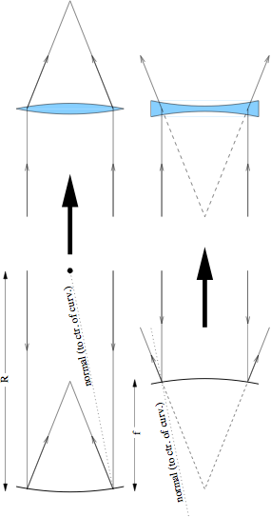
Reflector/Refractor Analogy
UW ASTR 597
For the purposes of understanding a reflecting system, one may replace with lenses (which we know how to trace/analyze)
  focal length and aperture the same; rays on other side
  for a reflector, f = R/2 [compare to 1/f = (n − 1)(1/R₁ − 1/R₂) for lens]
    for n = 1.5, R₂ = −R₁ (symmetric lens), f = R
    so glass lens needs twice the curvature of a mirror
Spring 2011
Notes:
Geometrical Optics
Lecture 5

Slide 30
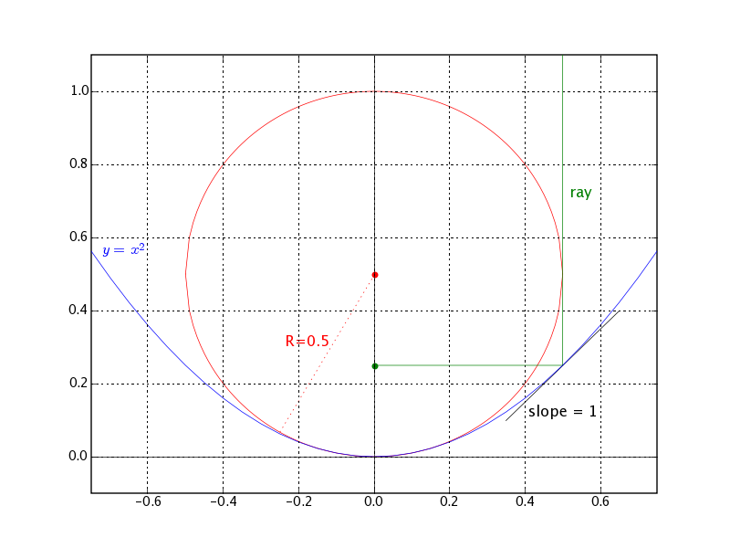
Parabolic Example
UW ASTR 597
Take the parabola:
y = x²
Slope is y’ = 2x
Curvature is y’’ = 2
So R = 1/y’’ = 0.5
Slope is 1 (45°) at:
x = 0.5; y = 0.25
So focus is at 0.25:
f = R/2
Note that pathlength to focus is the same for depicted ray and one along x = 0
Spring 2011
Notes:
Geometrical Optics
Lecture 5

Slide 31
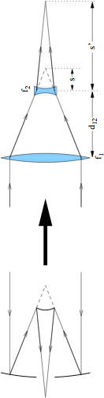
Cassegrain Telescope
UW ASTR 597
A Cassegrain telescope can be modeled as as positive and negative lens
  eyepiece not shown: only up to focus
Final focus depends on placement of negative lens
  if |s| = |f₂|, light is collimated; if |s| > |f₂|, light will diverge
    both s and f₂ are negative
For the Apache Point 3.5 meter telescope, for example:
  f₁ = 6.12 m; f₂ = −1.60 m; d₁₂ = 4.8 m; s = d₁₂ − f₁ = −1.32 m
  yields s’ = 7.5 m using 1/s + 1/s’ = 1/f₂
Spring 2011
Notes:
Geometrical Optics
Lecture 5

Slide 32
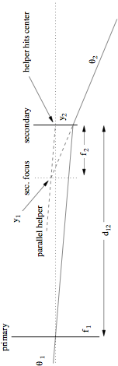
Cassegrain focus
UW ASTR 597
Abstracting mirrors as lenses, then lenses as sticks:
  trace central ray with angle θ₁
  figure out θ₂ and then focal length given s’ and d₁₂
    y₂ = d₁₂θ₁ (adopt convention where θ₁ is negative as drawn)
    y₁ = f₂θ₁ (f₂ is negative: negative lens)
    θ₂ = (y₁ − y₂)/f₂ = θ₁(f₂ − d₁₂)/f₂
    y_{f} = y₂ + θ₂s’ = θ₁(d₁₂ + s’(f₂ − d₁₂)/f₂)
    f_{eff} = d₁₂ + s’(f₂ − d₁₂)/f₂ = −f₁s’/s after lots of algebra
    for Apache Point 3.5 meter, this comes out to 35 meters
Spring 2011
Notes:
Geometrical Optics
Lecture 5

Slide 33
f-numbers
UW ASTR 597
f = D
f = 4D
D
D
f/1 beam: “fast”
f/4 beam: “slow”
The f-number is a useful characteristic of a lens or system of lenses/mirrors
Simply η = f/D
  where f is the focal length, and D is the aperture (diameter)
“fast” converging beams (low f-number) are optically demanding to make without aberrations
“slow” converging beams (large f-number) are easier to make
aberrations are proportional to 1/η²
  so pay the price for going “fast”
Spring 2011
Notes:
Geometrical Optics
Lecture 5

Slide 34
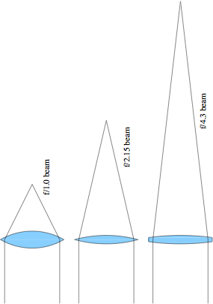
f-numbers, compared
UW ASTR 597
Lens curvature to scale for n = 1.5
  obviously slow lenses are easier to fabricate: less curvature
Spring 2011
Notes:
Geometrical Optics
Lecture 5

Slide 35
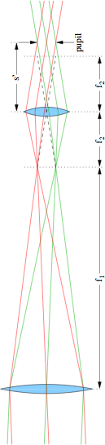
Pupils
UW ASTR 597
Consider two “field points” on the focal plane
  e.g., two stars some angle apart
The rays obviously all overlap at the aperture
  called the entrance pupil
The rays are separate at the focus (completely distinct)
Then overlap again at exit pupil, behind eyepiece
  want your pupil here
  just an image of the entrance pupil satisfying 1/s’ + 1/(f₁ + f₂) = 1/f₂
  size is smaller than entrance pupil by magnification factor
    M = f₁/f₂; in this picture, f₁ = 48; f₂ = 12; M = 4; s’ = 15
Spring 2011
Notes:
Geometrical Optics
Lecture 5

Slide 36
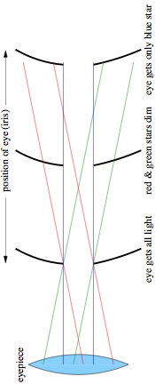
Pupils within Pupils
UW ASTR 597
Looking at three stars (red, green, blue) through telescope, eye position is important
So is pupil size compared to eye pupil
  dark adapted pupil up to 7 mm diameter (2–3 mm in daylight)
  sets limit on minimum magnification (if you want to use the full aperture)
    210 mm aperture telescope must have M > 30
    for f/5 scope, means f₂ < 35 mm; f/10 scope means f₂ < 70 mm
    3.5-m scope means M > 500; at f/10, f₂ < 70 mm
Spring 2011
Notes:
Geometrical Optics
Lecture 5

Slide 37
Vignetting
UW ASTR 597
Rays that don’t make it through an optical system are said to be vignetted (shadowed)
  maybe a lens isn’t big enough
  maybe your eye’s pupil isn’t big enough, or is improperly placed
Often appears as a gradual darkening as a function of distance from the field center
  the farther out you go, the bigger your lenses need to be
  every optical system has a limited (unvignetted) field of view
  beyond this, throughput goes down
Spring 2011
Notes:
Geometrical Optics
Lecture 5

Slide 38
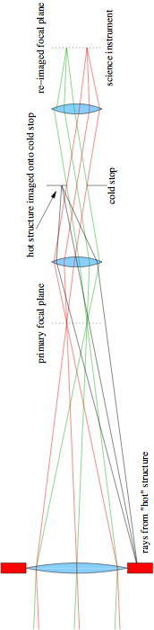
Infrared Cold Stop
UW ASTR 597
An infrared detector is very sensitive to terrestrial heat
  so want to keep off of detector
  if detector located at primary focal plane, it is inundated with emission from surroundings and telescope structure
    note black lines intersecting primary focal plane
Putting a “cold” stop at a pupil plane eliminates stray emission
  cool to LN₂; image of primary objective onto cold stop
  only light from the primary passes through; detector focal plane then limits field of view to interesting bit
Also the right place for filters, who prefer collimated light
Spring 2011
Notes:
Geometrical Optics
Lecture 5

Slide 39
Raytrace Simulations
UW ASTR 597
In Google, type in: phet
  top link is one to University of Colorado physics education page
  on this page, click: go to simulations
  on the left-hand bar, go to: light and radiation
  then click the geometric optics simulation link (picture)
Can play with lots of parameters
  real and virtual images
  lens radius of curvature, diameter, and refractive index
  see principle rays (ones you’d use to raytrace)
  see marginal rays
  use a light source and screen
  see the effect of two sources
Spring 2011
Notes:
Geometrical Optics
Lecture 5

Slide 40
Aberrations: the real world
UW ASTR 597
Lenses are thick, sinθ ≠ θ
  sinθ ≈ θ − θ³/6 + θ⁵/120 − θ⁷/5040 + …
  tanθ ≈ θ + θ³/3 + 2θ⁵/15 + 17θ⁷/315 + …
Different types of aberration (imperfection)
  spherical aberration
    all spherical lenses possess; parabolic reflector does not
  coma
    off-axis ailment: even aspheric elements have this
  chromatic aberration
    in refractive systems only: refractive index is function of λ
  astigmatism
    if on axis, then lens asymmetry; but can arise off-axis in any system
  field curvature/distortion
    detectors are flat: want to eliminate significant field curvature
Spring 2011
Notes:
Geometrical Optics
Lecture 5

Slide 41
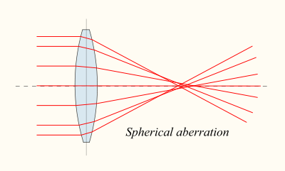
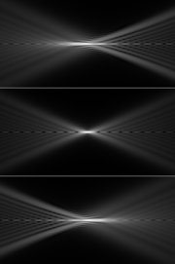
Spherical Aberration
UW ASTR 597
Rays at different heights focus at different points
Makes for a mushy focus, with a halo
Positive spherical lenses have positive S.A., where exterior rays focus closer to lens
Negative lenses have negative S.A., as do plates of glass in a converging beam
“Overcorrecting” a positive lens (going too far in making asphere) results in neg. S.A.
neg. S.A.
lens side
zero S.A.
pos. S.A.
Spring 2011
Notes:
Geometrical Optics
Lecture 5

Slide 42
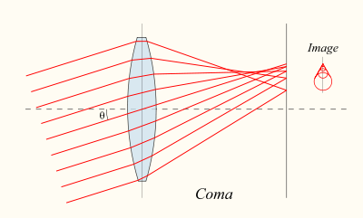
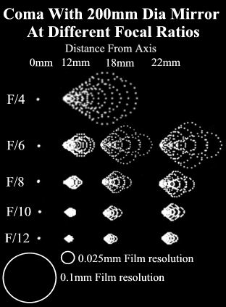
Coma
UW ASTR 597
Off-axis rays meet at different places depending on ray height
Leads to asymmetric image, looking something like a comet (with nucleus and flared tail)
  thus the name coma
As with all aberrations, gets worse with “faster” lenses
Exists in parabolic reflectors, even if no spherical aberration
Spring 2011
Notes:
Geometrical Optics
Lecture 5

Slide 43
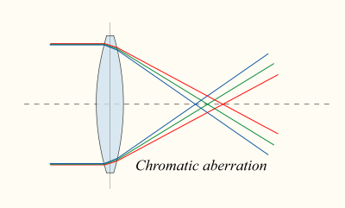
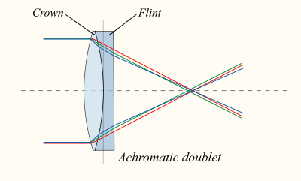
Chromatic Aberration
UW ASTR 597
Glass has slightly different refractive index as a function of wavelength
  so not all colors will come to focus at the same place
  leads to colored blur
  why a prism works
Fixed by pairing glasses with different dispersions (dn/dλ)
  typically a positive lens of one flavor paired with a negative lens of the other
  can get cancellation of aberration
  also helps spherical aberration to have multiple surfaces (more design freedom)
Spring 2011
Notes:
Geometrical Optics
Lecture 5

Slide 44
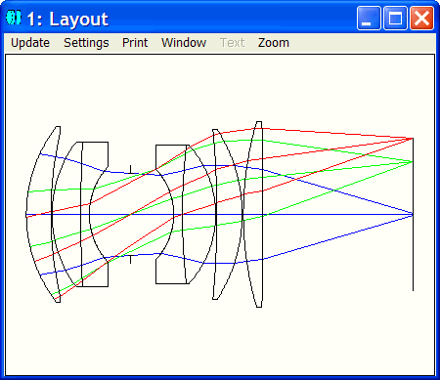
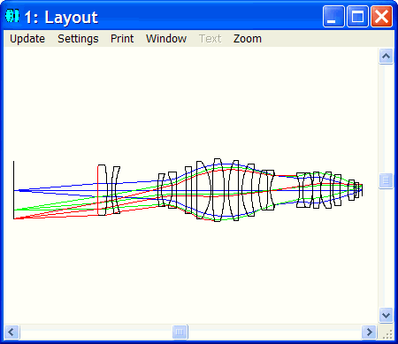
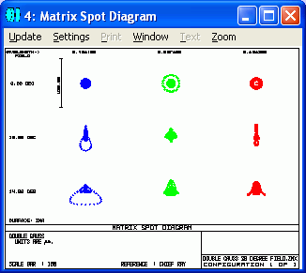
Zemax Examples
UW ASTR 597
Spring 2011
Notes:
Geometrical Optics
Lecture 5

Slide 45
Raytracing Program
UW ASTR 597
While it may not be Zemax, I’ve cobbled together a C-program (and Python) to do raytracing of any number of lenses/mirrors
  restricted to the following conditions:
    ray path is sequential: hitting surfaces in order defined
    elements are flat or have conic surfaces
    refractive index is constant, and ignorant of dispersion
    2-d only (though later will migrate to 3-d)
We can use this package to:
  analyze simple lens configurations
  look at aberrations
  build lens systems (beam expanders, telescopes)
Spring 2011
Notes:
Geometrical Optics
Lecture 5

Slide 46
Raytracing Algorithm
UW ASTR 597
Detailed math available on website (raytrace link)
Basically, compute intersection of ray with surface, then apply Snell’s Law
Can have as many surfaces as you want!
Must take care in defining physical systems
  e.g., make sure lens is thick enough for the diameter you need
Spring 2011
Notes:
Geometrical Optics
Lecture 5

Slide 47
Representing Mirrors
UW ASTR 597
The default/conventional behavior has light going from left to right (toward positive z)
But changing the sign of the refractive index signals a change of direction
  after all, refractive index indicates the speed of light in a medium, and the speed changes sign at a reflection
Example: APO 3.5 m scope (dims in mm)
  2
  1.0
  -1.0 0.0 -12279.7 -1.01927
  1.0 -4833.421 -3164.172 -2.18427
Note index changes from +1.0 initially to -1.0, then back to +1.0
Spring 2011

