Slide 1
Global Pricing Simulation Engine
Luxury Multi-Market Pricing Model | Neliswa Mbeje

Slide 2
Executive Context & Pricing Risk
Multi-market price inconsistency risk
Currency volatility exposure
Margin misalignment across regions
Objective: Build pricing engine ensuring margin discipline & data integrity

Slide 3
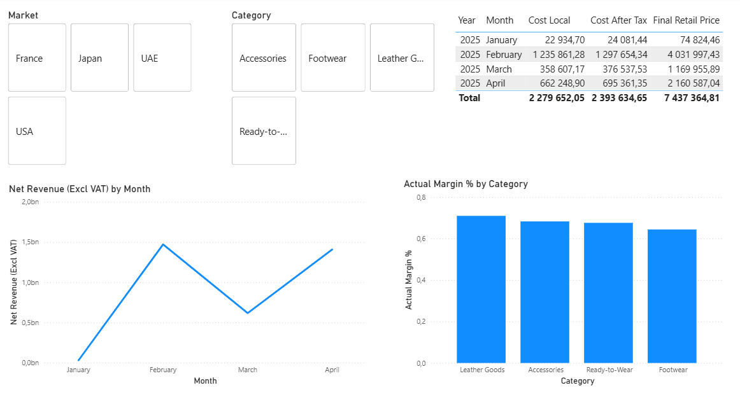
Pricing Calculation Logic
Step 1: Convert BaseCostEUR using FX rate
Step 2: Apply Import Tax
Step 3: Apply Target Margin
Step 4: Apply VAT

Slide 4
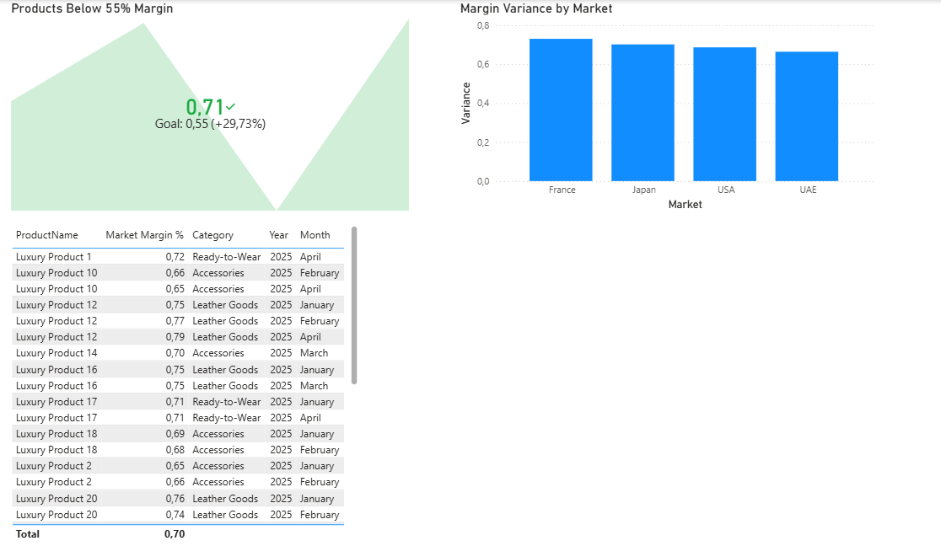
Data Model Architecture
Tables: Products | Markets | LaunchPlan
Relationships: ProductID & Market

Slide 5
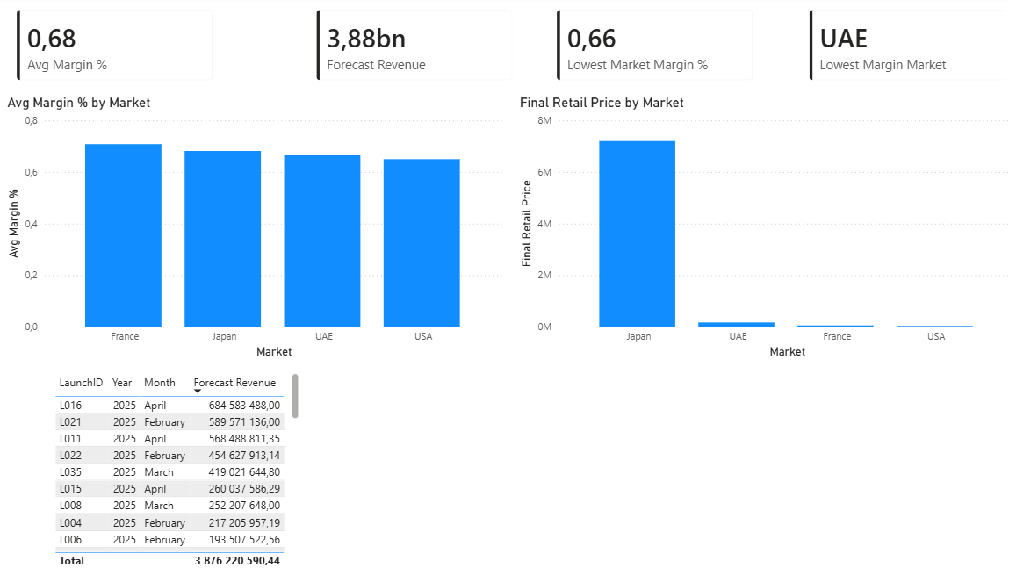
Executive Pricing Dashboard
Include: Avg Margin by Market
Price Comparison by Market
Forecast Revenue by Launch

Slide 6
Market-Based Pricing Analysis
Compare final retail price across markets
Highlight FX & Tax impact

Slide 7
Margin Monitoring & Risk Control
Avg Margin %
Margin Variance vs Target
Lowest Margin Market

Slide 8
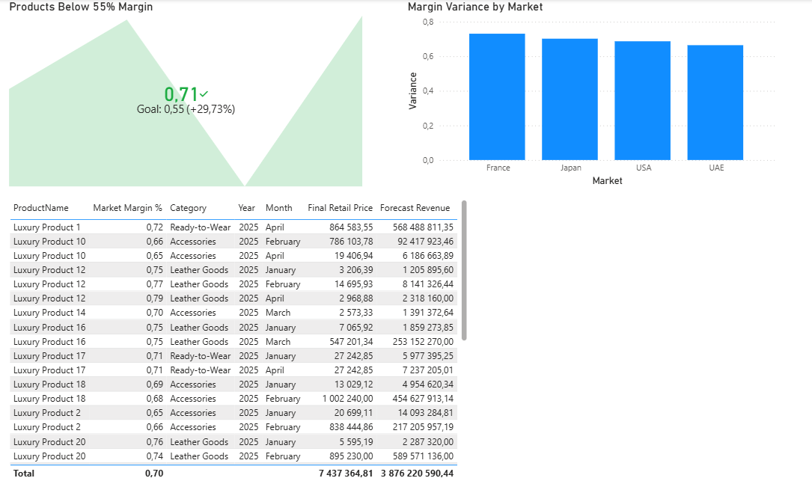
Product Launch Pricing Tracker
Fields: Product | Market | LaunchMonth | FinalPrice | ForecastRevenue

Slide 9
Pricing Data Validation Framework
FX validation check
Margin threshold alert (<55%)
Tax logic validation
Product cost completeness check

Slide 10
Strategic Business Impact
Ensures global price consistency
Protects brand margin integrity
Supports finance & supply chain collaboration
Enables data-driven launch planning

