Slide 1
Enterprise IT Service Operations Performance Dashboard
SLA & Incident Governance Framework | Neliswa Mbeje

Slide 2
Operational Context & Risk Exposure
Multi-market IT support environment
SLA breach exposure across priority levels
Limited escalation visibility
Objective: Structured SLA monitoring & governance model

Slide 3
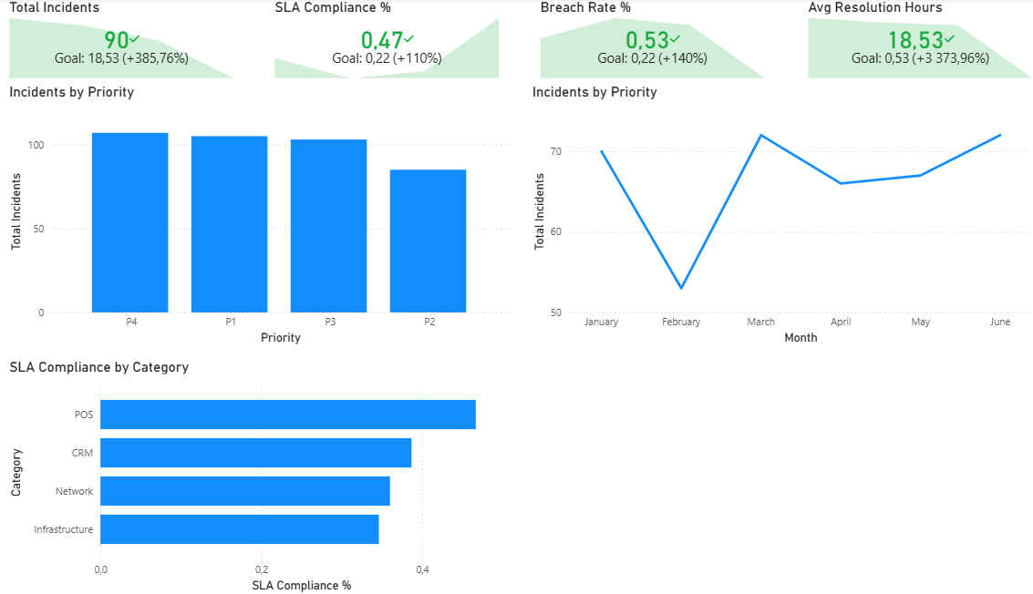
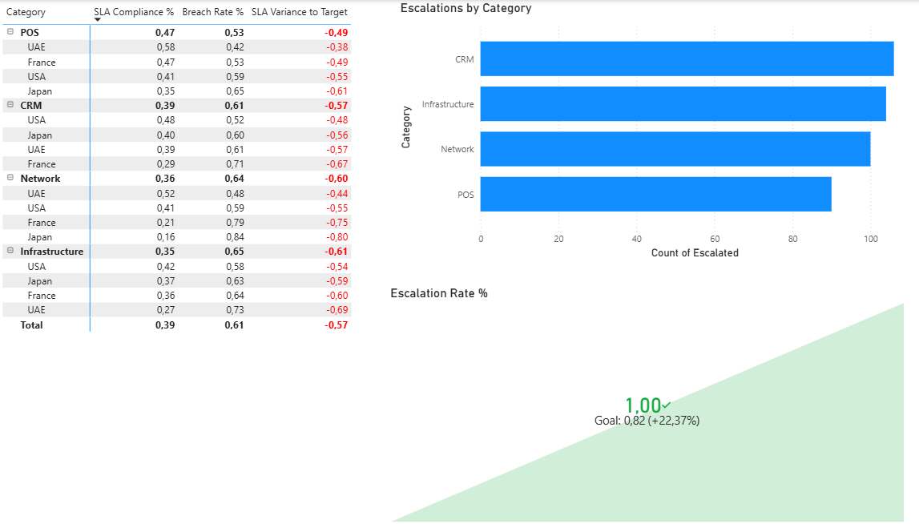
KPI Framework & Threshold Targets
SLA Compliance % (Target ≥ 96%)
Breach Rate % (Target ≤ 4%)
Avg Resolution Hours
Escalation Rate % (Target ≤ 8%)

Slide 4
Executive Service Dashboard Overview

Slide 5
Service Risk Monitoring Matrix
Fields: Category x Market
Values: SLA %, Breach %
Apply conditional formatting vs TargetSLA%

Slide 6
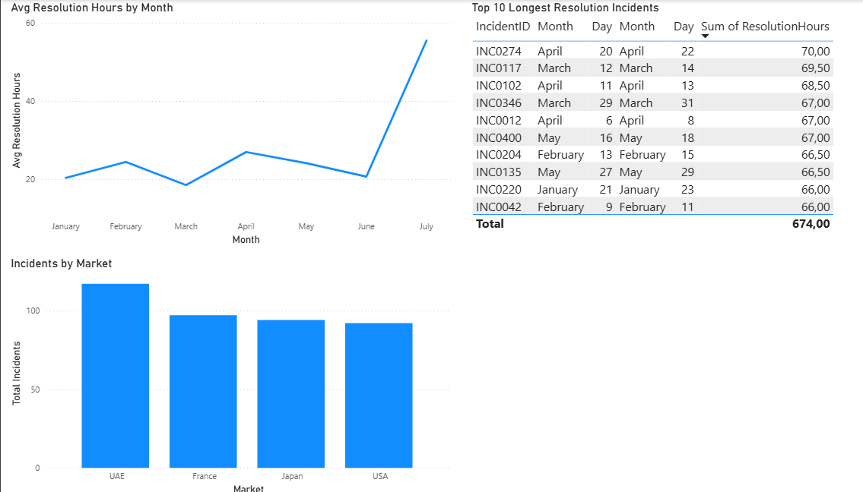
Incident Volume & Resolution Trend
Visuals Needed:
Monthly Incident Volume
Avg Resolution Hours by Month

Slide 7
Escalation Governance Model
1️⃣Incident Logged
• Ticket created • SLA timer starts
2️⃣ Tier 1 Support
• Initial triage • Basic troubleshooting • Resolution attempt
3️⃣ Tier 2 Escalation (Conditional)
• Technical investigation • Root cause analysis • Cross-team collaboration
4️⃣ Service Owner Review (If SLA Breach Risk)
• Risk evaluation • Mitigation plan • Resource reallocation
5️⃣ Executive Escalation (Critical Risk)
• Business impact review • Client communication • Executive decision

Slide 8
Operational Business Impact
Improved SLA transparency
Reduced breach exposure
Structured escalation governance
Stronger IT-business collaboration

Slide 9
Future IT Service Enhancements
ServiceNow integration
Automated SLA breach alerts
Predictive incident modeling
AI-driven anomaly detection

