Slide 1
Enterprise Data Governance & Quality Framework
Internal Governance Monitoring Model | Neliswa Mbeje

Slide 2
Executive Context & Business Risk
• Inconsistent CRM & pricing data integrity across domains
Duplicate records impacting segmentation and reporting
Lack of centralised quality monitoring
Strategic Risk: Reporting inaccuracy, client misclassification, pricing inconsistency

Slide 3
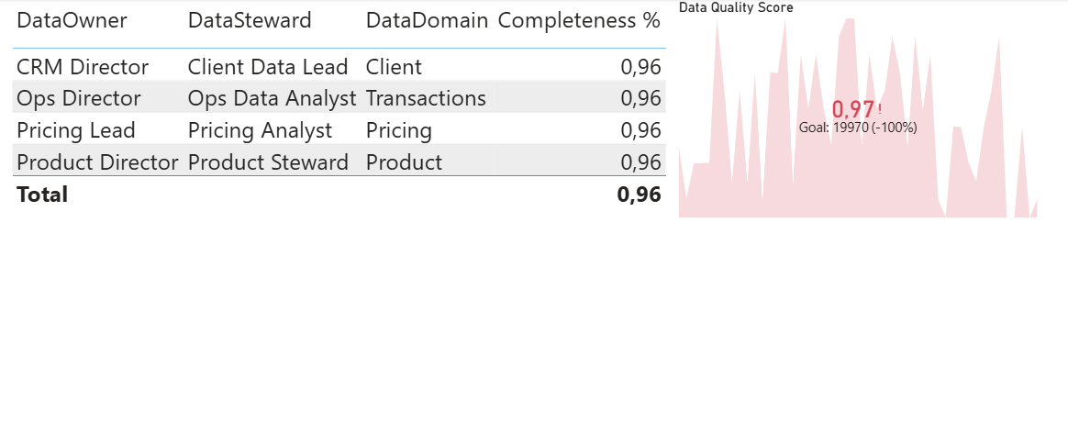
Governance Operating Model
Data Owner – Business accountability
Data Steward – Quality monitoring & KPI tracking
Data Custodian – System & infrastructure control

Slide 4
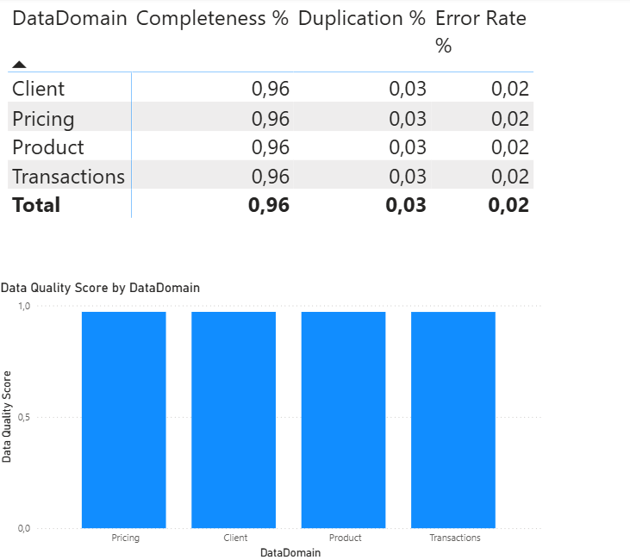
Data Quality KPI Framework
Completeness % = CompleteRecords / TotalRecords
Duplication % = DuplicateRecords / TotalRecords
Error Rate % = ErrorRecords / TotalRecords
Targets: Completeness ≥ 95% | Duplication ≤ 2% | Error ≤ 1.5%

Slide 5
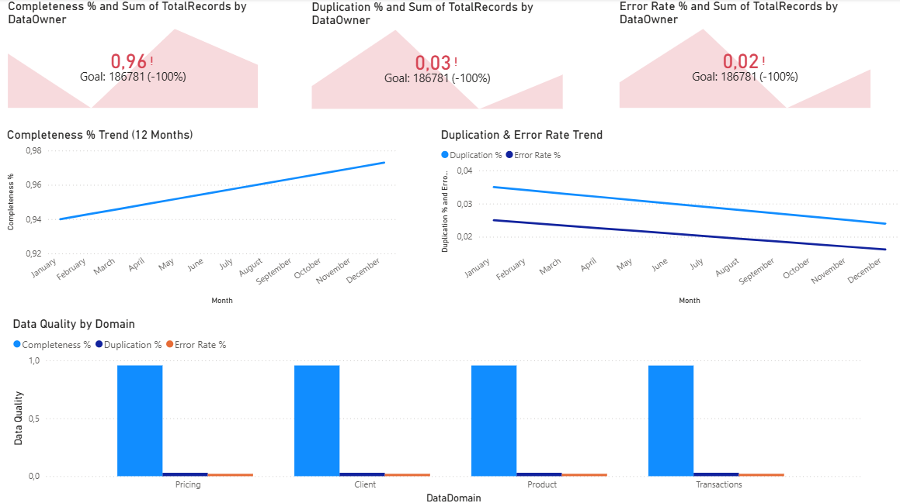
Executive Data Quality Dashboard
[INSERT DASHBOARD PAGE 1 SCREENSHOT HERE]
Dashboard Must Include:
• 3 KPI Cards (Completeness, Duplication, Error)
• 12-Month Trend Line
• Domain Comparison Column Chart

Slide 6
Quality Trend Monitoring
Commentary:
• Sustained improvement month-over-month
• Duplication reduction via cleansing initiative
• Error rate decline after validation automation

Slide 7
Domain Risk Scorecard
Apply Conditional Formatting:
• Completeness <95%
• Duplication >3%
• Error >2%

Slide 8
Governance Committee & Escalation Model
Monthly Quality Review Meeting
Threshold breach identification
Root cause analysis & remediation plan
Executive escalation if critical risk
Monthly Quality Review
• Data stewards present KPI dashboard • Domain performance reviewed
Threshold Breach Identification
Trigger:
• Completeness < 95% Automatically flagged in dashboard
Root Cause Analysis
• System mapping review • Data entry process analysis • Upstream dependency check
Remediation Plan • Data cleansing campaign • Validation rule enhancement
Executive Escalation (If Critical)
Escalate when: • Financial reporting risk Escalation to: • Governance Committee

Slide 9
Strategic Business Impact
• +3–4% reporting accuracy improvement
Improved CRM segmentation reliability
Reduced pricing inconsistency risk
Strengthened executive data trust

Slide 10
Next Phase Governance Roadmap
• Master Data Management integration
• Automated anomaly detection
• Cross-market governance alignment
• Governance maturity score tracking

