Slide 1
Luxury Client Value & Retention Intelligence Program
Executive CRM Simulation
Neliswa Mbeje

Slide 2
Executive Summary
300 global luxury clients | VIC / Elite / Premium segmentation
Retention Rate: 55%
62% revenue concentrated in top 30% clients
€1.8M revenue identified at churn risk
Objective: Transform CRM into revenue protection engine

Slide 3
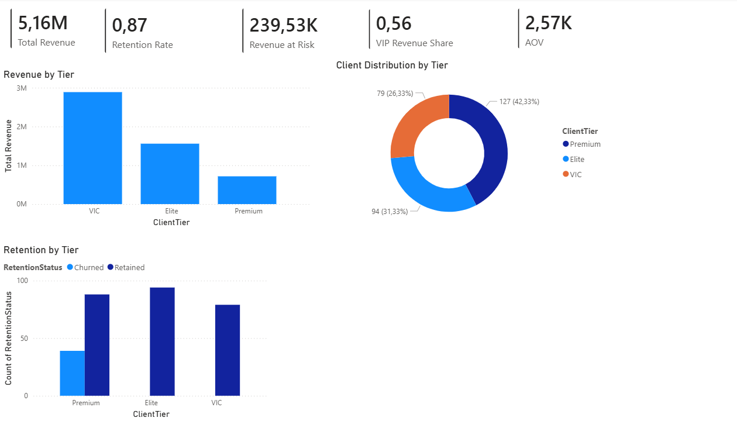
EXECUTIVE OVERVIEW

Slide 4
Client Value Pyramid
VIC: 28% clients → 45% revenue
Elite: 32% → 30% revenue
Premium: 40% → 25% revenue
High concentration risk in VIP tier

Slide 5
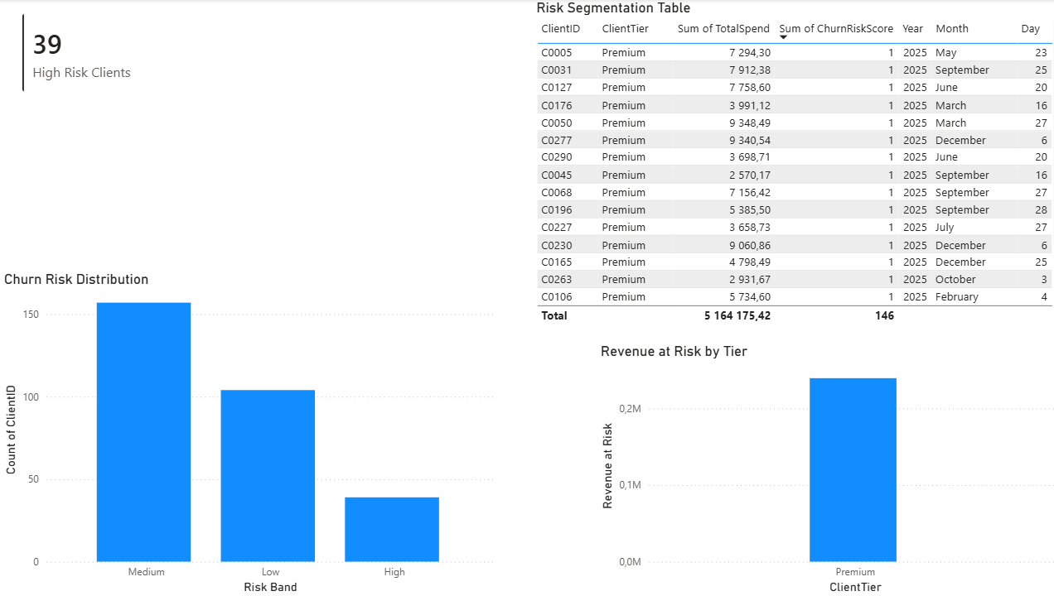
Revenue at Risk Model
Revenue at Risk = Total Spend × Churn Risk Score ≥ 0.7
22% clients classified High Risk
38% of at-risk revenue within VIP tier

Slide 6
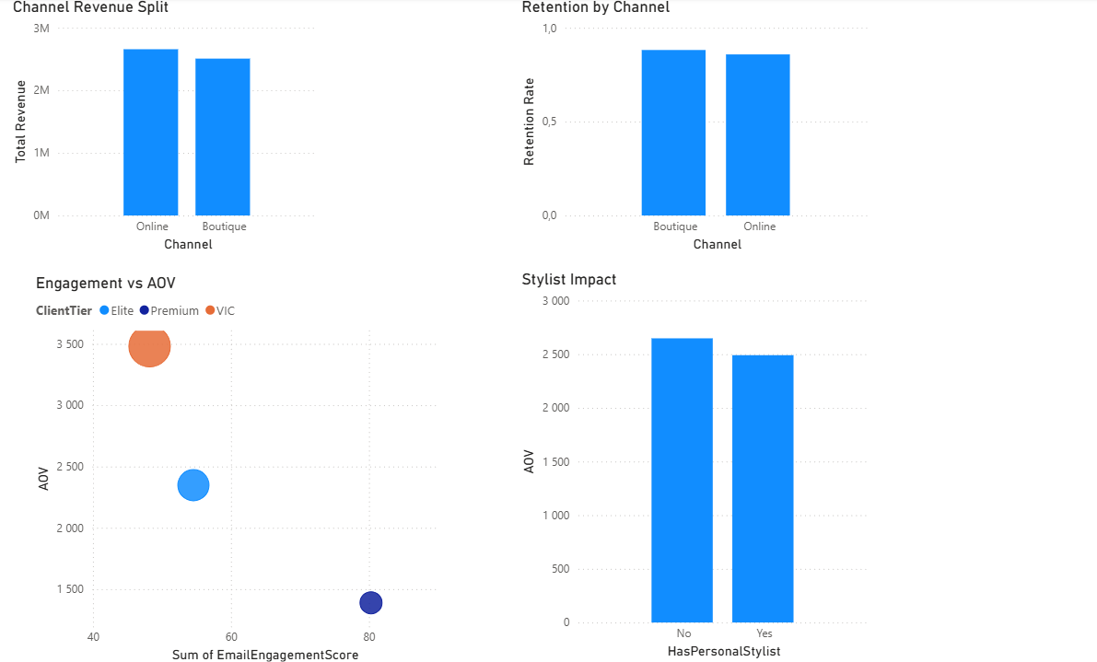
Behavioural Drivers
Personal Stylist Clients: +18% AOV
High Email Engagement: +23% Purchase Frequency
Boutique Channel: +15% retention uplift

Slide 7
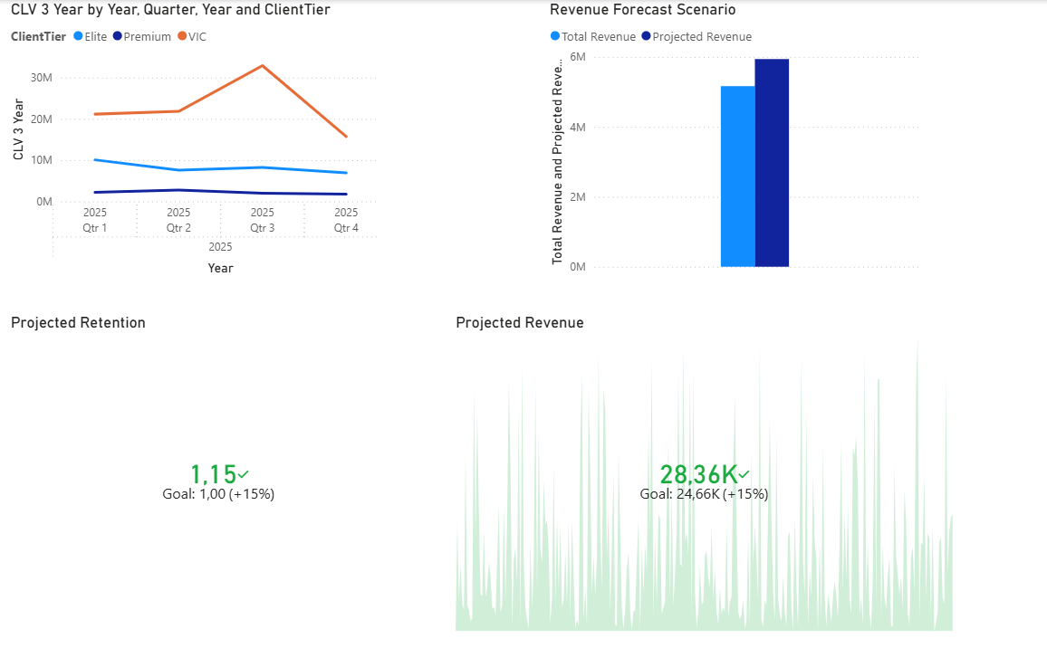
Client Lifetime Value Projection
CLV = AOV × Purchase Frequency × Duration
VIP CLV 3.4x Premium
+10% retention → +22% revenue uplift

Slide 8
6-Month Strategic Forecast
Retention 55% → 68%
Revenue at Risk -40%
VIP Revenue Share 62% → 72%
AOV Growth +15%

Slide 9
6-Month Strategic Forecast

Slide 10
CRM Governance Framework
Monthly churn review cadence
VIP protection playbooks
Tier-based engagement strategy
Executive dashboard reporting structure

Slide 11
Strategic Value to the Maison
Revenue Protection Engine
VIP Growth Accelerator
Predictive Retention Intelligence
Data-Driven Personalisation Infrastructure

