Slide 1
AI‑Driven Predictive Governance Model
AI/ML Governance Notebook Project
Neliswa Mbeje
IT Governance • Data Analytics • AI‑Driven Operations

Slide 2
Executive Overview
This project demonstrates how predictive analytics enhances IT governance.
Objectives:
Anticipate operational risks
Detect anomalies proactively
Improve service reliability
Enable data‑driven executive decisions

Slide 3
Business Problem
Large distributed IT environments struggle with:
Reactive incident management
Hidden performance degradation
Fragmented governance visibility
Rising operational costs
A predictive governance framework is required.

Slide 4
Solution Architecture
AI‑Driven Governance Framework:
Data Sources
Predictive Modeling
Risk Scoring
Feature Engineering
Data Preparation
Executive Dashboards

Slide 5
Dataset Overview
Synthetic 24‑month dataset simulating enterprise IT operations.
Key Fields:
Date
Region
Site
Incident Volume
SLA Breach Rate
System Downtime
User Satisfaction
Risk Score

Slide 6
Exploratory Data Analysis
Initial analysis performed to identify trends and distributions.
Insights:
Incident peaks follow seasonal load patterns
SLA breaches correlate with downtime spikes
User satisfaction declines during prolonged outages

Slide 7
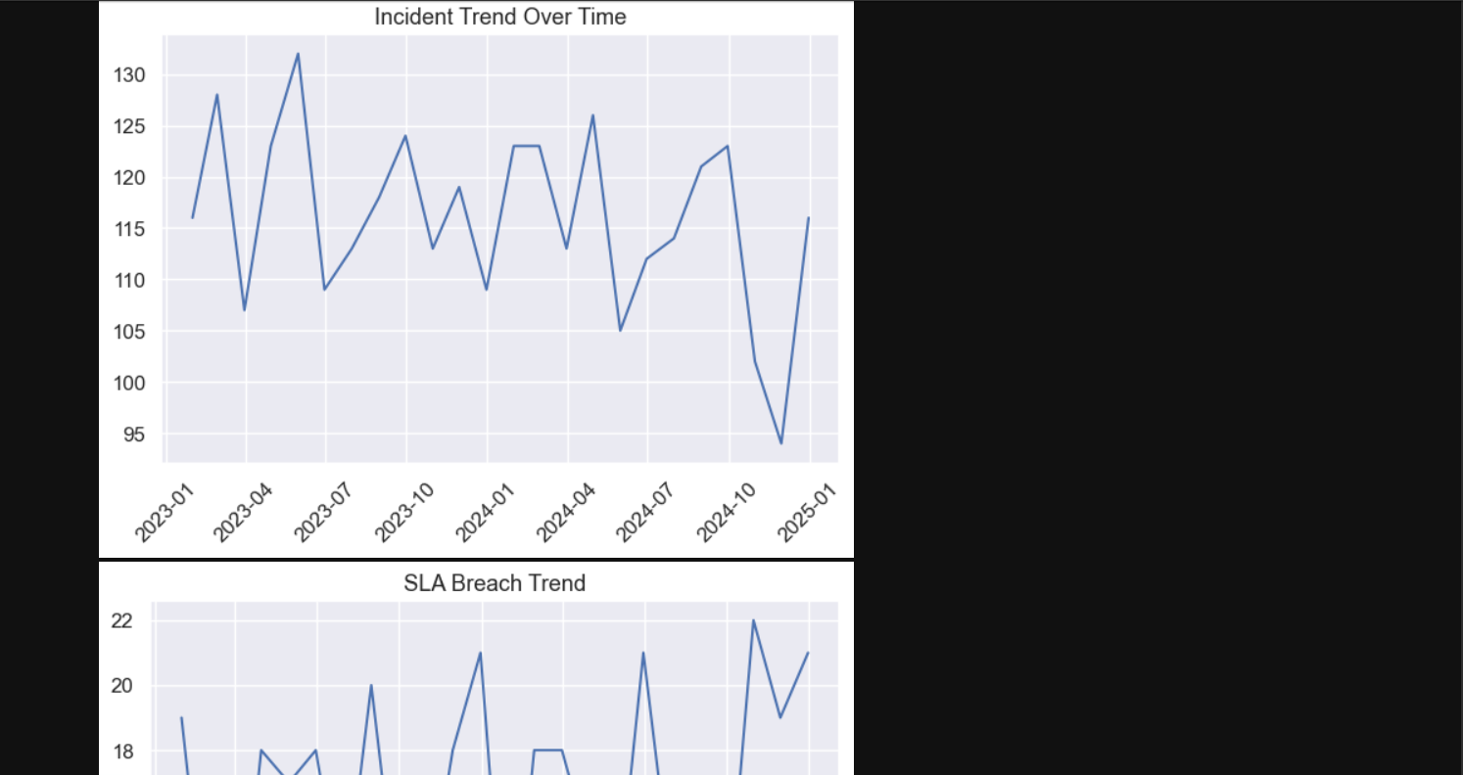
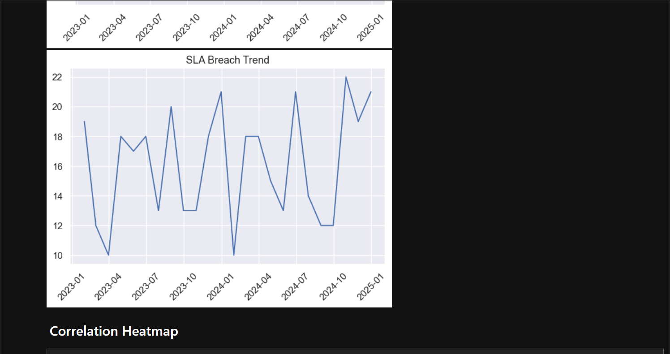
DATA DISTRIBUTION GRAPHS

Slide 8
Feature Engineering
Engineered predictive indicators:
Rolling Incident Average
Downtime Trend Index
SLA Volatility Measure
Regional Risk Weighting

Slide 9
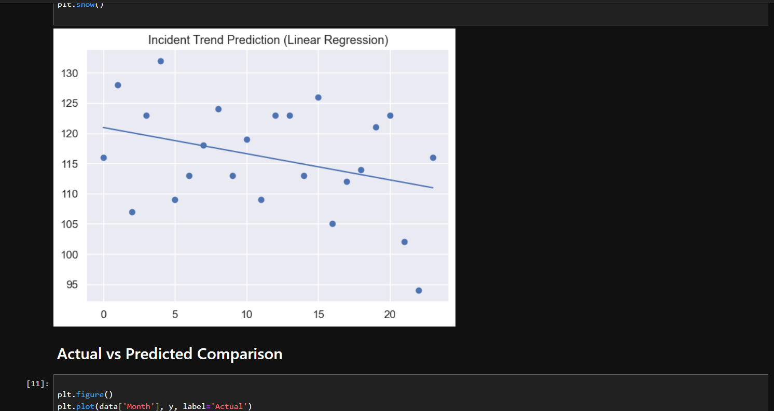
Predictive Modeling Approach
Purpose:
Forecast incident escalation
Predict SLA breach probability
Quantify operational risk trends

Slide 10
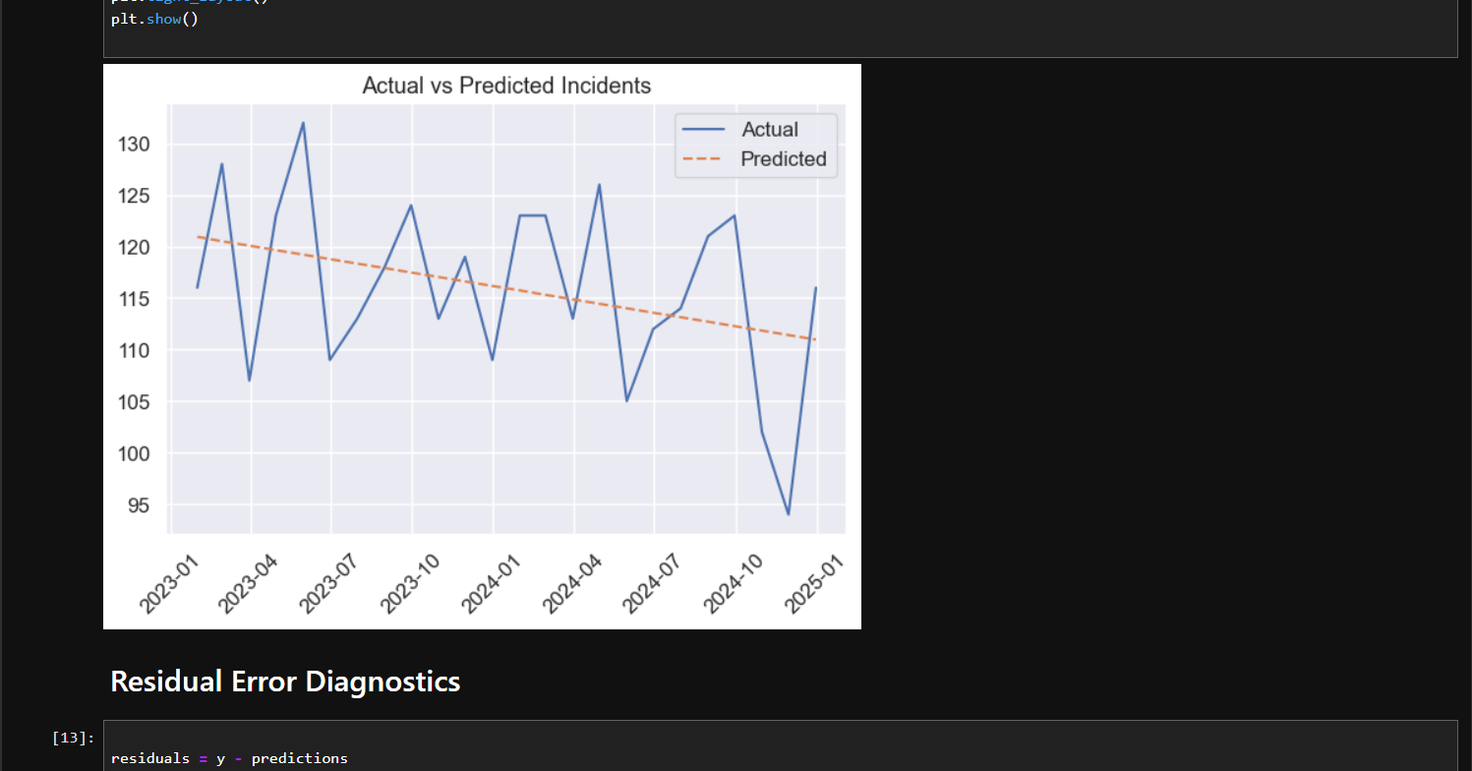
Model Performance
Evaluation Metrics:
R² Score
Mean Absolute Error
Prediction Confidence
Model demonstrates strong
predictive reliability.

Slide 11
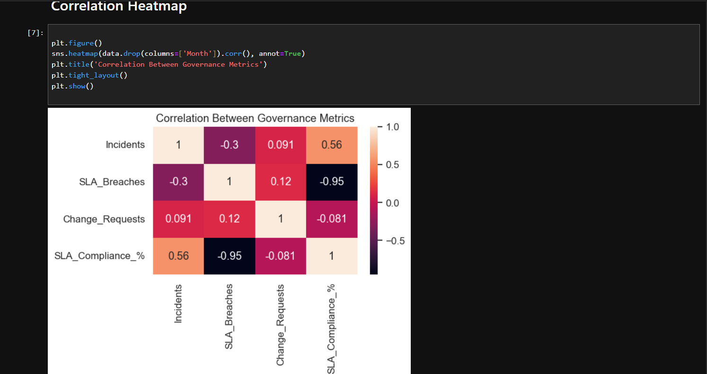
Visualization & Insights
Predictive insights presented through governance dashboards.
Key Views:
Incident Forecast Trends
SLA Breach Probability
Regional Risk Heatmaps

Slide 12
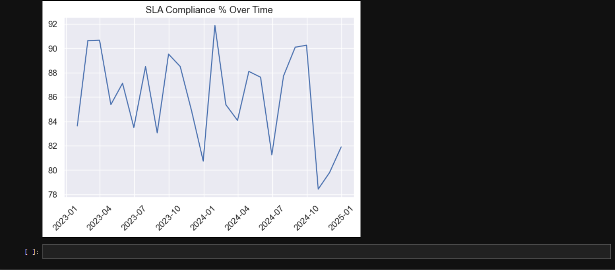
Business Impact
Operational Improvements:
Proactive incident prevention
Reduced downtime
Improved SLA compliance
Enhanced executive visibility
Stronger governance maturity

Slide 13
Scalability & Future Enhancements
Next Evolution:
Anomaly detection (Isolation Forest)
Deep learning time‑series forecasting
Real‑time monitoring pipelines
Automated executive alerts

Slide 14
Conclusion
This project demonstrates how AI transforms governance from reactive control to predictive intelligence.
Outcome:
A scalable, data‑driven governance model suitable for global luxury enterprises.

Slide 15
Appendix — Notebook Evidence
Include screenshots from the notebook:
1. Dataset preview
2. Data cleaning steps
3. Feature engineering code
4. Model training process
5. Forecast outputs

Slide 16
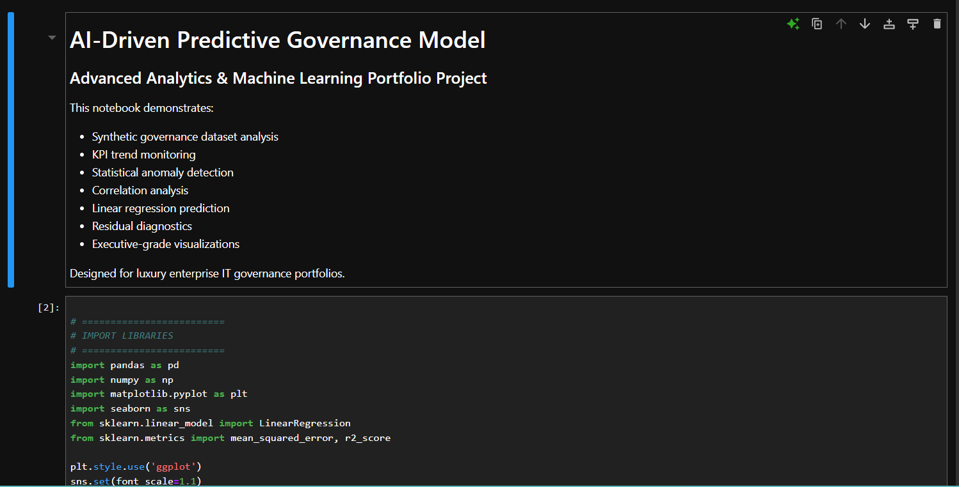
NOTEBOOK SCREENSHOTS

Slide 17
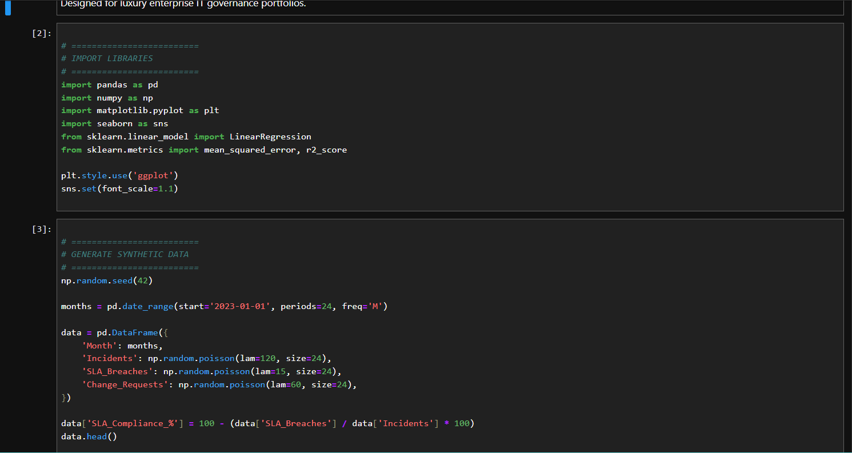
NOTEBOOK SCREENSHOTS

Slide 18
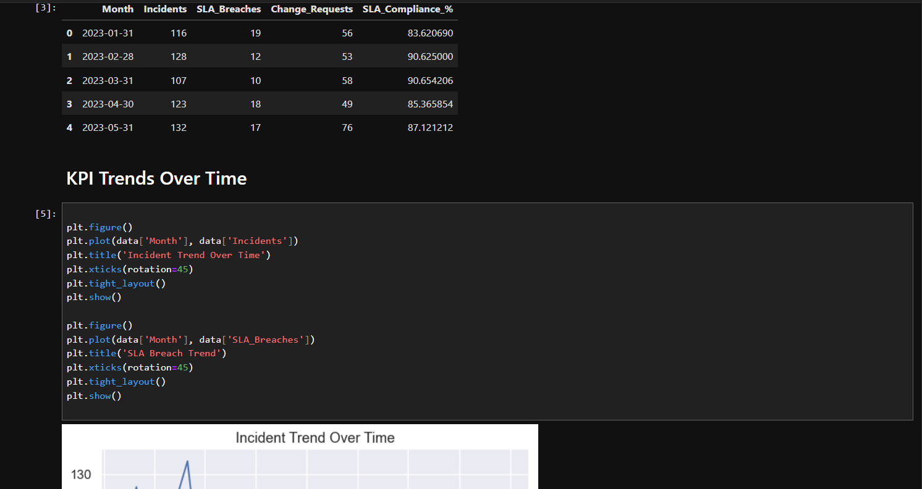
NOTEBOOK SCREENSHOTS

Slide 19
NOTEBOOK SCREENSHOTS

Slide 20
NOTEBOOK SCREENSHOTS

Slide 21
NOTEBOOK SCREENSHOTS

Slide 22
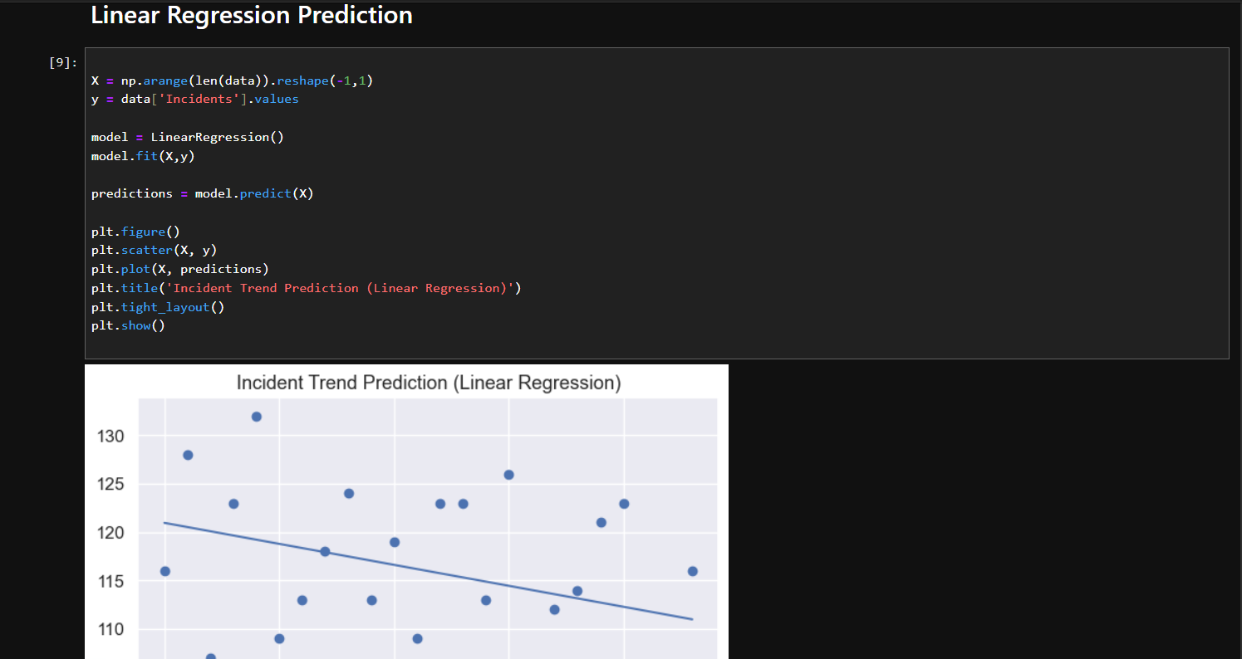
NOTEBOOK SCREENSHOTS

Slide 23
NOTEBOOK SCREENSHOTS

Slide 24
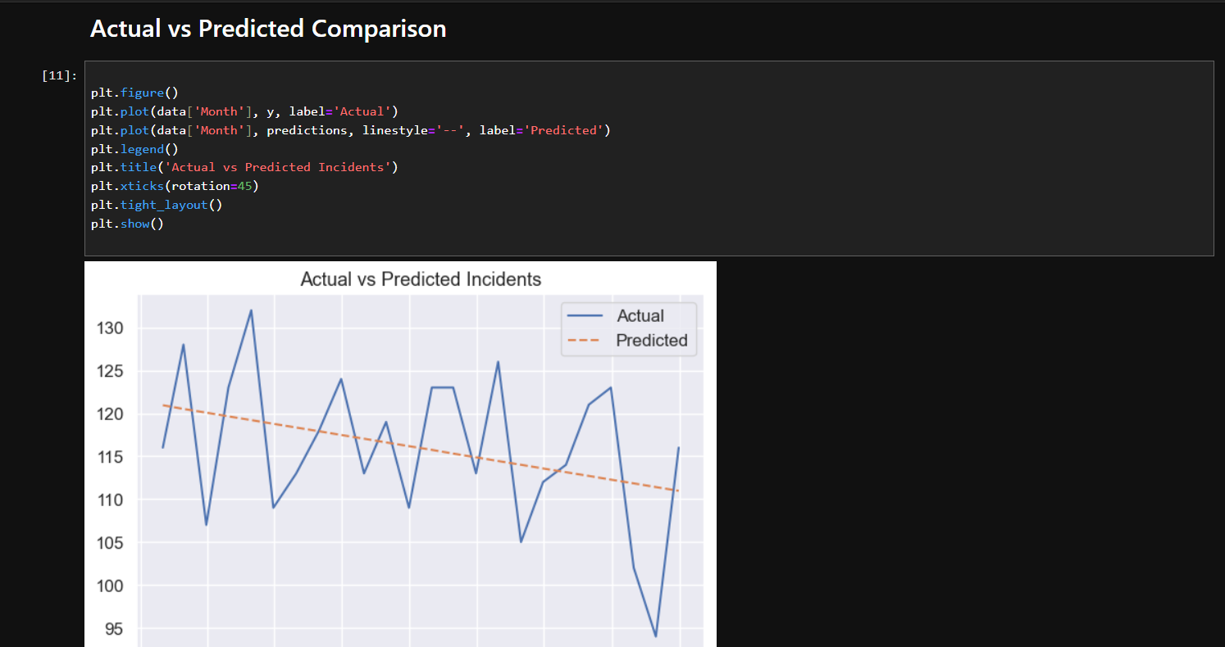
NOTEBOOK SCREENSHOTS

Slide 25
NOTEBOOK SCREENSHOTS

Slide 26
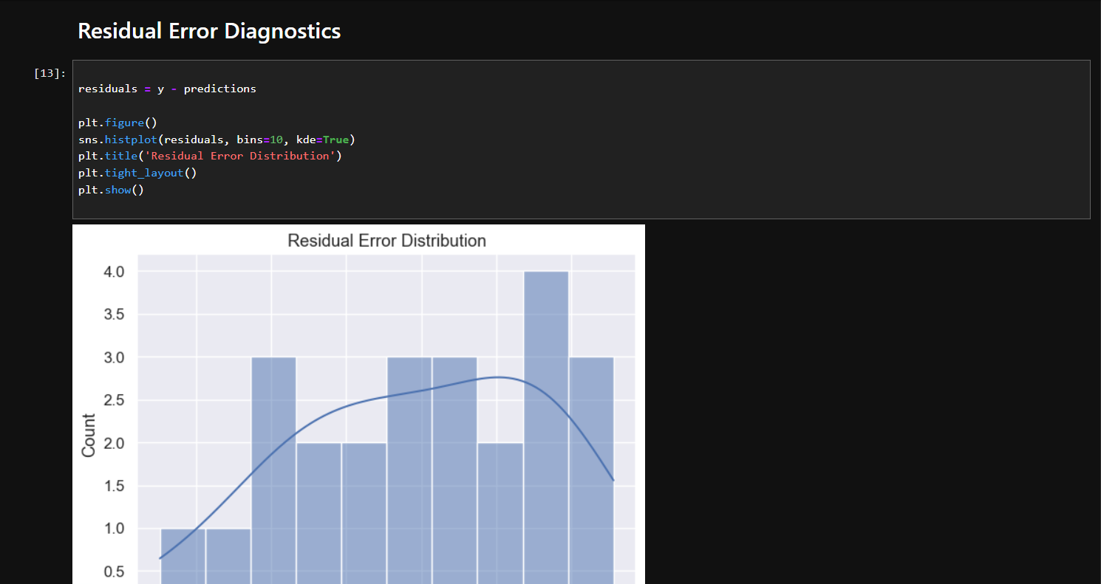
NOTEBOOK SCREENSHOTS

Slide 27
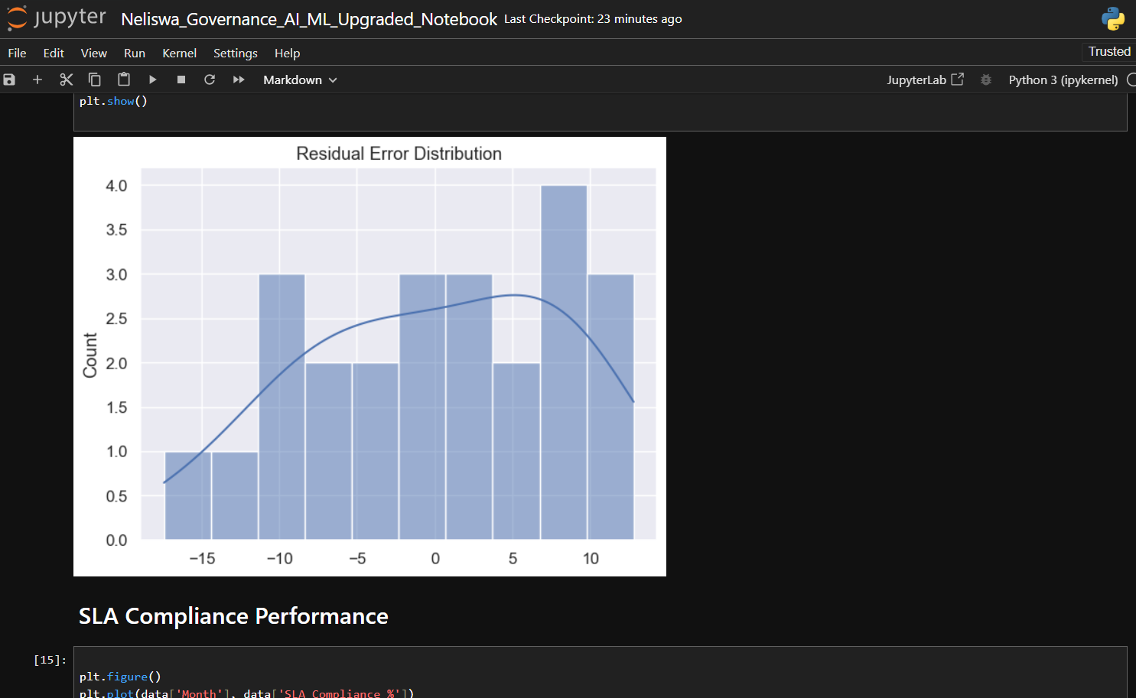
NOTEBOOK SCREENSHOTS

Slide 28
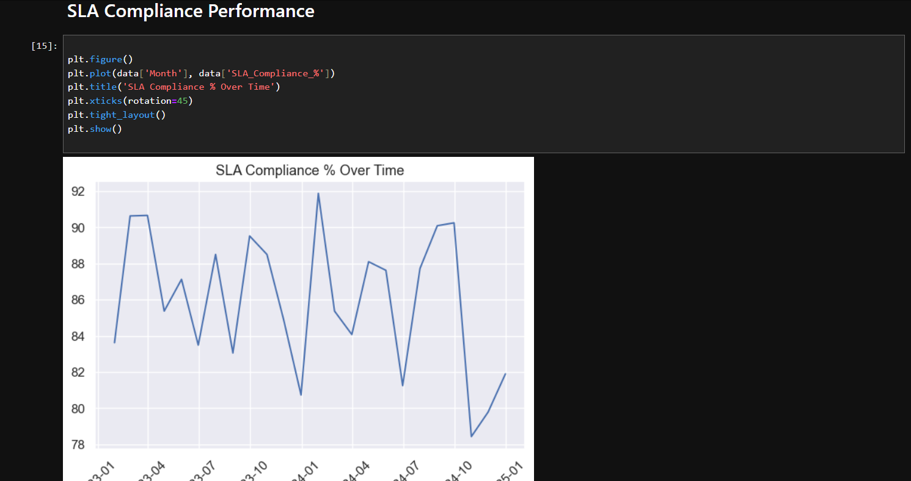
NOTEBOOK SCREENSHOTS

Slide 29
NOTEBOOK SCREENSHOTS

