Slide 1
Digital Workplace Adoption Acceleration Program
Dior UX Adoption Strategy Simulation
Neliswa Mbeje

Slide 2
Executive Summary — Digital Workplace Status
Adoption Rate: 29% (43 / 150 active users)
Training Completion: 53%
Support Tickets: 243
User Satisfaction: 4.23 / 5
Key Risks:
Low adoption maturity in Retail & Manufacturing
Ticket dependency linked to training gaps
Inconsistent feature utilisation
Strategic Objective: Move from reactive IT support to proactive enablement.

Slide 3
Adoption Maturity Segmentation Model
Score Range | Segment | Strategic Interpretation
> 7 | High Adoption | Engaged power users — Champions
4–7 | Moderate Adoption | Requires targeted enablement
< 4 | At Risk | Low usage + high support dependency

Slide 4
Training Impact Analysis
Users completing training demonstrate:
+40% higher weekly sessions
30% lower ticket rate
Higher feature usage diversity
Training is a primary adoption accelerator.

Slide 5
Operational Risk — Ticket Intelligence
Top Ticket Categories:
Performance Issues
Access Issues
Data Errors
62% of tickets linked to usability friction rather than system failure.

Slide 6
6-Month Transformation Scenario
Metric | Current | Target (6 Months) | Impact
Adoption Rate | 29% | 61% | Operational maturity increase
Training Completion | 53% | 78% | Reduced support dependency
Support Tickets | 243 | 150 | Operational efficiency
Satisfaction Score | 4.23 | 4.45 | Enhanced employee experience

Slide 7
Power BI Executive Dashboard Structure
Page 1 — Executive Overview:
KPI Cards (Adoption, Training, Tickets, Satisfaction)
Adoption Trend
Department Comparison

Slide 8
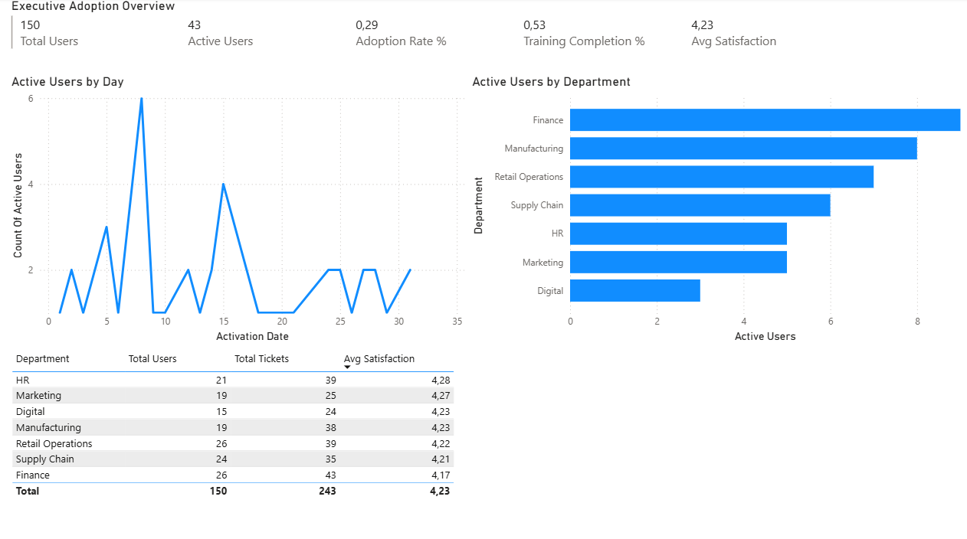
Power BI Executive Dashboard Structure - Executive Overview

Slide 9
Power BI Executive Dashboard Structure
Page 2 — Adoption Intelligence:
Training vs Adoption
Adoption Segmentation
Feature Usage Distribution

Slide 10
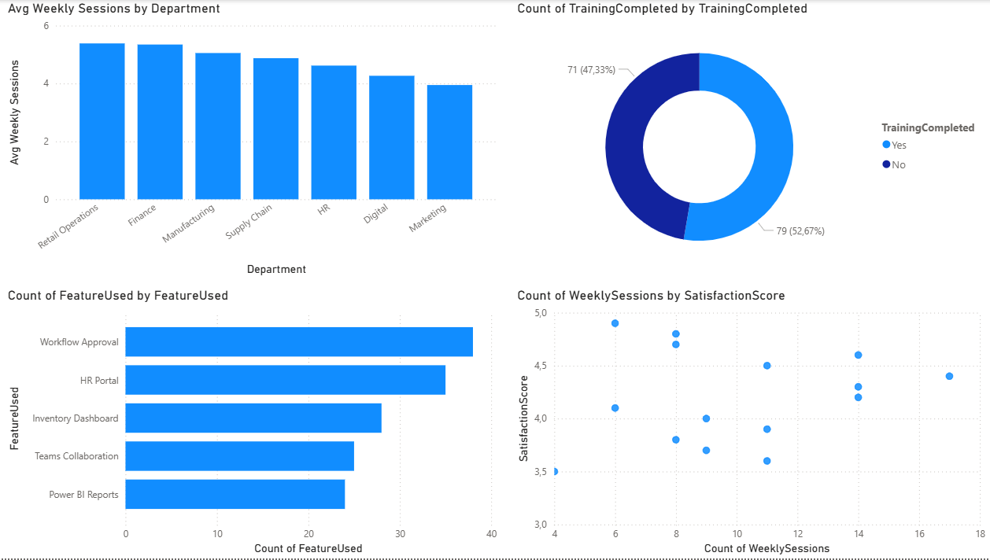
Power BI Executive Dashboard Structure - Adoption Intelligence

Slide 11
Power BI Executive Dashboard Structure
Page 3 — Operational Risk:
Ticket Trend
Category Breakdown
Satisfaction vs Ticket Analysis

Slide 12
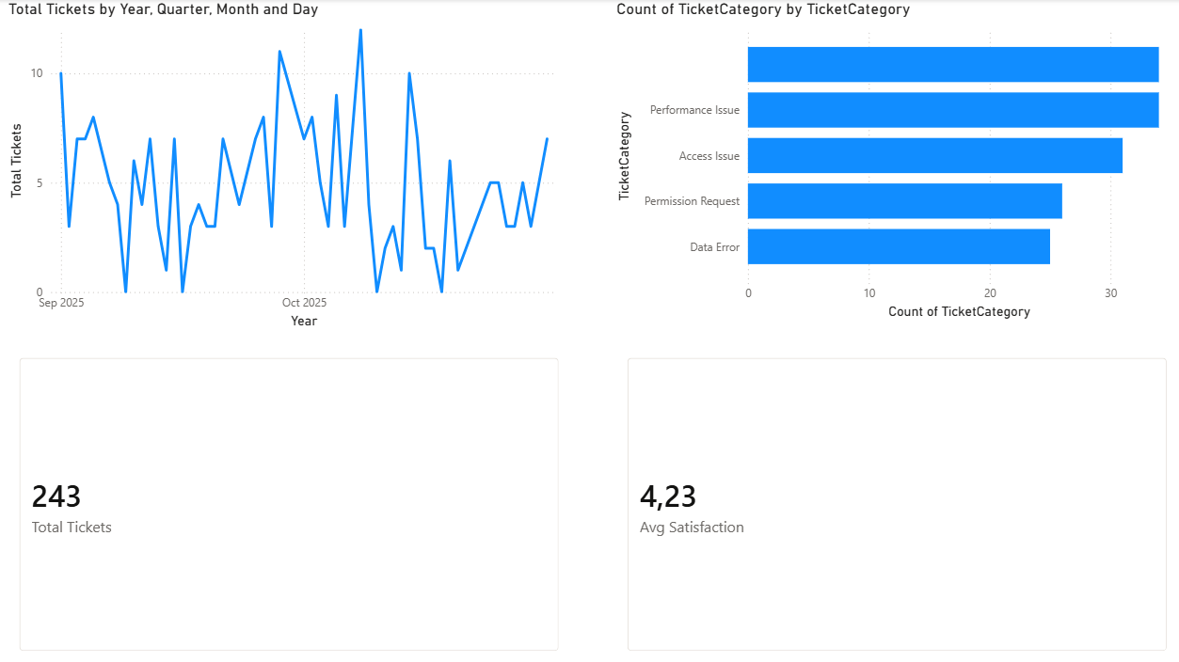
Power BI Executive Dashboard Structure - Operational Risk

Slide 13
Strategic Value to the Maison
This initiative positions IT as a strategic enabler of digital excellence.
Impact:
Increased digital maturity
Reduced operational friction
Stronger cross-functional alignment
Elevated employee digital experience

