Slide 1
Project 3 – Phase II: Governance Roadmap & MDM Integration
Objective: Transition from monitoring to automated governance
Neliswa Mbeje

Slide 2
Project 3 – Phase II: Governance Roadmap & MDM Integration
Objective: Transition from monitoring to automated governance
Focus Areas:
- Master Data Management Integration
- Automated Anomaly Detection
- Cross-Market Governance Alignment
- Governance Maturity Tracking

Slide 3
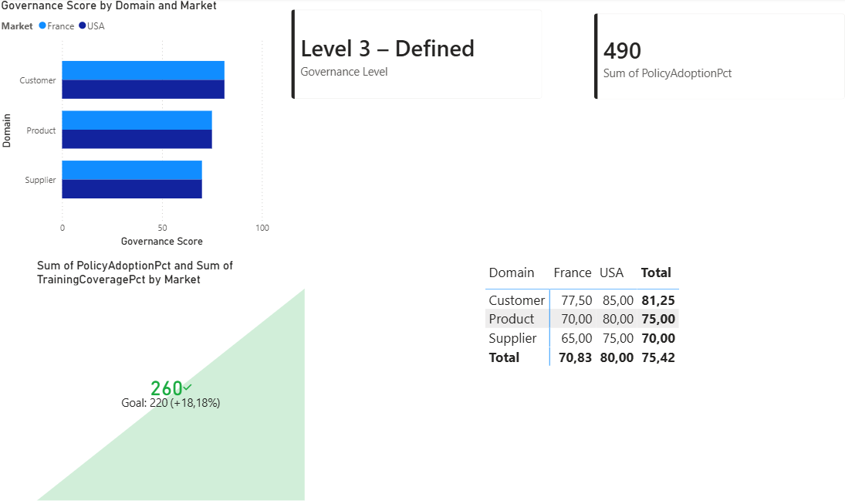
Current vs Target Governance Model
Current: Reactive data quality dashboards
Target: Automated governance with MDM integration

Slide 4
Governance Maturity Scorecard
Policy Adoption %
Training Coverage %
Automation Level
MDM Integration Status

Slide 5
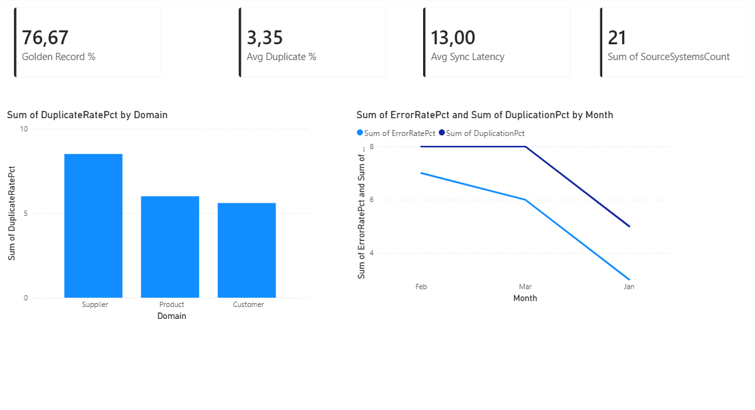
Master Data Management Integration KPIs
Duplicate Rate %
Golden Record Coverage %
Sync Latency (hrs)
Source Systems Count

Slide 6
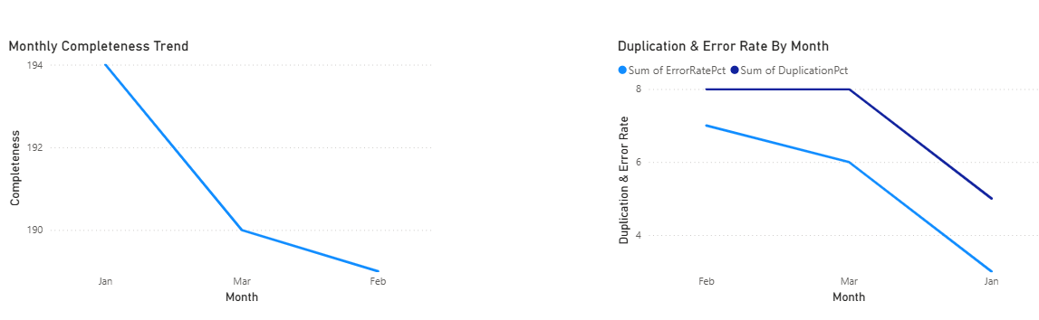
Automated Anomaly Detection
Monthly Completeness Trend
Duplication & Error Rate spikes
AnomalyFlag logic triggered by thresholds

Slide 7
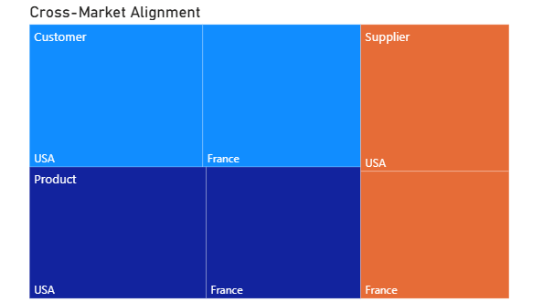
Cross-Market Governance Alignment
Compare governance maturity by market
Identify lagging domains

Slide 8
18-Month Governance Roadmap
Phase 1: Standardize ownership
Phase 2: MDM rollout
Phase 3: Automation implementation
Phase 4: Optimization & continuous monitoring
Month 1-3 Standardize ownership
Month 4 – 8 MDM rollout
Month 8 – 13 Automation implementation
Month 14 – 18 Optimization & continuous monitoring

Slide 9
Executive Impact Summary
Reduced duplication & latency
Improved cross-market alignment
Automated risk detection
Path toward Level 5 Governance

