Slide 1
Text Summarization with Deep Learning
Allen Jackson

Slide 2

The Problem
Why Summarize text?
Why Deep Learning?

Slide 3
The Data: The Wikihow Dataset
Title: How to Always Catch Pop Culture references1
Headline:
'\r\nMake a list of what your friends watch, read, and listen to now.,\r\nGo online to check celebrity gossip.,\r\nWatch popular TV shows to be in the know.,\r\nCheck Top 100 charts to see what music is popular now.,\r\nGo to the movies whenever something exciting is released.,\r\nFollow your favorite celebrities on Twitter and Instagram.,\r\nVary your interests to avoid missing references.,\r\nListen to podcasts about pop culture.'
Text:
' Use your friends’ conversations to figure out what’s popular. Pay careful attention to which shows, bands and artists, movies, and celebrities they mention. Make a list and add new references whenever they come up.\r\n\r\n\r\nYou can use this list to pick which people and sources of entertainment you should follow first. It’ll be most important for you to catch the references your friends drop, so this is a great place for you to begin your pop culture education.;\r\n, There are lots of websites and online magazines that detail the glitzy and glamorous lives of the rich and famous. Some teen magazines also have content on these topics. Use these to make sure you never miss a reference to someone’s new baby or a dramatic breakup.Download your favorite celebrity news outlet’s app to be instantly informed of new gossip.\r\nTry Us Weekly or People. Seventeen and Teen Vogue are also good sources.\r\n\r\n, TV shows are big sources of pop culture. Even if you don’t have cable, you can stream shows through platforms like Hulu. Be sure to also check out Netflix for binge-able content your friends will surely talk about.If you’re willing to wait a week for new episodes, you can usually watch popular shows either on the networks’ websites or on Hulu for free.\r\n\r\n, Billboard.com and iTunes both have Top 100 charts that keep track of the most popular songs in the United States. Go online to look at these charts and download the top 10 or 20 songs. You’ll be singing along to all the hits in no time.Billboard updates their chart weekly, and iTunes updates in real time.\r\n\r\n, You’ll know when this happens. Even if people aren’t planning Harry Potter-style midnight showing parties, make an event of big movie releases. Get your friends together on a Friday or Saturday night and do a group outing.\r\n\r\n, Social media has made it much easier to feel connected to the stars. Check Twitter to stay updated on their thoughts, opinions, and even their politics. Use Instagram to see their cute or funny photos.Check what’s trending on Twitter to see what people are talking about on a day-to-day basis. This is a great way to make sure you don’t miss any viral stories that could be tomorrow’s pop culture references.\r\n\r\n, As you start to follow new shows, celebrities, and artists, don’t stick with one genre. You may decide you really like crime shows, but be sure to check out some dramas as well. This will help you avoid missing references that fall a little outside your normal set of interests., If you’re a podcast listener, you’re in luck! There are tons of shows dedicated to giving you weekly content just about pop culture. The hosts will make jokes about it, criticize it, and generally keep you informed.NPR’s Pop Culture Happy Hour and Slate’s Culture Gabfest are catch-all shows about all pop culture. Who Charted? discusses top music and movies. Nerd Culture Podcast focuses on all things nerd, including comics, TV shows, and movies.You can also follow pop culture writers on Twitter.\r\n\r\n'

Slide 4
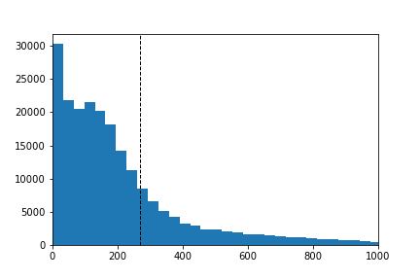
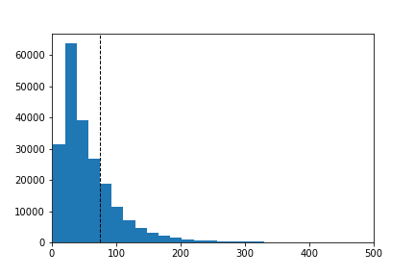
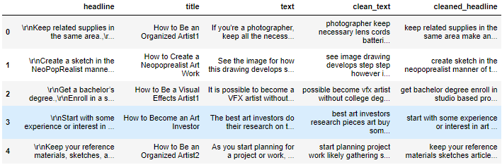
Data Wrangling and EDA
Cleaning
Max Sequence Length

Slide 5
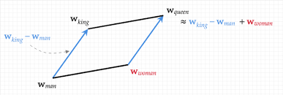
Preprocessing
Tokenizer
Embedding
Lagged Y’s

Slide 6

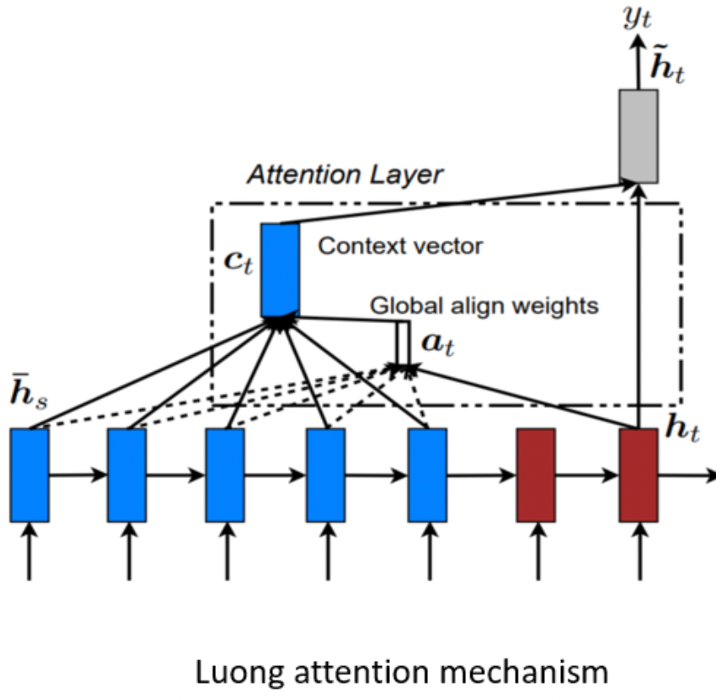
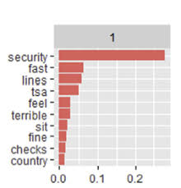
The Model P1: Components
photographer keep necessary lens cords
(Tokenization with padding length 10)
4617 14 329 4618 1852 0 0 0 0 0
(Tokens are transformed into embeddings and concatenated )
0.00464754
0.00329968 0.01332643
0.00605796 0.00459971
Tokenization and padding
Embedding
LSTM
Attention
(Embeddings are run through LSTM layers)
(Attention Layer)
Final Probability Distribution

Slide 7
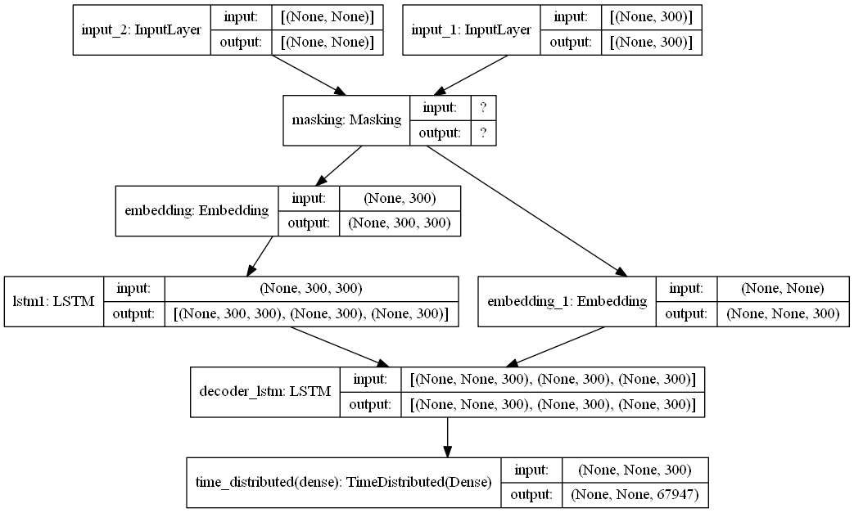
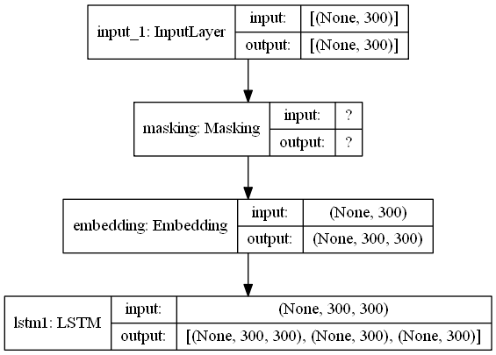
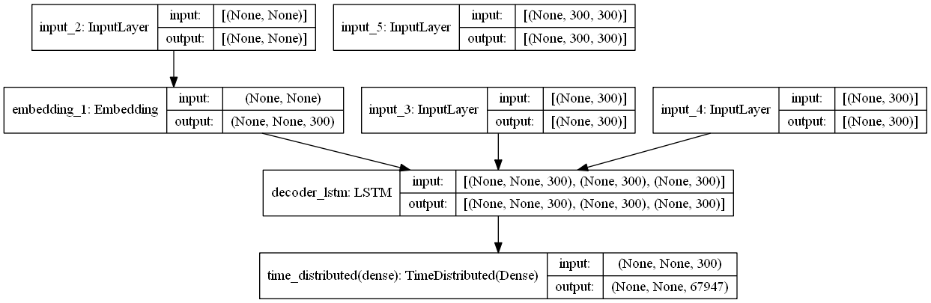
Model 1

Slide 8
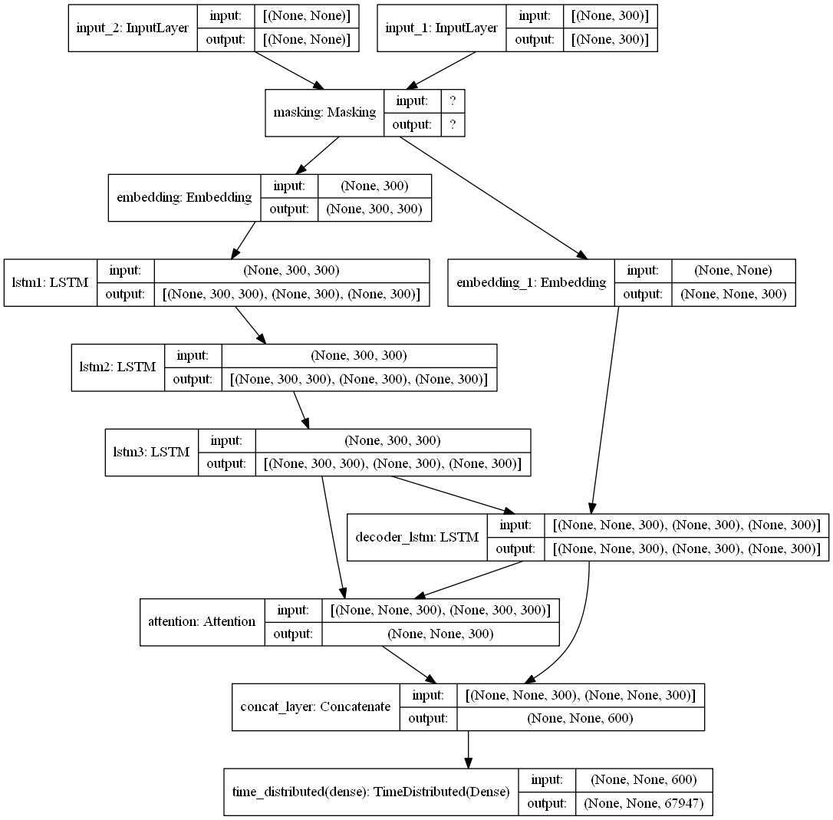
Model 2

Slide 9
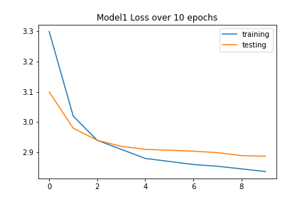
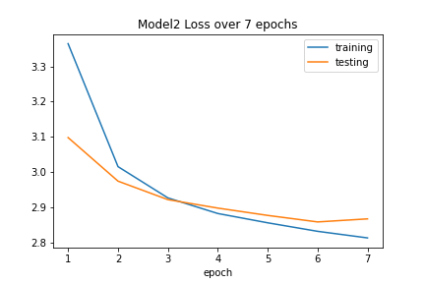
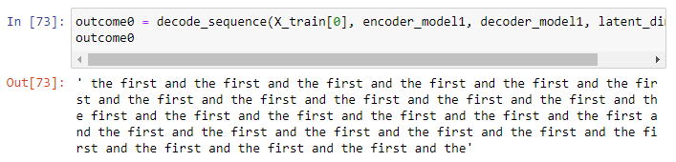
Results

Slide 10
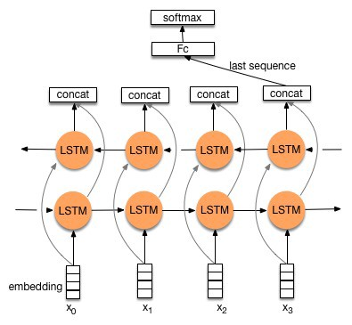
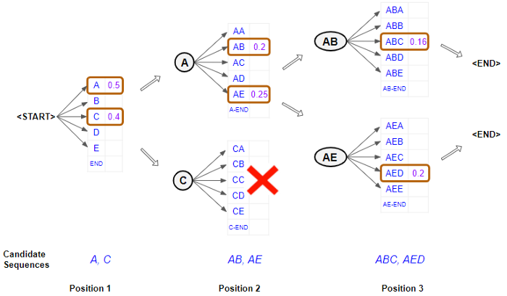
Next Steps
More Training
Bidirectional
BERT
Beam Search

