Slide 1
Predicting Attrition
Allen Jackson

Slide 2
The Problem:
Employee Attrition
How to avoid it
What avoiding it can do for businesses/organization

Slide 3
The Data
IBM Dataset (1470 Rows)
Factors include education, work life balance, performance ratings
Binary attrition factor
ID | Age | Attrition | BusinessTravel | DailyRate | Department
0 | 41 | Yes | Travel_Rarely | 1102 | Sales
1 | 49 | No | Travel_Frequently | 279 | Research & Development
2 | 37 | Yes | Travel_Rarely | 1373 | Research & Development
3 | 33 | No | Travel_Frequently | 1392 | Research & Development
4 | 27 | No | Travel_Rarely | 591 | Research & Development
5 | 32 | No | Travel_Frequently | 1005 | Research & Development
6 | 59 | No | Travel_Rarely | 1324 | Research & Development
7 | 30 | No | Travel_Rarely | 1358 | Research & Development
8 | 38 | No | Travel_Frequently | 216 | Research & Development
9 | 36 | No | Travel_Rarely | 1299 | Research & Development

Slide 4
Data Wrangling
Education
2
1
2
4
1
2
3
1
3
3
Education
College
Below College
College
Master
Below College
College
Bachelor
Below College
Bachelor
Bachelor
Data was mostly clean
Some categorical variables were marked by ordinal numbers
Changed ordinal rankings to label classifications

Slide 5
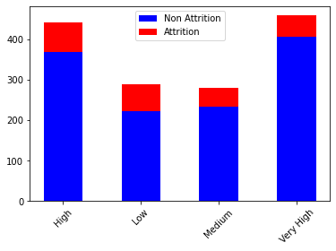
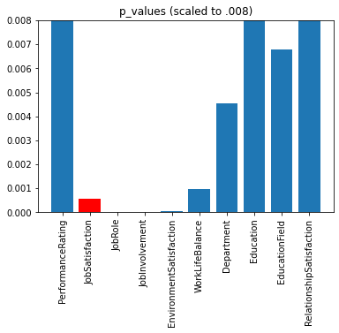
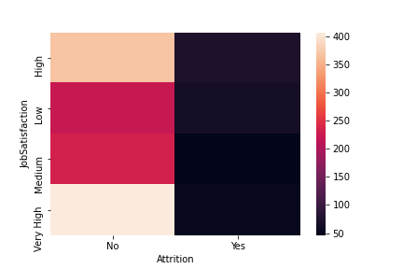
EDA and Hypotheses
Observed categorical variables
Ran Chi Squared test for suspected significant variables

Slide 6
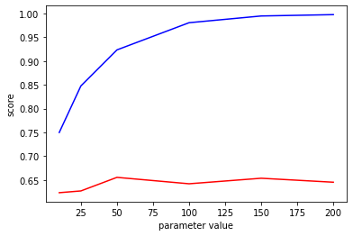
Model Training and Testing
Data broken up into training and testing data
Train Set: 925 Non Attrition, 177 Attrition, Total 1102
Test Set: 308 Non Attrition, 60 Attrition, Total 368
Models were trained on the training set and validated on test set in order to measure model effectiveness
XGB2 Number Iterations

Slide 7
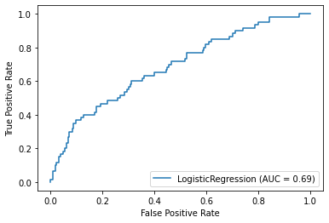
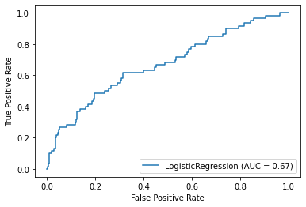
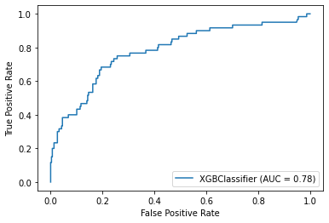
Measuring Models
Accuracy
AUC
Confusion Matrix
F1 Score
F1 Score: .03
Accuracy : .84
F1 Score: .34
Accuracy : .61
F1 Score: .36
Accuracy : .86
307 | 1
59 | 1
188 | 120
23 | 37
304 | 4
46 | 14
Threshold = .5

Slide 8
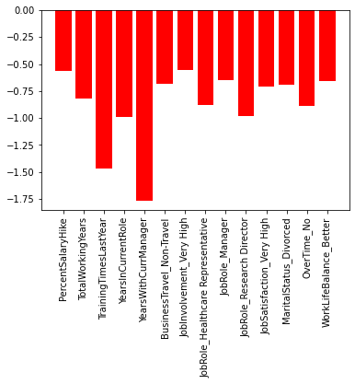
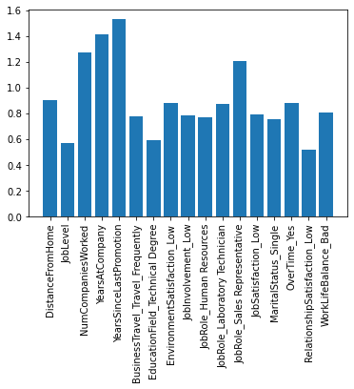
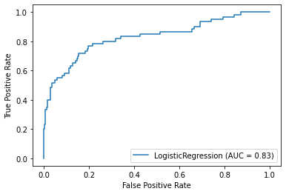
Modeling: Logistic Regression
177 | 131
9 | 51
242 | 66
14 | 46
293 | 41
29 | 31
Model 1
Model 1.5: Min Max
Model 2 : Balanced
Model 3/4: Hyper Parameter Tuning
Iteration Convergence
Threshold: .25
Recall: .85
Precision: .28
Threshold: .5
Recall: .77
Precision: .41
Threshold: .75
Recall: .52
Precision: .67

Slide 9
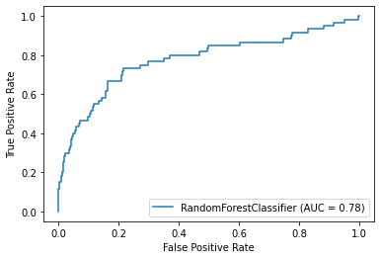
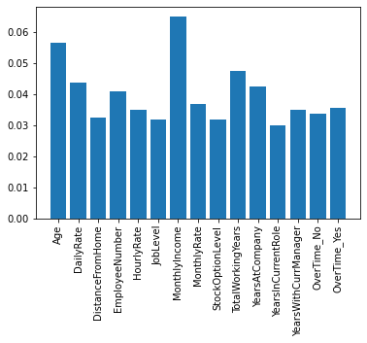
Modeling: Random Forest
Model 1
Model 2 : Balanced
Model 3/4: Hyper Parameter Tuning
Model 5 : Adjust Max Depth
251 | 57
21 | 39
305 | 3
50 | 10
308 | 0
60 | 0
Threshold: .25
Recall: .57
Precision: .45
Threshold: .5
Recall: .65
Precision: .4063
Threshold: .75
Recall: 0
Precision: NULL (no TP’s)

Slide 10
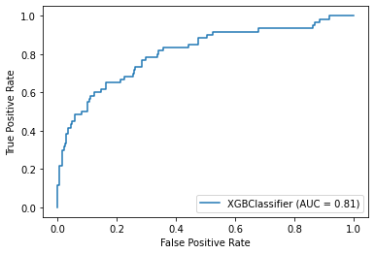
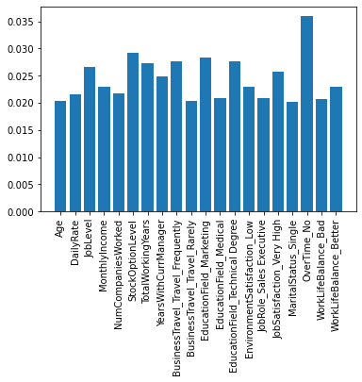
Modeling: XGBoost
Model 1
Model 2/3: Hyper Parameter Tuning
Model 4: Balancing
296 | 12
35 | 25
306 | 2
47 | 13
306 | 2
53 | 7
Threshold: .25
Recall: .42
Precision: .68
Threshold: .5
Recall: .22
Precision: .87
Threshold: .75
Recall: .12
Precision: .78

Slide 11
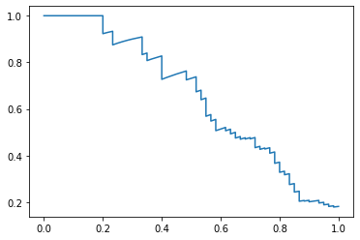
Insights and Application
Best Model: Logistic Regression
267 | 41
21 | 39
Top Factors Decreasing Turn over:
Years At company
Number of companies worked
Years since last promotion
Sales representatives
Top Factors Increasing Turn over:
Years With Manager
Years in current role
Training times last year
Research Directors

