Slide 1
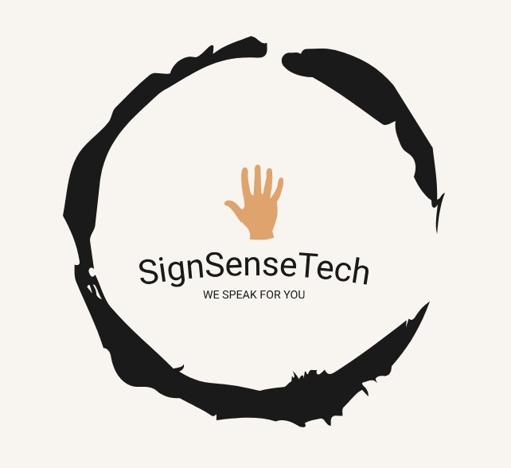
GUESS!!

Slide 2

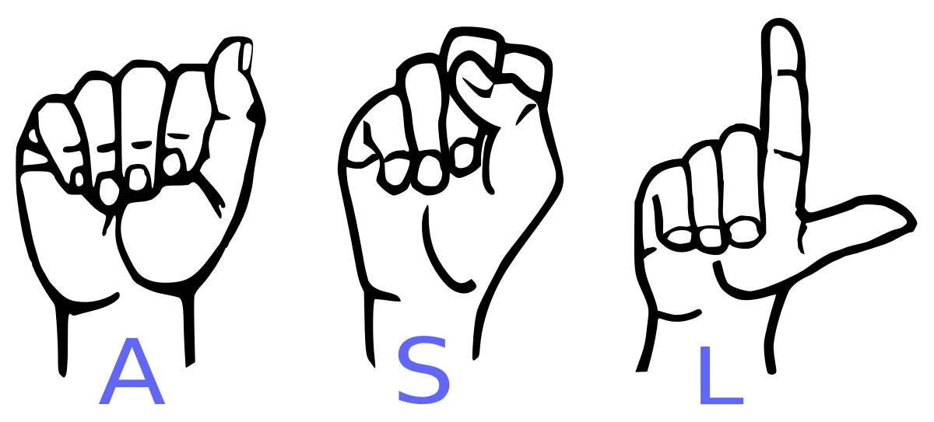
HINT

Slide 3
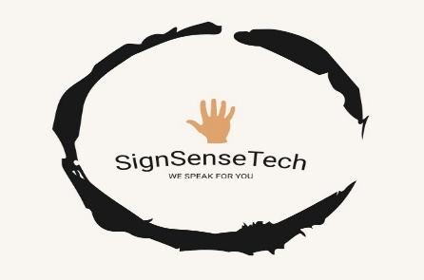
Conversion of Gesture to
TEXT
and
AUDIO

Slide 4
Conversion of Gesture to
TEXT
and
AUDIO
160121729011- I MAHIMA
160121729017- U POOJITHA
160121729028- E AKSHAY
160121729033- J NAVEEN
160121729040- K MANOJ
160121729048- N SANJAY

Slide 5
INTRODUCTION
“SignSenseTech” introduces a revolutionary AI-powered system that bridges this gap. Our machine learning model recognizes hand gestures corresponding to ASL alphabets, translating them into text and spoken audio in real-time. This empowers seamless communication between ASL users and non-signers, fostering greater inclusivity and accessibility.

Slide 6
SignSenseTech stands out in the market due to its proprietary dataset, meticulously crafted for training the ASL recognition model. Our utilization of Convolutional Neural Network (CNN) technology ensures high accuracy and efficiency in recognizing hand gestures. The seamless integration of character and audio output further sets us apart, providing a comprehensive solution for communication.

Slide 7
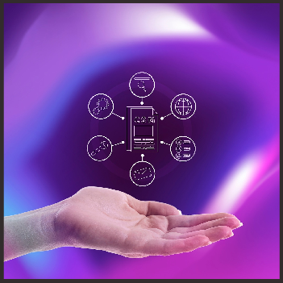
Company Purpose
We offer a comprehensive solution: our software recognizes hand gestures in real-time, converts them into text, and subsequently speaks the text aloud, bridging the gap between the Deaf and Mute community and the hearing world. We aim to break down barriers by providing innovative solutions that empower individuals with hearing and speech impairments to communicate effectively in a digital world.
Our Target Market:
Educational institutions: Enhancing learning and inclusivity for Deaf and Mute students.
Healthcare facilities: Improving communication with patients and promoting accessibility.
Government agencies: Providing accessible services and fostering community engagement.
Individuals: Empowering Deaf and Mute individuals with independent communication tools

Slide 8

Mission/Vision Statement
Mission: SignSenseTech is on a mission to bridge the communication gap for the Deaf and Mute community through advanced technology, fostering inclusivity and empowerment.
Vision: We envision a world where technology ensures that no individual is left unheard, where communication is accessible to all, regardless of hearing or speech abilities.

Slide 9
Core Values
Inclusivity: We believe in creating technology that includes everyone. Our solutions are designed to empower individuals with diverse abilities, ensuring that no one is left behind.
Innovation: We embrace a culture of continuous innovation, pushing the boundaries of technology to develop cutting-edge solutions that positively impact the lives of our users.
Empathy: Understanding the unique needs of the D&M community is at the heart of what we do. We approach our work with empathy, striving to make a meaningful difference in the lives of those we serve.
Collaboration: We value collaboration, both internally and externally. By partnering with the D&M community, researchers, and industry experts, we can collectively create more effective and impactful solutions.
Quality: We are committed to delivering high-quality products that exceed expectations. Our dedication to excellence ensures that our solutions are reliable, accurate, and user-friendly.

Slide 10
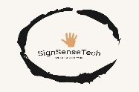
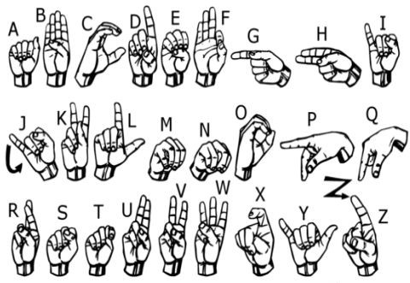
We implemented 27 symbols(A-Z, blank) of ASL in our project.

Slide 11
Methodology

Slide 12
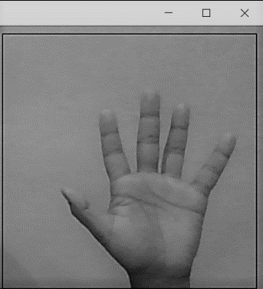
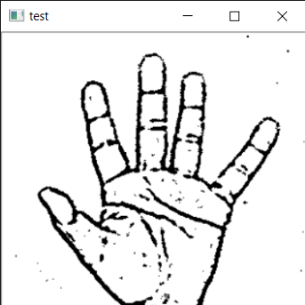
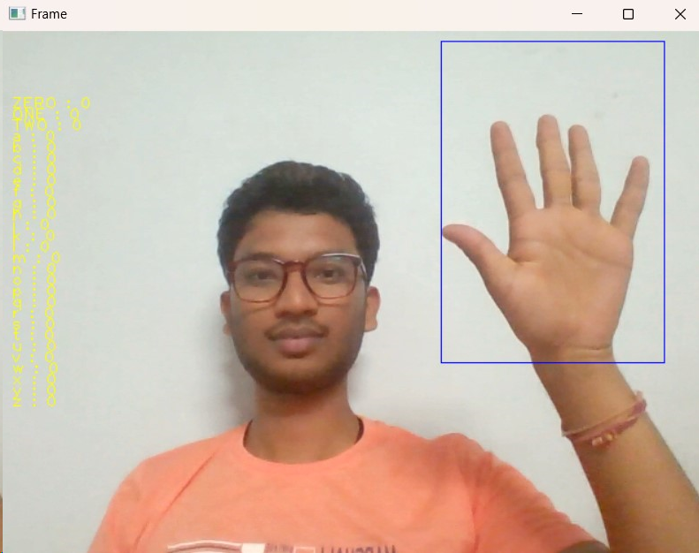
Image post Gaussian Blur
How we generated data set and did Data Preprocessing ?
Capturing Raw Image
Gray Scale Image

Slide 13

Layer 1
GESTURE CLASSIFICATION
Layer 2
Classify between Similar Symbols
Classify between 27 Symbols

Slide 14
Algorithm Layer 1:
Apply gaussian blur filter and threshold to the frame taken with opencv to get the processed image after feature extraction.
This processed image is passed to the CNN model for prediction and if a letter is detected for more than 50 frames then the letter is printed and taken into consideration for forming the word.
Space between the words are considered using the blank symbol.

Slide 15
Algorithm Layer 2:
We detect various sets of symbols which show similar results on getting detected.
We then classify between those sets using classifiers made for those sets only.
In our testing we found that following symbols were not showing properly and were giving other symbols also :
For D
For U
For I
For S
: R and U
: D and R
: T, D, K and I
: M and N

Slide 16
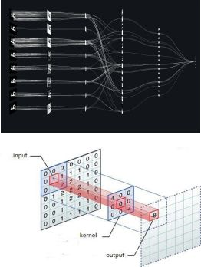
Convolutional Neural Networks
CNNs consist of multiple convolutional layers each layer containing numerous “filters” which perform feature extraction.
Initially these “filters” are random and by training, the feature extraction gets better by better.
It’s primarily used for image classification.

Slide 17
Our CNN Classifier Model

Slide 18
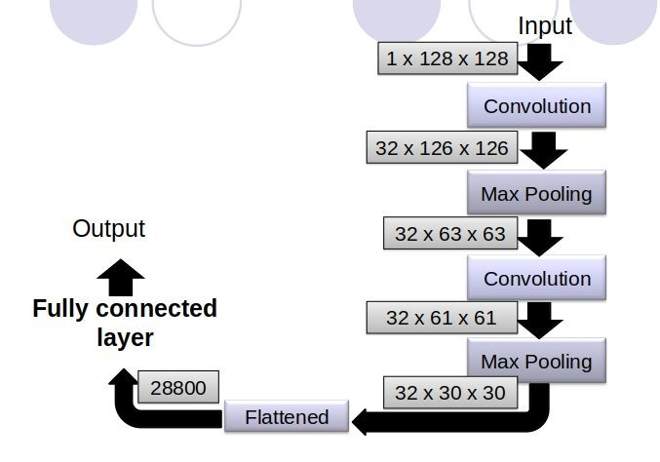

Slide 19
Team & Org Structure
CTO-Chief Technology Officer : Manoj Responsible for leading technological advancements and plays a pivotal role in driving innovation, overseeing the development of cutting-edge solutions, and ensuring the technical excellence of our products.
COO-Chief Operations Officer : Poojitha Oversees the operational aspects of SignSenseTech, ensures smooth day-to-day functioning, manages partnerships, and focuses on scaling operations to meet the demands of our growing user base.
CMO-Chief Marketing Officer : Akshay Leads the marketing efforts, and is responsible for developing and executing strategies to promote SignSenseTech's products, emphasizing their impact on communication accessibility.
CFO-Chief Financial Officer : Naveen Heads the financial operations, oversees budgeting, financial planning, and reporting to support the company's growth and sustainability.
CHRO-Chief Human Resources Officer : Sanjay Responsible for the human resources aspect of SignSenseTech, focuses on talent acquisition, employee development, and creating a positive workplace culture.
HDP-Head of Product Development : Mahima Leads the product development team, ensuring the seamless integration of text and audio features, plays a crucial role in delivering high-quality and user-friendly applications.

Slide 20

Products Line
Product Offerings
ASL Recognition System:
Functionality: Our core product utilizes a Convolutional Neural Network (CNN) to accurately recognize and translate American Sign Language (ASL) gestures into written text. Additionally, an integrated audio feature converts the recognized text into spoken language, facilitating communication for individuals with hearing and speech impairments.

Slide 21
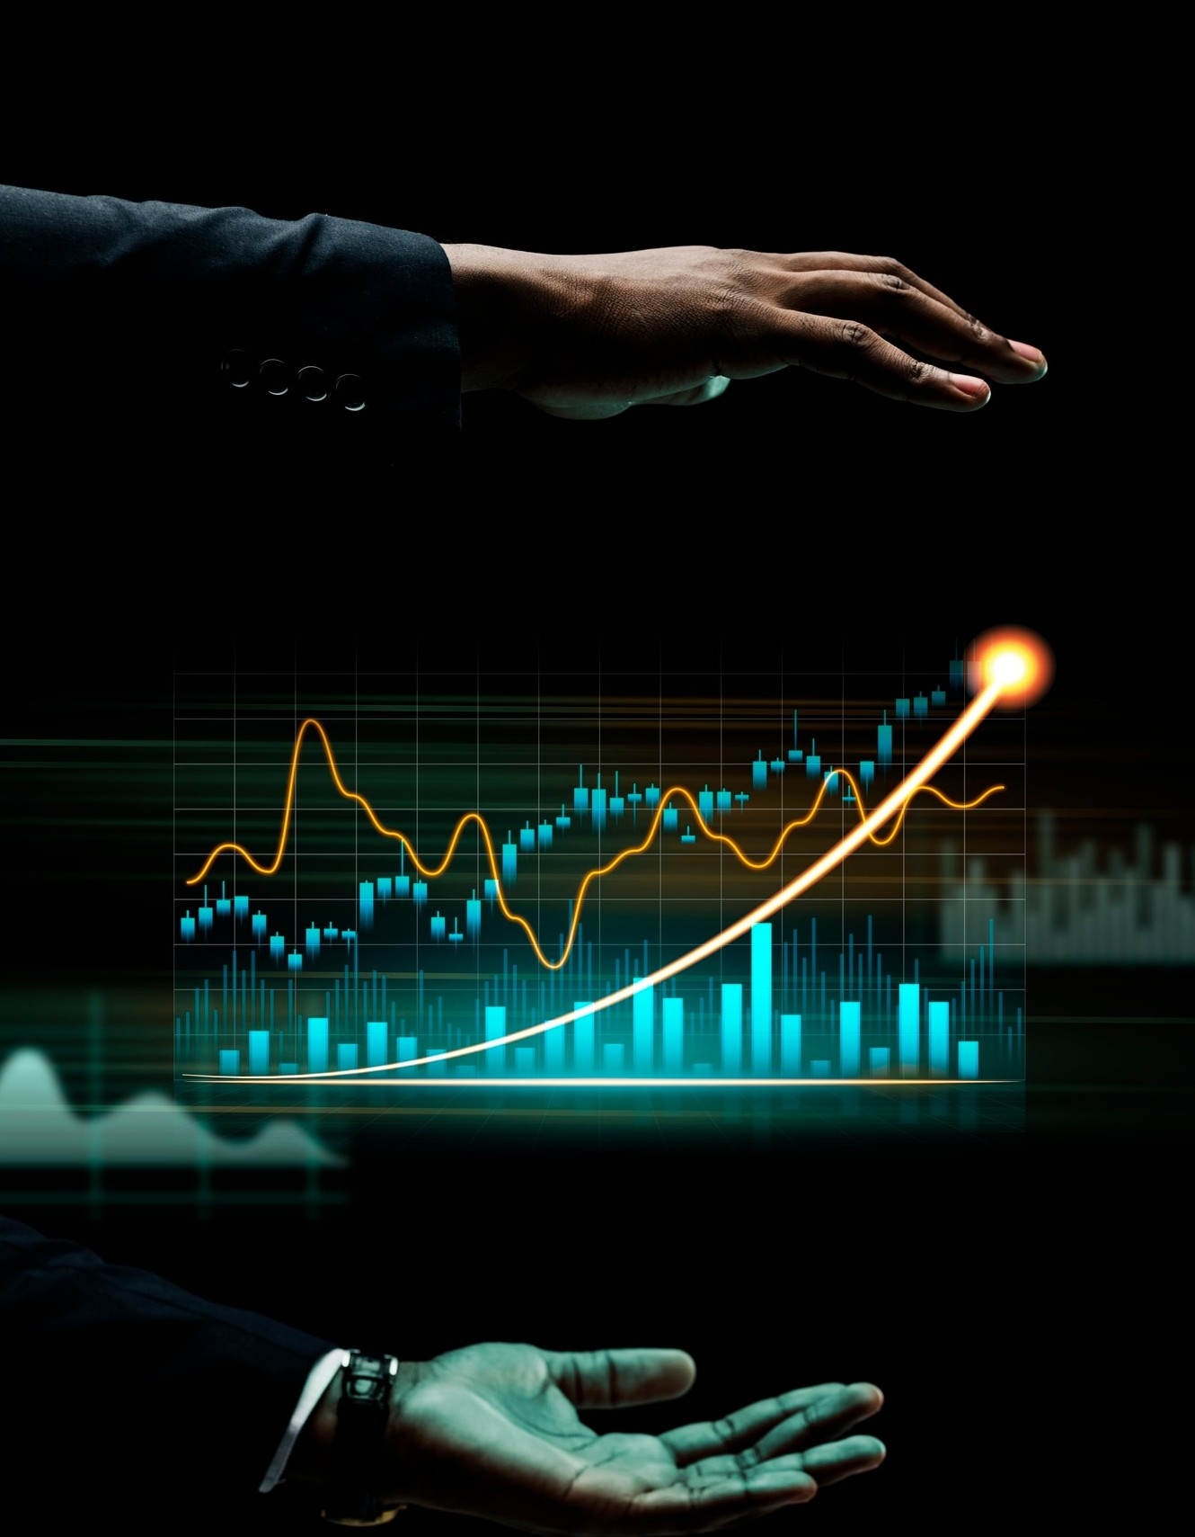
Service Offerings
Custom Dataset Development: We provide the service of creating custom datasets for organizations and researchers working in the field of sign language recognition. This service ensures that the recognition model is tailored to specific needs, enhancing accuracy and inclusivity.
Integration and Training Services: For businesses and institutions seeking to integrate our technology into their existing systems, we offer integration services and training programs. This ensures a seamless transition and optimal utilization of our ASL Recognition System.

Slide 22
Pricing Model
ASL Recognition System:
Charge: The ASL Recognition System will be priced as a one-time purchase or subscription model, depending on user preferences and usage patterns.
Markup: The pricing will reflect the value of our technology, considering development costs, ongoing support, and continuous improvement. Subscription models will include regular updates and access to new features.
SignSense Mobile Application:
Charge: The mobile application will be available for free download, with optional in-app purchases for premium features and customization options.
Markup: In-app purchases will be reasonably priced, providing users with the flexibility to enhance their experience without creating financial barriers.
Custom Dataset Development:
Charge: Custom dataset development services will be priced based on the scope and complexity of the project.
Markup: The pricing will reflect the expertise and effort required to create high-quality datasets tailored to the specific needs of the client.
The pricing model is designed to be competitive while ensuring sustainability and continued innovation. We aim to provide affordable access to our technology while maintaining the high standards of our products and services.

Slide 23
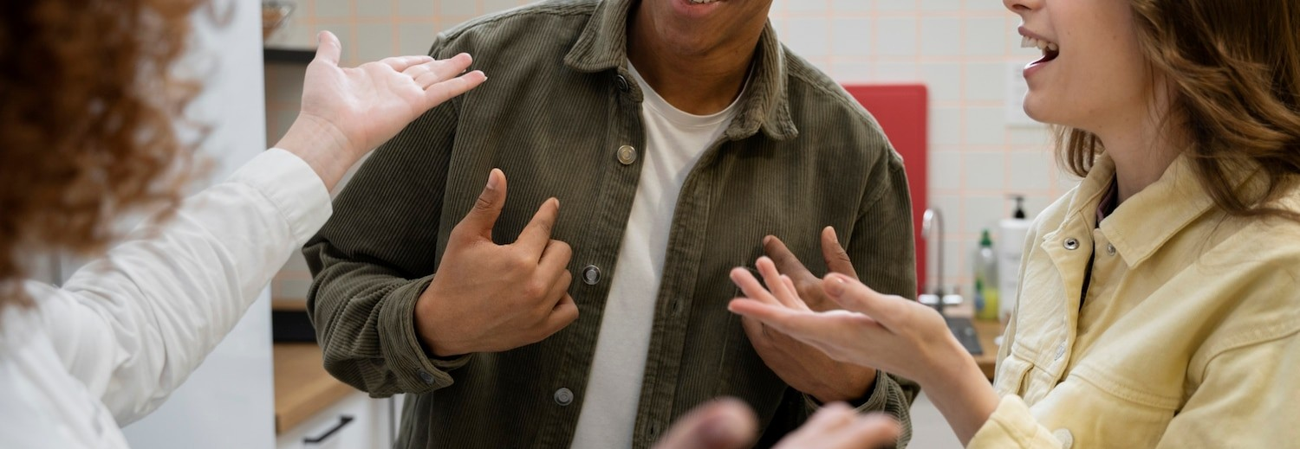
Our impact assessment focuses on measurable outcomes related to improved communication, social inclusion, and economic empowerment for the deaf and hard of hearing community. Through ongoing data collection and stakeholder engagement, we aim to demonstrate the tangible beneﬁts of our solutions.

Slide 24

Market Analysis
Target Market:
Primary: Deaf and Hard of Hearing individuals (DHH) of all ages and backgrounds.
Secondary: Professionals who interact with DHH individuals, such as educators, healthcare providers, customer service representatives, and family members.
Market Size:
Global DHH population: 466 million (WHO, 2021) • Indian DHH population: 18 million (WFD, 2022)
Growing awareness and accessibility focus create significant potential for SignSenseTech's technology.
Location Analysis:
India: Large DHH population, growing tech sector, and government initiatives promoting accessibility, making it a prime market for SignSenseTech.
Focus on urban centers: Higher DHH population density, better access to resources and technology infrastructure

Slide 25

Acquisition Channels
Targeted online advertising: Utilizing search engine marketing (SEM), social media advertising (Facebook, Instagram, LinkedIn), and targeted banner ads on relevant websites.
Partnerships and co-marketing: Collaborating with D/m organizations, educational institutions, healthcare providers, and assistive technology companies for cross-promotion and outreach.
Content marketing: Creating informative blog posts, articles, and videos about ASL, accessibility, and the benefits of SignSenseTech.
Event marketing: Participating in relevant conferences, workshops, and trade shows to showcase the technology and connecting with potential buyers.

Slide 26
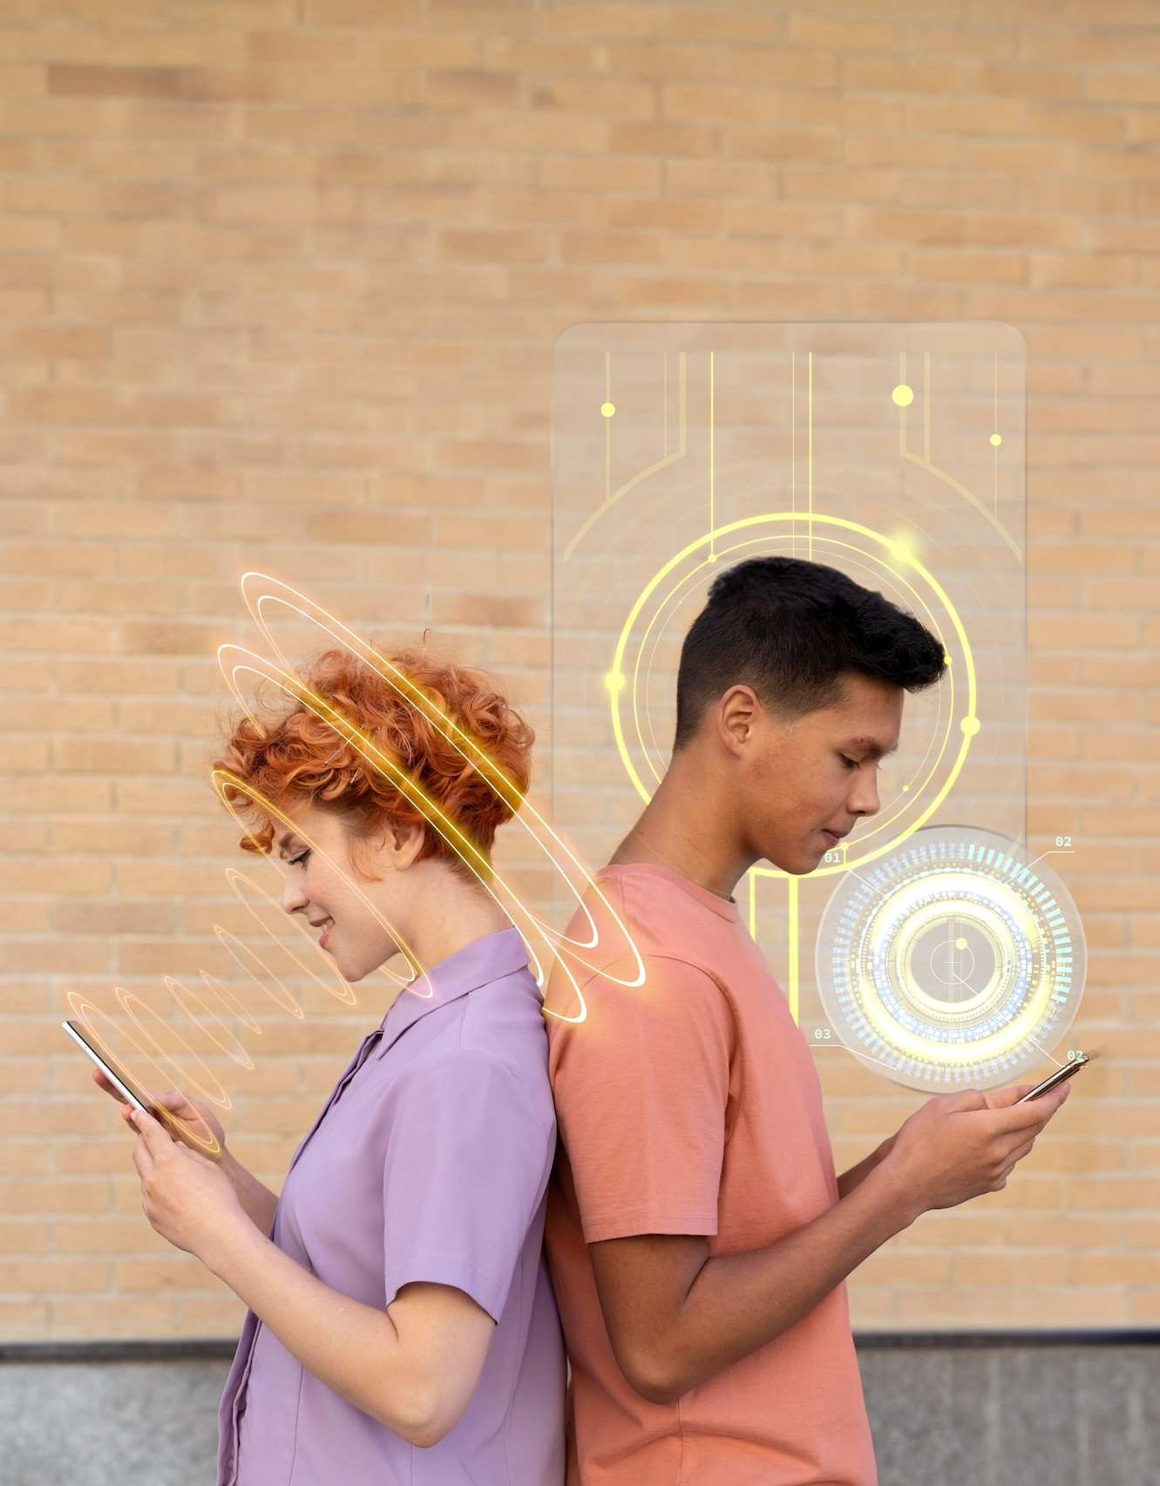
Conclusion
In transforming this project into a business plan, SignSenseTech envisions providing a scalable and sustainable solution. The intersection of machine learning, accessibility, and communication technology positions SignSenseTech as a socially responsible venture with the potential to make a positive impact on the lives of many. The commitment to ongoing research, user feedback, and technological advancements will be integral to the company's growth and success in delivering inclusive communication solutions.

Slide 27
Thank You !

