Slide 1
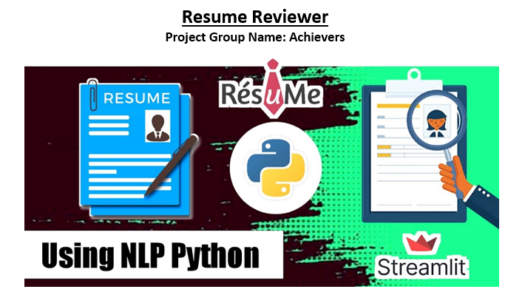
Presenting By
Achyuth Kumar Valeti
Anusha Nelluri
Venu Babu Linga

Slide 2
Introduction
Resume Reviewer is an application used to review the candidates resumes and grade them using the NLP (Natural Language Processing) techniques.
An individual can preview their resumes and the mandatory information like name, contact details.
Some of the details of candidates like level of experience and focus on the skills that the user has provided can be highlighted.
It is used to assist the candidates with recommended courses, as well as the certifications and qualifications required to have a resume selected, using the candidate's skills.
Many companies are using resume analyzer software to short list the candidates for the job openings based on the level of experience and the resume rating. It helps the Human resources department mainly to select candidates for the job interview.

Slide 3
Technologies
Python
Pymysql
Apache
Streamlit Framework

Slide 4
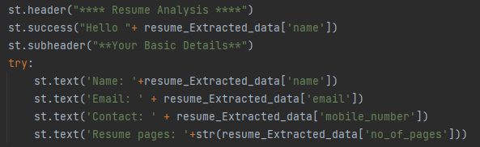
Features
A. Basic Details: This feature helps user to fetch basic details from resume.

Slide 5
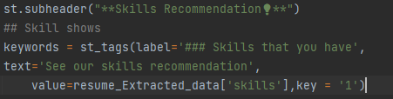
Features
B. Skills Recommendations: Candidates that are multi-skilled will have a bright career in any sector. However, many of the applicants are unaware of the necessary qualifications for the post. With a set of abilities based on the field based, we used the skill suggestions functionality.

Slide 6
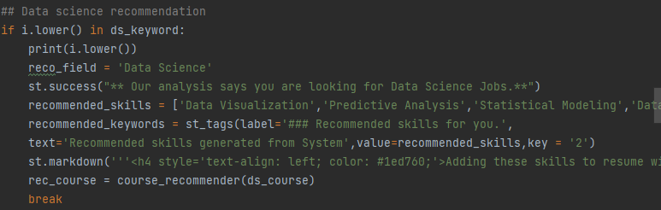
Features
C. Career Recommendations: Reviewing the job description is the most important part of creating a resume since it displays what the company is looking for in a candidate. After reviewing the curriculum vitae, candidates can preview the jobs that are available for them to apply for, which will be displayed in their career recommendations.

Slide 7
Features
D. Course Recommendations: Certifications and courses are becoming increasingly required for job vacancies in recent years. Because of their existing understanding of technology, certified individuals are more likely to receive job offers from organizations. As a result, resumes with certified candidates are in high demand. We used the feature to display the skill's suggested credentials in addition to the possibility of being hired.

Slide 8
Features
E. Resume Score: Resume Score compares each resume to important criteria that hiring managers and applicant tracking systems (ATS) look for when considering a job application. Applicant tracking systems are reported to reject 50% to 75% of job applications automatically. Resume Score is a brief explanation of which aspects of your resume would be used for certain jobs.

Slide 9
Features
F. Resume writing Tips & suggestions: We do have a section called resume tips & ideas, which will assist the user in preparing their resume with some standard information such as achievements, hobbies, and the number of projects they have worked on.

Slide 10
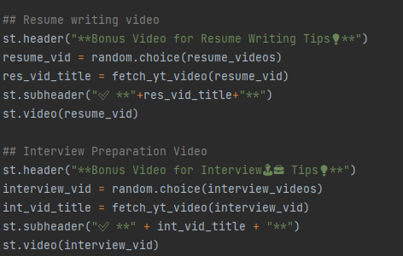
Features
G. YouTube video recommendations to build resumes: We've added video player links to help you prepare a better CV by correcting the layouts and content words.

Slide 11
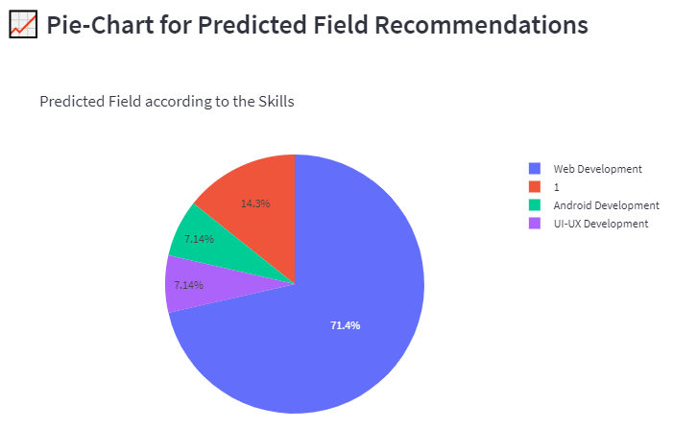
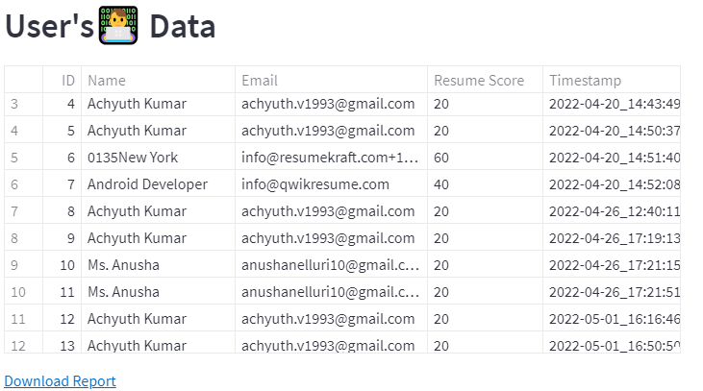
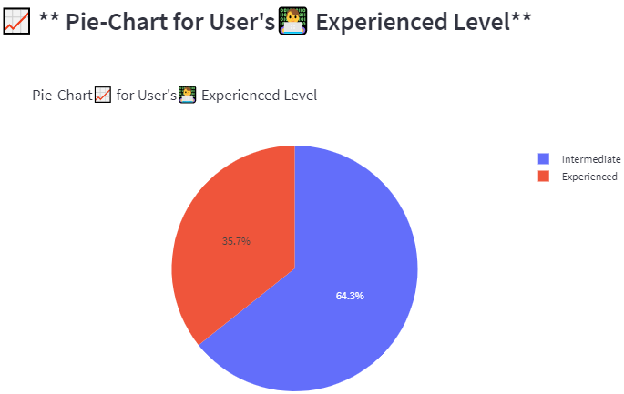
Features
Employer: In the Employer section, we could see the no of applications that are applied to the company with the information like experience, resume weightage, contact details extracted from the candidate resumes. And we do added visualization of percent of resumes received per role.

Slide 12
Conclusion
We have implemented the concepts learned in class and from ICP’s
By doing this project we gained hands-on experience about implementation of NLP in real-time projects from scratch.

Slide 13
References
https://docs.github.com/en/repositories
https://www.youtube.com
https://www.google.com
https://en.wikipedia.org/
https://stackoverflow.com/
https://geeksforgeeks.org/
https://streamlit.io/
https://docs.streamlit.io/
https://pypi.org/project/PyMySQL/
https://pymysql.readthedocs.io/en/latest/
https://www.apache.org/

