Slide 1

STRONG PASSWORD GENERATOR
IRONHACK AMST

Slide 2
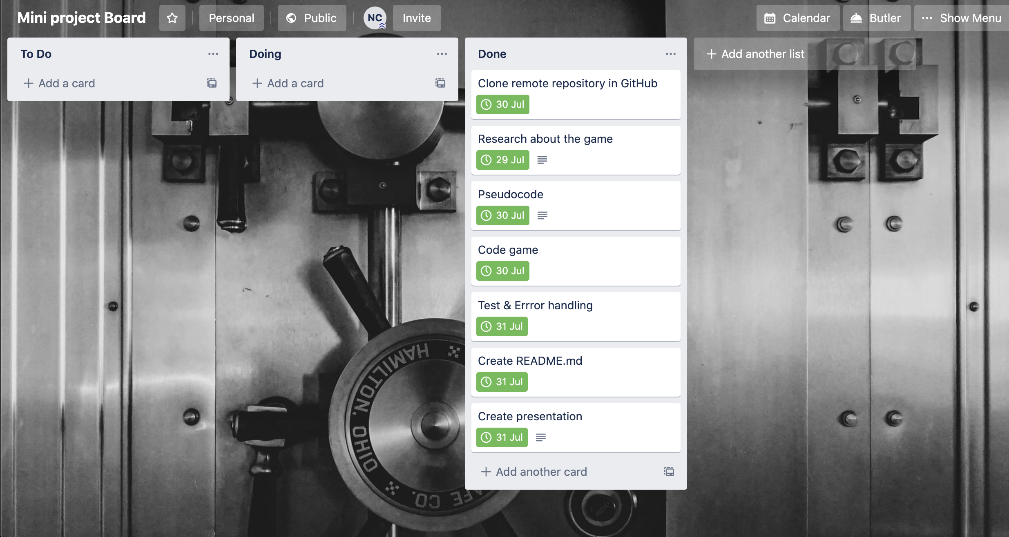
WORKFLOW

Slide 3
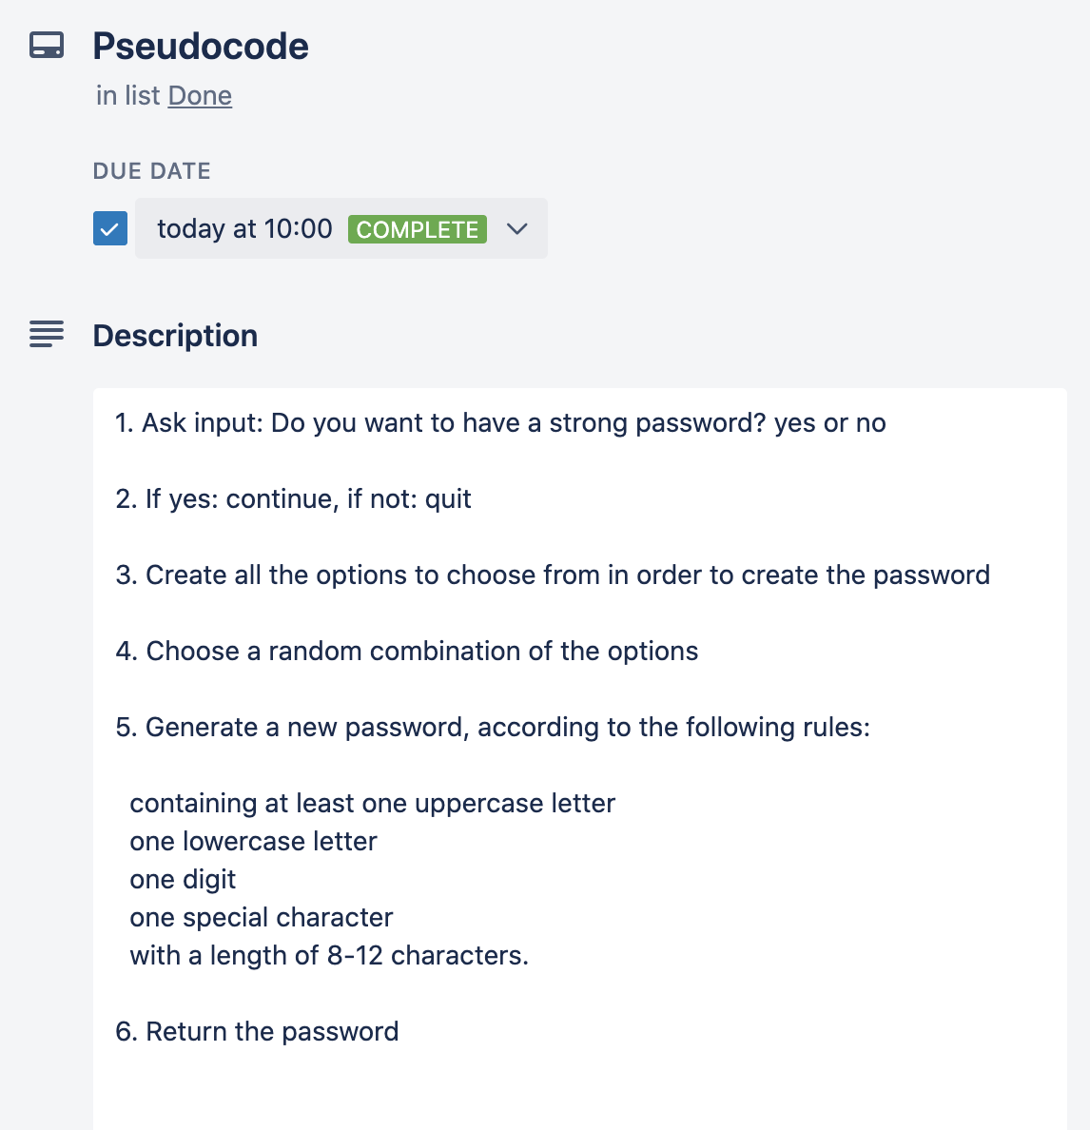
PSEUDOCODE

Slide 4
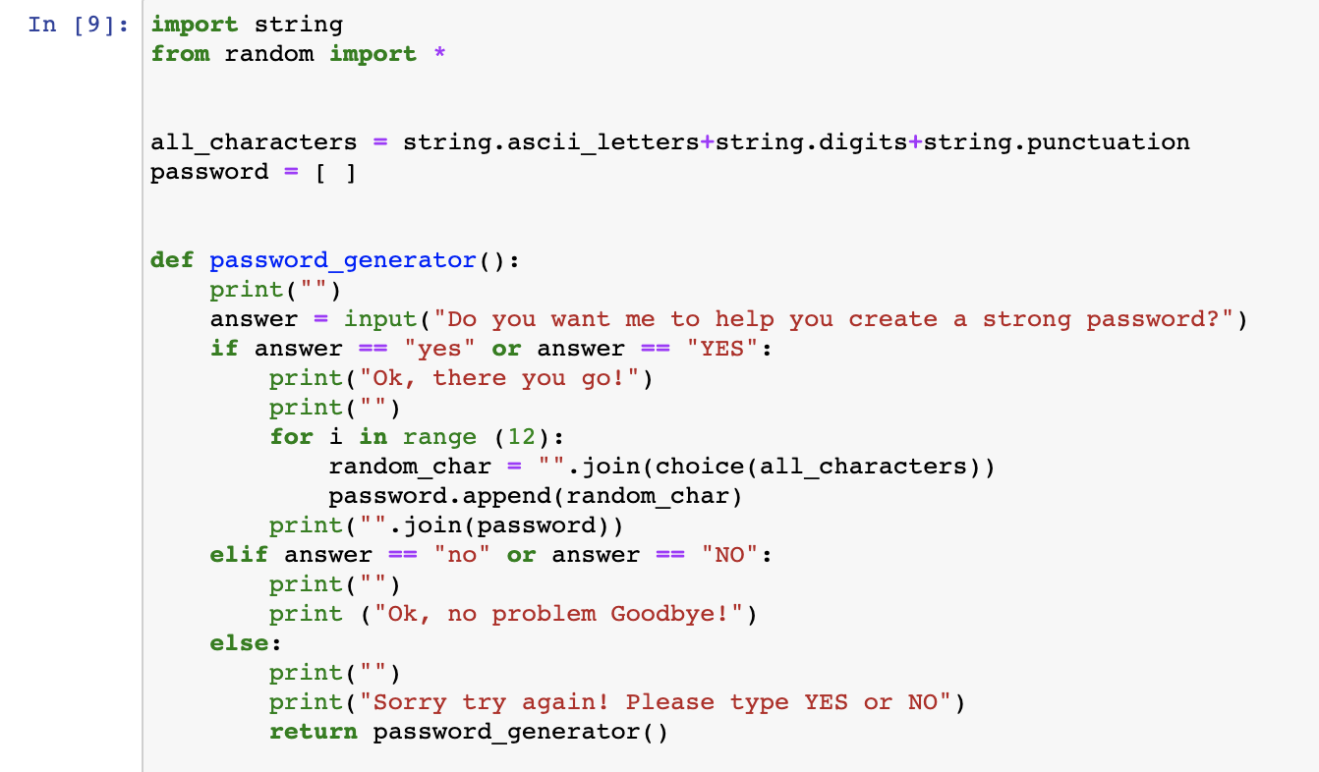
THE CODE

Slide 5
PSEUDOCODE
VS
ACTUAL CODE

Slide 6


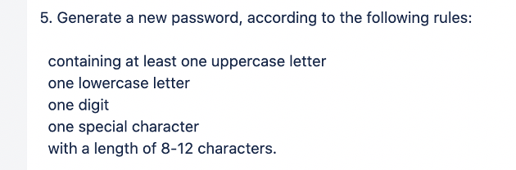

THE CODE

Slide 7
NOW
DEMO TIME !

