Slide 1

Airbnb Data Analysis Using Power BI
An Exploratory Dashboard-Based Investigation
Nelson Paul Christy| 07/09/2025

Slide 2
Presentation Agenda
Project Overview
Objectives & KPIs
Methodology
Visual Analytics & Insights
Key Takeaways
Recommendations

Slide 3
Why Analyze Airbnb Data?
Exploring Airbnb data offers valuable insights into pricing trends, guest behavior, host performance, and city-level performance. Using Power BI enables us to create dynamic dashboards that reveal actionable patterns and opportunities for improvement.

Slide 4
Project Objectives
Assessing City Location Scores
Host Response Time vs Ratings
Airbnb Pricing Visualization
Composite Scores (Check-in + Communication)
Listing Age & Host Tenure
Property Type Pricing (Tree Map)
Comprehensive City Insights Report

Slide 5
Data & Tools Used
Airbnb Dataset (Multiple Years)
Power BI Desktop
Data Cleaning via Power Query
Fields: Listing Date, Location Score, Price, Host Response Time, Guest Ratings, etc.

Slide 6
Analytical Approach
Data Cleaning and Preprocessing
Feature Engineering (Composite Scores, Tenure Calculation)
Power BI Dashboards (Tree Maps, Heatmaps, Trend Lines)
Deriving Insights from Visual Exploration

Slide 7
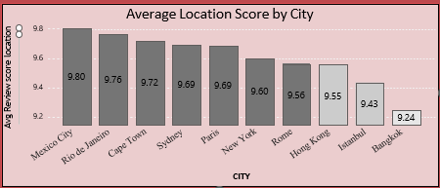
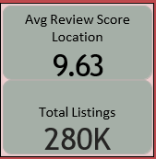
Least Favorable Locations by City
Location score for all Listings stands at 9.63 with a total listing at 280K.
Least favorable cities by average location score are Bangkok(9.24), Istanbul(9.43) and Hong Kong(9.55).
These cities contribute to 18.21%.

Slide 8
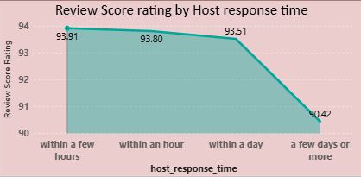
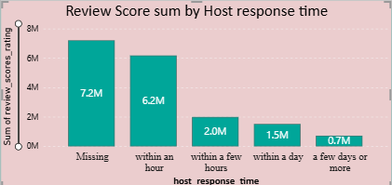
Response Time vs Ratings + Price Trends
Insights :
- Overall Average rating across host response times is 93.41%
- faster host response times contribute to higher ratings 93.80%.
- Mexico City(95.11%) followed by Cape town(94.53%) have the highest ratings.
- Hong Kong(90.02%) and Istanbul(91.61%) have the lowest ratings.

Slide 9
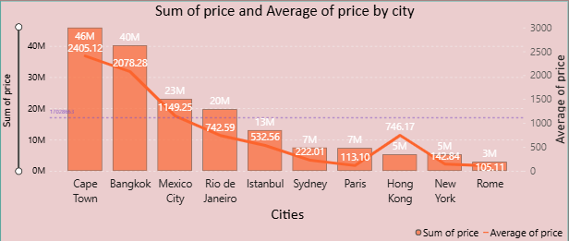
Listing Prices
Insights :
- Overall listings across cities stand at 280K.
- Avg Price $609, Total Listings sum @ $170 M.
- Rome(avg $105.11) is the least expensive city .
-Cape town being the costliest(avg $2405.12) and highest revenue generator if fully occupied(46M).

Slide 10
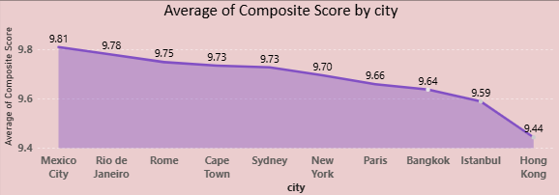
City-Wise Composite Experience Scores
Composite score metric = avg(Check-in Score + Communication Score)
Mexico city has an avg composite score of 9.81 against the average of 9.70 and Hong Kong being at the bottom with 9.44.
If Host is super host the composite scores change drastically.

Slide 11
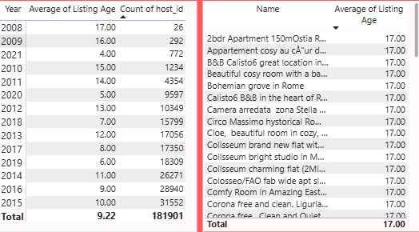
Host Tenure
We see the Listing age data starts from the year 2008 - 2021.
New York city has the highest Average listing age (11.69) for listings greater than 10 yrs.
Hosts with >10 years of experience have an average of 11.34 Vs < 10yrs @7.24 yrs

Slide 12
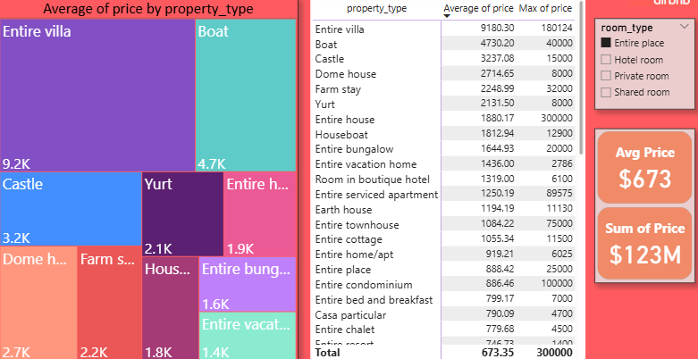
Property Type Pricing
Tree map visualizing avg prices for various room and property types, with specific attention given to the property type associated with the highest prices for entire place.
In Room Type = Entire place, we see Entire Villa, Boat and Castle are top 3.

Slide 13
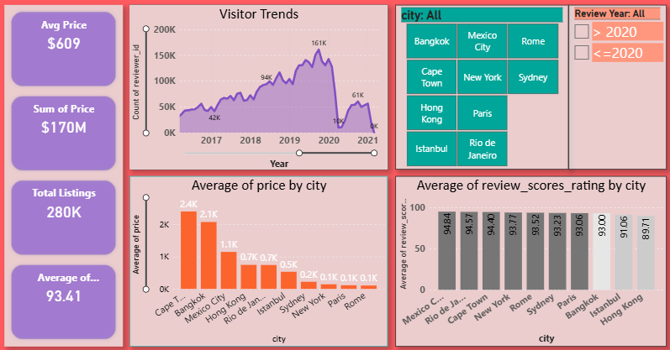
Comprehensive City Dashboard Insights
We see a drastic drop in visitor trend data after 2020 January(14k) to 2020 April (9k) – reason being lockdown due to spread of Corona Virus.

Slide 14
Key Findings & Next Steps
Low location score areas identified for improvement
Faster host response correlates with higher ratings
Price trends vary significantly by city and property type
2020 impacted travel and visitor trends across cities – due to lockdown.
Recommendations for hosts to ensure quick response for better booking rates.
Hosts to work towards becoming a super host.
Communication is key for improving customer base.
Reach on different platforms, and tourism departments

