Slide 1
U.S. SCHOOL DISTRICT FINANCE
Revenue, Spending & Funding Equity - FY2012
Nelson Wasike
Source: U.S. Census Bureau, Annual Survey of School System Finances (F-33)

Slide 2
WHAT WE'LL COVER
01
The Data
11,173 school districts, FY2012 Census finance survey
02
Finding: The Spending Gap
Per-pupil revenue varies nearly 4x by state
03
Finding: Funding Source Matters
Local vs. federal reliance predicts spending level
04
District-Level Reality
What a typical district actually spends
05
A Data Quality Catch
Why a handful of districts were excluded from comparisons
06
Implications
What this means going forward

Slide 3
THE DATA & METHODOLOGY
SOURCE
SCOPE
KEY FIX
U.S. Census Bureau
F-33 Survey, FY2012
11,173 unified school
districts, 50 states + DC
Missing-value codes
(-1,-2,-3,-9) converted
to true NaN before use
State-level per-pupil figures = (state total $) ÷ (state total pupils) — never an average of district ratios, which would let a tiny district count as much as a major city.

Slide 4
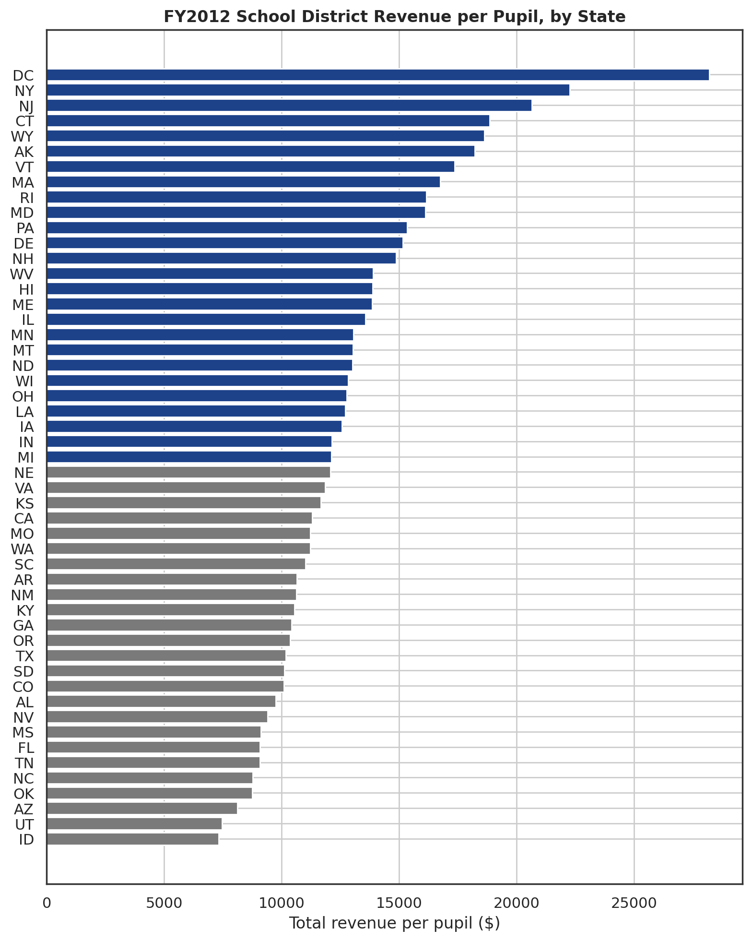
PER-PUPIL SPENDING VARIES NEARLY 4X ACROSS STATES
3.9x
gap between highest and lowest state
District of Columbia
$28,197 / pupil
New York
$22,251 / pupil
Idaho
$7,321 / pupil
Utah
$7,453 / pupil

Slide 5
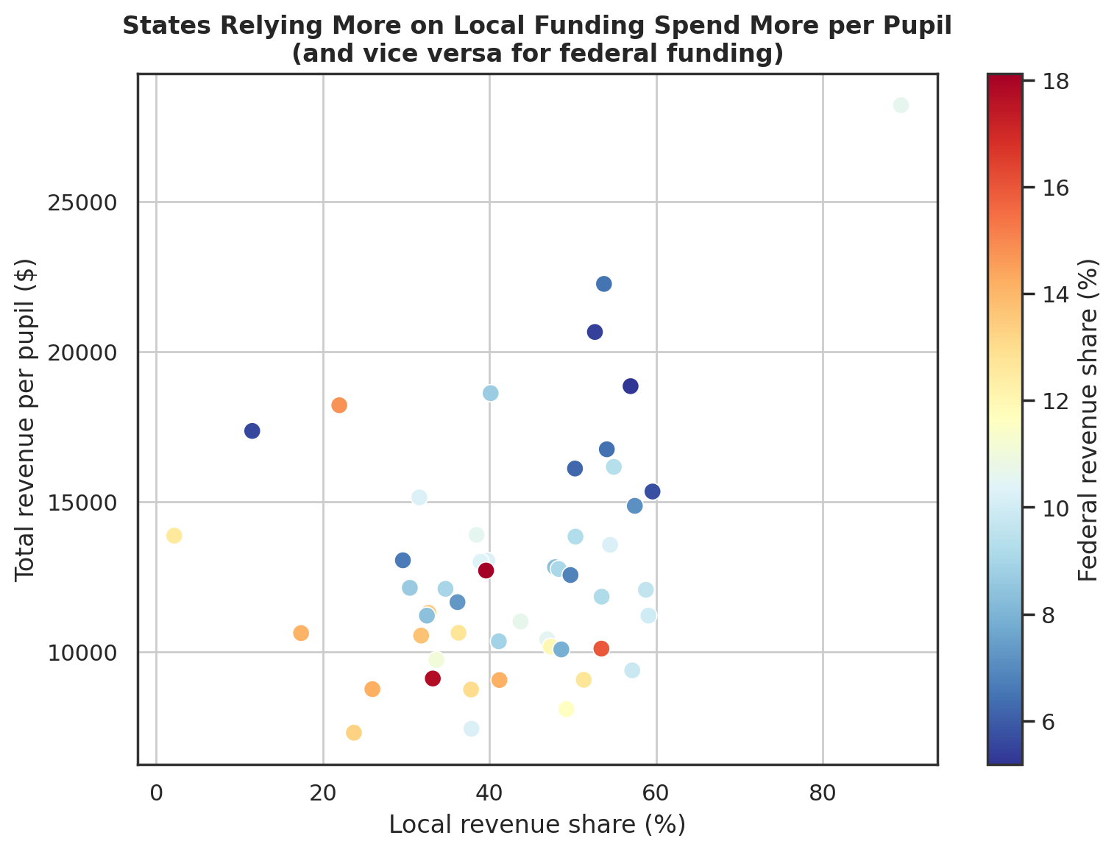
FUNDING SOURCE PREDICTS SPENDING LEVEL
Correlation with $/pupil
Local revenue share
+0.36
State revenue share
-0.28
Federal revenue share
-0.45
States leaning on local (property-tax) funding spend more; states leaning on federal funding spend less — federal aid is largely compensatory, targeted at lower-resource systems.

Slide 6
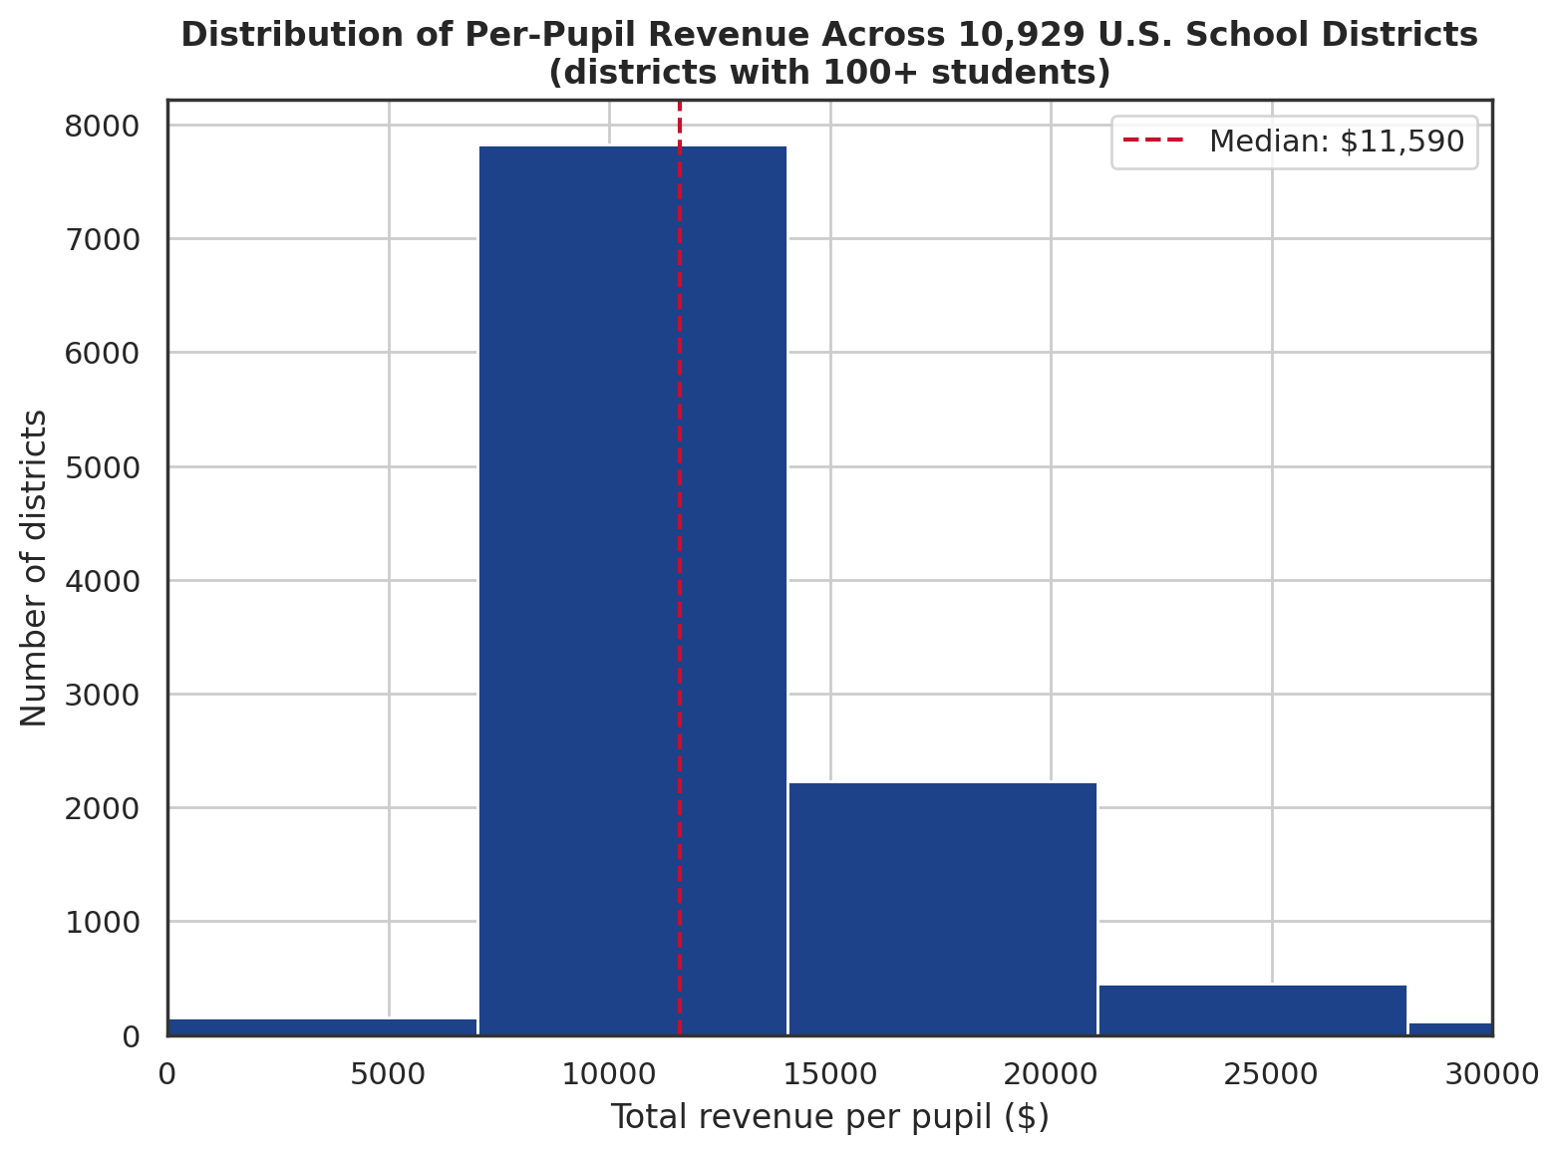
WHAT A TYPICAL DISTRICT ACTUALLY SPENDS
$11,590
Median district
$9,874 – $14,396
Middle 50% of districts
10,929
Districts compared
(100+ enrollment)

Slide 7
A DATA QUALITY CATCH WORTH KNOWING ABOUT
Some special-education cooperatives serve as few as 7 students while reporting full regional service budgets — producing per-pupil figures over $1,000,000. Correct math, meaningless comparison.
244
10,929
0
districts under 100 students, excluded from comparisons
districts kept for district-level analysis
districts silently discarded from the underlying data

Slide 8
IMPLICATIONS
1
Per-pupil funding inequality across states is structural - tied to how each state's school funding system is built, especially reliance on local property-tax revenue.
2
A high federal funding share signals underlying resource scarcity, not strong federal investment producing high overall spending.
3
Cross-district comparisons must account for enrollment size - small specialized districts can produce technically accurate but misleading per-pupil figures.
4
Extending this analysis across multiple fiscal years would show whether the local-vs-federal relationship found here is a stable, structural pattern.

Slide 9
QUESTIONS?
Nelson Wasike | U.S. School District Finance, FY2012
Source: U.S. Census Bureau, Annual Survey of School System Finances (F-33)

