Slide 1


What is SQL?
SQL also abbreviated as Structured Query Language (SQL), is the database language through which we can interact with databases.
SQL facilitates efficient data retrieval and manipulation.
SQL consists of set of commands which performs the desired operation on the database.
Example:
CREATE- used to create a table with some columns in a database.
INSERT- used to insert your information in a table.

Slide 2
Alter alter command
Transform Your Data, Command the Alterations!

Slide 3


ALTER Command
The ALTER TABLE statement is used to add, delete, or modify columns in an existing table.
It comes under DDL (Data Definition Language) category of commands.
It provides flexibility in modifying database objects without needing to drop and recreate them. This is particularly useful for preserving existing data and dependencies while making changes.

Slide 4
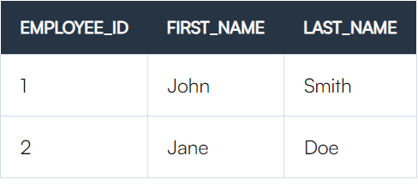


Employee table
ALTER Command to add Salary column in Employee table
Command
Output

Slide 5



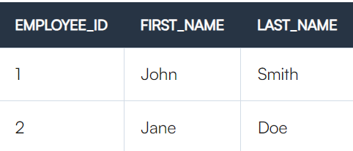
ALTER Command to modify the datatype of Salary column
Command
Output
ALTER Command to drop Salary column in Employee table
Command
Output

Slide 6


Alter Command to modify the constraint in Employee table
Constraints in SQL are rules and conditions applied to columns or tables to maintain consistency within a database.
Add primary key constraint to Employee_Id column in Employee table
Primary key: A primary key uniquely identifies each record in a table by preventing duplicate or null values in the specified column(s)
Query
Output

Slide 7
Quiz
What does the ALTER TABLE statement do?
Delete a table
Update the data in a table
Add, delete, or modify columns in a table
Create a new table
2. What happens when you use the ALTER TABLE statement to modify the data type of a column?
The data type of the column is changed, and all the data in the column is converted to the new data type
The data type of the column is changed, but the data remains unchanged
The data type of the column is changed, and the column is deleted
The data type of the column is changed, and new data is added to the column

