Slide 1
Hotel Aggregator analysis
Presented by: Nelson Arockia Raj
Last updated: May 16th, 2024

Slide 2
Table Of Contents
Hotel Aggregator Analysis
Purpose Statement (What are we talking about?)
Key findings
Conclusion

Slide 3
What are we talking
about?

Slide 4
Conduct descriptive analytics on the Hotel aggregator dataset, analyzing various factors such as pricing, availability, host characteristics, and review scores to derive actionable insights.
Objective

Slide 5
Key Findings

Slide 6
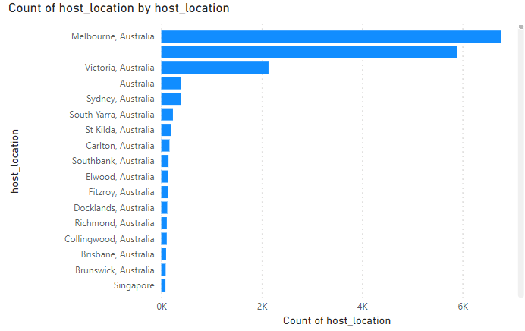
Geographical insights

Slide 7
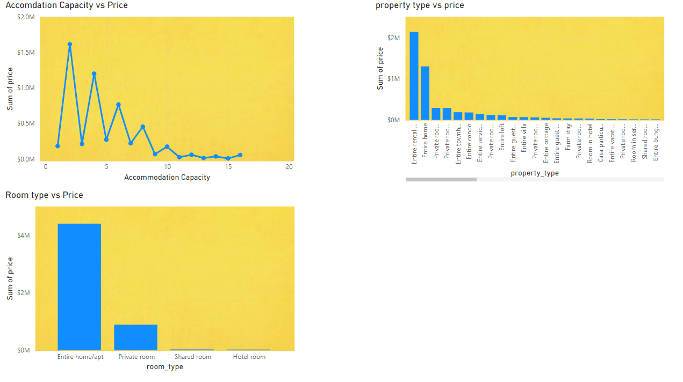
Pricing

Slide 8
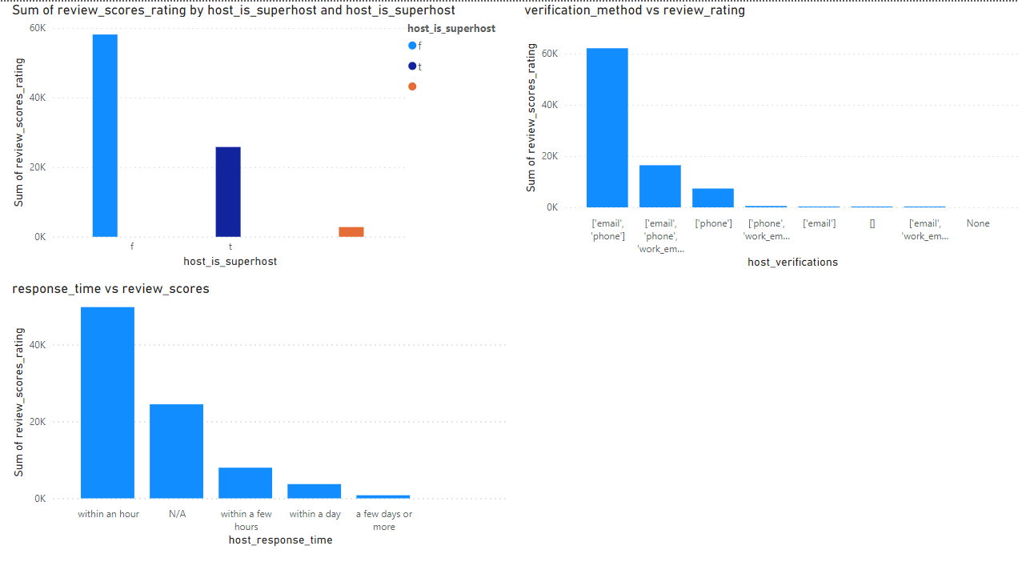
Host Performance

Slide 9
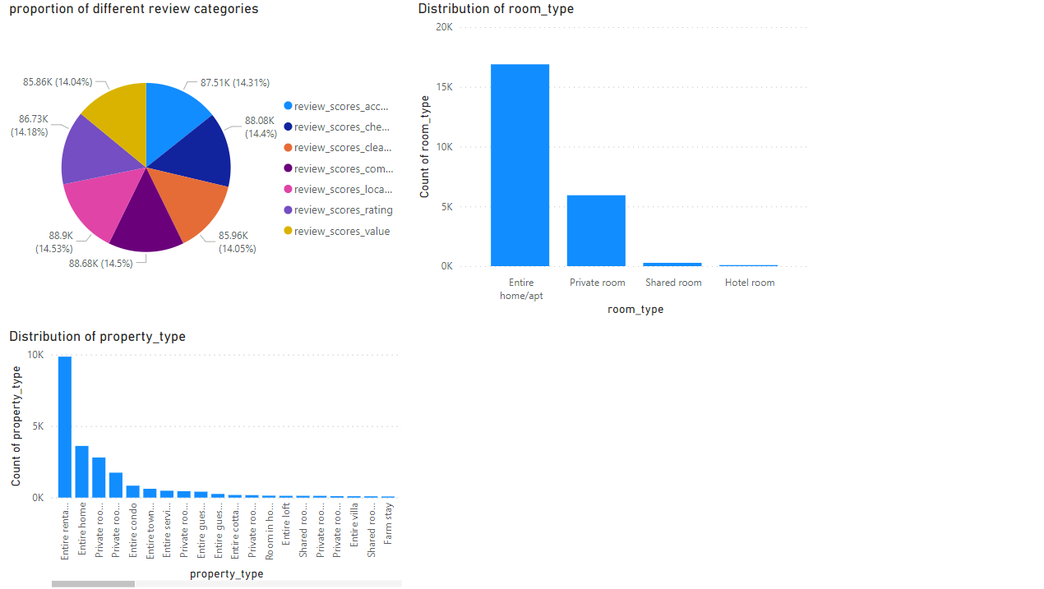
Property type and room analysis

Slide 10
Recommendations

Slide 11
Recommendations
1
2
3
Improve the review scores on value category to improve the listing performance
Maintain response time within an hour to improve the listing performance
Negative correlation between accomdation capacity and price

Slide 12
Thank you

