Slide 1


The `find` Command in Linux
+
Course: DevOps – Linux Commands
Group 2 Members:
Paul Ahorsu, Enoch Acheampong Owusu, Samson Amedegbe
Lecturer: Abdulai Abubakari Date: Monday, 10th October, 2025

Slide 2
Introduction
The `find` command is used to search for files and directories in Linux.
It helps users and administrators quickly locate files across directory structures.
Basic syntax: find [path] [options] [expression]

Slide 3
Purpose and Functionality
Used to search for files and directories based on criteria.
Filters include file name, type, modification time, size, owner, group, and permissions.

Slide 4
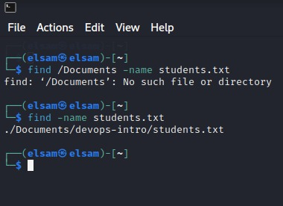
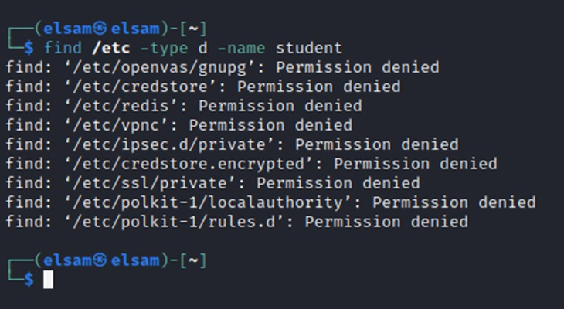
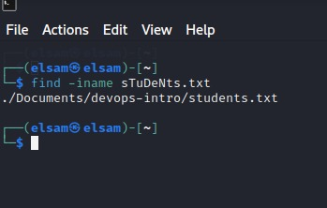
Basic Usage
find /home -name 'report.txt' # Find by name
find /home -iname 'report.txt' # Case-insensitive search
find /etc -type d -name 'nginx' # Find directories only

Slide 5
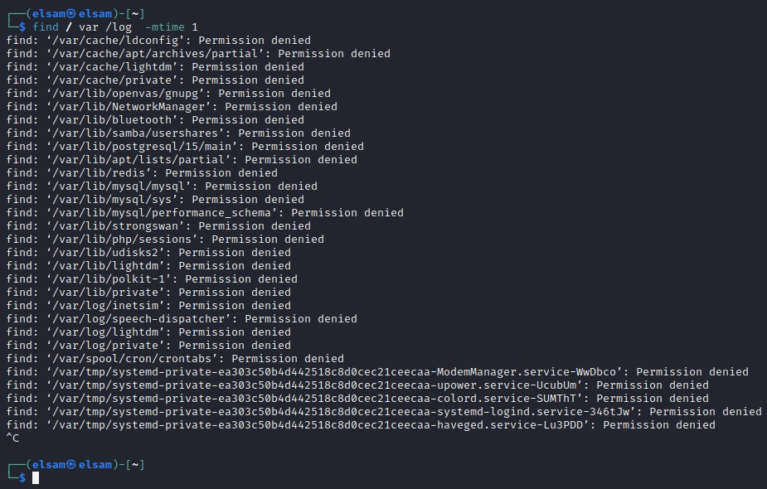

Searching by File Attributes
find / -size +100M # Files larger than 100MB
find /var/log -mtime -7 # Modified within 7 days
find /var/www -perm 644 # Files with permission 644
find /home -user paul # Files owned by Paul

Slide 6
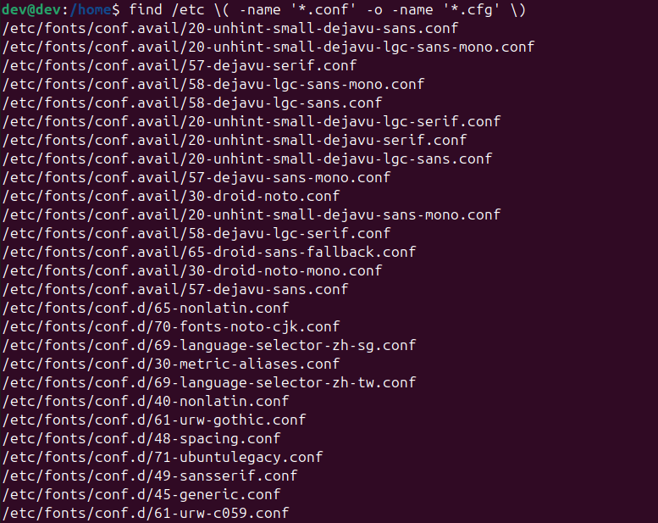
Combining Conditions
find /etc \( -name '*.conf' -o -name '*.cfg' \)
find /home -type f -name '*.sh' -a -size +10k # Files larger than 10KB

Slide 7
Running Commands on Found Files
find /tmp -type f -name '*.log' -exec rm {} \;
find /tmp -type f -ok rm {} \; # With confirmation

Slide 8
Depth Control and Empty Files
find . -maxdepth 1 -type f # Limit search depth
find /tmp -type f -empty # Empty files
find /tmp -type d -empty # Empty directories

Slide 9
Real-World Use Cases
Delete old logs: find /var/log -name '*.log' -mtime +30 -exec rm {} \;
Backup prep: find /home -size +1G –print
Security check: find / -perm -o=w

Slide 10
Live Demonstration Ideas
Show how to find files by name and size.
Find recently modified files (-mmin -30).
Combine with grep: find . -type f -name '*.conf' -exec grep -H 'Listen' {} \;
Use -exec to delete or copy files.

Slide 11
Tips and Best Practices
Always test with -print before deleting files.
Use quotes around patterns ('*.txt').
Combine with sudo for system-level searches.
Use -maxdepth and -mindepth to control recursion.

Slide 12
Summary
The find command is powerful for locating and managing files.
Supports complex filters and automated actions.
Essential for system maintenance and scripting in Linux.

Slide 13
References
Linux Manual Pages: man find
TutorialsPoint – Linux find Command
GeeksforGeeks – Find Command in Linux
DigitalOcean Tutorials

