Slide 1
CS575 - Mini Project
Presented by
Nelson Sharma
Roll No. - 2121CS07
PhD CSE, IIT Patna

Slide 2
OBJECTIVE
Detection of Premature Ventricular Contractions (PVCs) in ECG waveforms

Slide 3
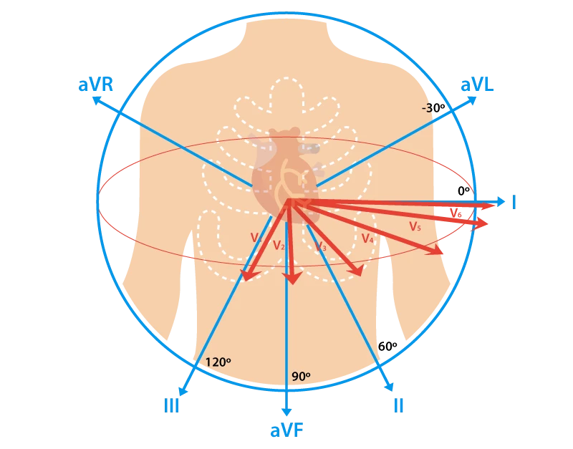
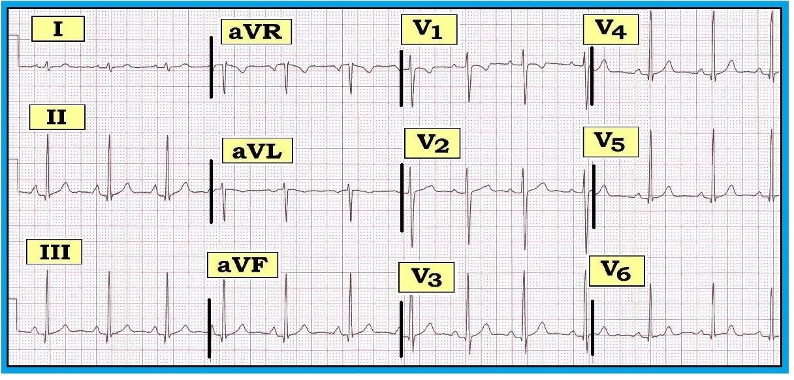
Introduction: ECG Waveform
Waveforms for different leads
Lead placement
Notes:
Graph of voltage/vs time - measures potential diff accross electrodes
Traditional 12 lead ecg , 6 limb v/s precodial leads - complete view
Various abnormalities - Lead2 for rhythm related

Slide 4
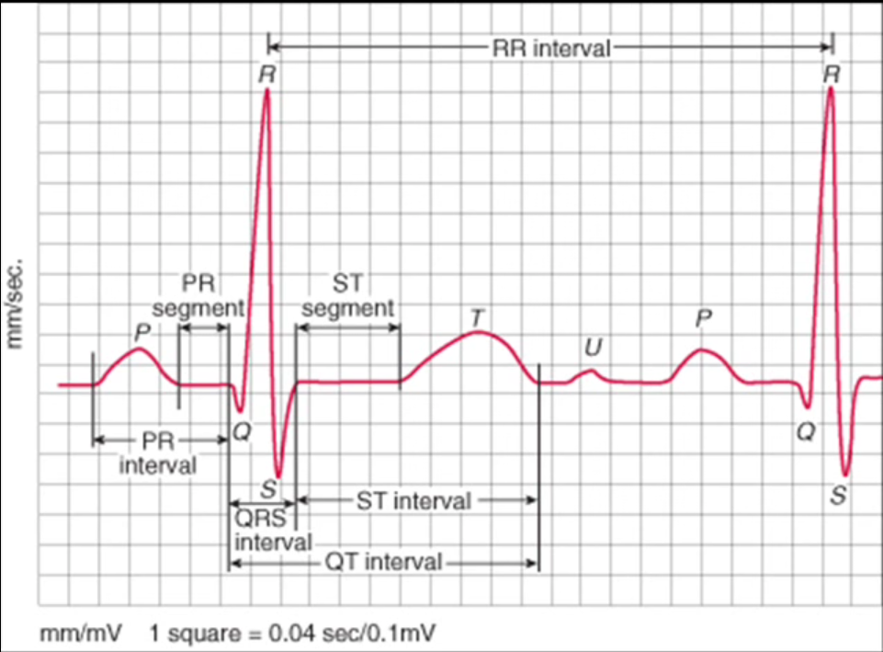
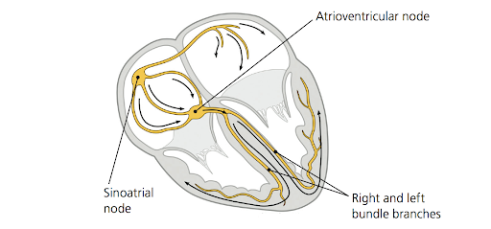
Lead II Waveform
Notes:
Cardiac cycle = 3 manin events A-dep - V-dep V-rep
Dep = cell becomes +vly charged Rep = opposite
Dep wave towards +ve electrode is +ve deflection

Slide 5
Arrhythmia Detection using Ectopic Beats
Origin
SA Node
Supraventricular
Ventricular
Multiple
Regular
Escape
Premature
Fusion
Regularity
Conduction
Notes:
Arrhythmia = any disturbance in the rate, regularity, site of origin or conduction of the cardiac electrical impulse.

Slide 6
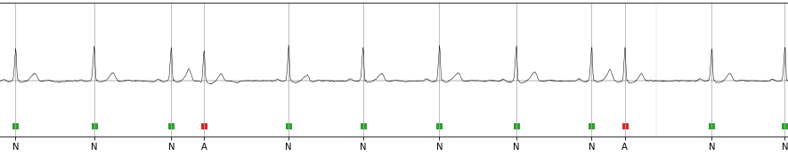
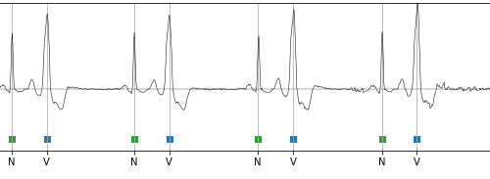
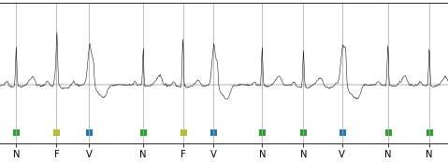
Arrhythmia Detection using Ectopic Beats
Supraventricular Premature beat.
Ventricular Premature beat.
Fusion beat.

Slide 7
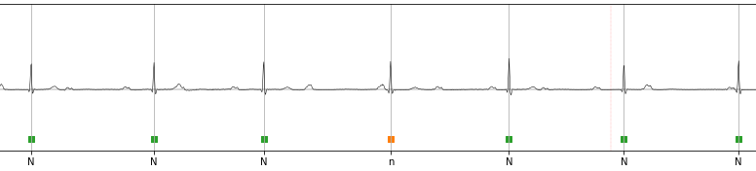
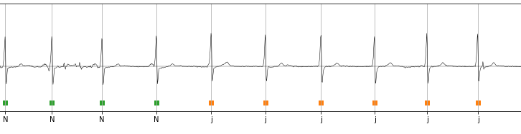
Supraventricular Escape beats

Slide 8
ECG Data
MIT-BIH Arrhythmia Database [mitdb] - contains 48 records of 2-channel ECG data of 30 minutes duration each, sampled at 360 HZ
> Data is annotated with timing information and beat labels by experts. > Pre-Processing: Removed Baseline Wander and Resampled at 128Hz

Slide 9
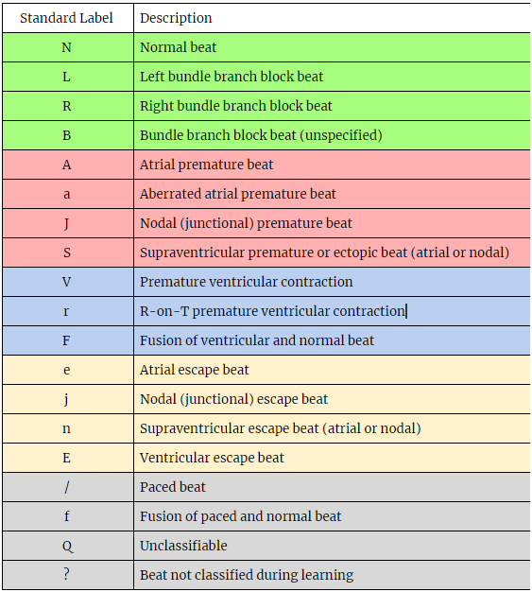
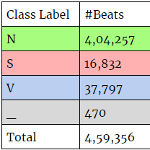
Standard PhysioNet Beat-Annotations
Notes:
Standard labels used by pysionet to annotate their database

Slide 10
Inter-patient variability
Patient-Specific Approach* : Variation in ECG waveform
Physical Condition: Age, Weight, Metabolism Rate
Prescribed Medication
Heart Condition: Injury, Enlargement, Artificial Pacemakers
Imbalance of Regulatory ions (Ca, K, Na) [*] Serkan Kiranyaz, Turker Ince and Moncef Gabbouj “Real-Time Patient-Specific ECG Classification by 1-D Convolutional Neural Networks”, IEEE TRANSACTIONS ON BIOMEDICAL ENGINEERING, VOL. 00, NO.00, pp. 0018-9294, (2015)
Notes:
Global v/s local classifer
Mix local classifier with patient -specefic beats

Slide 11
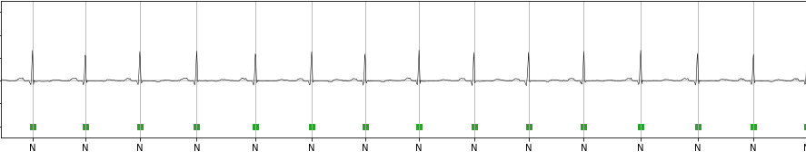
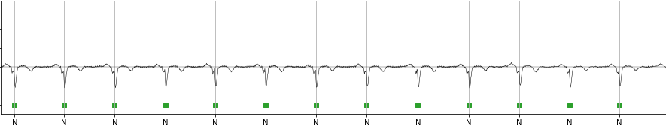
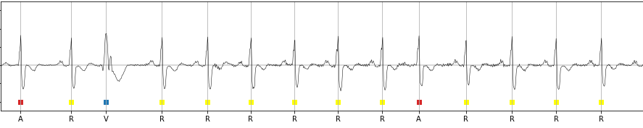
Notes:
Inter-patient variablility

Slide 12
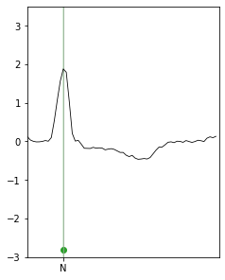
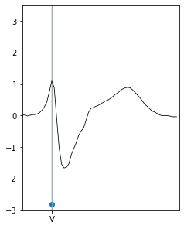
Beat Representation - Fixed Length

Slide 13
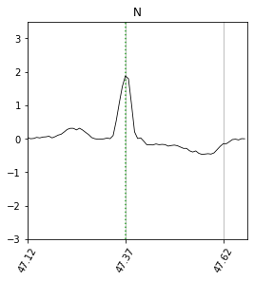
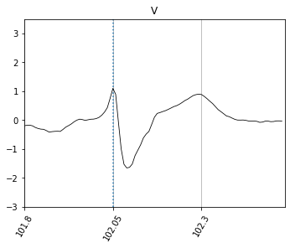
Beat Representation - Variable Length

Slide 14
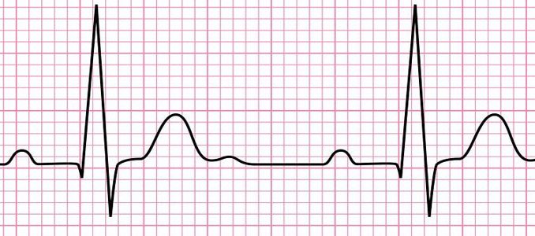
General Approach
Pre-Processing
Classification
N
Noise Removal
Analytical or Statistical Method
S
Peak Detection
V
Neural Networks
F
Feature Extraction and Selection
Q

Slide 15
Method #1 - Supervised Linear Model
ARIMA to estimate parameters for each beat
LDA on learnt parameter
ARIMA Model
LDA
N
Variable Length Beat
A

Slide 16
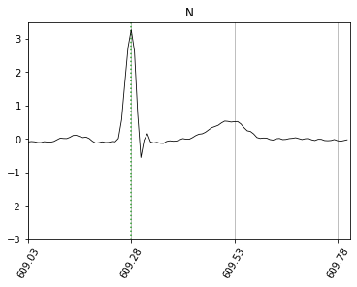
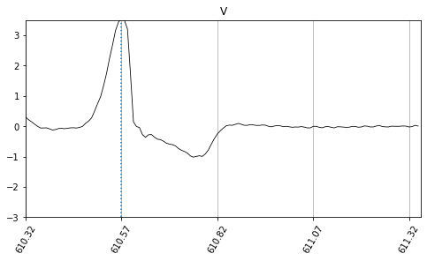
Method #1 - Use Variable Length Beats

Slide 17
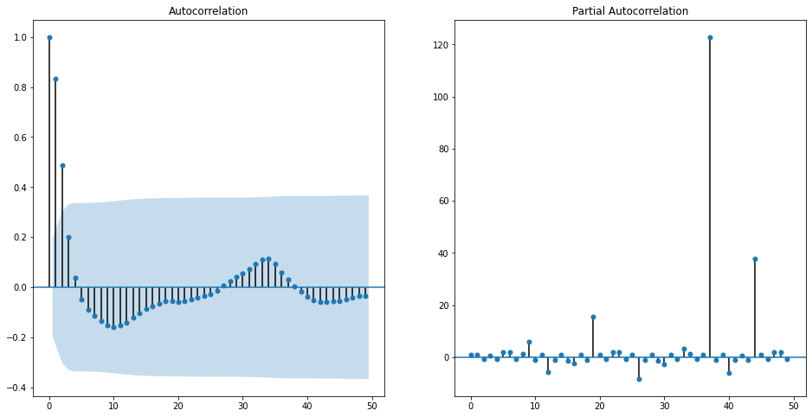
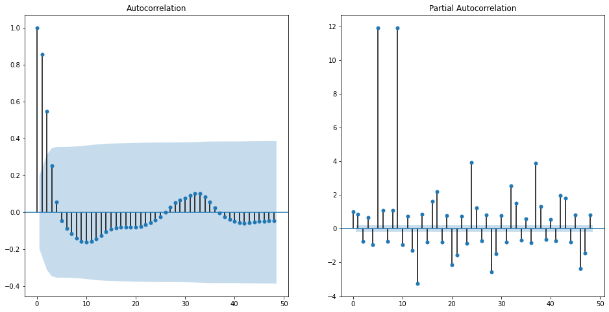
Method #1 - ACF and PACF

Slide 18
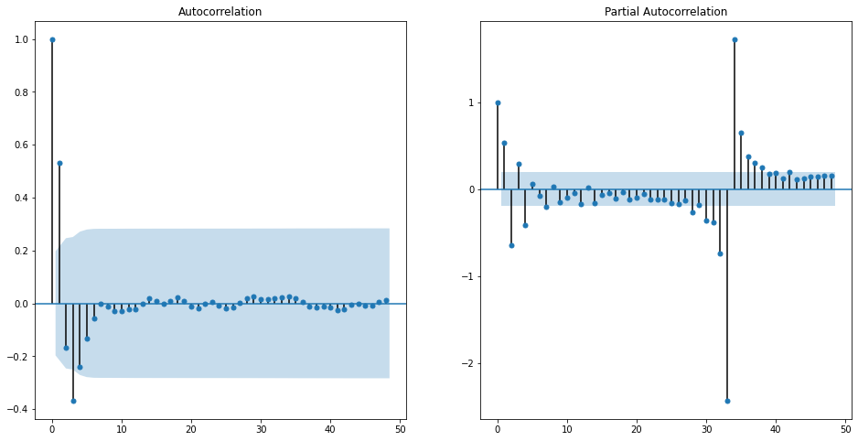
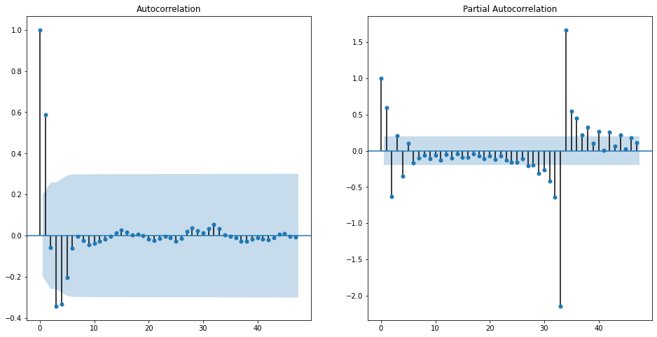
Method #1 - Differencing

Slide 19
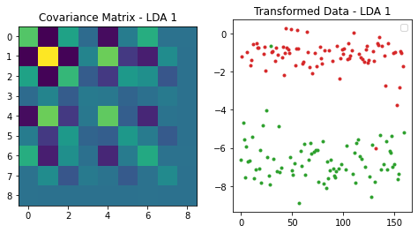
Method #1 - Result

Slide 20
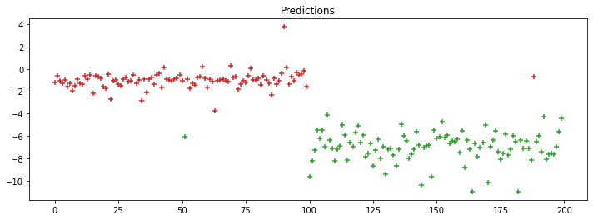
Method #1 - Predictions

Slide 21
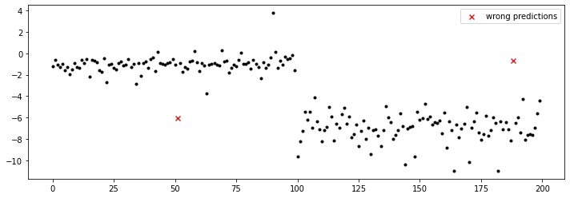
Method #1 - Predictions

Slide 22
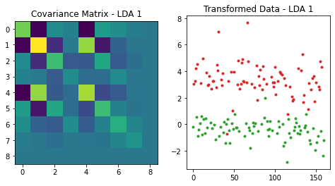
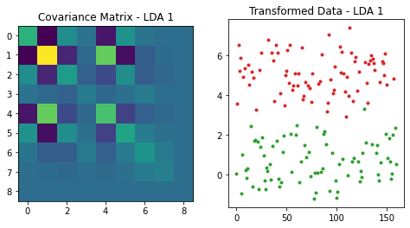
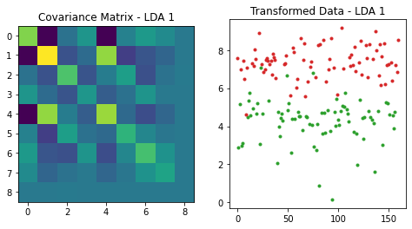
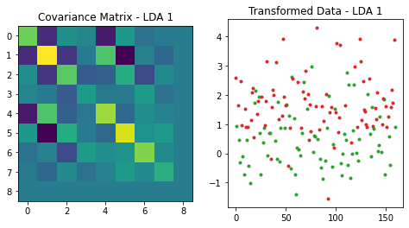

Slide 23
Method #2 - Semi - Supervised Encoder Model
LSTM Encoder-Decoder learn Normal Beats (64 Cells)
Threshold on Reconstruction error for classification
LSTM Encoder
LSTM Decoder
N
Fixed Length Beat
MAE
Threshold
A
Intermediate
Representation

Slide 24
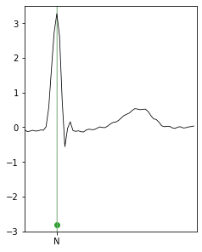
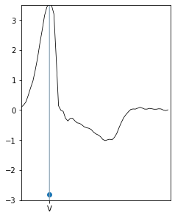
Method #2 - Use Fixed Length Beats

Slide 25
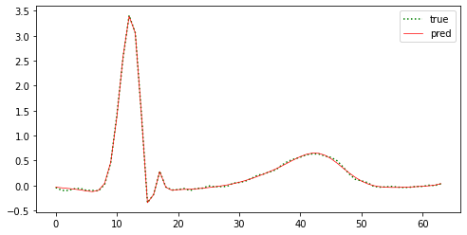
Method #2 - Reconstruction
MAE: 0.9320333448865205

Slide 26
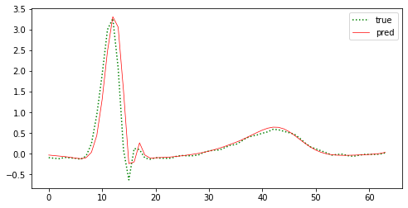
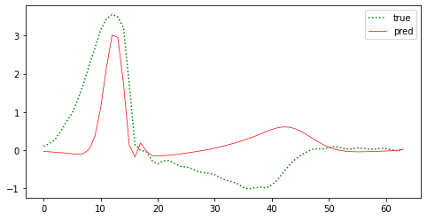
Method #2 - Reconstruction Error (MAE)
MAE: 6.676851023021376
MAE: 42.20973327757446

Slide 27
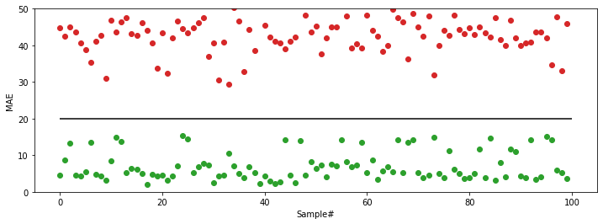
Method #2 - MAE Threshold

Slide 28
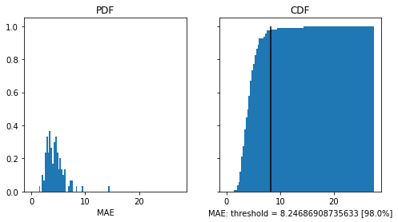
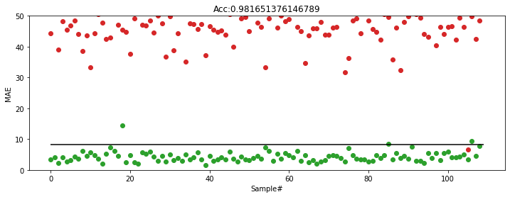
MAE Thresholding based on Probability Distribution

Slide 29
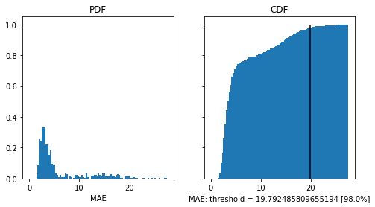
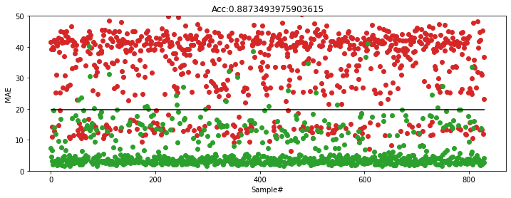

Slide 30
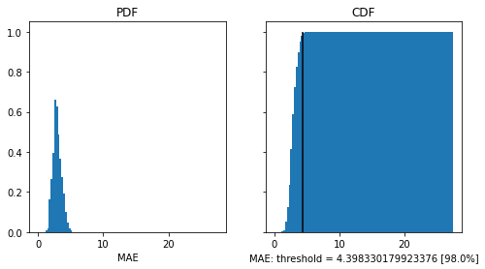
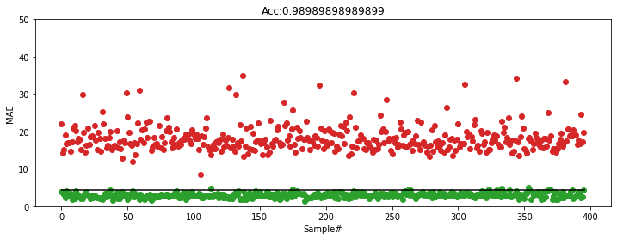

Slide 31
Result Comparison
Record | Acc [Linear Model] | Acc [LSTM Model]
116 | 98.16 | 98.5
215 | 98.78 | 96.5
210 | 96.67 | 89.0
233 | 88.73 | 88.0
214 | 93.36 | 91.5
228 | 98.34 | 93.5
221 | 98.98 | 98.5
119 | 98.98 | 100
203 | 88.28 | 72.0
106 | 97.98 | 96.0
Average | 95.826 | 92.35

Slide 32
Conclusion
Both Models has similar overall performance
Model performance varies per record - choice of model is flexible
Models capture patient specific information by encoding heart-beats.
Lightweight Models - Real-time monitoring, Active Learning
Improvements
More ways of encoding patient-specific data - personal information, historic medical data
Robustness to noise in ECG signals

Slide 33
Thank You

Slide 34
References
[1] Physionet.org [https://physionet.org/]
[2] Shu Lih Oh, Eddie Y.K. Ng, Ru San Tan, U. Rajendra Acharya "Automated diagnosis of arrhythmia using combination of CNN and LSTM techniques with variable length heart beats", Computers in Biology and Medicine 102 (2018) 278–287 (https://doi.org/10.1016/j.compbiomed.2018.06.002)
[3] Jen Hong Tan, Yuki Hagiwara, Winnie Pang, Ivy Lim, Shu Lih Oh, Muhammad Adam, San Tan, Ming Chen, U. Rajendra Acharya "Application of stacked convolutional and long short-term memory network for accurate identification of CAD ECG signals", Computers in Biology and Medicine 94 (2018) 19–26 (https://doi.org/10.1016/j.compbiomed.2017.12.023)
[4] Patrick Schwab, Gaetano C Scebba, Jia Zhang, Marco Delai, Walter Karlen "Beat by Beat: Classifying Cardiac Arrhythmias with Recurrent Neural Networks", Computing in Cardiology 2017; VOL 44, ISSN: 2325-887X DOI:10.22489/CinC.2017.363-223
[5] Chenshuang Zhang, Guijin Wang, Jingwei Zhao, Pengfei Gao, Jianping Lin, Huazhong Yang “Patient-specific ECG CLASSIfiCATION BASED ON RECURRENT NEURAL NETWORKS AND CLUSTERING TECHNIQUE” lASTED International Conference Biomedical Engineering (BioMed 201 7) February 20, 2017 Innsbruck, Austria
[6] Pengwei Xie, Guijin Wang, Chenshuang Zhang, Ming Chen, Huazhong Yang, Tingting Lv, Zhenhua Sang, Ping Zhang "Bidirectional Recurrent Neural Network and Convolutional Neural Network (BiRCNN) for ECG Beat Classification", IEEE Transactions 978-1-5386-3646-6 (2018)
[7] Xue Zhou, Xin Zhu, Keijiro Nakamura, and Noro Mahito "Premature Ventricular Contraction Detection from Ambulatory ECG Using Recurrent Neural Networks", IEEE Transactions 978-1-5386-3646-6 (2018)
[8] YUFA XIA AND YAOQIN XIE "A Novel Wearable Electrocardiogram Classification System Using Convolutional Neural Networks and Active Learning", IEEE Access, VOLUME 7, 2019 pp 2169-3536

Slide 35
References
[9] Philip de Chazal,Richard B. Reilly, "A Patient-Adapting Heartbeat Classifier Using ECG Morphology and Heartbeat Interval Features", IEEE TRANSACTIONS ON BIOMEDICAL ENGINEERING, VOL. 53, NO. 12, DECEMBER 2006 pp 0018-9294
[10] P. Hamilton, “Open source ECG analysis,” Comput. Cardiol., vol. 29, no. 1, pp. 101–104, Sep. 2002.
[11] Pengfei Li, Yu Wang, Jiangchun He, Lihua Wang, Yu Tian, Tian-shu Zhou, Tianchang Li, and Jing-song Li "High-Performance Personalized Heartbeat Classification Model for Long-Term ECG Signal", IEEE TRANSACTIONS ON BIOMEDICAL ENGINEERING, VOL. 64, NO. 1, JANUARY 2017 0018-9294
[12] T. Ince, S. Kiranyaz, M. Gabbouj, A generic and robust system for automated patient-specific classification of ECG signals, IEEE Trans.Biomed.Eng. 56 (2009) 1415–1426. doi:10.1109/TBME.2009.2013934.
[13] O. T. Inan, L. Giovangrandi, G. T. A. Kovacs, Robust neural-network based classification of premature ventricular contractions using wavelet transform and timing interval features, IEEE Trans.Biomed.Eng. 53 (2006) 2507–2515. doi:10.1109/TBME.2006.880879.
[14] J. Wiens, J. V. Guttag, Active learning applied to patient-adaptive heartbeat classification, Advances in Neural Information Processing Systems(2010) 2442–2450
[15] A Patient-Adaptable ECG Beat Classiﬁer Using a Mixture of Experts Approach. Yu Hen Hu, Surekha Palreddy, and Willis J. Tompkins. IEEE TRANSACTIONS ON BIOMEDICAL ENGINEERING, VOL. 44, NO. 9, SEPTEMBER 1997
[16] A deep learning approach for ECG-based heartbeat classification for arrhythmia detection. G.Sannino, G. De Pietro. Future Generation Computer Systems 86 (2018) 446–455

Slide 36
The End

