Slide 1
Mapping the Missing Midterm Presentation
Nelson Foster
DATS 6501-10 | Data Science Capstone
18 July 2019

Slide 2
Agenda
Problem Statement
Summary of Literature Review
Summary of Data Survey
Proposed Solution
High level Design
Current Progress
Next Steps

Slide 3
Problem Statement
A consolidated, consistent and current database of spatiotemporal and demographic data on missing persons can help law enforcement and advocacy groups identify trends in missing persons data, including but not limited to human trafficking or serial crime.
Local law enforcement and government agencies lack consistency in the data capture methods and availability of structured missing persons data, making spatial analysis difficult to conduct.

Slide 4
Summary of Literature Review
The National Missing and Unidentified Persons System (NamUs) is the Department of Justice’s “national information clearinghouse and resource center for missing, unidentified, and unclaimed person cases across the United States”
According to a senior official at NamUs, “[o]n average, 90,000 people are missing in the USA at any given time”
As of December 31, 2018, the FBI’s National Crime Information Center (NCIC) Missing Persons File contained 85,459 active missing persons cases, of which 38,561 (45.1%) were juveniles*
Currently, there are only 16,276 open cases in NamUs
*Juveniles are defined as under the age of 21. When using the criteria of under the age of 18, this figure is 29,758 (34.8%).

Slide 5
Summary of Data Survey
In researching available data in nine major cities, there were drastic inconsistencies in the availability of data.
Lack of standard data structure or governance method
Incomplete or redacted/amended records
Not updated timely
Inconsistency in encoding and capture methods across jurisdictions
Most websites had some sort of search engine, however the data was often unstructured, with each requiring a custom web scraping API to extract the data.
As each jurisdiction captures different data attributes, normalizing the data from multiple jurisdictions would be a laborious task.

Slide 6
Proposed Solution
Develop a Searchable, GIS-enabled application based on NamUS data as a Proof of Concept for setting national Data Governance Practices for Missing Persons data
While NCIC data is only publicly available in aggregate, NamUs is publicly available, highly structured and finely granular
Consists of twenty features to include:
Identifying information
Demographic data
Granular spatial data (of last contact)
Date

Slide 7
Data Overview
While NamUs does not have an API with all endpoints completely exposed, OpenDataSoft developed an API which scrapes a snapshot from the NamUs Dashboard
10,000 records with 20 features,
City Of Last Contact
Computed Missing Max Age
Computed Missing Min Age
County Of Last Contact
Current Age From
Current Age To
Date Of Last Contact
First Name
Gender
Geo Shape
geo_point_2d
id Formatted
image
Last Name
link
Middle Name
Modified Date Time
namus2Number (Unique Idenifier)
Race / Ethnicity
State Of Last Contact

Slide 8
High-Level Deliverable Design
Load data in Amazon S3 Bucket (using either flatfile or API call)
Parse and aggregate data using Amazon Athena/DynamoDB
Develop Spatial Analyses using Amazon EC2 Instance
Design SPA in another EC2 Bucket
Publish SPA

Slide 9
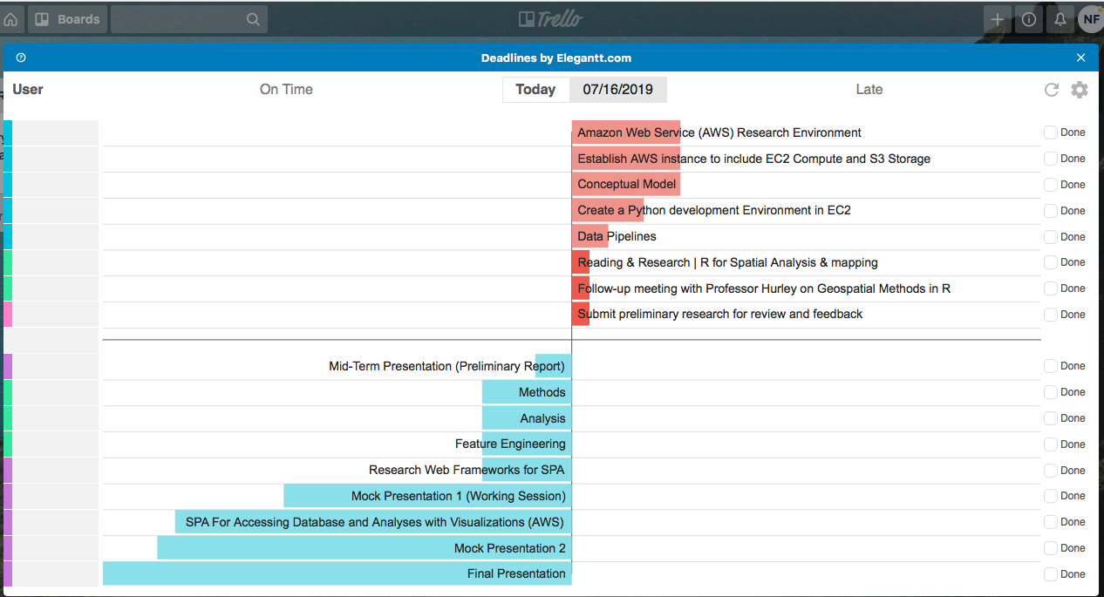
Current Progress

Slide 10
Next Steps
Design/build research environment in AWS
Compute (EC2)
Storage
Documents/files (S3 buckets)
Database (Amazon RDS)
Code data pipelines/APIs to acquire data and store in cloud RDS
Reconvene with Geospatial Statistics and Cloud Computing Professors
Develop spatial analyses, hypothesis tests, maps, etc.
Develop data product/deliverable
Single-page web application
Refine data product/deliverable and prepare presentations

Slide 11
Questions/Suggestions?

