Slide 1
Facial Recognition
Darius bailey | Nelson Foster
Machine Learning II
24 April 2019

Slide 2
Introduction
Facial recognition has been at the forefront of deep learning applications.
Our project sought to leverage publicly available facial image datasets and frameworks to train a deep network to correctly classify facial expressions.

Slide 3
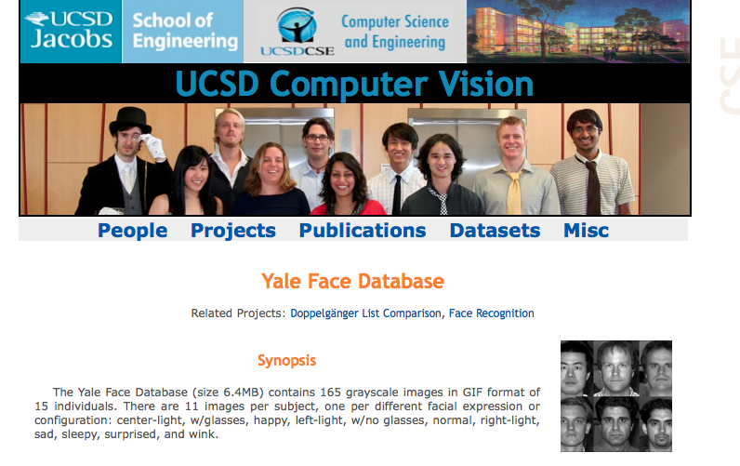
Description of the datasets
YaleFaces Database
compiled by the University of California – San Diego’s Computer Vision Program,
consists of 165 greyscale images with the following facial expressions, which were used as classes for the models:
Class 0: ‘glasses’
Class 1: ‘happy
Class 2: 'leftlight’
Class 3: 'normal’
Class 4: 'rightlight’
Class 5: 'sad’
Class 6: 'sleepy’
Class 7: 'surprised’
Class 8: 'wink’
Class 9: 'centerlight’
Class 10: ‘noglasses'

Slide 4
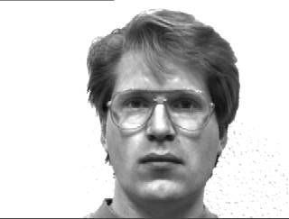
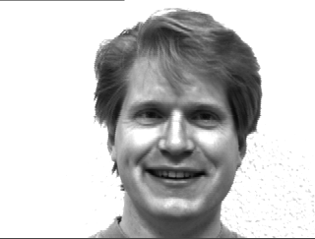
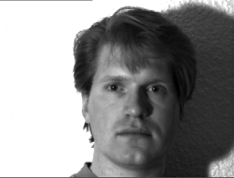
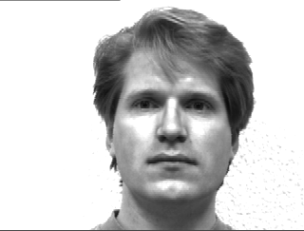
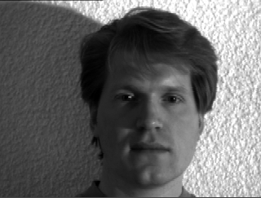
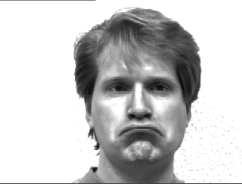
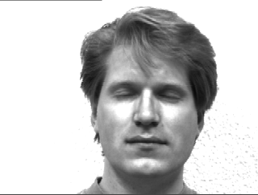
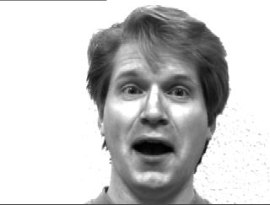
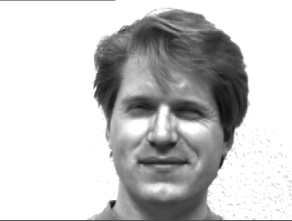
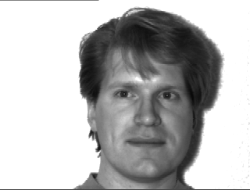
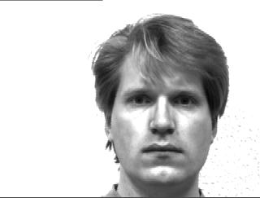
Example of Image Classes: Subject 1
0: ‘Glasses’
1: ‘Happy’
2: ‘Left Light’
3: ‘Normal’
4: ‘Right Light’
5: ‘Sad’
6: ‘Sleepy’
7: ‘Surprised’
8:‘Wink’
9: ‘CenterLight’
10: ‘No Glasses’

Slide 5
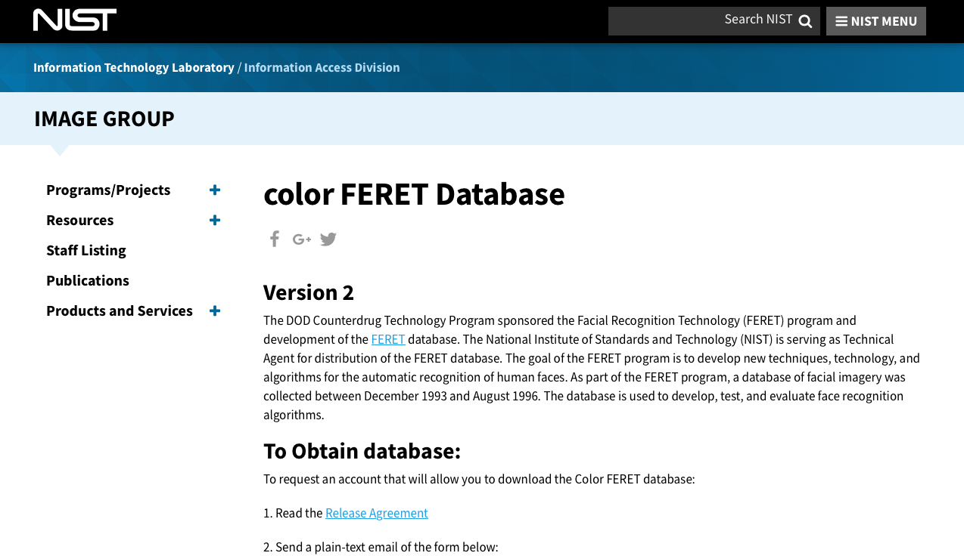
Description of the datasets (Cont’d)
ColorFERET Database
Compiled by National Institute of Standards & Technology’s (NIST) , the Color Face RecognitionTechnology Color FERET database contains over 11,000 images of various classes of facial orientation and other demographic metadata:
﻿regular frontal image
profile left
half left - head turned about 67.5 degrees left
quarter left - head turned about 22.5 degrees left
profile right
half right - head turned about 67.5 degrees right
quarter right - head turned about 22.5 degrees right

Slide 6
Experimental Setup
PyTorch was used as the primary deep learning framework for this exercise, and four convolutional neural network designs were tested.
Each design experimented with different numbers of convolutional layers, and batch normalizations

Slide 7
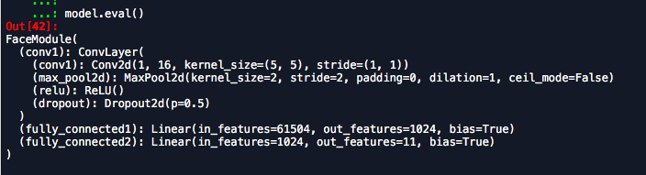
FaceModule

Slide 8
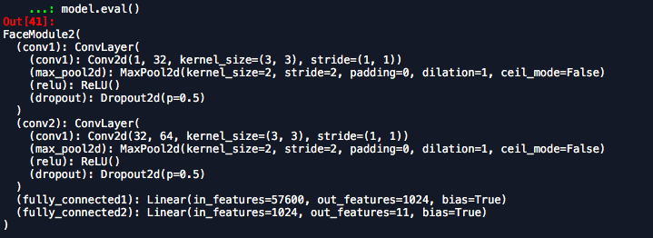
FaceModule2

Slide 9
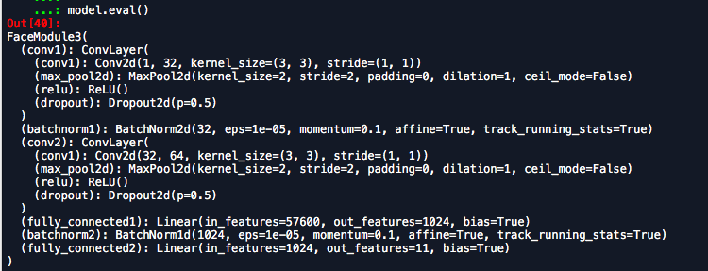
Facemodule3

Slide 10
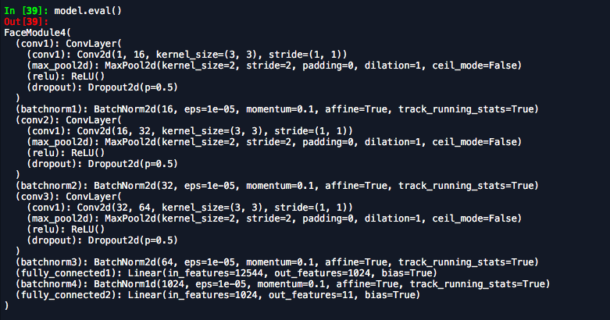
Facemodule4

Slide 11
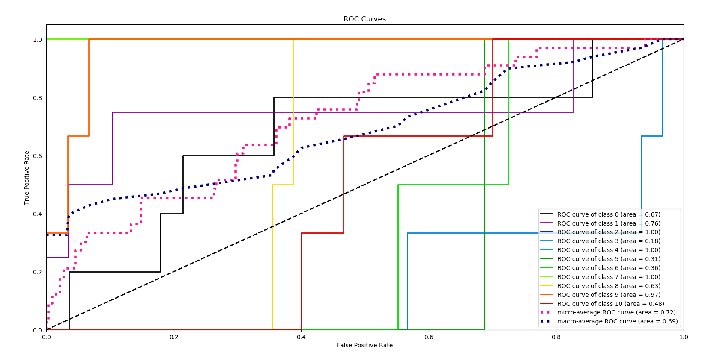
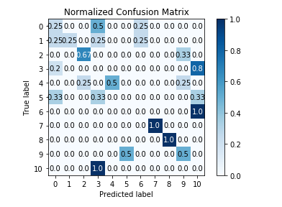
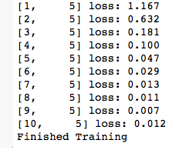
Evaluating performance | FaceModule
FaceModule, the initial network consisted of one convolutional layer (with one dropout layer), and two fully connected layers. Overall performance was at 30% Accuracy.

Slide 12
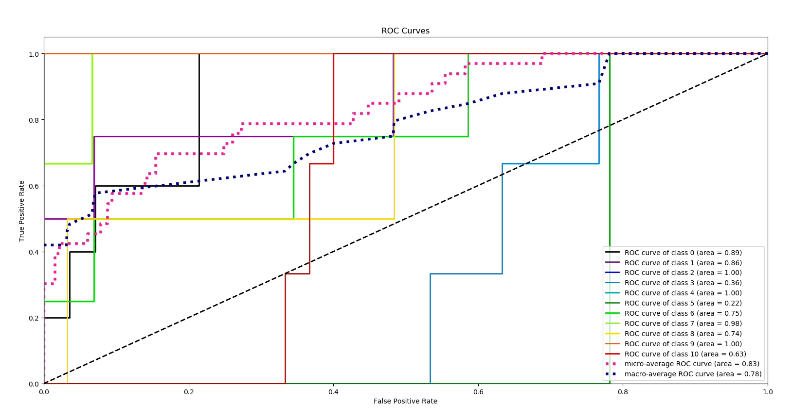
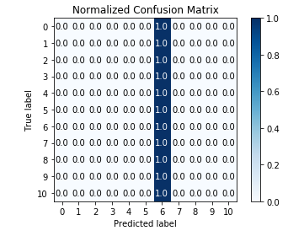
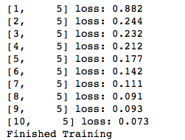
Evaluating performance | FaceModule2
For FaceModule 2, an additional convolutional layer was added, and the out-channels were increased from 16 to 32. Overall accuracy increased to 45%.

Slide 13
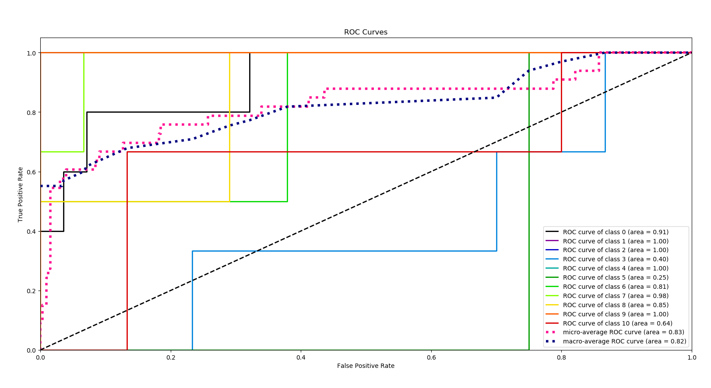
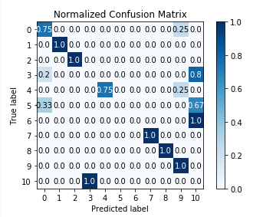
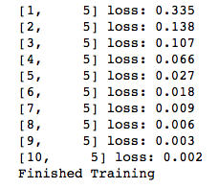
Evaluating performance | FaceModule3
In FaceModule3, a Batch Normalization layer was added. This significantly improved performance, to 57%.

Slide 14
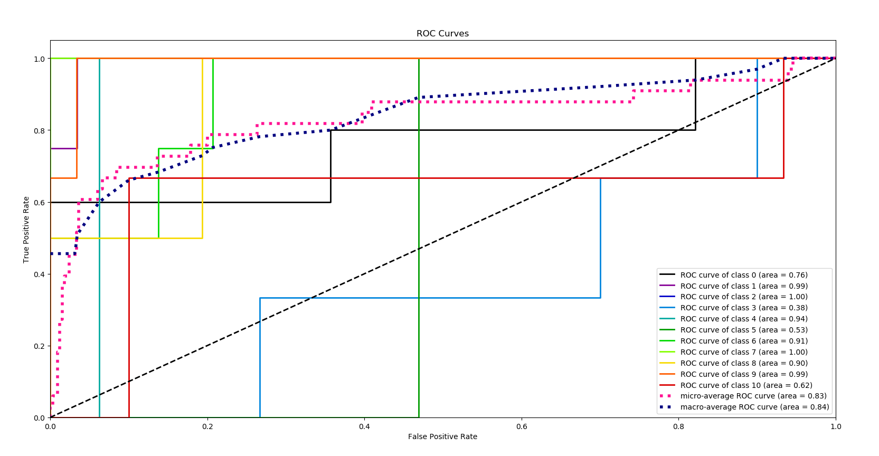
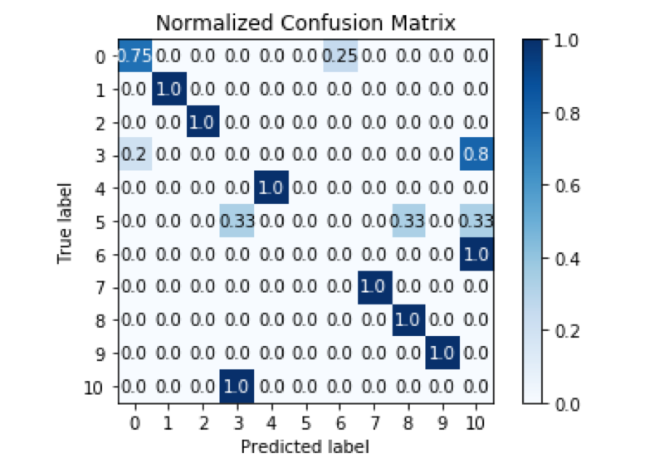
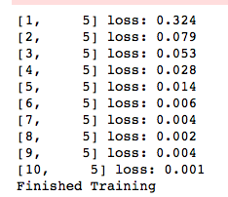
Evaluating performance | FaceModule4
FaceModule4 leveraged three convolutional layers and four batch normalization layers, but accuracy remained at 57%.

Slide 15
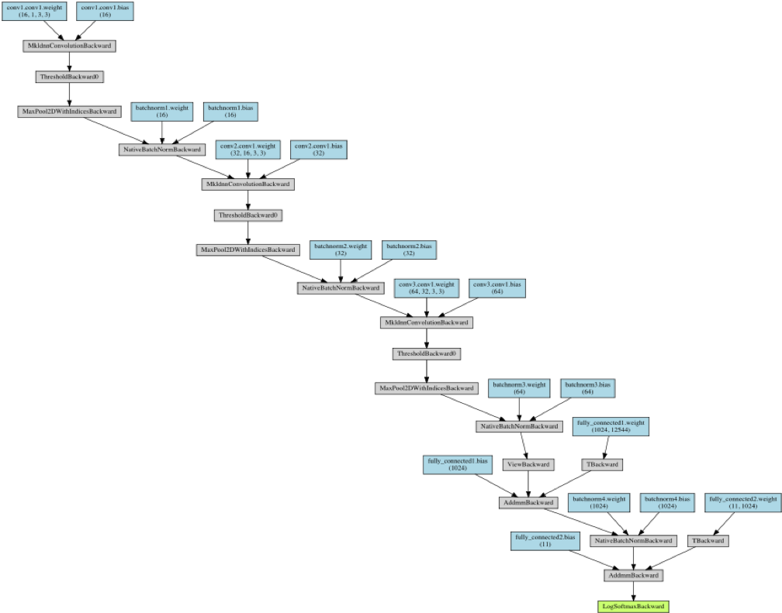

Slide 16


Slide 17
Per Class Accuracy: Subject 1
0. ‘Glasses’: 0.76
1. ‘Happy’: 0.99
2. ‘Left Light’: 1.00
3: ‘Normal’:0.38
4. ‘Right Light’: 0.94
5: ‘Sad’ 0.53
6: ‘Sleepy’0.91
7: ‘Surprised’ 1.00
8. ‘Wink’: 0.90
9. ‘CenterLight’: 0.99
10. ‘No Glasses’: 0.62

Slide 18
Summary and conclusions
Though an overall accuracy of 57% may not seem like good performance, when looking at the various classes, there three specific classes that the networks struggle with (i.e. accuracy below ~80%): Class 3 (‘Normal’), Class 5 (‘Sad’), and Class 10 (‘no glasses’).
Perhaps there are fine tuning methods that could be deployed so that the network can better identify the subtleties of these three categories.
3: ‘Normal’:0.38
5: ‘Sad’ 0.53
10. ‘No Glasses’: 0.62

