Slide 1
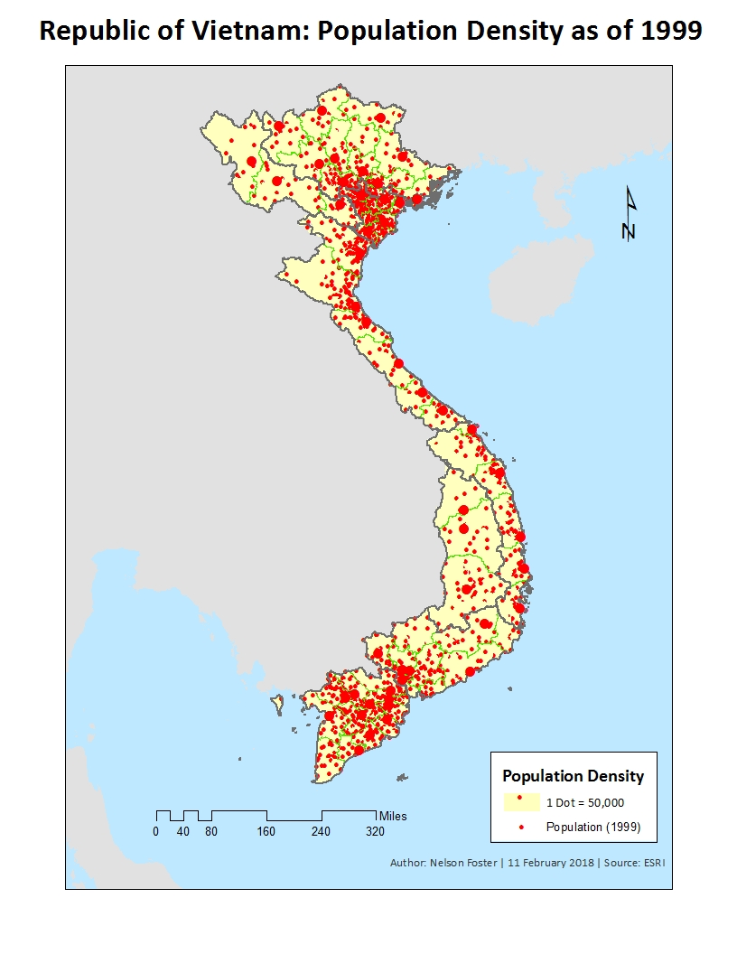
Not density really, more like distribution
7.65/9 overall
8/10 this map
Little hard to tell region and province apart, maybe try making region thicker and not black. Also need to include them on the legend
Make sure to export the JPGs at 300 dpi, that way it’s clearer and crisper
Take off the city dots
Dots are a bit big, and zoom in more on the country to get more detail
You can use more of the page, lots of white space on each map

Slide 2
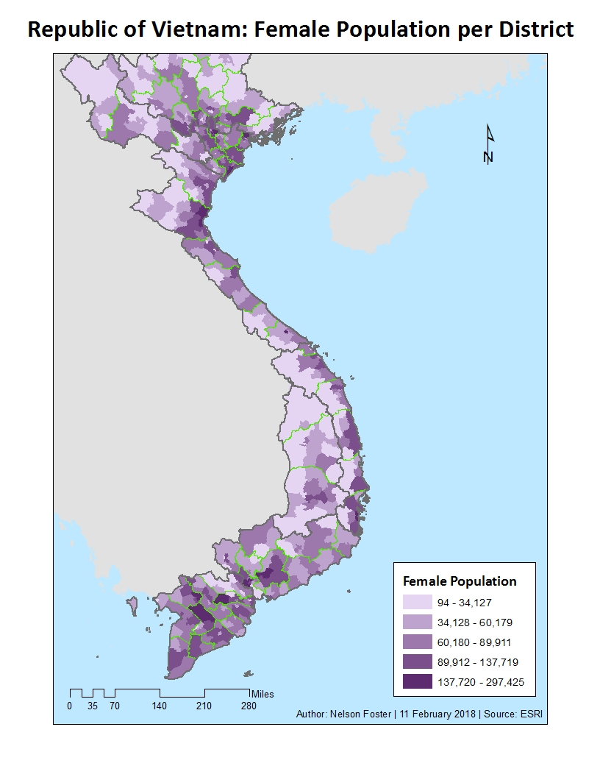
7.5/10
Zoom is odd, you should be centered on the country, not cut off
I like these purple colors, but a bit hard to tell region and province borders. Could use a bit more contrast
Need round numbers in legend, like 35,000, 60,000 etc. easier to read

Slide 3
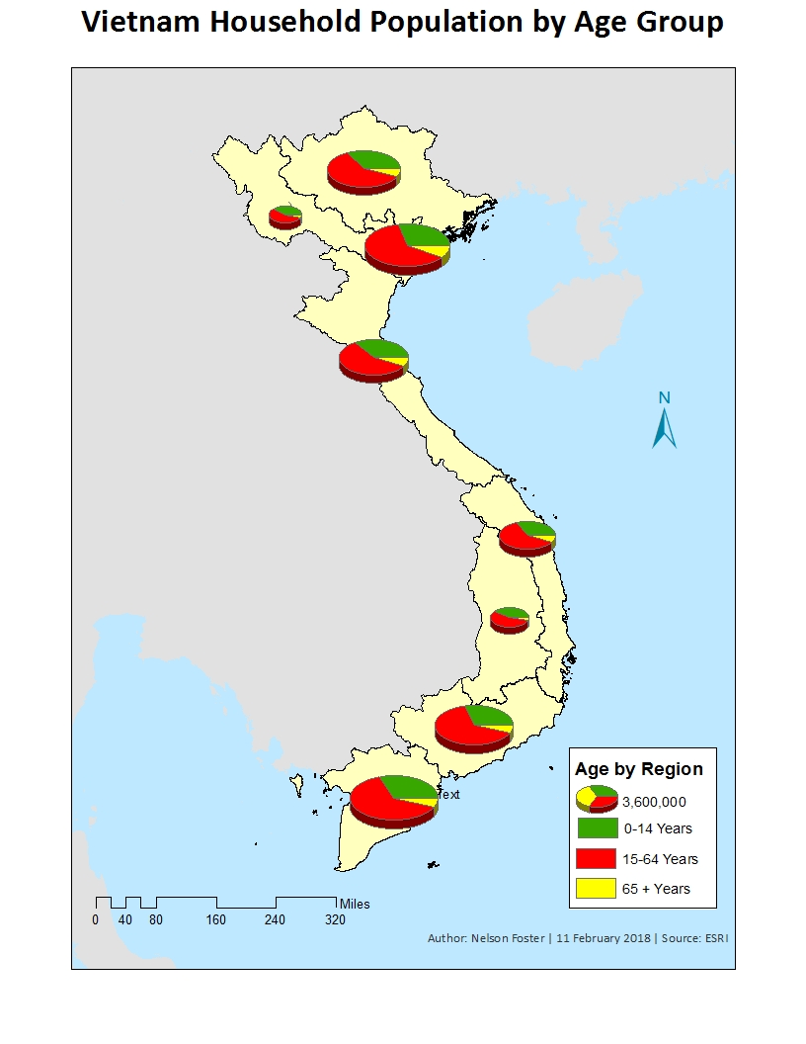
9.25/10
Try to keep zooms consistent between maps
Nice colors. Could make the black outline a bit lighter tho

Slide 4
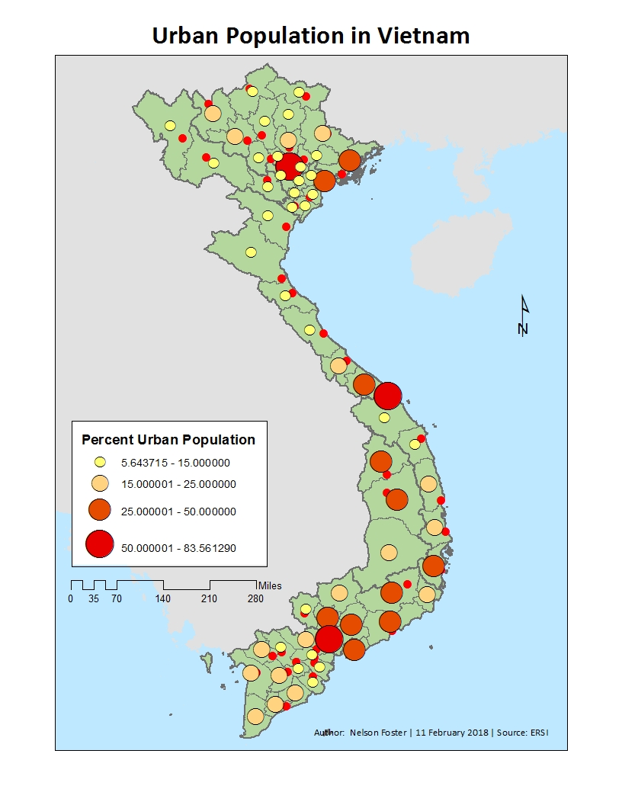
9.25/10
Green is a little too bright. Otherwise really nice
Round these, 5.64, 15.0 etc
Arial font?

Slide 5
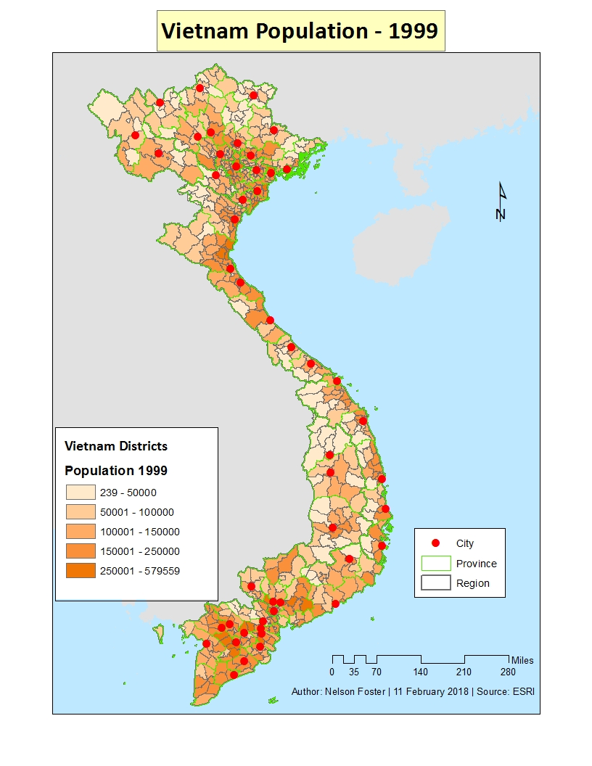
8.5/10
Bit hard to tell the districts apart, maybe take off the boundaries for them. May not need cities either, they cover up the small districts
Try to keep zoom and title style consistent through the maps
Nice job with round numbers, add commas tho

