Slide 1



Social Media
Template Pack.
For Nature’s Power Networking Company

Slide 2


Helping You Grow Your Online Audience on Social Media!
In this Social Media Template Pack, you will find several templates.
By customising these templates and making them your own, you can create images which can be used to promote the company interest.
This is a great way to advertise NPNC products and health services with your friends and family through social media and will, in return, help you to generate an income. NOTE: This Template is 100% cutomizable

Slide 3
How to Use These Templates
When posting on social media, you have the option to add an image to your post. Images help your post get noticed. Here you will find customisable templates that you can edit, download onto your laptop or mobile phone and post onto social media.
Edit any of these templates by adding your own pictures or text.
Save these templates onto your device.
They are then ready to post onto social media.
Add your Affiliate link to the caption of your social media post.

Slide 4
Easy to Use
These templates are saved as squares which make them suitable for Facebook, Instagram and LinkedIn.
The templates are easy to use and come with instructions on:
Template customisation.
Where to find free images.
How to download the templates.

Slide 5


ABOUT HIM
Your Name & Location
Right click images and select Change Picture
A Web Applications Developer
Proud NPNC Affiliate
Notes:
Update colours, add illustrations.

Slide 6

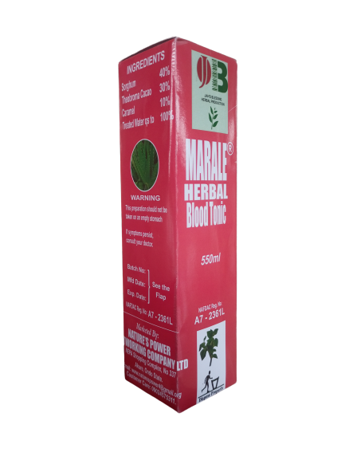
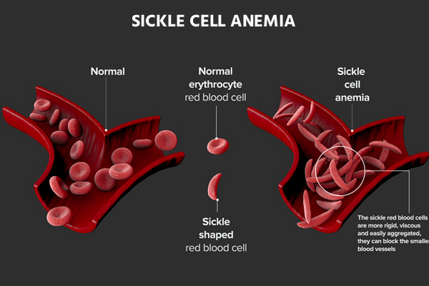

MARALE PLUS
Are you looking for a reliable solution to sickle cell crisis or frequent blood shortage?
Right click images and select Change Picture
MARALE PLUS IS THE SOLUTION

Slide 7

Get Cured Now!
Take [drug name] and experience the power of nature
Right click images and select Change Picture
[Product Name ]

Slide 8
Right click images and select Change Picture
Notes:
Update colours, update picture
Change layout

Slide 9
Right click images and select Change Picture
Notes:
Update colours, update picture
Change layout

Slide 10
Right click images and select Change Picture
Notes:
Update colours, update picture
Change layout

Slide 11
Right click images and select Change Picture
Notes:
Update colours, update picture
Change layout

Slide 12
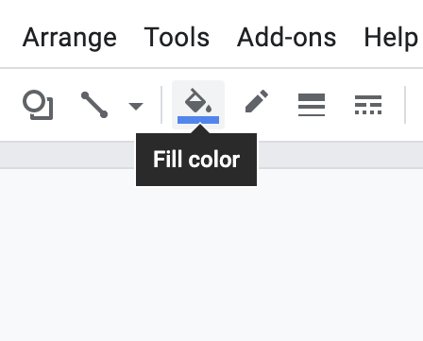
Template customisations
Fonts - Update fonts to match your brand using Slide > Edit Theme or use the default fonts
Colors - Edit colors to match your brand by clicking on the shapes and changing the fill and outline colors.
Images - To replace imagery with your own, right-click the image and click Replace image.
Edit colors, fonts, images and more

Slide 13
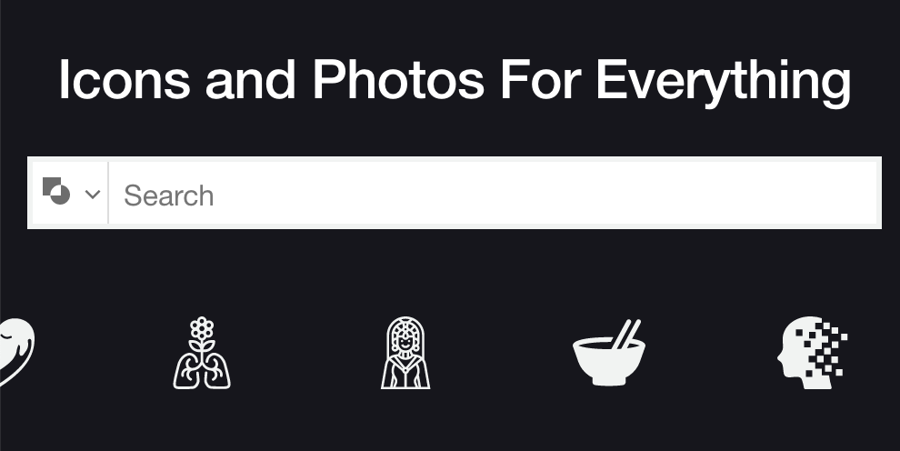
Image resources
If possible, use custom imagery from your creative team before turning to stock photos.
Imagery: You can find free stock photography at sites like Unsplash, Pexels or Reshot.
Iconography: You can find free or affordable icon resources at Flaticon, the NounProject and Iconfinder.
Accessibility: Check color/text accessibility with this contrast checker https://accessible-colors.com/
Download free icons and stock photography with the links above

Slide 14
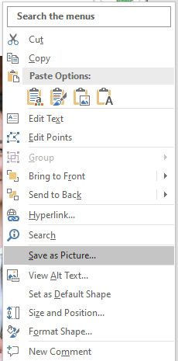
Download instructions
Select the slide you’d like to download. Right click, and select Save as Picture and it will be downloaded in PNG format for you to use on whichever social media site you prefer
Export templates in multiple file types

Slide 15
Posting Tips
Social media marketing can seem intimidating, but it doesn't have to be. These tips will help you navigate the wonderful world of social media!
Tip 1: Be consistent. Post at regular intervals.
Tip 2: Engagement is key. Remember social media is a two-way street. Engage with your audience.
Tip 3: Be human and personable. People do not like when they are being sold to, especially on social media.
Tip 4: Try new things! You don’t have to post the same thing everytime.
Tip 5: Have fun! Social media is meant to be an enjoyable experience - make your content fun to engage with!

Slide 16

So, what’s next?
Once you have customised your templates and saved them as images, you can post them on social media and start attracting your target audience to the product! Don't forget to add the specific NPNC product link to your post.

