Slide 1
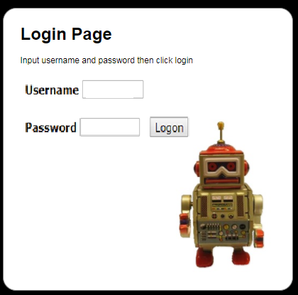
SQL INJECTION – “OLD SCHOOL”
'or ''='
'or ''='
Robot Parts eCommerce Store
Notes:
Copyright 2018 Stacy D. Nelson

Slide 2
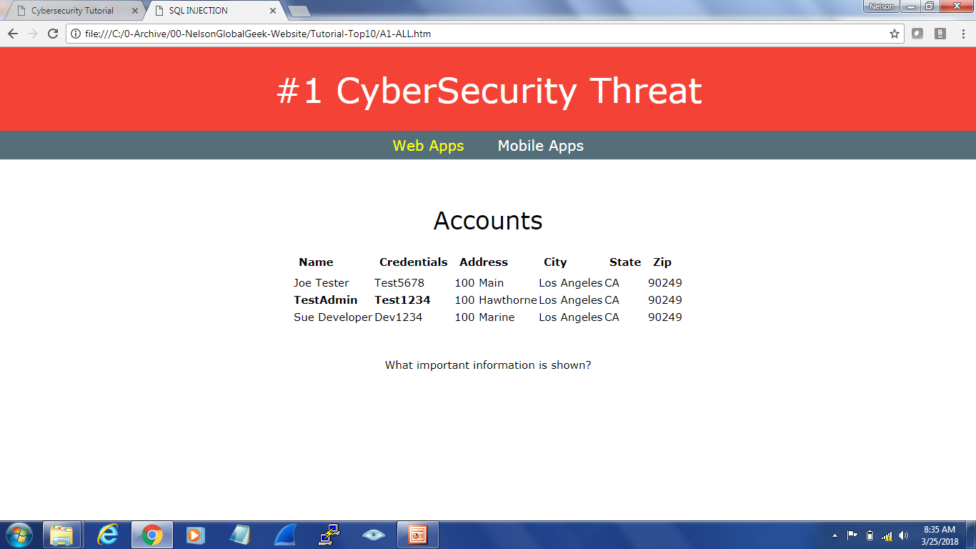
Gotcha!
SQL Injection
Legal or Illegal?

Slide 3
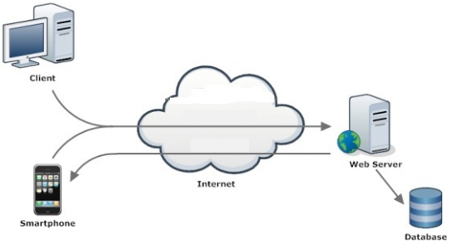
SQL INJECTION – “OLD SCHOOL”
Inputting unexpected special codes to trick an app
SQL
Injection
ADMIN PASSWORD
Notes:
Copyright 2018 Stacy D. Nelson

Slide 4
What did we learn?
SQL INJECTION
SQL Injection occurs when an attacker can send hostile data to an interpreter
SQL INJECTION RISKS
Stolen Data
Notes:
Copyright 2018 Stacy D. Nelson

Slide 5


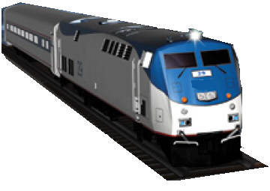

Operations
SQL INJECTION – NEW CHALLENGES
Positive Train Control System

Slide 6
Locomotive 1 has a maximum SAFE speed of 60 mph
What if someone injects SQL?
UPDATE train SET speed = 100 where Locomotive = 1;

Slide 7
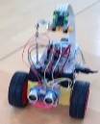
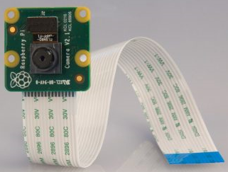
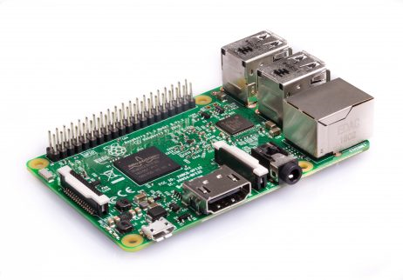


PiCamera
Raspberry Pi
Simulated SQL Injection of
Locomotive messaging systems
using AR3 Robot
Sensors
CamJam EduKit 3
WATCH TRAIN CONTROL SIMULATION
https://www.youtube.com/watch?v=bMkm36I56uI

Slide 8
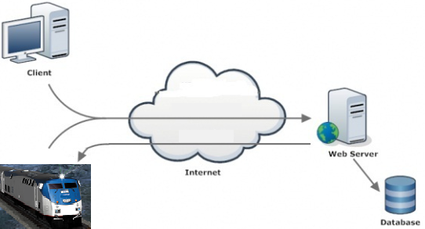
SQL INJECTION – NEW CHALLENGES
Tricking apps into doing something unexpected
SQL
Injection
Notes:
Copyright 2018 Stacy D. Nelson

Slide 9
What did we learn?
SQL INJECTION
SQL Injection occurs when an attacker can send hostile data to an interpreter
SQL INJECTION RISKS
Stolen Data, Destroyed Data, Denial of Service, Destroy Things & Possibly Harm People
Notes:
Copyright 2018 Stacy D. Nelson

Slide 10
What is today’s class about?
SQL Injection
Cybersecurity:
Instructor Name: Nelson
Notes:
Copyright 2018 Stacy D. Nelson

Slide 11
Structured Query Language
Relational Database
SQL
Microsoft SQL Server
Oracle
MySQL
Nmap
HPWebInspect
Rational AppScan
SQLNinja
MS Source Code Analyzer

Slide 12



SQL
DATABASE
schedule
SQL
Any application with a SQL database
can be vulnerable to SQL Injection
https://www.w3schools.com/sql/sql_intro.asp
https://www.khanacademy.org/computing/computer-programming/sql/sql-basics/v/welcome-to-sql

Slide 13

SQL
CREATE DATABASE COD;
CREATE TABLE schedule (
id INT(3),
course VARCHAR(30),
teacher VARCHAR(30),
semester VARCHAR(10)
);
INSERT INTO schedule VALUES (101,”Cybersecurity”, “Nelson”, “Fall2018”);
MySQL
DATABASE
schedule
SELECT * FROM schedule where teacher=“Nelson”;

Slide 14


SQL
INSERT INTO schedule VALUES (102,”Networking”, “Smith”, “Fall2018”);
UPDATE schedule SET teacher = “Jones” where id = 102;
MySQL
DATABASE
schedule
+-----+--------------------+------------+-------------+
| id | course | teacher | semester |
+-----+---------------------+-----------+-------------+
| 101 | Cybersecurity | Nelson | Fall2018 |
+-----+---------------------+-----------+-------------+
| 102 | Networking | Jones | Fall2018 |
+-----+---------------------+----------+--------------+
+-----+--------------------+------------+-------------+
| id | course | teacher | semester |
+-----+---------------------+-----------+-------------+
| 101 | Cybersecurity | Nelson | Fall2018 |
+-----+---------------------+-----------+-------------+
SELECT * FROM schedule WHERE teacher=“Nelson”;
SELECT * FROM schedule WHERE teacher = ‘’or'1'='1';

Slide 15

SQL
+-----+--------------------+------------+-------------+
| id | course | teacher | semester |
+-----+---------------------+-----------+-------------+
| 101 | Cybersecurity | Nelson | Fall2018 |
+-----+---------------------+-----------+-------------+
| 102 | Networking | Jones | Fall2018 |
+-----+---------------------+----------+--------------+
| 103 | Cybersecurity | Hacker | Fall2018 |
+-----+---------------------+----------+--------------+
MySQL
DATABASE
schedule
ILLEGAL
Select * from schedule where ‘’=‘’;INSERT INTO schedule VALUES (103, “Cybersecurity”, “Hacker”, “Fall2018”);
Select * from schedule where ‘’=‘’;DROP TABLE schedule;
Select * from schedule where ‘’=‘’;DROP DATABASE COD;

Slide 16
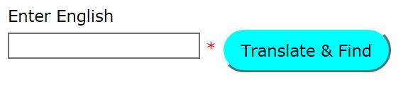


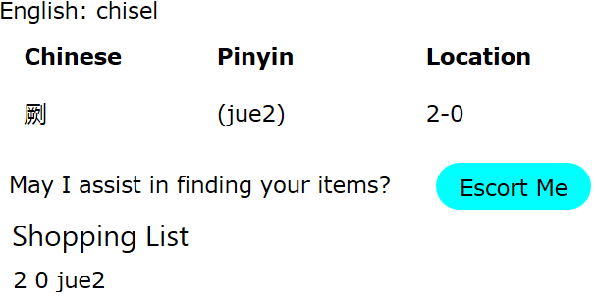

chisel
Connect through WebServer
Another Robot Parts Store SQL Injection
Exam the code
How many vulnerabilities can you identify?
Connect to DB
Search DB
Return Result
chisel
Robot Parts Store

Slide 17
Input Validation
<?php
$getEnglishErr = "";
$getEnglish = "";
if ($_SERVER["REQUEST_METHOD"] == "POST") {
if (empty($_POST["itmE"])) {
$getEnglishErr = “What do you need?";
} else {
$getEnglish = validate_input($_POST["itmE"]);
if (!preg_match("/^[a-zA-Z ]*$/",$getEnglish)) {
$getEnglishErr = "Only letters and white space allowed";
}
}
}
function validate_input($data) {
$data = trim($data);
$data = stripslashes($data);
$data = htmlspecialchars($data);
return $data;
}
What about ‘ -- ;
SELECT * FROM schedule WHERE teacher = ‘’or'1'='1';

Slide 18
Validate Input
Username: JoeTester@gmail.com
Password: Test5678#
Use Case: Validate Username
Use Case: Validate Password
Only allow A-Z a-z @ .
Only allow A-Z a-z #@$1-9
JoeTester@gmail.com
Test5678#
'or ''='
'or ''='
‘ -- ; Not Allowed

Slide 19
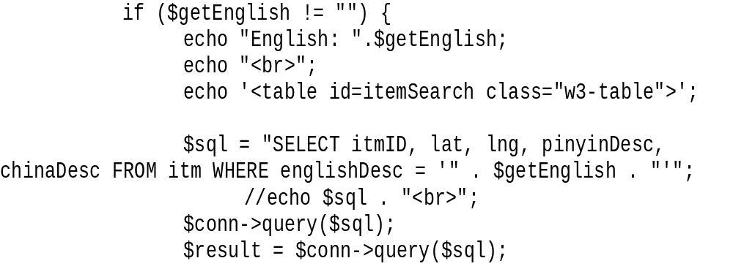
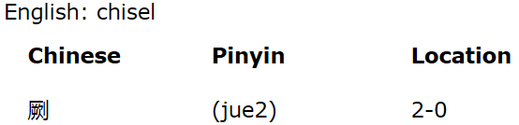
Expected SQL Query
Select itmID, lat, lng, pinyinDesc, chinaDesc FROM itm WHERE englishDesc = ‘Chisel’;

Slide 20
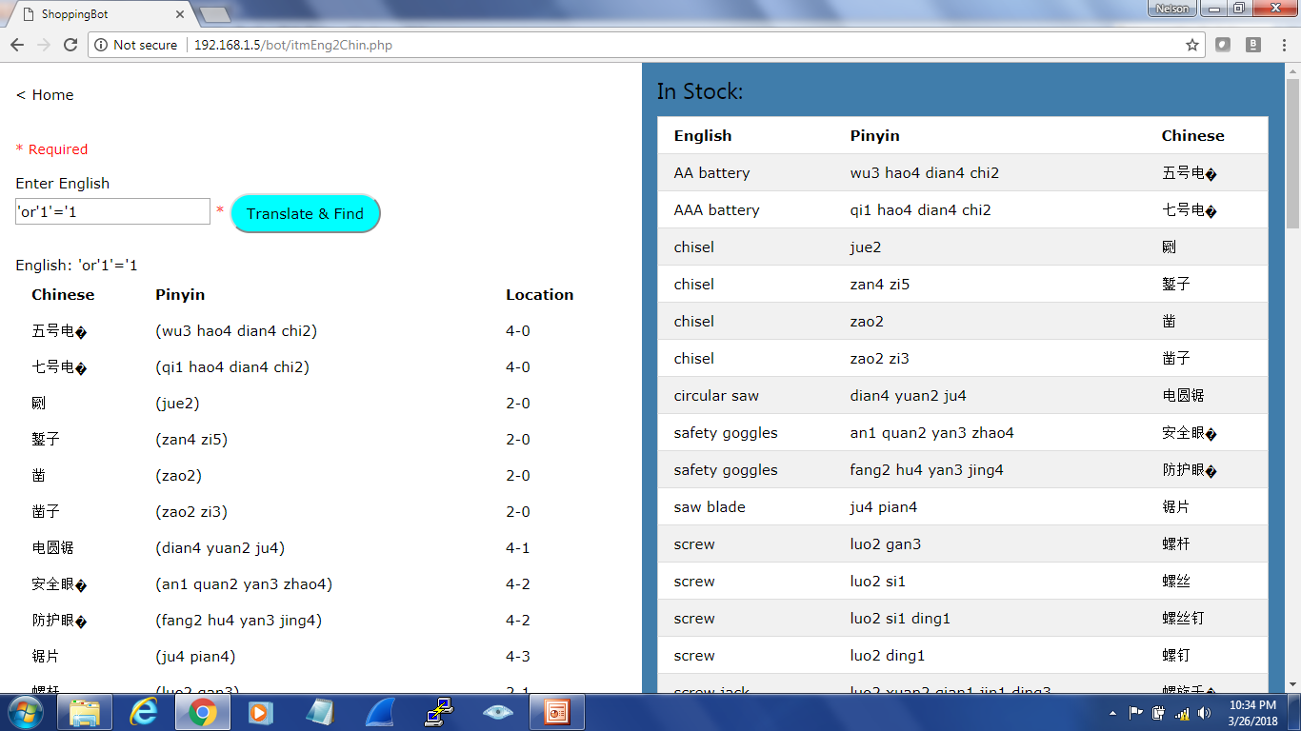

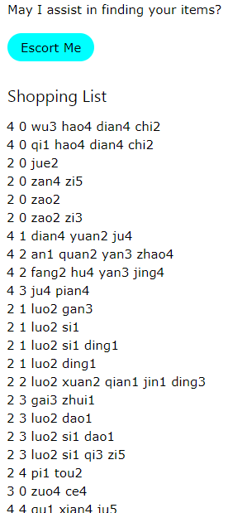

Select itmID, lat, lng, pinyinDesc, chinaDesc FROM itm WHERE englishDesc = ‘’or'1'='1';
Dumped all records in table
Shopping List contains every item in the store
DoS for Robot Escort Service

Slide 21
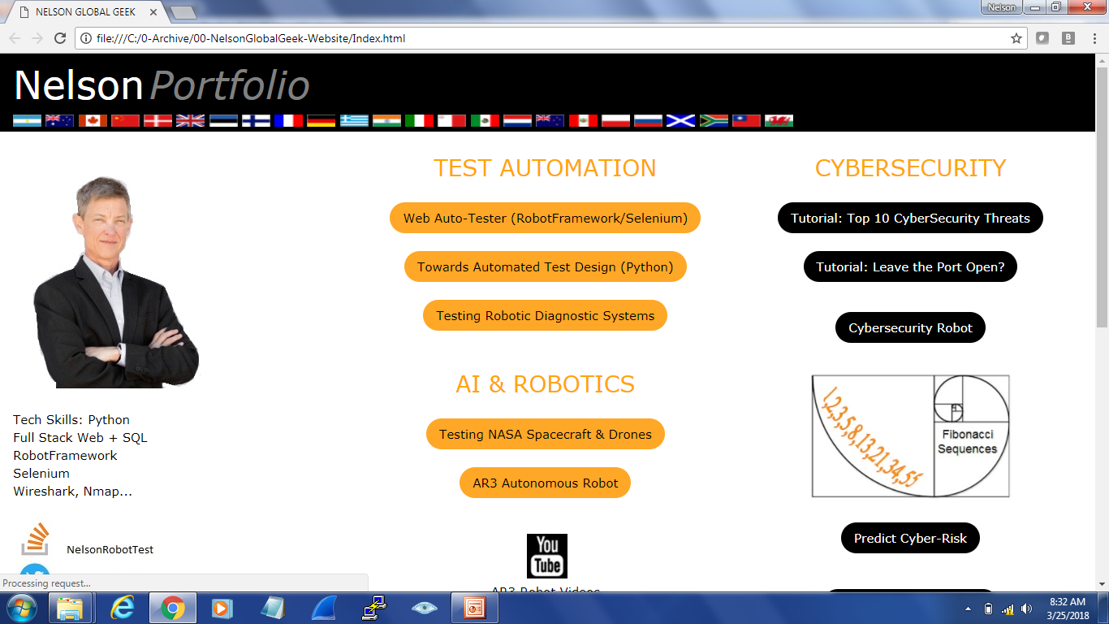
Cybersecurity Tutorial: Go to www.NelsonGlobalGeek.com
Tutorial: Top 10 Cybersecurity Threats

Slide 22
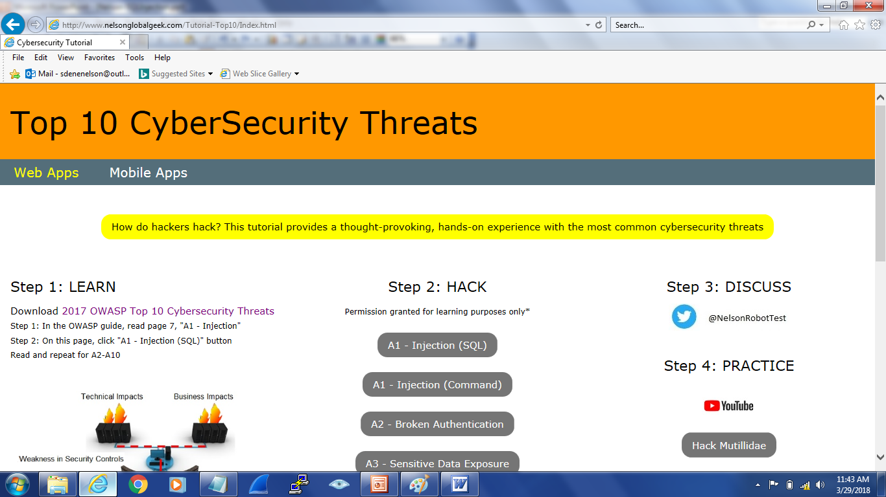
CLICK

Slide 23
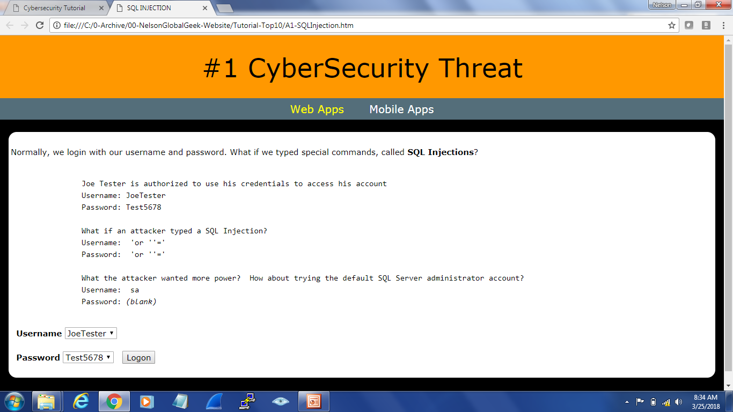

Slide 24
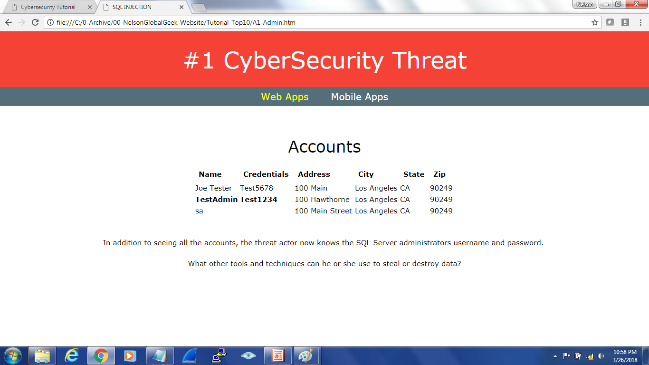

Slide 25
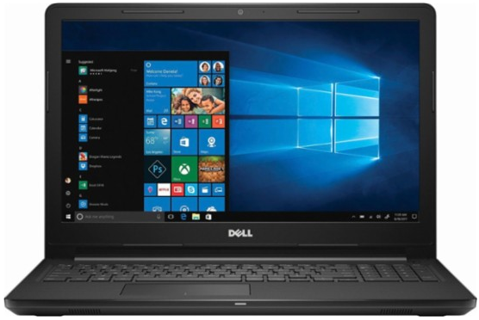

How do you suggest we protect against SQL Injection?
Notes:
Time permitting – cover protections

Slide 26
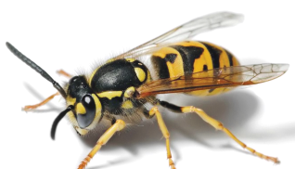

HOW to PROTECT against SQL Injection
Validate input
API (SOAP, REST)
“WhiteList” server-side input
Escape special characters
LIMIT result set
API Security
Access Security
Network Security
Database Security
Security Policies & Procedures
Open Web App Security Project

Slide 27
Validate Input
Username: JoeTester@gmail.com
Password: Test5678#
Use Case: Validate Username
Use Case: Validate Password
Only allow A-Z a-z @ .
Only allow A-Z a-z #@$1-9
JoeTester@gmail.com
Test5678#
'or ''='
'or ''='
‘ -- ; Not Allowed
Notes:
Convert the predefined characters "<" (less than) and ">" (greater than) to HTML entities:
<?php
$str = "This is some <b>bold</b> text.";
echo htmlspecialchars($str);
?>
The HTML output of the code above will be (View Source):
<!DOCTYPE html>
<html>
<body>
This is some &lt;b&gt;bold&lt;/b&gt; text.
</body>
</html>
The browser output of the code above will be:
This is some <b>bold</b> text.
mb_stripos() - Finds position of first occurrence of a string within another, case insensitive
•strpos() - Find the position of the first occurrence of a substring in a string
•strrpos() - Find the position of the last occurrence of a substring in a string
•strripos() - Find the position of the last occurrence of a case-insensitive substring in a string
•stristr() - Case-insensitive strstr
•substr() - Return part of a string
•str_ireplace() - Case-insensitive version of str_replace
stripos

Slide 28
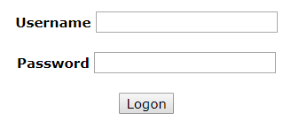
API 101
In the beginning of the internet…
Data was passed in querystrings using clear text:
http://www.e.com/p.htm?id=SessionID999999999999999&cc=4388123456781234&n=SamSurfer
Data was passed in HTTP body using clear text:
Username = Saylor Slow
Password = Buddy1
Input was not validated very well so SQL Injections were easy…

Slide 29


Custom Web Service
App Components
Currency Conversion
Language Translation
Temperature Converter
Web Services
Better security

Slide 30
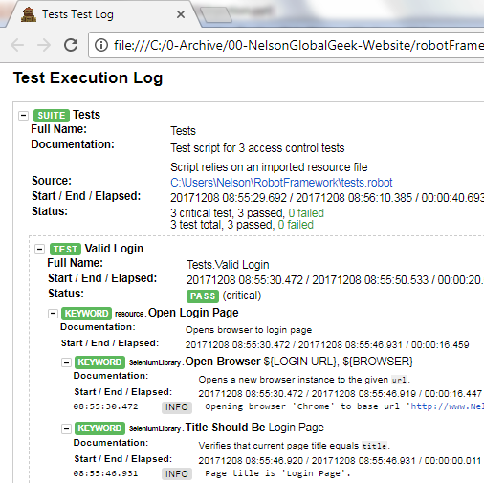
SOAP is an XML message that travels over HTTP
-<kw name="Open Login Page">
-<kw name="Open Browser">
-<arguments>
<arg>${LOGIN URL}</arg>
<arg>${BROWSER}</arg>
</arguments>
<msg level="INFO">Opening browser 'Chrome' to base url 'http://www.NelsonGlobalGeek.com/robotFramework/index.html'.</msg>
<status="PASS"/>
</kw>
-<kw name="Title Should Be">
-<arguments>
<arg>Login Page</arg>
</arguments>
<msg level="INFO">Page title is 'Login Page'.</msg>
<status="PASS"/>
</kw>
POWERFUL BUT TOO COMPLEX
XML has meaningful tags
XML codes and decodes data

Slide 31
JSON
JavaScript Object Notation
{ "name":"John", "age":31, "city":"New York" }

Slide 32
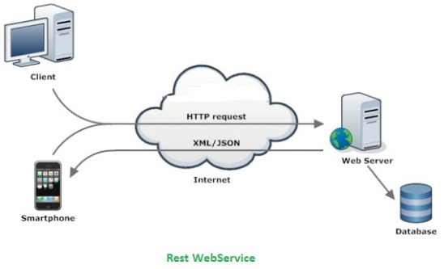
REST is a JSON message that travels over HTTP
DATA
Roy Thomas Fielding wrote a dissertation, REpresentational State Transfer (REST)

Slide 33
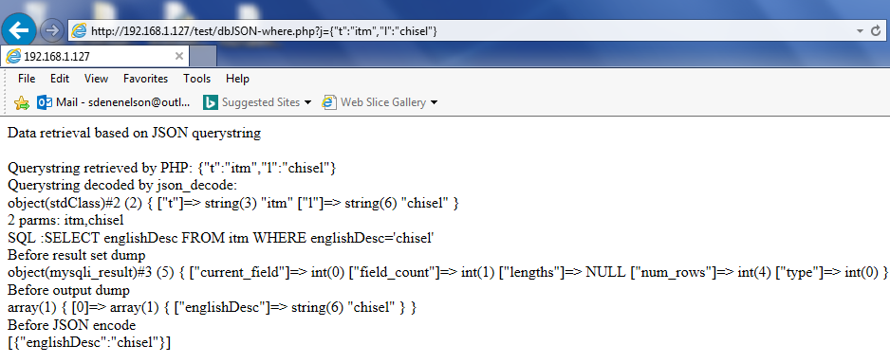
JSON

Slide 34
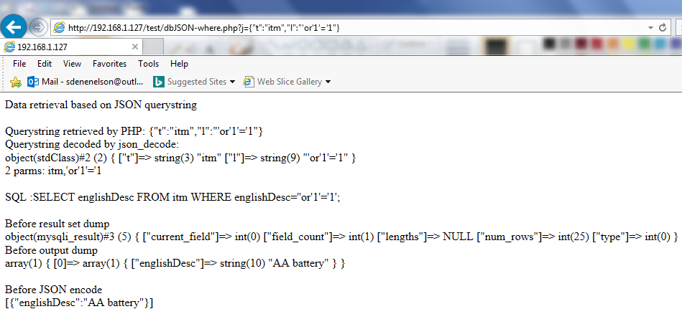
JSON
SQL Injection

Slide 35
What did we learn?
SQL INJECTION
SQL Injection occurs when an attacker can send hostile data to an interpreter
SQL INJECTION RISKS
Stolen Data, Destroyed Data, Denial of Service, Destroy Things & Possibly Harm People
PREVENT SQL INJECTION
PREVENT SQL INJECTION
Validate Input, Use REST API, Configure Security…
INPUT VALIDATION
INPUT VALIDATION
Cleansing data that has been input into a form
Notes:
Copyright 2018 Stacy D. Nelson

Slide 36
SQL Injection Project
You are the CISO
Write a Security Policy to Prevent SQL Injection at your Start-up
Technical Controls
Network Security
REST Security
Database Security
Access Security
Risk Management

Slide 37
REST Security
Validate input – accept “known” good input and reject bad input
Encode data using known libraries MS Anti-XSS or OWASP AntiSammy
Restrict message size
Display only generic error messages
Consider business logic attacks
Log suspicious activity

Slide 38
More REST Security
Validate JSON and XML for malformed data
Verbs should be used as intended:
GET only retrieves data it does not DELETE data
Be aware of race conditions
API gateways can monitor, throttle, and control access to the API
Monitor activity (normal usage patterns…)
Throttle API usage to prevent DoS
Store API keys in secure keystore
Notes:
RESTful Service Best Practices
Recommendations for Creating Web Services
Todd Fredrich 2012

Slide 39
Access Security
Authorization
Does the person have the requested permission for the resource?
Follow the least privileges principle (DB accounts have minimal privileges)
Authentication
2 Factor when possible
OAuth for authentication (http://oauth.net/documentation/spec/
OpenID for additional authentication (http://openid.net/developers/specs)
Transport Security
Authenticate over SSL
Use TLS
Switching between HTTP and HTTPS introduces vulnerabilities
Manage Access Security
Change default passwords
Listening components must have passwords
Limit the number of failed login attempts, password lock time…
Enforce password strength
Limit account behavior – sessions per account, CPU consumption…

Slide 40
Network Security
Never expose your DB directly on the internet
Segment your internal network and separate DB using firewalls…Allow only select internal IP addresses to access the DB
Monitor network port scanning attempts of DB ports
UDP Port 1434 – MS SQL Server SQL Browser Service (instance mapper)
Slammer Worm exploited MS SQL Server buffer overflow on port 1434
SQLPing – find instances listening, sqlsecurity.com – hide from SQLPing
Port 1521 – Oracle TNS listener
Notes:
Never expose your DB directly on the internet
Segment your internal network and separate DB using firewalls…Allow only select internal IP addresses to access the DB
Monitor network port scanning attempts of DB ports

Slide 41
Database Security Configuration
DB Configuration:
Apply vendor patches
Don’t run unrelated services on DB server (Windows Domain Controllers)
-Configure and monitor remote admin connections (if possible, avoid)
-Enable auditing
-Remove demonstration accounts on production DB

Slide 42
What did we learn?
SQL INJECTION
SQL Injection occurs when an attacker can send hostile data to an interpreter
SQL INJECTION RISKS
Stolen Data, Destroyed Data, Denial of Service, Destroy Things & Possibly Harm People
PREVENT SQL INJECTION
PREVENT SQL INJECTION
Validate Input, Use REST API, Configure Security…
INPUT VALIDATION
INPUT VALIDATION
Cleansing data that has been input into a form
Notes:
Copyright 2018 Stacy D. Nelson

Slide 43
RESOURCES
OWASP SQL Injection https://www.owasp.org/index.php/SQL_Injection
National Vulnerability Database https://nvd.nist.gov/
W3 Schools SQL Tutorial https://www.w3schools.com/sql/sql_intro.asp
Top 10 Cybersecurity Threats http://www.NelsonGlobalGeek.com
Blind SQL Injection https://www.owasp.org/index.php/Blind_SQL_Injection
Google: SQL Server, Oracle, or MySQL
REST Security Cheat Sheet https://www.owasp.org/index.php/REST_Security_Cheat_Sheet
OWASP Mutillidae Test Environment
http://www.NelsonGlobalGeek.com
-> Click Tutorial: Top 10 CyberSecurity Threats
-> click Mutillidae
http://www.irongeek.com/i.php?page=mutillidae/mutillidae-deliberately-vulnerable-php-owasp-top-10
Notes:
Find SQL injection for executing function calls and stored procedures p. 560

