Slide 1
An End-to-End Trainable Neural Network for Image-based Sequence
Recognition and Its Application to Scene Text Recognition
Model Overview
Object Function: CTCLoss
Prediction Display
1

Slide 2
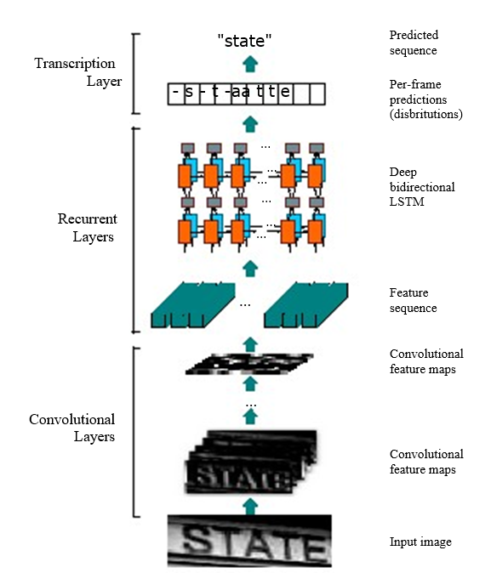
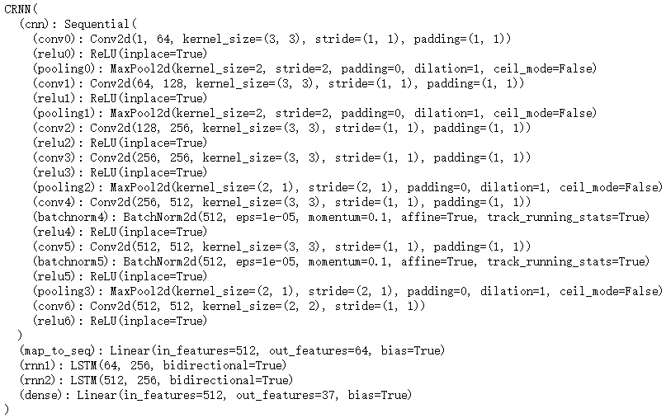
Model Overview
2

Slide 3




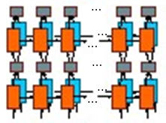


Model Overview
width
CNN
stack
height
height ( as horizontal features)
...
input images
Convolutional
feature maps
linear
width
Dense
Character Probability
sequence features
sequence length (width)
Bi-LISM
backward: parameter updating
sequence length (width)
CTC loss
sequence length (width)
3

Slide 4
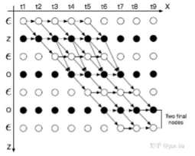
Object Function: CTCLoss
Calculates loss between a continuous (unsegmented) time series and a target sequence. CTCLoss sums over the probability of possible alignments of input to target, producing a loss value which is differentiable with respect to each input node. The alignment of input to target is assumed to be "many-to-one", which limits the length of the target sequence such that it must be :the input length.
Example：
Target Sequence: Zoo
CTC will find the all satisfied paths, and sum over the probability of possible alignments of input to target. The object function is to maximum the sum of the probability.
the possible alignments of “ZOO”
4

Slide 5
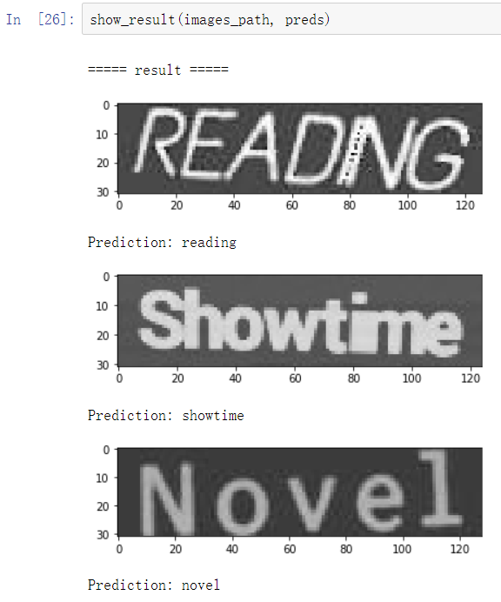
Prediction Display
Prediction Display
5

Slide 6
Thanks

