Slide 1
Relation Classification via Convolutional Deep Neural Network
Model Overview
Data Preprocess
Feature Engineering
Model Structure

Slide 2
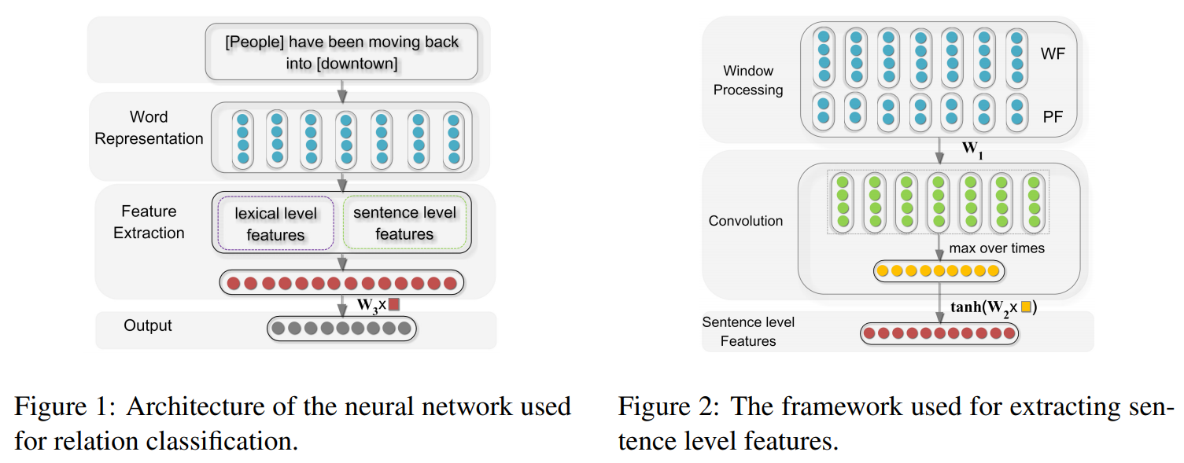
Model Overview

Slide 3
Data Preprocess
Input Sentence:
8001 "The most common <e1>audits</e1> were about <e2>waste</e2> and recycling."
Message-Topic(e1,e2)
Comment: Assuming an audit = an audit document.
Data Preprocessor
Output JSON:
8001", "relation": "Message-Topic(e1,e2)",
"head": "audits",
"tail": "waste",
"subj_start": 3, "subj_end": 3,
"obj_start": 6, "obj_end": 6,
"sentence": ["The", "most", "common", "audits", "were", "about", "waste", "and", "recycling", "."], "comment": " Assuming an audit = an audit document."}

Slide 4
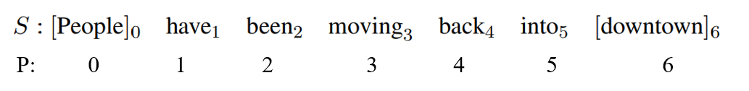
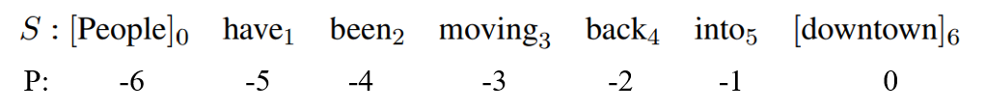

Feature Engineering
Sentence Level Features：
Word Features：
Position Features:
Sentence Features：
All of the word tokens of the sentence S are then represented as a list of vectors (x0, x1, · · · , x6), where xi corresponds to the word embedding of the i-th word in the sentence. To use a context size of w, we combine the size w windows
of vectors into a richer feature. For example, when we take w = 3, the WF can be represented as follows:
The relative distance to head entity and tail entity. the relative distances of “moving” in sentence S to “people” and “downtown” are 3 and -3, respectively. The relative distances also are mapped to a vector of dimension de (a hyperparameter);
For head entity [People]:
For tail entity [downtown]:
PF = [d1, d2].

Slide 5
Feature Engineering
Lexical Level Features：
L1：Embedding Word Features for Entity 1
L2 : Embedding Word Features for Entity 2
L3 : Left and right tokens of noun 1
L4: Left and right tokens of noun 2
L5 : WordNet hypernyms of nouns: a word with a broad meaning constituting a category into which words with more specific meanings fall
For head entity [People]: (the left, itself, the right) = ([People], [People],[have])
For head entity [downtown]: (the left, itself, the right) = ([into], [downtown], [downtown])

Slide 6
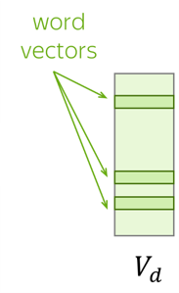
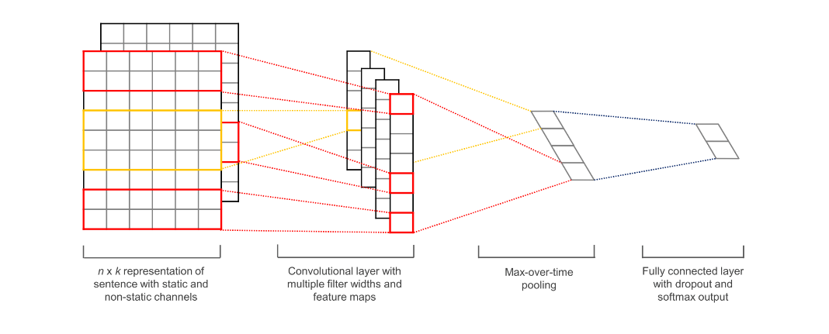
Model Details
Word Features:

Slide 7
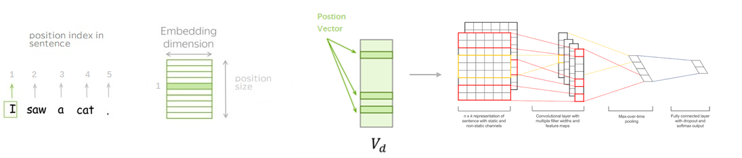
Model Details
Position Features:

Slide 8
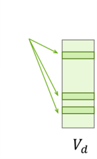
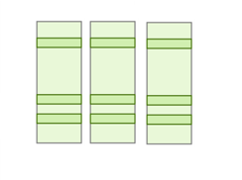
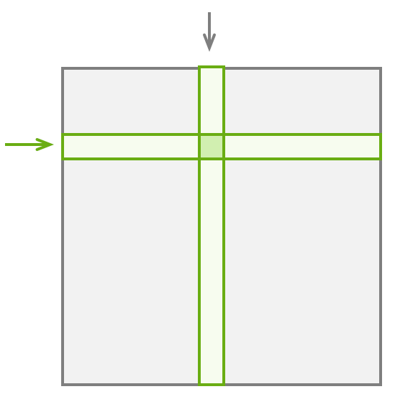
Model Details
Forward:
word vector
max_seq_len
max_seq_len
Kernel
position for entity 1 vector
filter number
filter number
concat
convolution
padding masking
position for entity 2 vector
[max_seq_len , (word_emd + pos_emd *2)]
padding

Slide 9
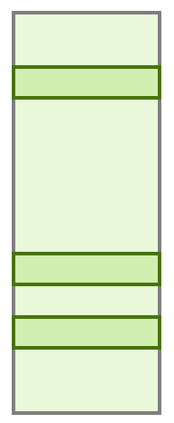
Model Details
Number of relation class
Forward:
Dense
hidden size
Lexical Feature
Sentence Features
+
linear
linear
filter number
maximum pooling
Lexical Features
max_seq_len
Lexical Features
filter number
For head entity [People]: (the left, itself, the right) = ([People], [People],[have])
+
For head entity [downtown]: (the left, itself, the right) = ([into], [downtown], [downtown])
padding

Slide 10
Thanks

