Slide 1
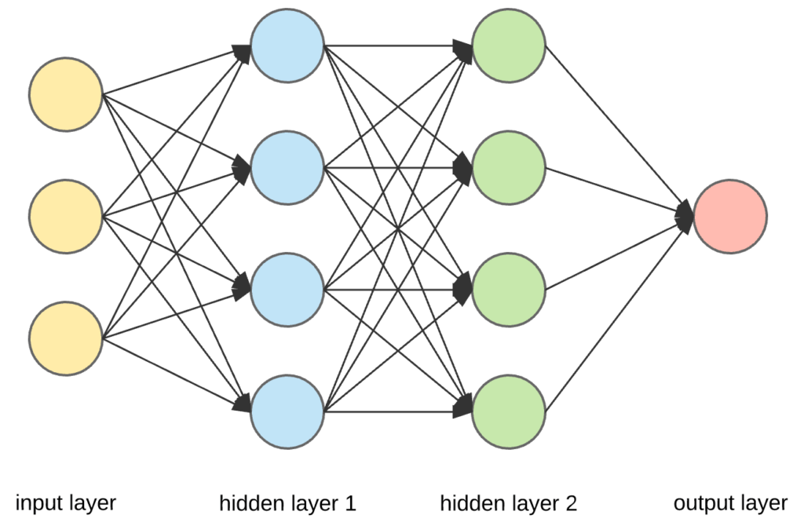
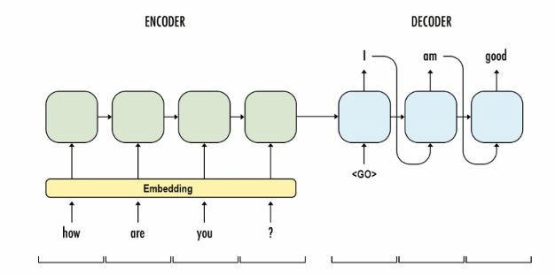
Bahdanau Attention Mechanism
Dense
query (batch_size, seq_len, attention_units)
multiply
encoder output (values):（batch_size,seq_len,units）
reduce_sum
context vector + x (embedding) :
(batch_size,units)
softmax
attention weight:
(batch_size, seq_len, 1)
Dense
Attention
Adding + tanh
<GO> am good
Dense
decoder hidden state (key):(batch_size,units)
key:（batch_size, 1,attention_unit）

Slide 2
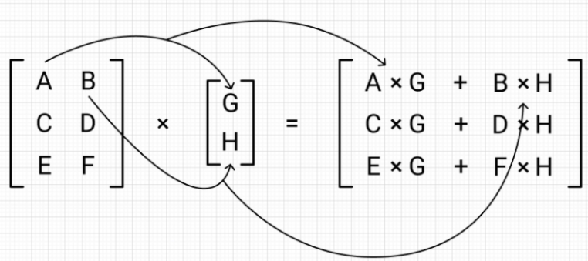
DotProduct Attention Mechanism
Dense
query (batch_size, seq_len, attention_units)
multiply
encoder output (values):（batch_size,seq_len,units）
reduce_sum
context vector + x (embedding) :
(batch_size,units)
softmax
attention weight:
(batch_size, seq_len, 1)
dot_product + tanh
Attention
<GO> am good
Dense
decoder hidden state (key):(batch_size,units)
key:（batch_size, 1,attention_unit）

