Slide 1
Background
Traditional
Nowadays
organoleptic tasting
data mining methods

Slide 2
Objectives
1. The key variables that affect the quality.
2. The correlation between variables.
3. The consistency of the influence variables
4. Prediction and Evaluation.

Slide 3
Objectives
1. The key variables that affect the quality.
2. The correlation between variables.
3. The consistency of the influence variables
4. Prediction and Evaluation.

Slide 4
Tools
Python
Matplotlib
Scikit-learn

Slide 5
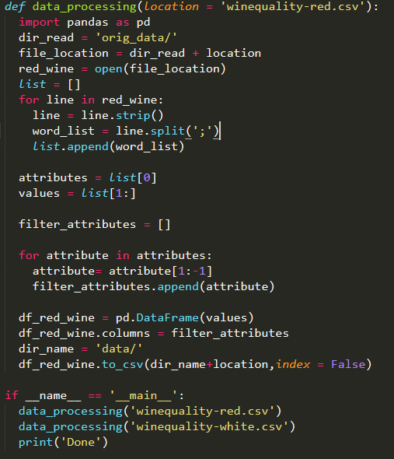
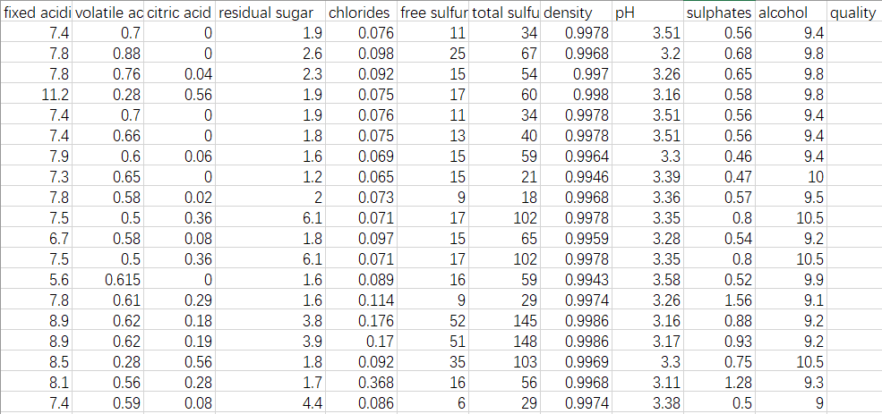
Data Description and Pre-Processing

Slide 6



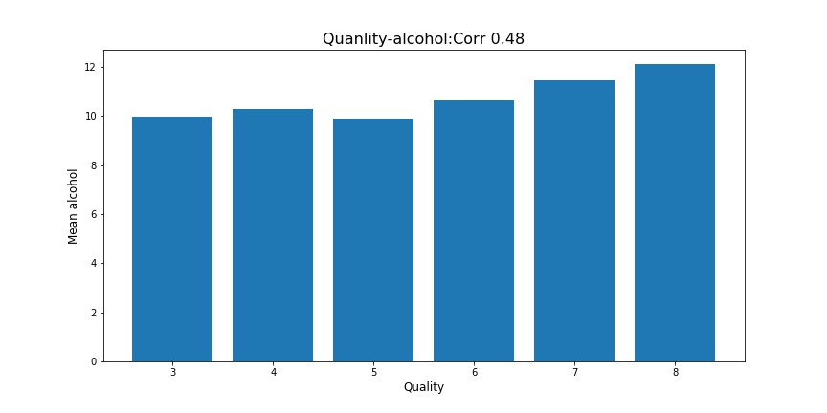

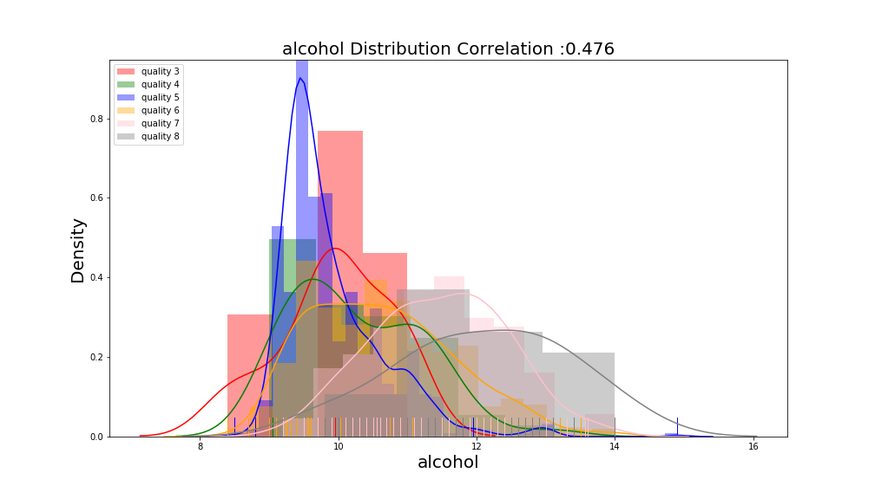
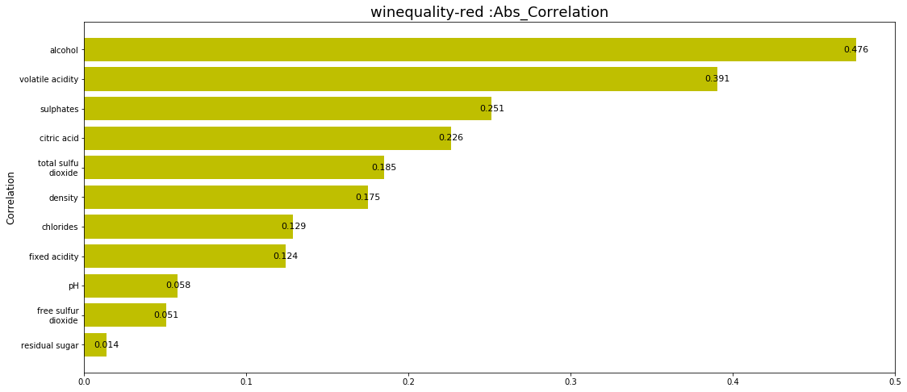
General Steps：part1

Slide 7


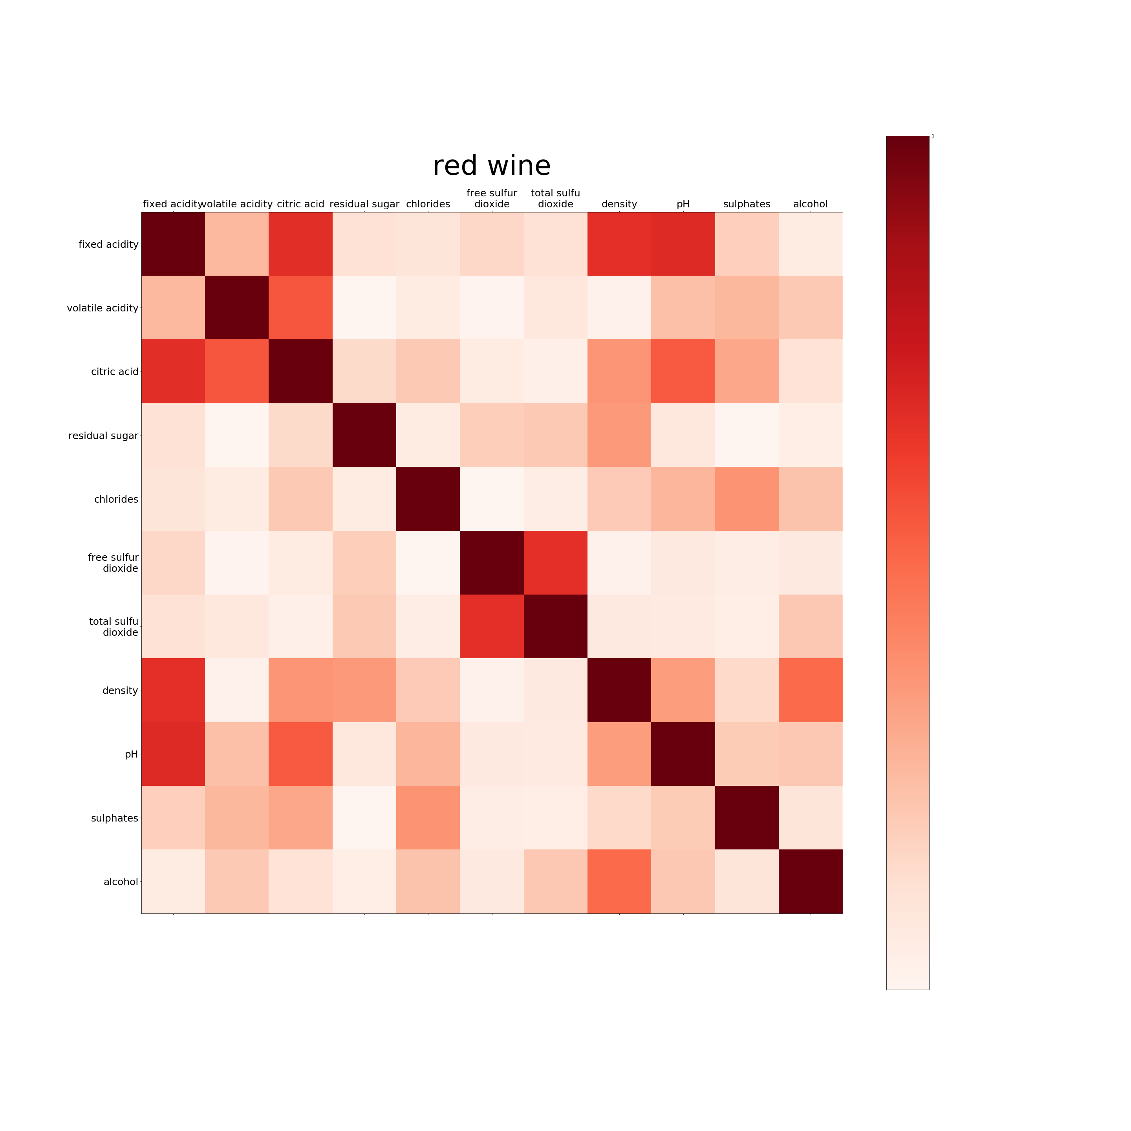
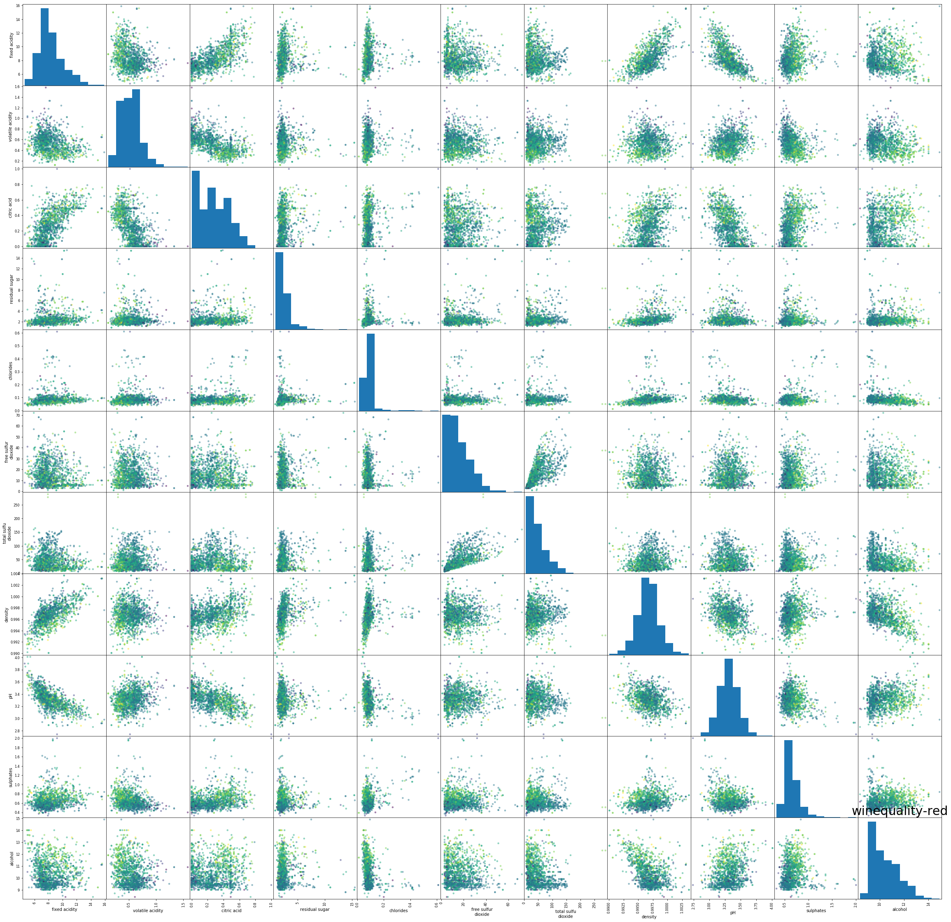

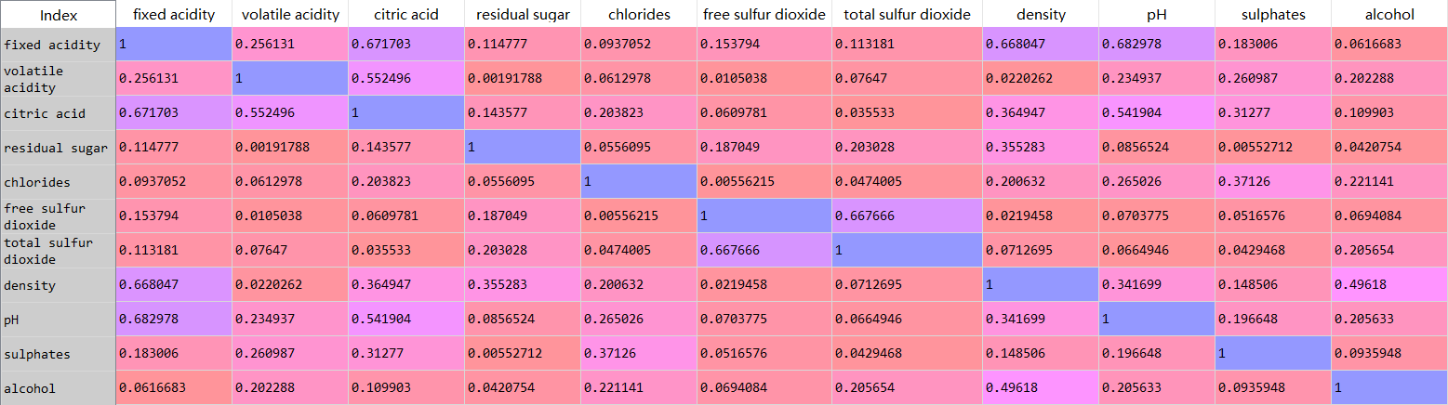
General Steps：part2

Slide 8
part3：Prediction and Evaluation
Red Wine
Red Wine
Red Wine
50%
Logistic Regression
62%
42%
Neural Network
61%
60%
54%
K-Nearest Neighbor
65%
61%
Decision Tree

