Slide 1
2
0
1
5
POWERPOINT TEMPLATE
ADD YOUR SUBTITLE HERE

Slide 2
CONTENTS
1
YOUR TITLE
ADD YOUR TEXT IN HERE
2
YOUR TITLE
目录
ADD YOUR TEXT IN HERE
3
YOUR TITLE
CONTENTS
ADD YOUR TEXT IN HERE
4
YOUR TITLE
ADD YOUR TEXT IN HERE
5
YOUR TITLE
ADD YOUR TEXT IN HERE

Slide 3
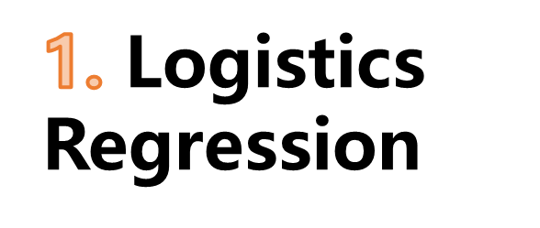


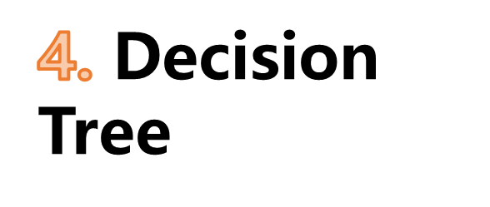
4.Quatity Prediction
75% for training
25 % for testing

Slide 4
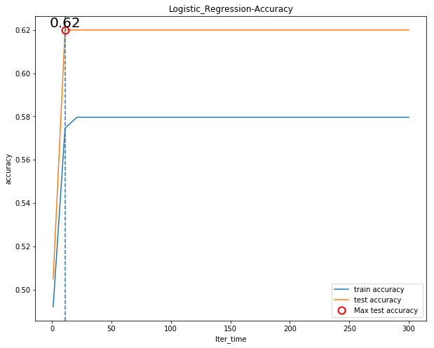
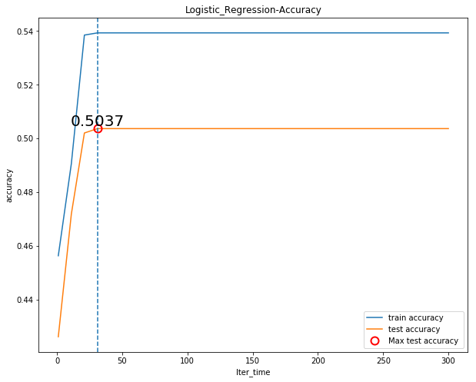
1.Logistics Regression
Red Wine
White Wine

Slide 5
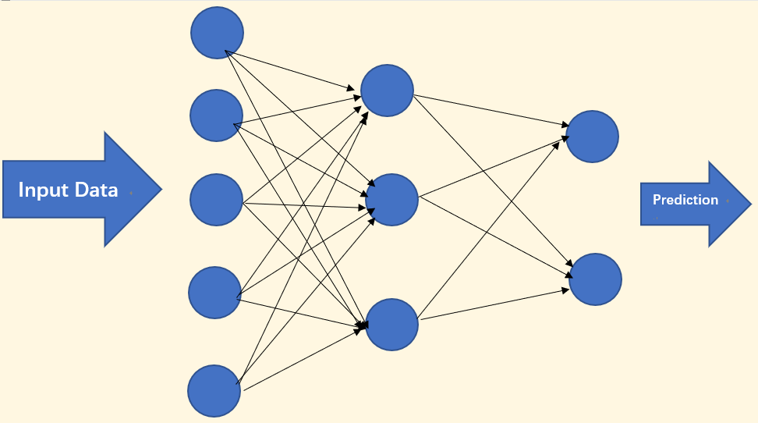
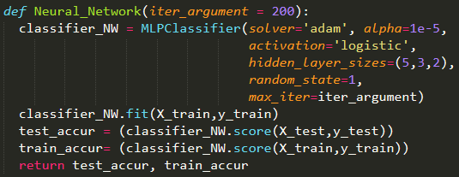
2.Neural Network
Hidden Layer Design

Slide 6
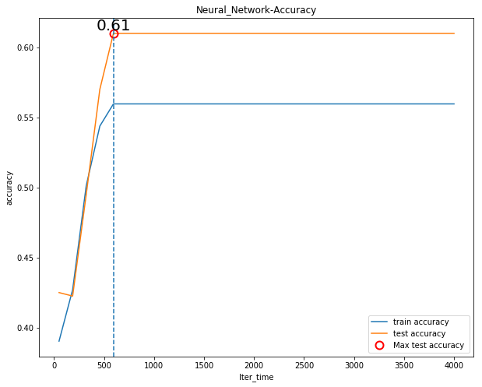
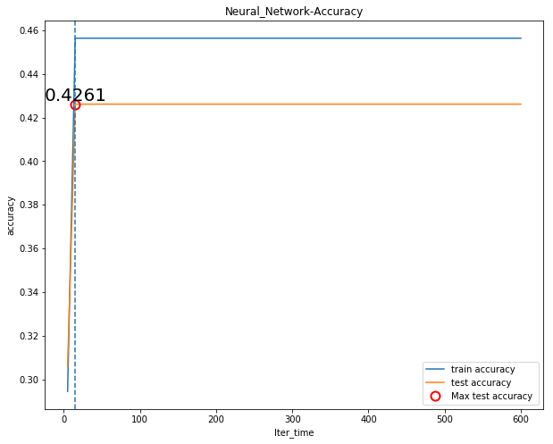
2.Neural Network
Red Wine
White Wine

Slide 7
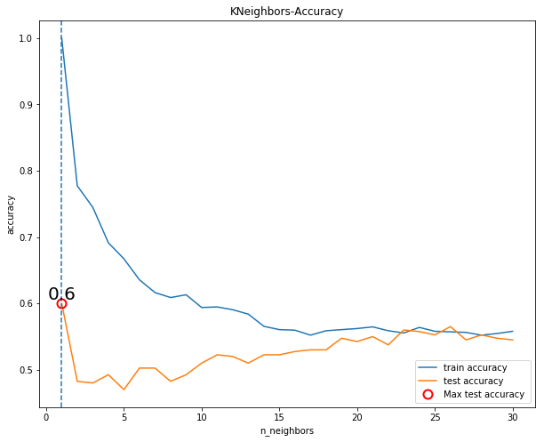
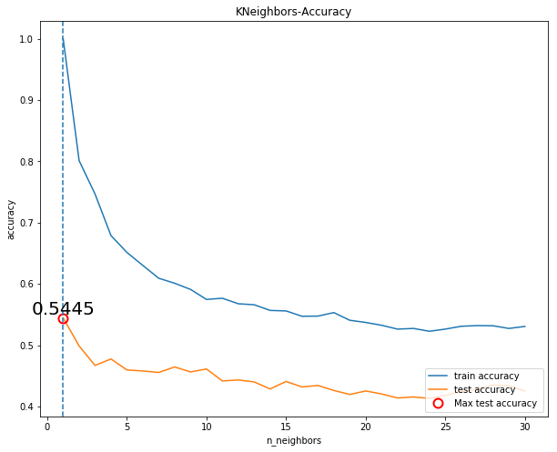
3.K-Nearest Neighbor
Red Wine
White Wine

Slide 8
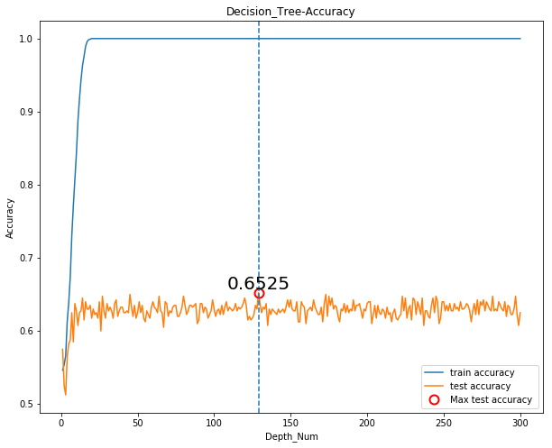
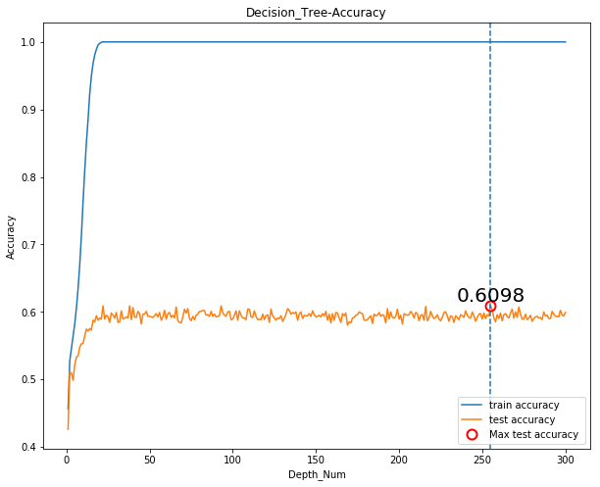
4.Decision Tree
Red Wine
White Wine

Slide 9
Performance Comparison
Red Wine
White Wine
Red Wine
50%
Logistic Regression
62%
42%
Neural Network
61%
60%
54%
K-Nearest Neighbor
65%
61%
Decision Tree

Slide 10
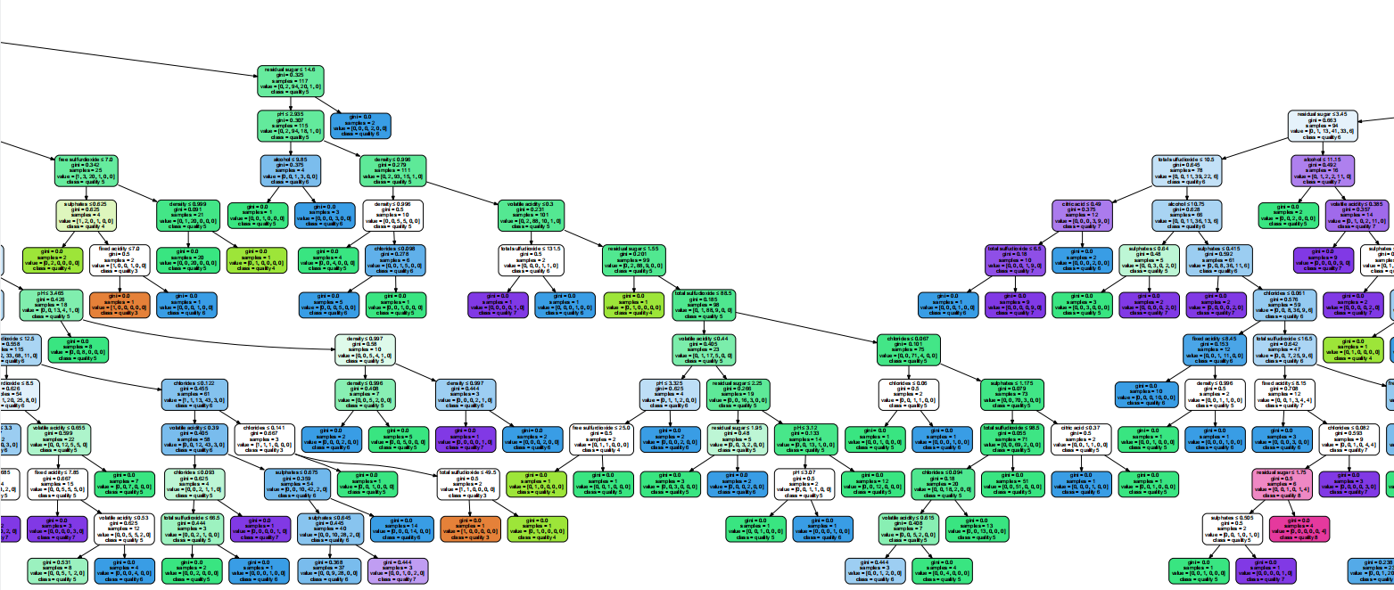
Best Model -Decision Tree
Tree structure

Slide 11
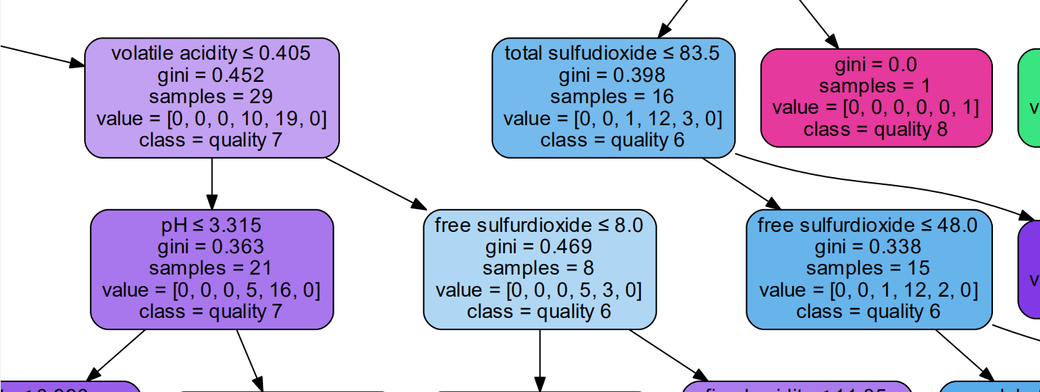
Best Model -Decision Tree
Details

Slide 12
Project Limitations and future works
Reduce unnecessary dimensions
Delete low correlation attribute or PCA
Try other way to calculate attribute influence
Adjust Parameter of Models
such as change activation function or tree splitting criterion ID3 and C4.5
Try more machine learning models
Support Vector Machine

Slide 13
THANKS

