Slide 1
ជីវិត
LifeLink KH
Blood donor matching for Cambodia
Nem Sothea · Moeun Nithvaraman · Suon Pisey · Sourn SAVOURN · Oun Sreynich
Group 2 · Cross-Platform Mobile App Development · Track B · Final Defense
Notes:
30 seconds here. The clock for the whole talk — 30 minutes of slides with a 5-minute demo
sitting inside it at 16:00 — is docs/po/presentations/run-of-show.md, along with what to cut
first if the slot turns out to include the demo rather than sit beside it.
Open with the problem, not the product. One line: "Right now, when a Cambodian hospital
needs blood urgently, someone writes a Facebook post and hopes the right person scrolls
past." Then move on — slide 2 does the work.
Do not read the team list aloud; it is on the slide and the closing slide covers roles.

Slide 2
WHY
បញ្ហា
The Problem
▪ Hospitals and the National Blood Transfusion Center rely on Facebook posts
▪ A post reaches whoever scrolls past — not compatible donors nearby
▪ No way to filter by blood type, distance, or donor eligibility
▪ No way to know if anyone is coming to help
▪ Blood emergencies are measured in minutes; this process is not
LifeLink KH · Group 2 · Track B · Final Defense (Week 16)
Notes:
This is the slide that earns attention. Stay concrete and do not inflate it.
Say: the current process is not a bad app, it is no app. It is a social media post and
hope. Reach without targeting is not reach — most people who see the post have the wrong
blood type or are in the wrong city, and the people who could actually help never see it.
If asked for national statistics: we have not sourced verified figures yet, and we would
rather present none than present numbers we cannot cite. The problem statement comes from
how hospitals currently operate, which is observable without a statistic.

Slide 3
WHO
អ្នកប្រើប្រាស់គោលដៅ
Target Users
▪ Donor — a voluntary blood donor, on the mobile app
▪ Requester — a patient or family member needing blood, mobile
▪ Hospital staff — verifies requests, confirms donations, on web
▪ Administrator — manages users and hospitals, on web
▪ Pilot scope: Phnom Penh first, other provinces later
LifeLink KH · Group 2 · Track B · Final Defense (Week 16)
Notes:
The assignment asks for a target user. Ours is the Donor — everything else exists to serve
that person's decision to help.
Emphasise the split: donors and families are on the phone because emergencies happen away
from a desk. Hospital staff are on the web because they work at a desk with a browser. That
split is why the project has two clients, which slide 6 explains.
The four roles come from the PRD, section 3. Do not invent a fifth on the spot.

Slide 4
WHAT
មុខងារសំខាន់បី
Three Core Features
▪ 1 · Donor register — blood type, location, automatic 56-day eligibility check
▪ 2 · Urgent request broadcast — push to matching donors by type and distance
▪ 3 · History + reminder — tracks cooldown, alerts donor when eligible again
▪ Matching uses ABO/Rh compatibility, not exact blood type only
▪ Khmer and English on both clients, Khmer as the default
LifeLink KH · Group 2 · Track B · Final Defense (Week 16)
Notes:
Exactly three features, as the assignment requires. Say the numbers out loud — "one, two,
three" — so the grader can tick them off.
The fourth bullet is worth pausing on: O-negative can help almost anyone, AB-positive can
receive from anyone. Matching on exact type alone would throw away most of the available
supply. That detail signals we understood the domain rather than guessing at it.
If asked what is NOT in version 1: in-app chat, rewards or gamification, hospital blood
inventory, iOS, and automated medical verification. All are recorded as out of scope in the
PRD, section 2.2 — deliberately excluded, not forgotten.

Slide 5
WHY
ហេតុអ្វីត្រូវជាកម្មវិធីទូរស័ព្ទ
Why Mobile, Not a Website
A blood emergency needs an instant, location-aware push alert on a donor's phone — a website can neither push a time-critical notification nor read real-time GPS.
▪ Push notification — reaches a donor who is not looking at their phone
▪ Real-time GPS — ranks donors by actual distance to the hospital
▪ Installed app — no URL to find while a relative is in a corridor
LifeLink KH · Group 2 · Track B · Final Defense (Week 16)
Notes:
This is a graded requirement — one sentence, defended. Deliver the sentence in bold on the
slide verbatim, then stop. Do not elaborate unless asked.
LIKELY QUESTION: "Couldn't a progressive web app do push notifications?"
ANSWER: Partly, and that is the honest answer. Web push exists, but it is unreliable on the
devices our donors actually use, it cannot read GPS in the background, and it cannot be
distributed through the Play Store — which is this course's M7 requirement. We also need the
app installed and present on the home screen, because a donor who has to remember a URL
during an emergency will not use it.
LIKELY QUESTION: "Then why build a web portal at all?"
ANSWER: Different user, different context. Hospital staff work at a desk and need to
confirm donations; that is a browser job. The mobile app is for the people who are moving.

Slide 6
HOW
ស្ថាបត្យកម្មប្រព័ន្ធ
Architecture
Spring Boot API ──▶ PostgreSQL (Flyway)
▲ ▲
REST/HTTPS │ │ REST/HTTPS
│ │
Flutter app ─┘ └─ Next.js web portal
(donors / patients) (hospitals / admin)
→ Play Store
Backend Spring Boot · PostgreSQL · Flyway
Web Next.js · TypeScript · Tailwind
Mobile Flutter → native Android
Push Firebase Cloud Messaging
Location Google Maps · geolocator
Local dev + CI Docker Compose · GitHub Actions
LifeLink KH · Group 2 · Track B · Final Defense (Week 16)
Notes:
One API, two clients. Say that first; the diagram then reads itself.
The key decision here is Flutter rather than a hybrid wrapper. Flutter builds a native
Android binary, which is what the Play Store requirement at M7 actually needs. We considered
wrapping the Next.js app in Capacitor and rejected it — that is recorded in ADR 0001.
Flyway matters more than it looks: the database schema is versioned migrations, not
hand-edited tables, so every environment gets the same schema in the same order.
If asked why not one codebase for everything: the two clients serve different users in
different contexts, and they map cleanly onto team roles.

Slide 7
HOW
ការគ្រប់គ្រងវិសាលភាព
How We Manage Scope
▪ 19 features registered — 8 in the build, 8 deliberately deferred
▪ Cut against what the course grades, not what interests us
▪ Definition of Done: spec signed off, merged, QA verified, no open bugs
▪ Every architecture choice recorded as a decision record
▪ Deferred features keep their documents — that is our future work
LifeLink KH · Group 2 · Track B · Final Defense (Week 16)
Notes:
This slide answers a question the audience has not asked yet: is this a plan or a wish?
Two things to say here, in this order.
First, we read our own PRD adversarially and found seven promises it made in prose but never
turned into requirements — for example, it said users may request deletion of their data, and
no feature provided it. That is how the registry got to 19.
Second, we then cut it to 8. Nineteen features across thirteen part-time weeks does not fit,
and a plan that does not fit produces eight half-finished features instead of eight working
ones. So we cut against the five things the course grades — authentication, push, GPS, a
relational database, a Play Store release — not against what we personally found interesting.
LIKELY QUESTION: "Why isn't feature X in your app?"
ANSWER: It probably is in docs/scope.md, with the reason. Name one deliberately: account and
data deletion is deferred, and we flag it as a privacy obligation rather than a feature — it
is only acceptable because the pilot runs on our own test accounts, and it comes back first
if a real donor ever uses this.
If asked how we track work: features have stable IDs, so a bug, a test case and a commit can
all point at the same identifier. QA signs off against acceptance criteria, not against a
demo.
Do not spend more than a minute here. It is a credibility slide, not the substance.

Slide 8
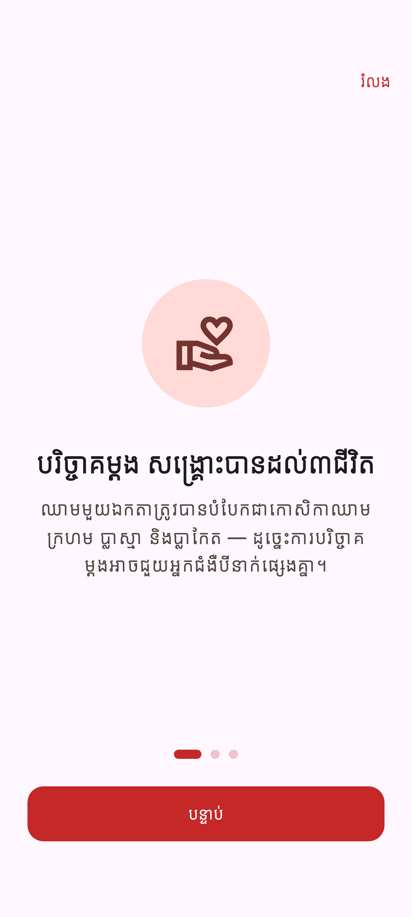
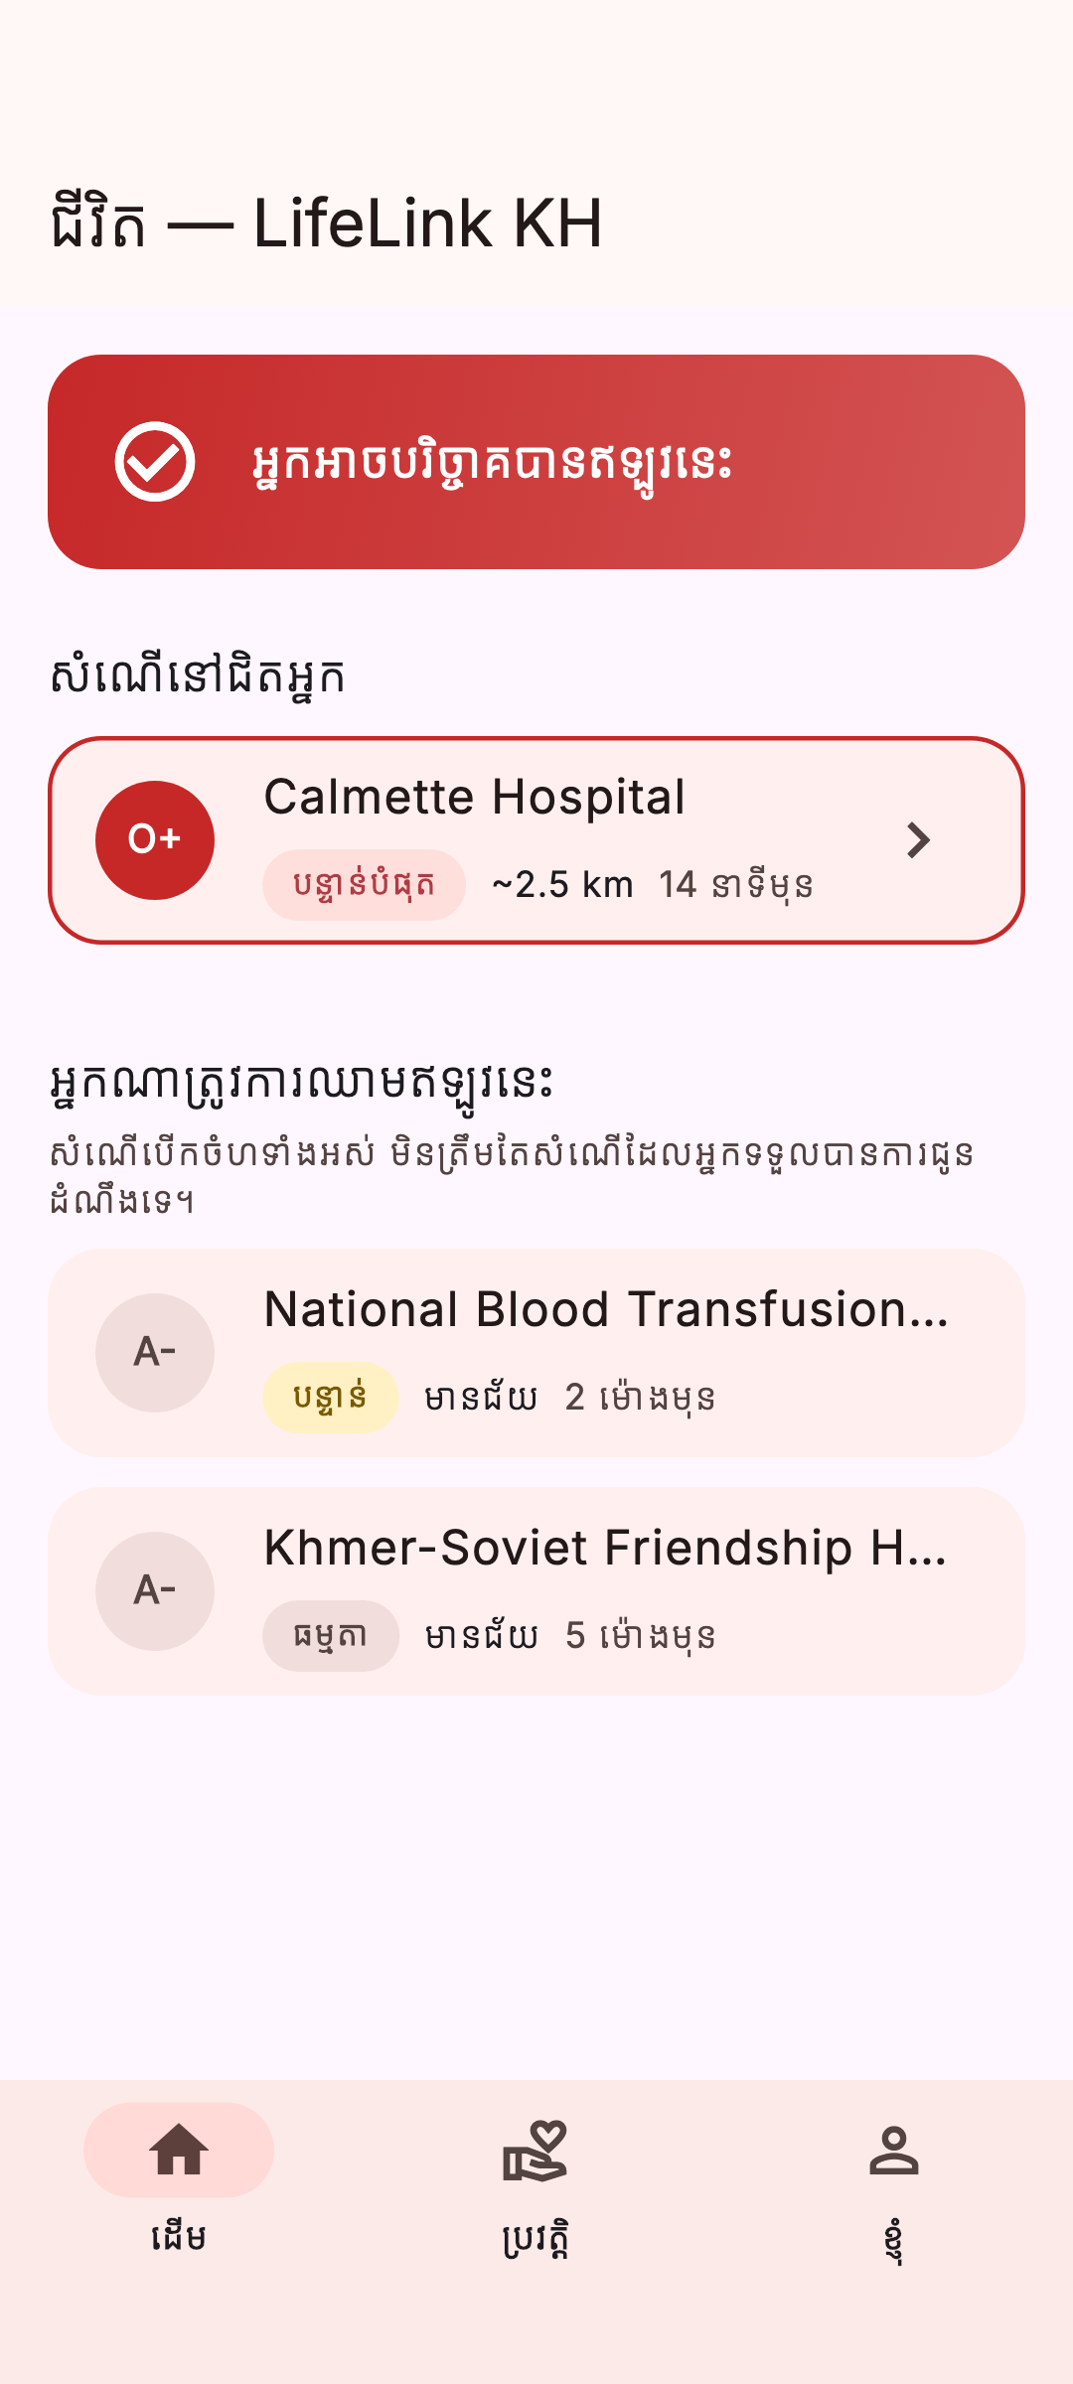
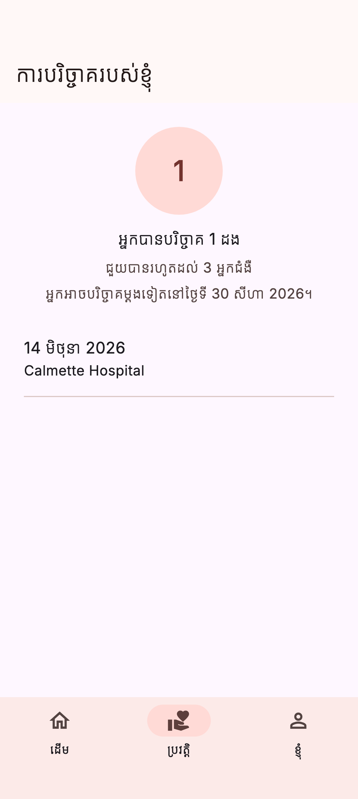
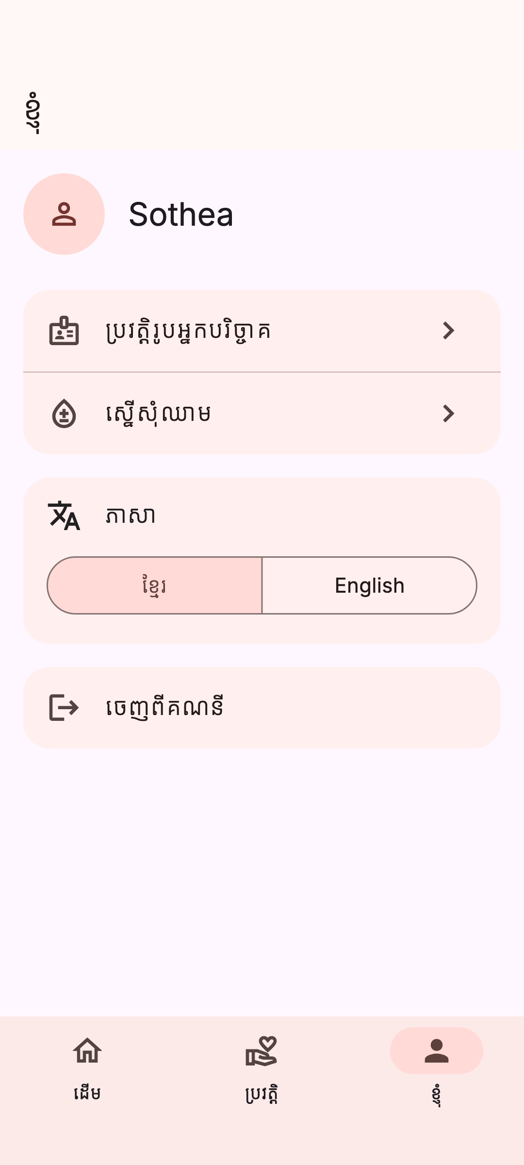
PROOF
អេក្រង់ក្នុងទូរស័ព្ទ
The App, on a Phone
Intro — what the app is, before asking for an account
Home — alerts for you, then who else needs blood
History — what your donations added up to
Profile — blood type, district, eligibility
LifeLink KH · Group 2 · Track B · Final Defense (Week 16)
Notes:
Four screens, Khmer, from a real build on a real device — not mockups, and not the
wireframes from M1. Say that once; nobody believes a screenshot is live, and it costs one
sentence to say the app is running behind it.
Left to right is the donor's actual order: the intro carousel runs once per install
(DEC-011 — the app used to ask for a Google account before saying what it wanted one for),
then home, then the two tabs a returning donor lives in.
Home is worth one extra sentence if the room is quiet: the top half is alerts matched to
you, the bottom half is the public board. GET /matches/me is empty most days by design — a
donor is only matched when someone nearby needs their type — and that emptiness used to be
the whole screen.
If the live demo cannot run in the room, this slide and the next are the fallback. Narrate
them from docs/po/demo-script.md rather than reading the captions aloud.

Slide 9
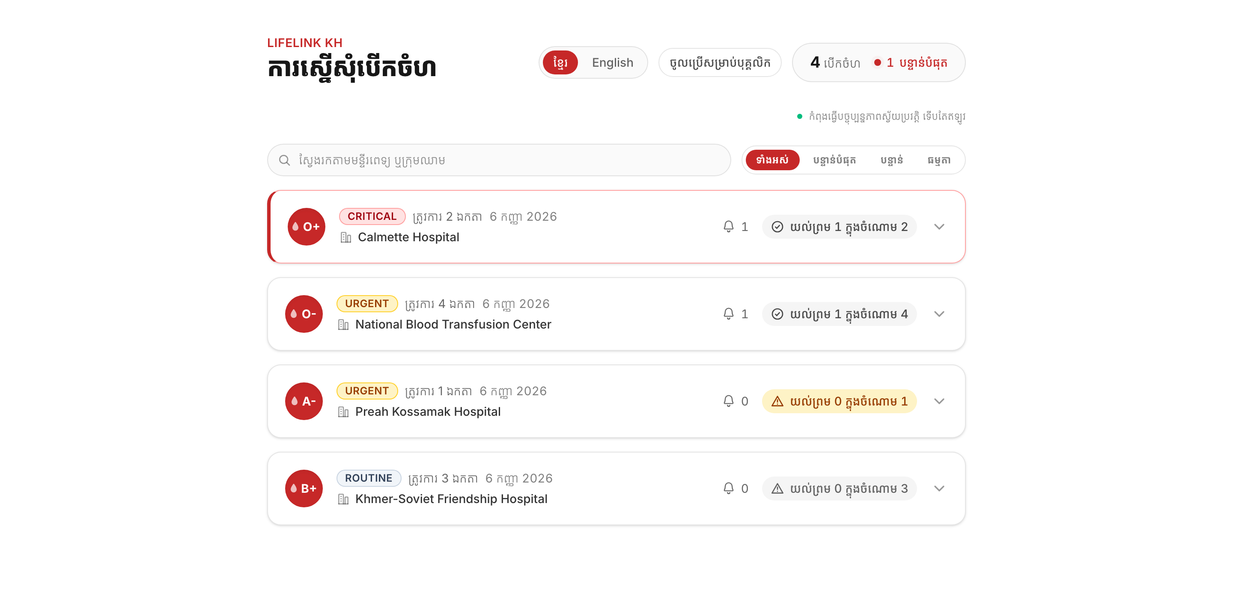
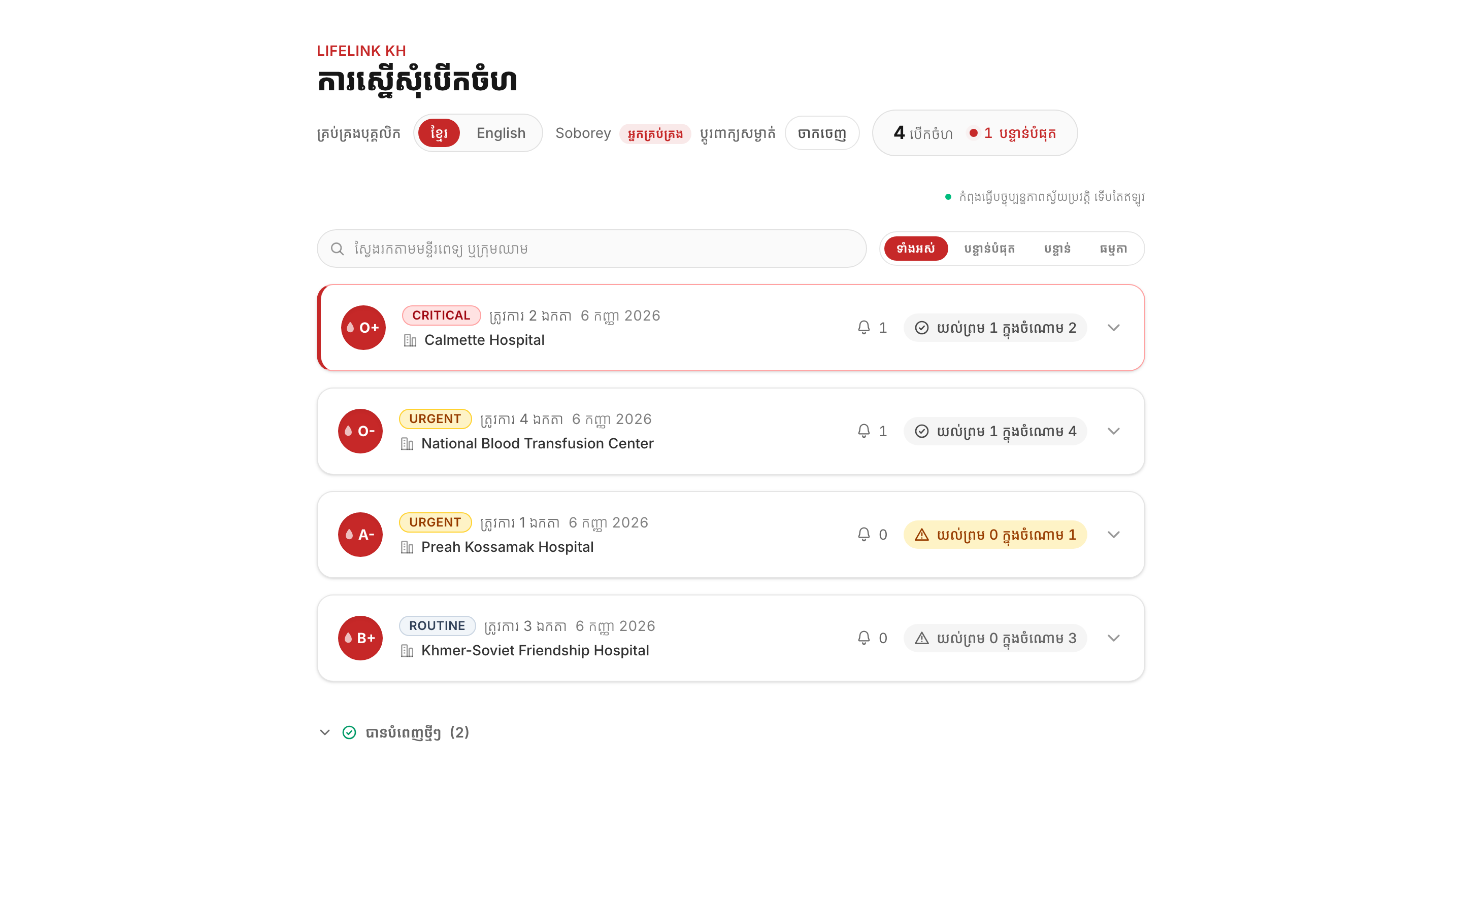
PROOF
អេក្រង់ក្នុងកុំព្យូទ័រ
The Portal, in a Browser
Public board — open requests, no account needed
The same board, signed in as hospital staff
LifeLink KH · Group 2 · Track B · Final Defense (Week 16)
Notes:
The web half, and the answer to "why two clients" made visible: donors are on a phone
because emergencies happen away from a desk, hospital staff are at a desk with a browser.
The public board (left) needs no account at all — a deliberate override of the auth threat
model, argued in DEC-009, so that a request can be shared as a link to someone who has not
installed anything. It also publishes a named donor's blood type and district, which is on
the risks slide as a debt with an expiry, not as a feature.
Staff accounts (right) replaced a JWT pasted into a .env file by hand (DEC-010). Nobody
self-signs-up for the portal: an admin grants access to someone who has already signed in
once as an ordinary user. Mention that only if asked how hospitals get accounts.
All three images are regenerated by the same pass that updates the README's screenshots —
docs/assets/screens/. If a screen changes, regenerate there and re-run this script.

Slide 10
DEMO
ការបង្ហាញផ្ទាល់
Live Walkthrough
▪ Two devices, one browser — donor, requester, hospital portal side by side
▪ Requester creates an urgent request — blood type, urgency, hospital
▪ Push notification fires — instant, targeted, not a Facebook scroll
▪ Donor accepts — and the family's phone is told a donor is coming
▪ Hospital confirms on the portal — the 56-day cooldown starts
▪ Full script: docs/po/demo-script.md — narration for every step
LifeLink KH · Group 2 · Track B · Final Defense (Week 16)
Notes:
This is the hand-off slide, not the demo itself. Say one sentence and switch devices:
"Rather than describe it, let me show it" — then tab away from the deck.
Five minutes, and it does not fit the six-step golden path, so the donor is PRE-STAGED:
registered, signed in, permission granted, sitting on Home before the room walks in. The two
screenshot slides you just showed are what registration looks like — that is why they come
immediately before this one. The demo then runs post → push → accept → push back → confirm →
history, with
the beats and the wording in run-of-show.md. Rehearse it to 4:30; the spare 30 seconds is where
a slow emulator goes.
Everything said out loud from here follows docs/po/demo-script.md, not this slide. That
file has the full narration, plus ready answers for the questions people actually ask
mid-demo (why a phone app and not a website, what happens if nobody accepts, why there's
no map). This slide exists so the deck doesn't go straight from "here's our scope" to "any
questions" with no visible proof in between.
Fallback if the live app cannot run in the room (no network, no projector HDMI for a
device, borrowed machine): the two screenshot slides before this one, or the screen
recording from docs/po/demo-script.md section 8, which is the checklist for the day
before — recording, cold rehearsal, and rotating the seeded portal password before it is
typed on a projector.
LIKELY QUESTION: "What if the demo breaks?"
ANSWER: Say so plainly rather than fighting it in front of the room, then either retry
once or switch to the fallback recording. A visible recovery reads better than a
stalled silence.

Slide 11
WHEN
ដំណាក់កាលការងារ
Milestones · M1 → M7
M1 W3-4 ERD (done), wireframes for the 4 core screens only, API spec for the 8 core FRs
M2 W5-6 Spring Boot init (PostgreSQL, Flyway), Flutter + Next.js init, docker-compose up runs backend…
M3 W7-9 Google Sign-In + donor register + FCM token registration end-to-end (feature 1)
M4 W10-12 Request create + ABO/Rh and distance matching + eligibility computation + request-alert push…
M5 W13 Donation history list + 56-day eligibility status + the single hospital web page (feature 3)
M6 W14 GPS via geolocator, Khmer/English i18n, Android build, iOS build (device/simulator only, DEC-…
M7 W15 Test pass, signed AAB, Flutter app published to Play Store internal testing
Parsed from CLAUDE.md section 4 — the single source for milestone dates
Notes:
Do not read all seven aloud. Name three: M2 is the stack running under Docker, M4 is the
core matching feature end to end, M7 is published to Play Store internal testing by Week 15.
M7 is the assignment's hard requirement, so say the words "internal testing" explicitly.
This table is generated from our planning document, not retyped — which is why it cannot
disagree with the plan. We changed three milestone rows this week when we found that
matching was scheduled before the eligibility check it depends on. The risks slide near the
end covers what's still open now.

Slide 12
WHEN
ស្ថានភាពបច្ចុប្បន្ន
Where We Are Today
▪ M1 through M6 complete — verified live on device, not just tests
▪ Backend: 201 tests green against real PostgreSQL via Testcontainers
▪ Mobile: 201 tests green — iOS and Android both build today
▪ Since M7: two-way push, public board, portal staff accounts, language switch
▪ Demo runs on one local machine — store release sequenced after it
LifeLink KH · Group 2 · Track B · Final Defense (Week 16)
Notes:
Test counts are re-run before every rebuild of this deck, not copied forward — this slide has
said 138, 184 and 196 on the way to today's 201, each one true when it was written. Both
numbers come from full runs on 2026-09-25: `./mvnw verify` with Docker up (201 passed, 0
skipped — the Testcontainers integration tests silently skip when Docker is down, so "0
skipped" is the number that matters, not "BUILD SUCCESS") and `flutter test` (201 passed).
That the two are equal is a coincidence, not a typo.
"Verified live" is a deliberate phrase, not filler: a green suite has been insufficient
before on this project — a schema mismatch once shipped behind a green build because the
integration test that would have caught it skipped without Docker. Every milestone since is
checked on an actual device or browser.
The fourth bullet is work that grew AFTER the graded milestones, in September. Newest first:
two-way push (FR-NOTIFY-003, 2026-09-25) — the family who posted is now told when a donor
accepts; until then push went to donors only and the requester waited in silence. Then the public
request board (DEC-009), portal staff sign-in and the staff lifecycle replacing a
hand-pasted PORTAL_DEV_JWT (DEC-010), the mobile language switch, the intro carousel
(DEC-011), and a push-language bug where every alert went out in Khmer regardless of the
user's setting. None of it is a new FR; docs/scope.md records all of it, including the two
debts it carries. Say "grown, and written down" — the point is that scope changes are
visible, not that nothing changed.
On the last bullet, if asked: the demo you just watched runs entirely on one laptop —
compose for backend, database and portal, the app on an emulator or a tethered phone. The
signed AAB and the Play Store internal-testing upload are written up end to end in
docs/tech-lead/deploy-runbook.md and sequenced AFTER the demo, deliberately (DEC-012). A
store upload changes nothing about what this room sees; what it adds is a distribution
channel, and Play Console identity verification plus review latency is days of waiting
outside our control. Behind the demo, its worst case is a late release. In front of it, its
worst case is a missed defense.
Say the cost of that choice in the same breath, do not let it be found: if M7's clause is
graded literally as a store release, this leaves a graded milestone open today. The runbook
is written, the account is being opened, and executing it is about a day once the demo is
behind us.
LIKELY QUESTION: "Can you show us the app?"
ANSWER: Already did — the two screenshot slides earlier, and the live walkthrough after them.

Slide 13
MEASURE
សូចនាករជោគជ័យ
Success Metrics
▪ ≥ 200 registered donors in Phnom Penh in the first pilot month
▪ ≥ 70% of urgent requests get an acceptance within 60 minutes
▪ Median time from request to first acceptance under 30 minutes
▪ ≥ 50 completed, hospital-verified donations during the pilot semester
▪ Push notification delivery rate ≥ 95%
LifeLink KH · Group 2 · Track B · Final Defense (Week 16)
Notes:
Five numbers, all from the PRD. These are targets we set, not results we have.
The important one is the third: median time to first acceptance. It is the number that says
whether we actually beat a Facebook post, and it is the reason the app exists.
Note that hospital-verified matters in the fourth metric. A self-reported donation is not
evidence; a donation confirmed by hospital staff is.
LIKELY QUESTION: "How will you measure these?"
ANSWER: scripts/metrics.sql — it produces all five off the live database in one run, and it
can be run in front of the room. We originally planned event-capture instrumentation on every
milestone and cut it (DEC-003 withdrawn by DEC-004); for a pilot this size the queries give
the same five numbers for none of the build cost.
Be honest about the limit, in the same breath: the query is real, the pilot data is not. Every
row today is a team-created test account. The output carries a `sample` column next to every
percentage for exactly that reason — quote the denominator out loud, never the percentage
alone. Two of three requests accepted inside an hour is 67% and it proves nothing.
Metric 5 is the one to be careful with: notified_at is set when Firebase ACCEPTS the send, not
when a phone displays it. Call it send-success, not delivery, and say true delivery lives in
Firebase's own reporting. Being precise here costs nothing and being caught overstating it
costs the whole slide.

Slide 14
HONEST
ហានិភ័យ និងការសម្រេចចិត្ត
Risks + Open Decisions
▪ M7 backend runs on a tunneled laptop, not hosted infrastructure
▪ Donor phone numbers unverified — coordination happens through push, not calls
▪ Low donor density early — needs campus and NGO onboarding drives
▪ Account and data deletion deferred — must ship before real donors
▪ Three hospital staff accounts share one password — one credential, three people
▪ Public board shows donor names — deliberate, no consent step yet
LifeLink KH · Group 2 · Track B · Final Defense (Week 16)
Notes:
The Week-2 version of this slide listed two decisions as open that are now closed
(notified-donor count: ADR 0008; the deploy runbook: written) — replaced with what's
actually live today. Point this out if it's a returning audience: closed risks got removed,
not quietly forgotten.
On the tunnel: `API_BASE_URL` is baked into the signed AAB at build time, so internal
testers reach a laptop-hosted backend through ngrok/cloudflared (`DEC-007`), not a real
deploy. Chosen deliberately — a hosted deploy is new infrastructure work M7's timeline
doesn't need, and the pilot is still team-only test accounts. Revisit before any real donor
outside the team uses the app, the same trigger that brings account deletion back into scope.
On the two security bullets. The bigger one closed on 23 September and is worth saying out
loud as a closed item rather than leaving off the slide: until that day a password committed in
migrations V13-V16 opened all four portal accounts, including the ADMIN. V19 replaced those
digests with hashes of random values nobody holds, and the real passwords now come from the
environment at startup (DEC-013). What is left is narrower and is what the bullet says: one
environment value covers three hospital accounts, so three people share a credential. Each row
still carries its own salt, so cracking one does not open the others.
The public board publishes a named donor's blood type and district to anyone with the link
(DEC-009) — safe only because every donor row today is a team-created test account, and there
is no consent step because until that day there was nothing to consent to. Say it rather than
waiting to be asked: a recorded choice with a recorded expiry is a different thing from an
oversight found at the defense.
The language switch is no longer a risk — the mobile app got one on 2026-09-06, alongside a
fix for push alerts that had been going out in Khmer no matter what the user chose. The team-
size question moved to the closing slide, where it is asked directly.
LIKELY QUESTION: "Isn't it a problem that so much is still open this late?"
ANSWER: Compare this list to the Week-2 one — most of that list closed. What's open now is
what's genuinely still open, not a pile that never got smaller.

Slide 15
WHO BUILDS IT
ក្រុមការងារ
Team + One Open Question
Nem Sothea Tech Lead · Flutter · also PO, Security · Docker, CI, release
Moeun Nithvaraman Backend · PostgreSQL · Flyway · matching logic
Suon Pisey Frontend · Next.js portal · API client · i18n
Sourn SAVOURN PO · PRD · briefs · wireframes · feature registry
Oun Sreynich QA · test plan · milestone acceptance · bug tracking
Open question for the instructor: the assignment specifies teams of 3 — we are 5. How should we proceed?
LifeLink KH · Group 2 · Track B · Final Defense (Week 16)
Notes:
End on the question, not on thanks. Ask it directly and then stop talking.
We are raising it rather than waiting to be asked, because the answer may change team
composition or how the work is graded, and it is cheaper to know in Week 2 than Week 10.
If the answer is "split into teams of 3": our roles already divide along clean boundaries —
each person owns a directory and a document set, so a split is a reassignment, not a rewrite.
If asked who does what day to day: there is no separate DevOps or PM role. Tech Lead absorbed that
work — Docker, CI, deploy, release. Definition-of-Done tracking deliberately stayed with QA, because
with Tech Lead also holding Security and co-PO, QA is the only gate outside one person.
The deploy runbook that gap referred to is written (docs/tech-lead/deploy-runbook.md); what is
left of M7 is running it. Product definition is co-held by Sourn and Sothea, so PRD and FR sign-off is
not one person's signature. Tech Lead still holds Security, which concentrates approval there;
QA sign-off is kept independent for exactly that reason.

