Slide 1
Load Balancer Setup
with Nginx on AlmaLinux
Group-2:
1. Suon Pisey
2. Nem Sothea
3. Sourn Savourn
4. Oun Sreynich
5. Moeun Nithvaraman
High-Availability Web Infrastructure | Step-by-Step Guide
April 2026 | AlmaLinux 10 | Nginx 1.26 | PHP-FPM
1 / 16

Slide 2
OVERVIEW
Table of Contents
01
Project Overview
08
Demo : Site A & Site B
02
Why Use a Load Balancer?
09
Demo : Health Dashboard
03
Architecture & Process Flow
10
Demo : Nginx Load Balancer in Action
04
Environment Details
11
Verification & Testing
05
Phase 1 : VM1 - Websites + Dashboard
12
Challenges & Solutions
06
Phase 1 : Configuration & SELinux
13
Extending the Infrastructure
07
Phase 2 : VM2 - Load Balancer Setup
14
Conclusion
2 / 16

Slide 3
01 PROJECT OVERVIEW
Project Overview
Two virtual machines working together as a high-availability web infrastructure
VM1 - Web Server (192.168.1.8)
VM2 - Load Balancer (192.168.1.20)
Site A on port 8081 (Primary Web App)
Site B on port 8082 (Secondary Web App)
Health Dashboard on port 8080
PHP-FPM for dynamic content
Real-time uptime monitoring
Nginx reverse proxy on port 80
Round-robin traffic distribution
Proxies to VM1:8081 and VM1:8082
Automatic failover on backend failure
Single public entry point for users
3 / 16

Slide 4
02 WHY LOAD BALANCER?
Why Use a Load Balancer?
High Availability
Scalability
Traffic Distribution
If one backend fails, traffic is automatically redirected to the healthy one.
Add more backend servers without changing the public endpoint.
Prevents overload on a single server using round-robin, least connections, etc.
Zero-Downtime Maintenance
Simplified SSL/TLS
Take one backend offline while the other continues serving requests.
Terminate certificates on the load balancer only - backends stay simple.
4 / 16

Slide 5
03 ARCHITECTURE
Architecture & Process Flow
Client Request
Request Flow
1. User accesses http://<VM2_IP>
2. Nginx selects a backend (round-robin)
3. Request proxied to VM1 :8081 or :8082
4. Backend responds through Nginx to client
5. Dashboard checks health every 10 seconds
VM2 - Nginx Load Balancer (port 80)
Health Dashboard
upstream: 192.168.1.8:8081 | 192.168.1.8:8082 Algorithm: Round-Robin | Failover: Automatic
Port 8080 Auto-refresh every 10s Monitors both backends Response time in ms
Site A (port 8081)
Site B (port 8082)
Primary Web Application VM1: 192.168.1.8
Secondary Web Application VM1: 192.168.1.8
5 / 16

Slide 6
04 ENVIRONMENT
Environment Details
Operating System
Web Server
Dynamic Content
Firewall
AlmaLinux 10 (RHEL-compatible)
Nginx 1.26
PHP-FPM 8.x
firewalld (optional)
SELinux
VM1 IP Address
VM2 IP Address
Dashboard Port
Enforcing (custom booleans/ports)
192.168.1.8
192.168.1.20
8080 (health monitoring)
6 / 16

Slide 7
05 PHASE 1: VM1
Phase 1: VM1 - Two Websites + Dashboard
Step 1: Install Nginx & PHP-FPM
Step 2: Create Website Directories
sudo dnf install -y nginx php php-fpm
sudo systemctl enable --now nginx php-fpm
Provides web serving + dynamic PHP content
/var/www/site_a/html (Site A)
/var/www/site_b/html (Site B)
/var/www/dashboard/html (Dashboard)
Step 3: Create Sample Pages
Step 4: Configure Nginx Virtual Hosts
index.html with welcome message
uptime.php for live server uptime
Each site has unique styling & identity
site_a.conf - listen 8081
site_b.conf - listen 8082
dashboard.conf - listen 8080 (PHP)
7 / 16

Slide 8
06 CONFIG & SELINUX
Phase 1: Configuration & SELinux
Nginx Virtual Host Configuration (site_a.conf)
SELinux Configuration
server {
listen 8081;
root /var/www/site_a/html;
index index.html index.php;
location ~ \.php$ {
fastcgi_pass unix:/run/php-fpm/www.sock;
include fastcgi_params;
fastcgi_param SCRIPT_FILENAME
$document_root$fastcgi_script_name;
}
}
# Allow custom ports
sudo semanage port -a -t http_port_t \
-p tcp 8081
sudo semanage port -a -t http_port_t \
-p tcp 8082
sudo semanage port -a -t http_port_t \
-p tcp 8080
# Allow network connections
sudo setsebool -P \
httpd_can_network_connect 1
Firewall Rules
Validate & Restart
sudo firewall-cmd --permanent --add-port={8081,8082,8080}/tcp
sudo firewall-cmd --reload
sudo nginx -t && sudo systemctl restart nginx php-fpm
8 / 16

Slide 9
07 PHASE 2: VM2
Phase 2: VM2 - Nginx Load Balancer
Load Balancer Config (/etc/nginx/conf.d/load_balancer.conf)
Step 1: Install Nginx
upstream backend_servers {
server 192.168.1.8:8081;
server 192.168.1.8:8082;
}
server {
listen 80;
location / {
proxy_pass http://backend_servers;
proxy_set_header Host $host;
proxy_set_header X-Real-IP $remote_addr;
}
location /dashboard {
proxy_pass http://192.168.1.8:8080;
}
}
sudo dnf install -y nginx
Step 2: SELinux Boolean
sudo setsebool -P httpd_can_network_connect 1
Step 3: Open Firewall
sudo firewall-cmd --permanent --add-service=http sudo firewall-cmd --reload
Step 4: Start Nginx
sudo systemctl enable --now nginx
9 / 16

Slide 10
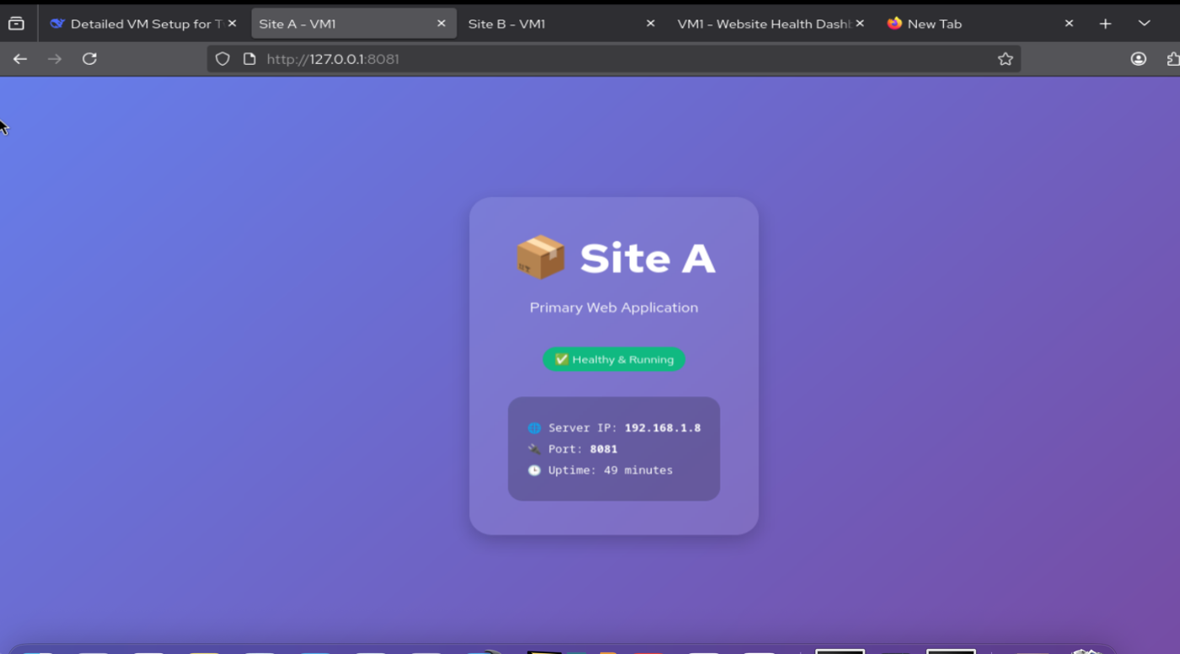
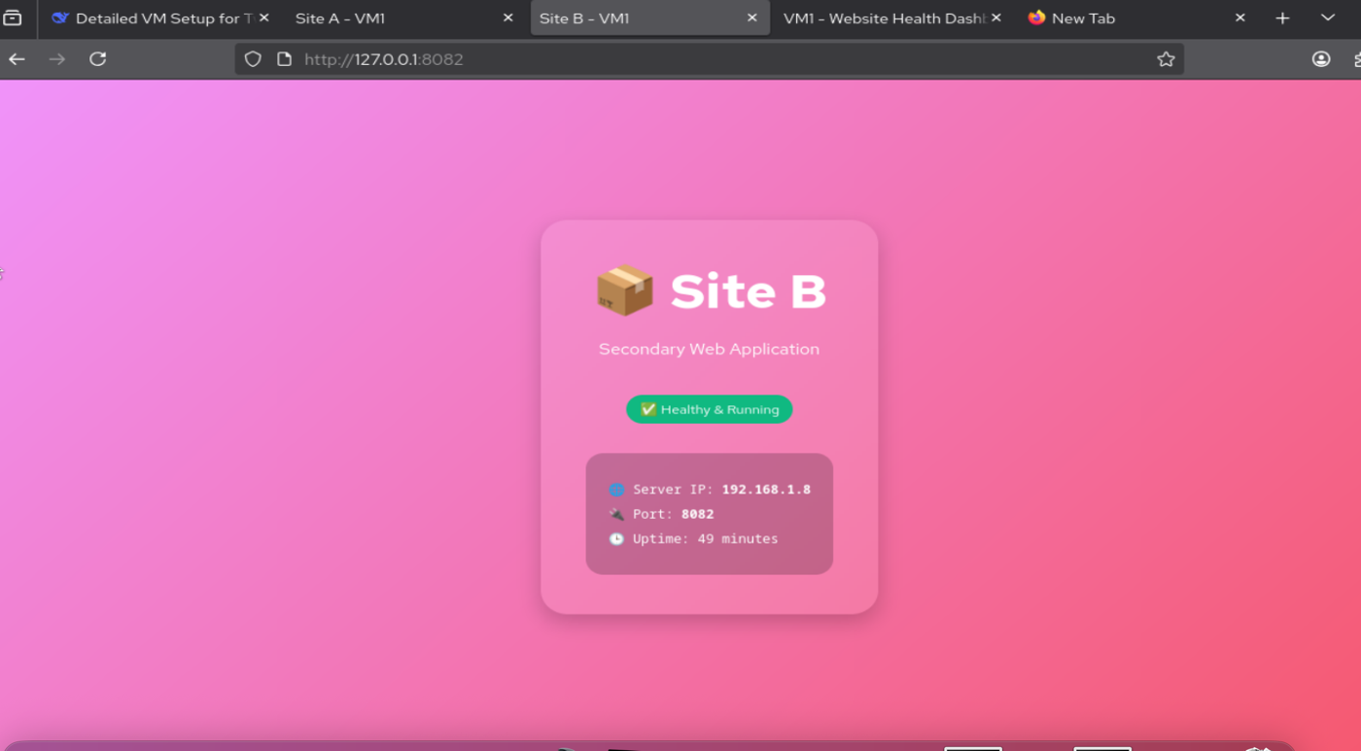
08 DEMO: WEBSITES
Demo: Site A & Site B
Site A - Primary Web Application (port 8081)
Site B - Secondary Web Application (port 8082)
Server IP: 192.168.1.8 | Status: Healthy & Running | Uptime: 49 min
Server IP: 192.168.1.8 | Status: Healthy & Running | Uptime: 49 min
10 / 16

Slide 11
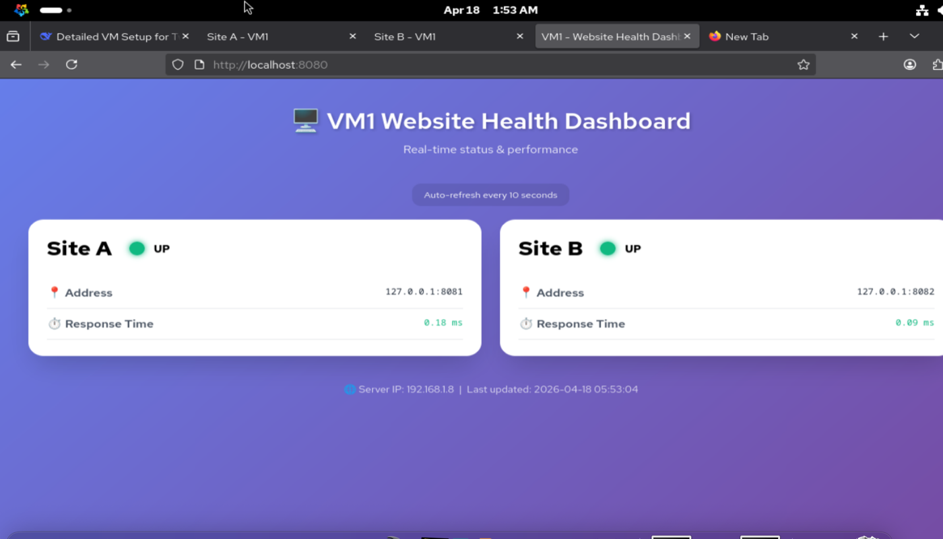
09 HEALTH DASHBOARD
Demo: Health Dashboard
Auto-Refresh
Updates every 10 seconds automatically
Response Time
Measures latency in milliseconds per backend
Status Monitor
Green = UP, Red = DOWN Real-time health check
Dual Backend
Monitors both Site A (:8081) and Site B (:8082)
11 / 16

Slide 12
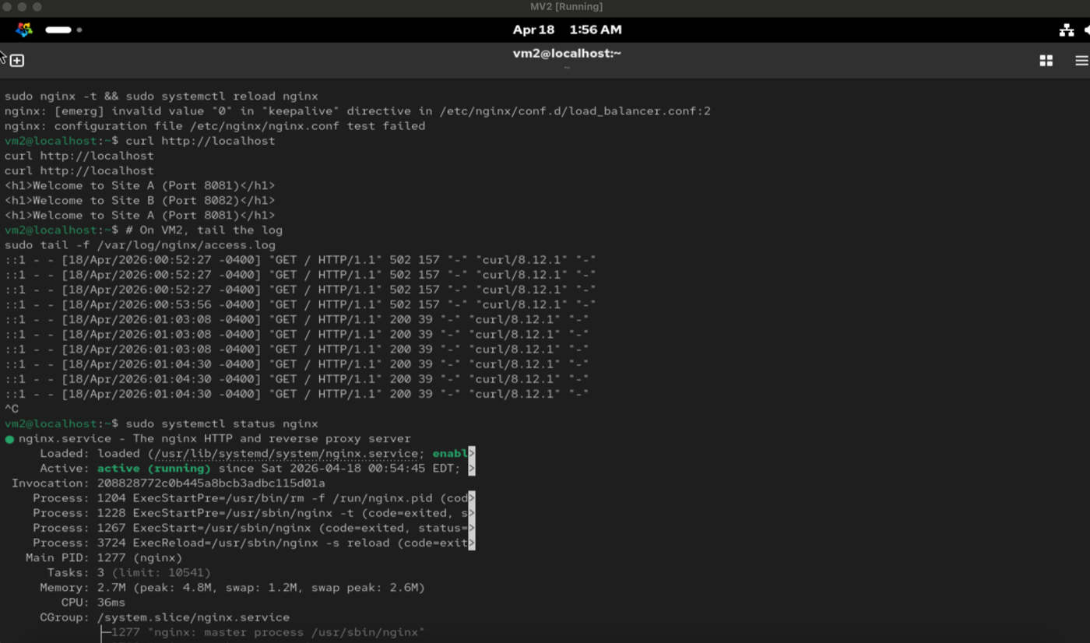
10 LB IN ACTION
Demo: Nginx Load Balancer in Action
Round-Robin Proof
curl shows alternating responses: Site A then Site B then Site A...
Access Logs
tail -f shows requests being distributed across both backends
Service Status
systemctl status nginx shows active (running) on VM2
HTTP 200 OK
All responses return HTTP 200 - backends are healthy
12 / 16

Slide 13
11 TESTING
Verification & Testing
Site A Direct
Site B Direct
curl http://192.168.1.8:8081
curl http://192.168.1.8:8082
Expected: Welcome message or styled page
Expected: Welcome message or styled page
Dashboard
Load Balancer
curl http://192.168.1.8:8080
curl http://192.168.1.20 (x3)
Expected: Health status JSON or HTML
Expected: Alternating: Site A, B, A...
Dashboard via LB
Failure Test
curl http://192.168.1.20/dashboard
sudo systemctl stop nginx (VM1)
Expected: Dashboard HTML page
Expected: VM2 stops routing to failed backend
13 / 16

Slide 14
12 CHALLENGES
Challenges & Solutions
CHALLENGE
CHALLENGE
CHALLENGE
SELinux Blocking Ports
PHP-FPM Network Error
Port 80 Conflict
SOLUTION
SOLUTION
SOLUTION
Used semanage port -a to add custom HTTP ports
Enabled httpd_can_network_connect SELinux boolean
Stopped & removed HAProxy that was occupying the port
CHALLENGE
CHALLENGE
CHALLENGE
Nginx Syntax Errors
Emoji Display Issues
PHP Socket Permission
SOLUTION
SOLUTION
SOLUTION
Replaced config & validated with nginx -t before restart
Added <meta charset="UTF-8"> to all HTML pages
Fixed via SELinux boolean + PHP-FPM socket permissions
14 / 16

Slide 15
13 EXTENDING
Extending the Infrastructure
Add More Backends
Load Balancing Algorithms
Enable SSL/TLS
Simply add new server lines in the upstream block. No client-side changes needed - instant horizontal scaling.
Switch from round-robin to: least_conn; (fewest connections) ip_hash; (sticky sessions) random; (randomized)
Obtain a certificate (Let's Encrypt) and add listen 443 ssl; on VM2. Backends communicate over plain HTTP.
Session Persistence
Logging & Monitoring
Use sticky cookie (Nginx Plus) or ip_hash for session affinity. Keeps user on same backend.
Access logs show which upstream handled each request. Integrate with Grafana or Prometheus for visualization.
15 / 16

Slide 16
14 CONCLUSION
Conclusion
Production-ready, scalable, and monitored web infrastructure
Built entirely with open-source tools (Nginx + PHP-FPM)
Load balancer ensures high availability with automatic failover
Health dashboard provides real-time visibility into backend status
SELinux enforcing mode maintained for enterprise-grade security
All common challenges addressed with practical solutions
AlmaLinux 10 | Nginx 1.26 | PHP-FPM 8.x | April 2026
Thank You!
16 / 16

