Slide 1
🌱
An offline farm-management app
built for Cambodian small-scale farmers.
SmartFarm
Track money. Plan activities.
All in Khmer. All offline.
កសិកម្មឆ្លាតវៃ ងាយស្រួល
Presented by the SmartFarm team

Slide 2

THE PROBLEM
Farming small plots is a daily juggle of memory and guesswork
💰
Untracked money
📅
Missed activities
Income and expenses live in notebooks or memory.
By harvest time, no one knows real profit.
Planting, watering, spraying, harvesting — easy to lose the schedule.
A missed window costs a season.
Patchy connectivity
Rural areas have weak or no internet.
Cloud-only farming apps don't work where farmers actually farm.
SmartFarm — កសិកម្មឆ្លាតវៃ ងាយស្រួល
2 / 15

Slide 3
THE SOLUTION
One offline app, three tools farmers already need
💰
📅
⚙️
Finance Tracker
Calendar & Activities
Settings & Backup
Income & expense in KHR or USD.
Live balance.
Categories, filters, dual currency.
Month grid with activity dots.
Plant / Tend / Protect / Harvest types.
Mark done, never forget.
Light / dark theme.
CSV export, JSON backup & restore.
One tap to clear & start fresh.
100% offline · Khmer-first UI · KHR + USD · No accounts, no data leaves the phone
SmartFarm — កសិកម្មឆ្លាតវៃ ងាយស្រួល
3 / 15

Slide 4
USER FLOW
From first launch to daily use
Splash
Onboarding
Main App
Daily Use
🌱 Brand intro
2 seconds
3 pages
Finance · Plan · Reports
Tab bar with
3 modules
Add txn · Plan task
Backup
First run takes ~30 seconds. Daily use is single-tap actions.
Persistent local storage means the app opens with your data — every time, online or off.
SmartFarm — កសិកម្មឆ្លាតវៃ ងាយស្រួល
4 / 15

Slide 5
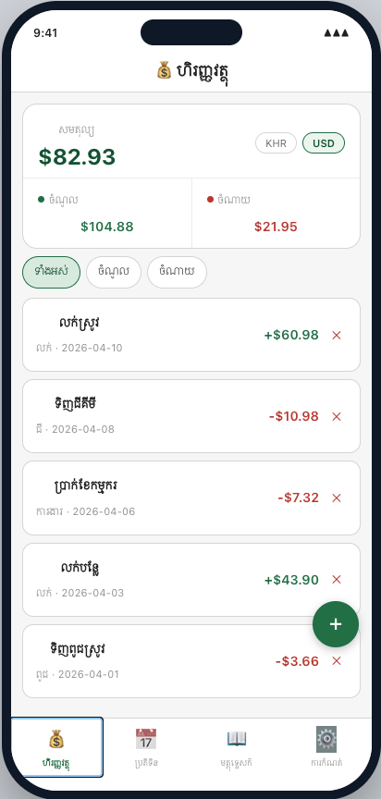
FEATURE 1 / 3
Finance Tracker — track every riel and dollar
Why farmers care
Profit isn't profit until you've counted it.
Most small farmers know revenue but not net.
What it does
• Add income / expense in seconds (FAB → bottom sheet)
• Dual currency: KHR ↔ USD at a stable rate (4,100)
• Categories: ជី, ពូជ, ការងារ, ឧបករណ៍, លក់
• Live balance, income, expense breakdown
• Filter chips: All / Income / Expense
• CSV export for record-keeping or microfinance applications
Add Transaction Flow
Tap + → Income / Expense → Amount + Date + Currency → Category + Note → Save
=
SmartFarm — កសិកម្មឆ្លាតវៃ ងាយស្រួល
5 / 15

Slide 6
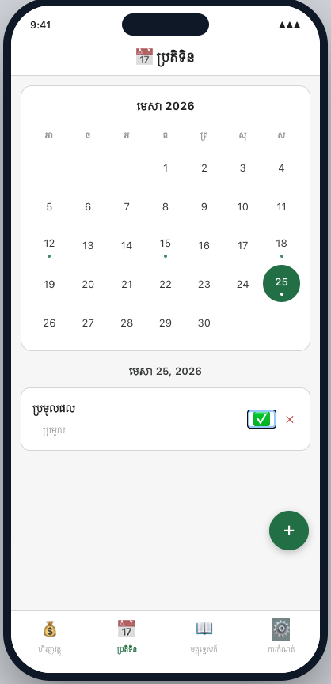
FEATURE 2 / 3
Calendar & Activities — never miss a season
Why farmers care
Crop cycles are unforgiving.
A missed spray window or a late harvest costs an entire season's margin.
What it does
• Month-grid view with dot markers on busy days
• Activity types: ដំណាំ (Plant) · ថែទាំ (Tend) · ការពារ (Protect) · ប្រមូល (Harvest)
• Tap a day → see only that day's activities
• Mark done with a single tap
• Add → Name + Date + Type → save → calendar dot appears
Schedule Activity Flow
Pick day → Tap + → Name + Date + Type → Save → Dot on calendar
SmartFarm — កសិកម្មឆ្លាតវៃ ងាយស្រួល
6 / 15

Slide 7
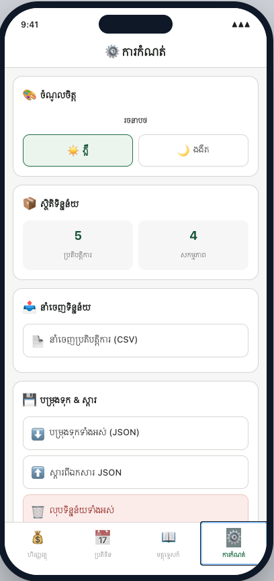
FEATURE 3 / 3
Settings & Backup — own your data
Why farmers care
Phones break. Phones get sold. Phones get reset.
Two seasons of records vanish in one moment without backup.
What it does
• Light / dark theme — usable in bright sun and at night
• Data stats — see counts at a glance
• CSV export — share with cooperatives, MFIs, tax officers
• Full JSON backup — one tap, save to Files / share / cloud
• Restore — load a backup file, replace current data
• Clear all — fresh start, with a confirmation guard
Backup & Restore Flow
Settings → Backup all (JSON) → Save file → (later) Restore from file → Confirm
SmartFarm — កសិកម្មឆ្លាតវៃ ងាយស្រួល
7 / 15

Slide 8
WHY NOW & WHY US
Four reasons SmartFarm is different
[OFF]
Truly offline
[KH]
Khmer-first by design
Every feature works with airplane mode on.
Reference data is bundled. Storage is local.
Cloud-first competitors fail in rural Cambodia.
Every label, every category —
in Khmer. Not a translation layer.
[$$]
Dual currency native
[--]
No account, no friction
KHR and USD both first-class.
Reflects how Cambodian commerce actually works.
Open the app. Use it.
No login, no email, no data leaves the phone.
SmartFarm — កសិកម្មឆ្លាតវៃ ងាយស្រួល
8 / 15

Slide 9
STATUS & TECH STACK
Working demo today, native iOS tomorrow
Today
Next 3 months
• Working React + Vite demo
• Khmer UI, KHR/USD, theme toggle
• All three modules functional
• CSV export + JSON backup live
• Native iOS port (Swift / SwiftUI)
• iOS 13+ deployment target
• CoreData persistence
• Local notifications for activities
Stack: React 18 · Vite · localStorage → SwiftUI · CoreData · iOS 13+
SmartFarm — កសិកម្មឆ្លាតវៃ ងាយស្រួល
9 / 15

Slide 10
THE OPPORTUNITY
A real audience, a real product, a clear path
Cambodia
Smartphones
Connectivity
agriculture-led economy
wide & growing reach
still the blocker
Small farmers form the backbone of rural livelihoods.
Few have any digital tool today.
Entry-level older iPhones are common,
even in rural districts.
Network coverage is uneven; data is costly.
Offline-first is the unlock.
What we have right now
• A working app, not a deck — every feature on the previous slides is built and runs offline today.
• Khmer UX validated against the real domain (categories, activity types).
• A clear, conservative roadmap to a native iOS app supporting devices farmers actually own.
SmartFarm — កសិកម្មឆ្លាតវៃ ងាយស្រួល
10 / 15

Slide 11
COMPETITIVE LANDSCAPE
Why farmers will pick SmartFarm over what they have today
Feature
Paper notebook
Cloud farming app
SmartFarm
(today)
e.g. Plantix
(us)
Works fully offline
✓
✗
✓
Khmer-first interface
✓
✗
✓
Searchable records
✗
✓
✓
Activity reminders & calendar
✗
✓
✓
Backup & restore
✗
✓
✓
Free, no account required
✓
✗
✓
Designed for Cambodian farmers
~
✗
✓
SmartFarm is the only offline, Khmer-first option built specifically for rural Cambodian farmers.
SmartFarm — កសិកម្មឆ្លាតវៃ ងាយស្រួល
11 / 15

Slide 12
Thank you
សូមអរគុណ
Questions, partnerships, pilots — let's talk.
SmartFarm — កសិកម្មឆ្លាតវៃ ងាយស្រួល

