Slide 1
Mass Report Generation Using REST
Nem Stefanovic
Tech Lead, Kooltra Ltd.
nem@kooltra.com
Notes:
Nem Stefanovic, Tech Lead at Kooltra
I am responsible for all aspects of our Kooltra’s technology
Kooltra – Fast growing Toronto Startup
a Foreign Exchange trading platform, built primarily on Force.com Platform
We are empowering small to medium sized FX brokers by offering a complete back office solution
Our system integrates with liquidity providers, financial institutions, and regulators

Slide 2

What we don’t want to do…
[1] https://openclipart.org/detail/172659/pile-of-documents
Notes:
This is supposed to depict a traditional approach to report generation. Metaphore for:
Effort
Manual work
Wasteful resources
What we want:
automation, regular report generation
Don’t want to burden customers, but have the reports available for customers if they want it
Generate the reports within the limits imposed by Salesforce

Slide 3
Problem Statement
How to generate hundreds of customer reports on a daily basis?
How to manage system resources and SF limits when producing hundreds of daily reports?
HTTP timeouts? CPU execution time? Heap size? Pending operations?
getContentAsPDF() function is NOT supported through triggers, scheduled apex, bulk jobs, or SF REST self call-ins. How to use in mass report generation?
Use Cases:
Customer daily financial positions
Sanctions screening for individuals and corporates
Workflow and approval processes
Notes:
The problem is: How do we generate hundreds (or more) reports on a regular basis?
More importantly, how do we manage our time and resource to achieve this task?
Read limits….
And, SF has built-in native PDF generation capabilities. We want to take advantage of this! PDFs also tend to look very professional rather than text documents.
Read use cases:
In kooltra, users trade currencies, we show net positions at the end of a day
We also have sanctions screening to search a database for black-listed names, returns names list with percentage hit. – can automate process to occur bi weekly or monthly.
As part of that process, we retain metadata about each report showing certified hit, and user that approved it.

Slide 4
Key Topics
JSON for metadata management and information transfer
REST and HTTP POST Callouts
Mass customer report generation architecture
Notes:
This talk breaks down as follows:
I begin by discussing JSON, applied to metadata and attachments
Followed by REST and HTTP callouts
REST – allows us (or external client) to execute a function on our org
The first two topics are integral to the mass report generation process
The last point is an overview of the whole report generation infrastructure
We will see examples for each section.

Slide 5
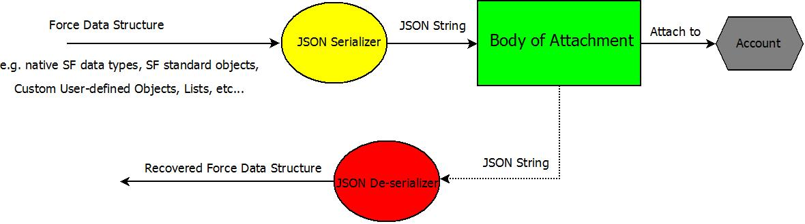
JSON Usage Overview

Slide 6
Introduction to JSON
class Record {
string firstname {get; set;}
string lastname {get; set;}
string entitytype {get; set;}
string thedate {get; set;}
string searchtime {get; set;}
}
Record rec = new Record(); // populate the record fields
String jsonstr = JSON.serialize(rec); // Example to serialize to JSON
Record rec2 = (Record)JSON.deserialize(jsonstr,Record.class); // de-serialize

Slide 7
Using Attachments for Data Storage
Attachment datain;
List<JSONclass> currentlist = new List<JSONclass>();
String pdfpendingjson = JSON.serialize(currentlist);
try {
datain = new Attachment(parentId =accountid,name='PDF_PENDING', body = Blob.valueOf(pdfpendingjson) );
} catch (Exception e) { // Catch errors
datain = new Attachment(parentId = accountid, name='Error', body = Blob.toPdf('Error: Could not create attachment. Exception:'+e) );
}

Slide 8
Demonstration #1 –JSON for Data Storage
We create a JSON class to store a list of records
We create an account
We create an attachment for the account, containing the JSON string
The attachment content is de-serialized and output

Slide 9
REST in the Salesforce Platform
Example:
@RestResource(urlMapping='/BulkPDFAttach/*')
global with sharing class BulkPDFAttach{
@HttpPost
global static void doPost(String indata) {
// code goes here
}
}
Notes:
Here is an example for how to set up a REST layer

Slide 10
HTTP Post - Initialization
Example:
HttpRequest req = new HttpRequest();
req.setEndpoint('https://naXX.salesforce.com/services/apexrest/YourNamespace/BulkPDFAttach/');
req.setMethod('POST');
req.setHeader('Authorization', 'Bearer '+ sessionId);
req.setHeader('content-type', 'application/json');
req.setBody(‘JSON string here…’);
req.setTimeout(60000); // milliseconds -- made large for bulk posts!
// NOTE: ensure you set the remote site setting for your org!!!

Slide 11
HTTP Post – Callout and Response
Http http = new Http();
HttpResponse response = null;
try {
response = http.send(req);
system.debug('response is:'+response);
} catch (System.CalloutException e) {
System.debug('Callout exception Exception:'+e);
}

Slide 12
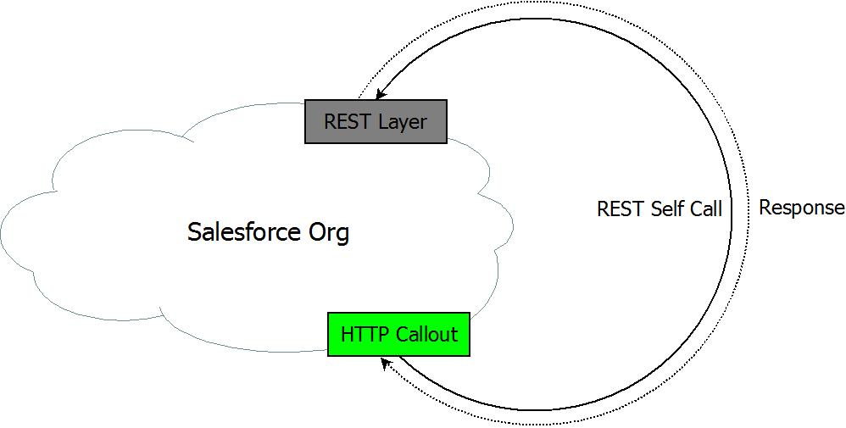
Demonstration #2 – REST and HTTP Callout
We execute an HTTP callout to a REST layer set up on the same org
The HTTP callout information output is displayed
The HTTP response is also displayed

Slide 13
Mass Report Generation Architecture
Putting it all together…
Initiate the bulk report generation process
Click a button
Schedule a job
REST call-in from External Process
Update object JSON metadata
Attach your report data, in JSON, to your objects as attachments
Generate each report as PDF and insert as attachment
Delete previous data attachments

Slide 14
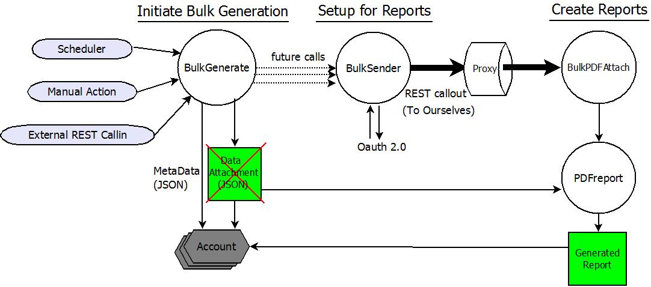
Mass Report Generation Architecture

Slide 15
Demonstration #3 – Mass Report Generation
We do the following….
Create 100 Accounts (AUTO1,AUTO2,….)
Execute our report generation process
Generate 30 lines of random string data across 6 columns to represent report data
Produce some metadata about each report, added to MetaNotes field on each Account

Slide 16
SF Limitations and the PDF generation process
HTTP callout limits
Max 100 callouts in transaction
Max timeout of 120 seconds
Can not callout when pending operations, e.g. DML, future, batch apex, scheduled apex
Heap size max 6MB synchronous, 12MB asynchronous
CPU execution limits
10 second execution time limit
getContentAsPDF() Function
CAN NOT be used in scheduled apex, triggers, batch jobs or e-mail services
CAN NOT be called from REST call-in from same org ---- As of Summer ‘15 Critical Update!
Error – Callout Loop Not Allowed

Slide 17
Summary
We initiate the mass customer report generation process via scheduling, external REST call-in, or manual action
Customer report data is stored as a JSON string in each attachment
Metadata, stored as JSON strings on Account fields, is used to manage the reports
Metadata is passed into the PDF generation page through URL parameters
Customer PDF reports are generated using the attachment contents, and re-attached to their objects as final PDF reports

Slide 18
Questions and Answers
Thank you!

