Slide 1
第三讲：UNIX进程环境、进程控制和进程关系
段翰聪, 李林
Computer Science of UESTC

Slide 2

Contents
Process status transition diagram
Process start and termination
Create and terminate process
Race condition
Process relationship

Slide 3
Process status
用户态运行
1
中断、中断返回
系统调用
中断
返回到
用户态
返回
核心态
运行
9
2
抢先
7
退出
僵死
被抢先
重新调度
进程
睡眠
在内存中就绪
在内存
中睡眠
4
唤醒
3
内存足够
创建
换
出
换
出
换
入
8
fork
内存不足
仅在对换系统中
6
唤醒
5
睡眠且换出
就绪且换出

Slide 4
Linux的进程组织
进程的物理组织结构
Proc 1
Proc 1
Proc 1
Proc 1
Proc 1
Current
进程的逻辑组织结构
P1
P1
P1
P1
P1
P1
P1
P1

Slide 5
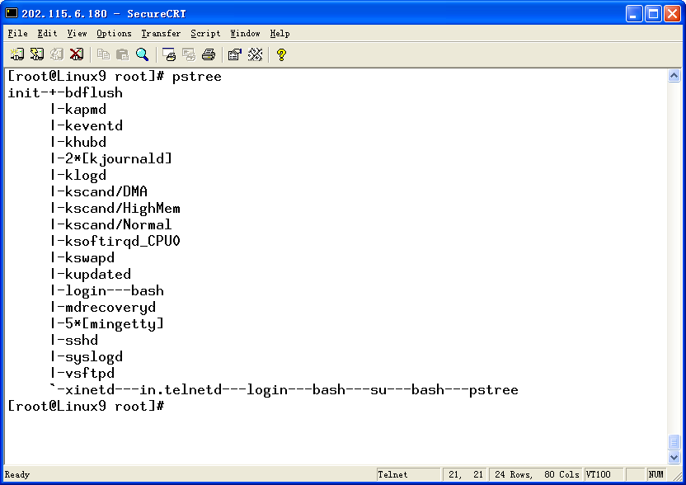

Slide 6
Linux的进程结构
进程状态（State）
调度信息（Schedule）
标识（Identifiers）
进程间通信（Inter-Process Communication）
时间和定时器（Times and Timers）
文件系统（File system）
。。。。
。。。。
虚拟内存（Virtual memory）

Slide 7
Linux的进程结构
process virtual Memory
vm_area_struct
task_struct
vm_end
vm_start
mm_struct
data
vm_flags
mm
count
vm_inode
pgd
vm_ops
vm_next
mmap
code
mmap_avl
mmap_sem
vm_end
vm_start
vm_flags
vm_inode
vm_ops
vm_next
vm_area_struct

Slide 8
Linux的进程结构
inode
fs_struct
task_struct
count
umask
fs
*root
inode
files
*pwd
files_struct
inode
count
f_mode
close_on_exec
f_pcs
open_fs
f_flags
fd[0]
f_count
fd[1]
f_owner
……
f_inode
f_op
file operation
routines
fd[255]
f_version
file

Slide 9
Process start
A C program starts execution with a function main. When a C program is started by the kernel, a special start-up routine is called before main function is called, which obtains address of main and arguments from main. It would copy these information to u-area of process control block .
  int main ( int argc, char *argv[] );

Slide 10
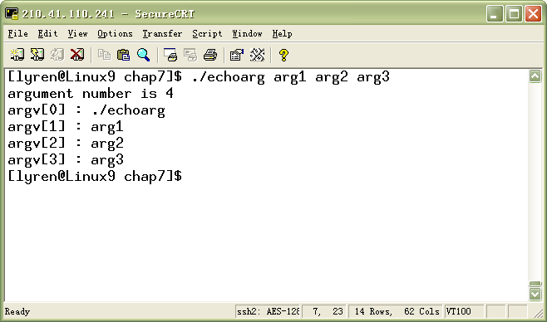
Command-line arguments
int main(int argc, char **argv)
{
int i;
printf("argument number is %d\n",argc);
for(i=0;i<argc;i++)
printf("argv[%d] : %s\n",i,argv[i]);
exit(0);
}

Slide 11
Process termination
There are five ways for process to terminate
  Normal termination
    Return from main；
    Calling exit
    Calling _exit
  Abnormal termination
    Calling abort;
    Terminated by a signal.

Slide 12
exit and _exit Function
  void exit( int status ); /* <stdlib.h> */
  void _exit (int status ); /* <unistd.h> */
Two functions terminate a program normally: _exit ,which returns to the kernel immediately, and exit which performs certain cleanup processing and then returns to the kernel.
The exit function has always performs a clean shutdown of the standard I/O library: the fclose function is called for all open stream. This causes all buffered output data to be flushed.

Slide 13
atexit Function
  #include <stdlib.h>
  int atexit ( void ( *func )(void) );
  Int on_exit ( void (*func)( int, void * ), void *arg );
With ANSI C a process can register up to 32 functions that are automatically called by exit. These are registered by atexit or on_exit function
The exit function calls these functions in reverse order of their registration.

Slide 14
Example: (showtime.c)
#include <limits.h>
#include <stdio.h>
#include <stdlib.h>
#include <unistd.h>
#include <sys/times.h>
static void showtimes(void) {
double ticks;
struct tms tinfo;
if ((ticks = (double) sysconf(_SC_CLK_TCK)) == -1)
perror("Failed to determine clock ticks per second");
else if (times(&tinfo) == (clock_t)-1)
perror("Failed to get times information");
else {
fprintf(stderr, "User time: %8.3f seconds\n", tinfo.tms_utime/ticks);
fprintf(stderr, "System time: %8.3f seconds\n", tinfo.tms_stime/ticks);
fprintf(stderr, " child u time: %8.3f seconds\n",tinfo.tms_cutime/ticks);
fprintf(stderr, "Child sys time: %8.3f seconds\n", tinfo.tms_cstime/ticks);
}
}
int main(void) {
if (atexit(showtimes)) {
fprintf(stderr, "Failed to install showtimes exit handler\n");
return 1;
}
return 0;
}

Slide 15
How a C program is started and terminates
_exit
User
function
register Fun.
return
exit
doesn’t return
call
call
return
User process
_exit
main
function
exit
func.
call
register Fun.
exit
doesn’t return
return
return
call
call
exit
doesn’t return
return
C start-up
routine
Standard I/O
cleanup
_exit
exec
Kernel

Slide 16
Memory layout of a Program
Historically, a C program has been composed of the following pieces:
  Text segment：This is the machine instructions that are executed by the CPU. It is shareable.
  Initialized data segment. It contains variables that are specifically initialized in the program. E.g.：
    int maxcount = 99;
  Uninitialized data segment. It is often called the ‘bss’ segment. Data in this segment is initialized by the kernel to 0 or NULL pointer before the program start executing：
    long sum[1000];
  Stack. This is where automatic variable are stored, along with information that is saved each time a function is called.
  Heap. Dynamic memory allocation takes place on the heap.

Slide 17
Typical memory arrangement
High address
Command-line argument
and Environment variables
stack
heap
Uninitialized data (bss)
initialized to 0 or NULL
by exec
Initialized data
text
read from program file
by exec
Low address

Slide 18
Memory allocation
  #include <stdlib.h> #include <alloca.h>
  void *calloc(size_t nmemb, size_t size); void *alloca(size_t size);
  void *malloc(size_t size);
  void *realloc(void *ptr, size_t size);
  void free(void *ptr);
calloc. Allocates space for a specified number of object of a specified size. The space is initialized to all 0 bits.
malloc. Allocates a specified number of bytes of memory, the initial value of the memory is indeterminate.
realloc. Changes the size of a previously allocated area.
The above three allocation call sbrk, which allocates memory from heap. But alloca <alloca.h> function allocates memory in the stack frame of the caller. This temporary space is automatically freed

Slide 19
Environment variables
The environment variables are usually of the form ‘name = value’ . Their interpretation is up to the various applications.
We can handle environment variables through following functions.
  ＃include <stdlib.h>
  char *getenv ( const char *name );
  int putenv (const char *str )； /* str like “name = string” */
  int setenv ( const char *name, const char *value, int rewrite );
  void unsetenv ( const char *name);

Slide 20
Environment variables (Cont.)
The getenv function returns a pointer to the value of a name=value string.
The putenv takes a string of the form name=value and place it in the environment list. IF the name already exists, its old value was displaced.
The setenv sets name to value. If name exists, then (a) if rewrite is nonzero, the old value was displaced. (b) if rewrite is 0, nothing occurs.

Slide 21
Resource limits
Every process has a set of resource limits, some of which can be quire and changed by following functions.
  #include <sys/time.h>
  #include <sys/resource.h>
  int getrlimit ( int resource, struct rlimit *rlptr );
  int setrlimit ( int resource, const struct rlimit *rlptr );
  struct rlimit {
  rlim_t rlim_cur; /* soft limit: current limit */
  rlim_t rlim_max; /* hard limit: maximum value for rlim_cur*/
  }

Slide 22
Resource limits (Cont.)
resource must be one of:
  RLIMIT_CPU. CPU time limit in seconds. When the process reaches the soft limit, it is sent a SIGXCPU signal.
  RLIMIT_DATA . The maximum size of the process data segment (initialized data, uninitialized data, and heap).
  RLIMIT_FSIZE. The maximum size of files that the process may create. Attempts to extend a file beyond this limit result in delivery of a SIGXFSZ signal.
  RLIMIT_LOCKS. A limit on the combined number of flock() locks and fcntl() leases that this process may establish (Linux 2.4 and later).

Slide 23
Resource limits (Cont.)
  RLIMIT_MEMLOCK. The maximum number of bytes of virtual memory that may be locked into RAM using mlock() and mlockall().
  RLIMIT_NOFILE. Specifies a value one greater than the maximum file descriptor number that can be opened by this process.
  RLIMIT_NPROC. The maximum number of processes that can be created for the real user ID of the calling process.
  RLIMIT_STACK. The maximum size of the process stack, in bytes. Upon reaching this limit, a SIGSEGV signal is generated.
  Etc.

Slide 24
Resource limitation
Three rules govern the changing of the resource limits：
  A soft limit can be changed by any process to a value less than or equal to its hard limit.
  Any process can lower its hard limit to a value greater than or equal to its soft limits. This is irreversible for normal users.
  Only superuser process can raise a hard limit.

Slide 25
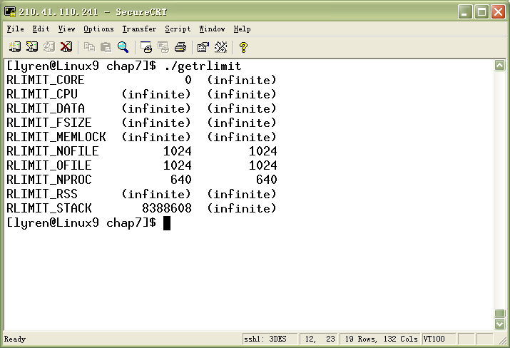
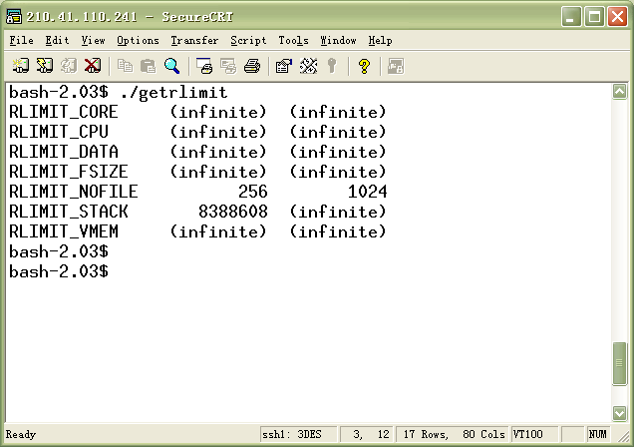
Getrlimit.c
Linux
Solaris

Slide 26
getrusage Function
#include <sys/resource.h>
int getrusage(int who, struct rusage *usage);
Getrusage function returns the current resource usages, for a who of either RUSAGE_SELF or RUSAGE_CHILDREN. The former asks for resources used by the current process, the latter for resources used by those of its children that have terminated and have been waited for.
struct rusage {
struct timeval ru_utime; /* user time used */
struct timeval ru_stime; /* system time used */
……
}

Slide 27
Process identifiers
Every process has some identifiers, such as unique process ID. All processes in system form a process trees. Generally, each process has only one parent .
  pid_t getpid(void); 返回：调用进程的进程ID
  pid_t getppid(void); 返回：调用进程的父进程ID
  pid_t getuid(void); 返回：调用进程的实际用户ID
  pid_t geteuid(void); 返回：调用进程的有效用户ID
  gid_t getgid(void); 返回：调用进程的实际组ID
  gid_t getegid(void); 返回：调用进程的有效组ID

Slide 28
Process identifiers (cont.)
There are some special processes. In tradition Unix system, process ID 0 is usually the scheduler process and if often known as the swapper. Process ID 1 is usually the init process. Process ID 2 is the pagedaemon.
But in Linux system, something is changing.

Slide 29
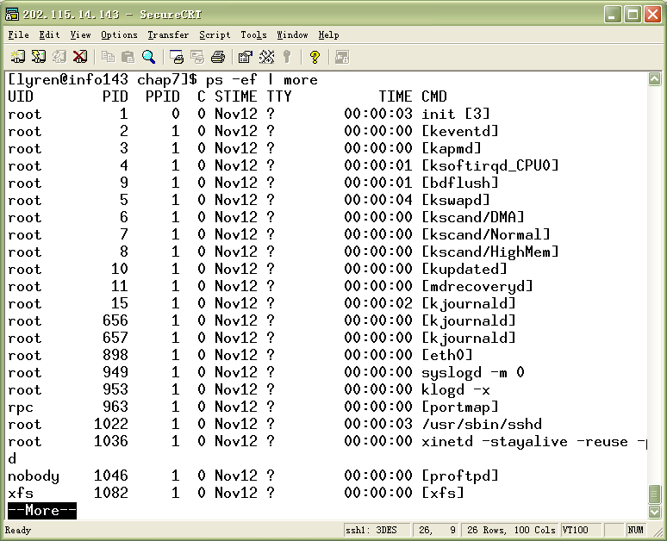
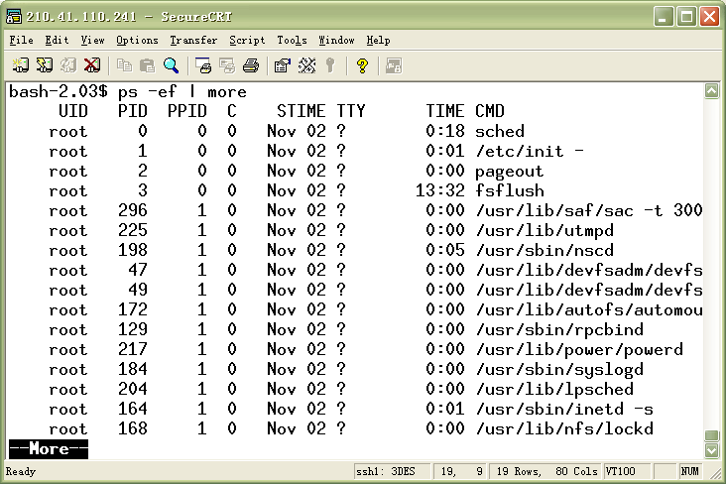
Linux
Solaris

Slide 30
fork Function
  pid_t fork(void);
The only way a new process is created by the Linux kernel is when an existing process call the fork function. This function is called once but returns twice. The return value in the parent is the process ID of the new child while the return value in the child is 0. (why?)
Both the child and parent continue executing with the instruction that follows the call to fork. The child gets a copy of the parent’s data space, heap, and stack (except little information) (Copy-on-write).
In general, we never know if the child starts executing before the parent or vice versa.（尽管Linux内核会有意选择子进程首先执行）

Slide 31
进程描述符(process descriptor)
struct task_struct
unsigned long state;
int prio;
struct task_struct *parent;
struct list_head task;
pid_t pid;
……
struct task_struct
unsigned long state;
int prio;
struct task_struct *parent;
struct list_head task;
pid_t pid;
……
struct task_struct
unsigned long state;
int prio;
struct task_struct *parent;
struct list_head task;
pid_t pid;
……
struct task_struct
unsigned long state;
int prio;
struct task_struct *parent;
struct list_head task;
pid_t pid;
……
进程描述符
任务链表

Slide 32
fork函数工作
调用dup_task_struct为新进程创建一个内核栈；
检查当前用户拥有的进程数是否超出配额；
子进程状态设置为TASK_UNINTERRUPTIBLE;
调用copy_flags()更新flags成员；
调用get_pid()为新进程获取一个有效的PID;
根据传递给clone()的参数标志，拷贝或共享打开的文件、文件系统信息、信号处理函数、进程地址空间和命名空间等；
让父子进程平分剩余的时间片；
最后，作扫尾工作并返回一个指向子进程的指针
fork()
clone()
do_fork()
copy_process()

Slide 33
Difference between parent and child after fork
Properties inherited from parent:
  Real user/group ID, effective user/group ID
  Supplementary group ID
  Process group ID
  Session ID；
  Control terminal.
  Set-user/group-ID
  current work directory
  File mode mask
  Signal mask；
  environment；
  Resource limits
Difference between parent and child：
  return value from fork
  Process ID
  Parent process ID；
  The child’s value for tms_utime, tms_stime ,tms_cutime,tms_ustime are set to 0；
  File locks do not be inherited by child
  Pending alarm are cleared for child

Slide 34
Example
write has not buffer。
int glob = 6; /* external variable in initialized data */
char buf[ ] = "a write to stdout\n";
int main(void)
{
int var; /* automatic variable on the stack */
pid_t pid;
var = 88;
if (write(STDOUT_FILENO, buf, sizeof(buf)-1) != sizeof(buf)-1)
err_sys("write error");
printf("before fork\n"); /* we don't flush stdout */
if ( (pid = fork()) < 0)
err_sys("fork error");
else if (pid == 0) { /* child */
glob++; /* modify variables */
var++;
} else
sleep(2); /* parent */
printf("pid = %d, glob = %d, var = %d\n", getpid(), glob, var);
exit(0);
}
标准IO函数是带缓存的

Slide 35
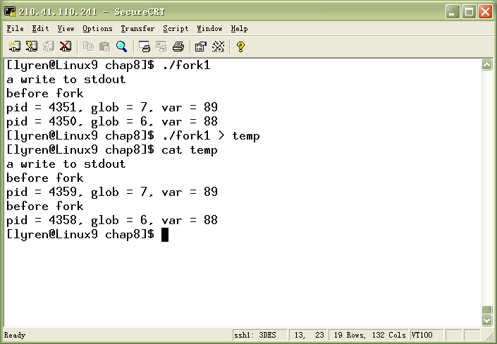
打印两次，因为，标准I/O库对普通输出是全缓存的。

Slide 36
badPID.c
int main(void) {
pid_t childpid;
pid_t mypid;
mypid = getpid();
childpid = fork();
if (childpid == -1) {
perror("Failed to fork");
return 1;
}
if (childpid == 0) /* child code */
printf("I am child %ld, ID = %ld\n", (long)getpid(), (long)mypid);
else /* parent code */
printf("I am parent %ld, ID = %ld\n", (long)getpid(), (long)mypid);
return 0;
}

Slide 37
File sharing
After fork , The parent and child share a file table entry for every open descriptor. So the parent and child share the same file offset. If both parent and child write to the same descriptor, without any form of synchronization, their output will be intermixed.
There are two normal cases for handling the descriptors after a fork.
  The parent waits for the child to complete.
  The parent and child each go their own way. This scenario is often the case with network servers.

Slide 38
Sharing of open files after fork
v-node tables
parent process table
v-node
information
file tables
fd flags
v-node
Information
current file size
file status flags
fd 0:
current file offset
fd 1:
v-node ptr
fd 2:
……
v-node
information
file status flags
v-node
Information
current file size
current file offset
child process table
v-node ptr
fd flags
fd 0:
fd 1:
v-node
information
fd 2:
file status flags
……
current file offset
v-node
Information
current file size
v-node ptr

Slide 39
Two uses for fork
When a process wants to duplicate itself so that the parent and child can each execute different section of code at same time. This is common for network server.
When a process wants to execute a different program. This is common for shells. In this case the child does an exec right after it return from the fork.
Some operating systems combine the operations fork and exec to one function spawn.

Slide 40
processchain.c
int main (int argc, char *argv[]) {
pid_t childpid = 0;
int i, n;
if (argc != 2){ /* check for valid number of command-line arguments */
fprintf(stderr, "Usage: %s processes\n", argv[0]);
return 1;
}
n = atoi(argv[1]);
for (i = 1; i < n; i++)
if (childpid = fork())
break;
fprintf(stderr, "i:%d process ID:%ld parent ID:%ld child ID:%ld\n",
i, (long)getpid(), (long)getppid(), (long)childpid);
return 0;
}

Slide 41
processfan.c
int main (int argc, char *argv[]) {
pid_t childpid = 0;
int i, n;
if (argc != 2){ /* check for valid number of command-line arguments */
fprintf(stderr, "Usage: %s processes\n", argv[0]);
return 1;
}
n = atoi(argv[1]);
for (i = 1; i < n; i++)
if ((childpid = fork()) <= 0)
break;
fprintf(stderr, "i:%d process ID:%ld parent ID:%ld child ID:%ld\n",
i, (long)getpid(), (long)getppid(), (long)childpid);
return 0;
}

Slide 42
exit Function
There are three way for process to terminate normally and two forms of abnormal termination.
  Executing a return from the main.
  Calling the exit function.
  Calling the _exit function.
  Calling the abort，which generate SIGABRT signal.
  When the process receive certain signal, which may be cause the process terminate.
Regardless how a process terminates, the same code in the kernel is eventually executed. This kernel codes closes all the open descriptors, releases the memory.

Slide 43
exit Function (Cont.)
Whenever a process terminate, the kernel goes through all active processes to see if the terminating process is the parent of any process that still exists. If so, the parent process ID of the still existing process is changed to be 1 (init). ( The parent terminate before child does)
Another case: The kernel has to keep a certain mount of information for every terminating, so that the information is available when its parent calls wait or waitpid. Minimally, this information consists of the process ID, the termination status, and the amount of CPU time, etc.. ( the child terminate before its parent)

Slide 44
do_exit()
将task_struct中的标志成员设置为PF_EXITING;
如果进程记帐功能开启，则调用acct_process输出记帐
调用__exit_mm()函数释放进程占用的mm_struct，如果没有其他进程使用它们，则彻底释放；
调用sem_exit()函数。如果进程排队等候IPC信号，则离开队列；
调用__exit_files()、__exit_fs()、__exit_namespace()和__exit_sighand()，以分别递减文件描述符、文件系统数据、名字空间和信号处理函数的引用计数；
设置task_struct的成员exit_code为exit()函数提供的参数；
调用exit_notify()向符进程发送信号，并将其子进程的父进程重新设置为线程组中的其他线程或init进程，并把进程状态设置为TASK_ZOMBIE;
最后，调用schedule()切换到其他进程；

Slide 45
wait and waitpid Function
When a process terminates, either normally or abnormally, the parent is notified by the kernel sending the SIGCHLD signal.
  pid_t wait( int *statloc ）；
  pid_t waitpid( pid_t pid, int *statloc, int options ）；
When a process calls wait or waitpid, it will:
  block (if all of its children are still running) or
  Return immediately with the termination status of a child ( if a child has returned and is waiting) or
  Return immediately with an error.( If it doesn’t have any child)
If the process is calling wait after receiving the SIGCHLD, we expect wait to return immediately.
一个进程需要等待其所有子进程终止？
问题：

Slide 46
删除进程描述符
Wait这函数族都是调用一个系统调用wait4()，它的标准动作是挂起调用进程，直到其中某个子进程退出,然后调用relase_task()：
  调用free_uid()减少该进程拥有者的进程使用计数；
  调用unhash_process()从pidhash上删除该进程，同时也要从task_list中删除该进程；
  调用put_task_struct释放进程内核栈和thread_info结构所占的页，并释放task_struct所占的高速缓存

Slide 47
fanwait.c
int main(int argc, char *argv[]) {
pid_t childpid;
int i, n;
if (argc != 2) {
fprintf(stderr, "Usage: %s n\n", argv[0]);
return 1;
}
n = atoi(argv[1]);
for (i = 1; i < n; i++)
if ((childpid = fork()) <= 0)
break;
while(wait(NULL) > 0) ; /* wait for all of your children */
fprintf(stderr, "i:%d process ID:%ld parent ID:%ld child ID:%ld\n", i, (long)getpid(), (long)getppid(), (long)childpid);
return 0;
}

Slide 48
parentwait.c
int main (void) {
pid_t childpid;
/* set up signal handlers here ... */
childpid = fork();
if (childpid == -1) {
perror("Failed to fork");
return 1;
}
if (childpid == 0)
fprintf(stderr, "I am child %ld\n", (long)getpid());
else if (wait(NULL) != childpid)
fprintf(stderr, "A signal must have interrupted the wait!\n");
else
fprintf(stderr, "I am parent %ld with child %ld\n", (long)getpid(),
(long)childpid);
return 0;
}

Slide 49
chainwaitmsg.c
int main (int argc, char *argv[]) {
pid_t childpid;
int i, n;
pid_t waitreturn;
if (argc != 2){ /* check number of command-line arguments */
fprintf(stderr, "Usage: %s processes\n", argv[0]);
return 1;
}
n = atoi(argv[1]);
for (i = 1; i < n; i++)
if (childpid = fork())
break;
while(childpid != (waitreturn = wait(NULL)))
if ((waitreturn == -1) && (errno != EINTR))
break;
fprintf(stderr, "I am process %ld, my parent is %ld\n",
(long)getpid(), (long)getppid());
return 0;
}

Slide 50
wait and waitpid Function (Cont.)
There are three mutually macros that tell us how the process terminate. They can determine whether the child process was normal exit or abnormal return.
If child process was abnormal return, we can also get the signal number.

Slide 51
wait and waitpid Function (Cont.)
Macro | Description
WIFEXITED(status) | True if status was returned for terminating normal. In this case, WEXITSTATUS(status) can fetch the low-order 8 bit of the exit or _exit.
WIFSIGNALED(status) | True if status was returned for terminating abnormal (by signal), In the case, WETRMSIG(status) can fetch the signal number.
WIFSTOPPED(status) | True if status was returned for a child that is currently stopped. In this case, WSTOPSIG(satus) can fetch the signal number that caused the child stop.

Slide 52
Showreturn.c
void show_return_status(void) {
pid_t childpid;
int status;
childpid = r_wait(&status);
if (childpid == -1)
perror("Failed to wait for child");
else if (WIFEXITED(status) && !WEXITSTATUS(status))
printf("Child %ld terminated normally\n", (long)childpid);
else if (WIFEXITED(status))
printf("Child %ld terminated with return status %d\n",
(long)childpid, WEXITSTATUS(status));
else if (WIFSIGNALED(status))
printf("Child %ld terminated due to uncaught signal %d\n",
(long)childpid, WTERMSIG(status));
else if (WIFSTOPPED(status))
printf("Child %ld stopped due to signal %d\n",
(long)childpid, WSTOPSIG(status));
}

Slide 53
showreturnmain.c
void show_return_status();
int main(void) {
int childpid;
childpid = fork();
if (childpid == -1) {
perror("Could not fork");
return 1;
}
if (childpid > 0)
show_return_status();
else {
fprintf(stderr,"Child process %ld about to sleep\n",(long)getpid());
sleep(5);
fprintf(stderr,"Child process %ld about to exit\n",(long)getpid());
}
return 0;
}

Slide 54
wait and waitpid Function (Cont.)
pid_t waitpid( pid_t pid, int *statloc, int options ）；
The interpretation of the pid argument for waitpid depends on its value.
  pid == -1 : waits for any child process.
  pid > 0 : waits for the child whose process ID equal pid
  pid == 0 : waits for any child whose process group ID equals that of the calling process
  pid < -1 : waits for any child whose process group ID equals the absolute value of pid.

Slide 55
wait and waitpid Function (Cont.)
The options argument lets us further control the operation of waitpid. This argument is either 0 or following value.
  WNOHANG: waitpid will not block if a child specified by pid is not immediately available. In this case, the return value is 0.
  WUNTRACED: If the implementation supports job control, the status of any child specified by pid that has stopped, and whose status has not been reported since it has stoped, is returned.

Slide 56
wait and waitpid Function (Cont.)
The differences between wait and waitpid functions are:
  wait can block the caller until a child process terminates, while waitpid has an option that prevents it from blocking.
  waitpid doesn’t wait for the first child to terminate. It has a number of options that control which process it wait for.
So, waitpid provides three features that aren’t provided by the wait function.
  waitpid lets us wait for one (or group) particular process.
  waitpid provides a nonblocking version of wait.
  waitpid supports job control.

Slide 57
wait3 and wait4 Functions
#include <sys/resource.h>
pid_t wait3(int *status, int options, struct rusage *rusage)
pid_t wait4(pid_t pid, int *status, int options, struct rusage *rusage)
Both return: process ID if OK, 0, or -1 on error.
These two functions allows the kernel to return a summary of resource used by the terminated process and all its child processes.
The resource info includes such as the amount of user CPU time, the amount of system CPU time, and the like.
struct timeval ru_utime; /* user time used */
struct timeval ru_stime; /* system time used */
long ru_msgsnd; /* messages sent */
long ru_msgrcv; /* messages received */
long ru_nsignals; /* signals received */

Slide 58
exec Functions
The fork function creates a copy of the calling process, but many applications require the childprocess to execute code that is different from that of the parent. The exec family of functions provides a facility for overlaying the process image of the calling process with a new image.
  int execl( const char *pathname, const char *arg0, ……);
  int execv( const char *pathname, char *const argv[] );
  int execle( const char *pathname, const char *arg0,……, char *const envp[] );
  int execve(const char *pathname, char *const argv[], char *const envp[] );
  int execlp( const char *filename, const char *arg0, ……);
  int execvp( const char *filename, char *const argv[]);
What’s difference?
若filename中
无’/’,则按搜索
路径搜索程序

Slide 59
Relationship of the six exec
execlp
execl
execle
build argv
build argv
build argv
execvp
Try each
PATH prefix
execv
use
environ
execve
(系统调用)

Slide 60
exec Functions (Cont.)
Properties that the new program inherits from the calling process.
  process ID and parent process ID
  real user ID and real group ID
  supplementary group IDs process group ID
  session ID controlling terminal
  time left until alarm clock current work directory
  root directory file mode create mask
  file locks process signal mask
  pending signals resource limits
  tms_utime, tms_stime, tms_cutime, tms_cstime

Slide 61
exec Functions (Cont.)
The handling of open files depends on the value of the close-on-exec flag for each descriptor. Note that the default is to leave the descriptor open across the exec unless we specifically set the close-on-exec flag using fcntl. （fcntl\F_SETFD\FD_CLOEXEC）
Note that the real user ID and real group ID remain the same across the exec, but the effective IDs can change, depends on the status of the set-user-ID and the set-group-ID bits for the program file that is executed. If the set-user-ID bit is set, the effective user ID becomes the owner ID of the program file. Otherwise, the effective user ID is not changed.

Slide 62
Example
char *env_init[] = { "USER=unknown", "PATH=/tmp", NULL };
int main(void)
{
pid_t pid;
if ( (pid = fork()) < 0)
err_sys("fork error");
else if (pid == 0) { /* specify pathname, specify environment */
if (execle("echoall",
"echoall", "myarg1", "MY ARG2", (char *) 0,
env_init) < 0)
err_sys("execle error");
}
if (waitpid(pid, NULL, 0) < 0)
err_sys("wait error");

Slide 63
if ( (pid = fork()) < 0)
err_sys("fork error");
else if (pid == 0) { /* specify filename, inherit environment */
if (execlp("echoall",
"echoall", "only 1 arg", (char *) 0) < 0)
err_sys("execlp error");
}
exit(0);
}
int main(int argc, char *argv[])
{
int i;
char **ptr;
extern char **environ;
for (i = 0; i < argc; i++) /* echo all command-line args */
printf("argv[%d]: %s\n", i, argv[i]);
for (ptr = environ; *ptr != 0; ptr++) /* and all env strings */
printf("%s\n", *ptr);
exit(0);
}
echoall

Slide 64
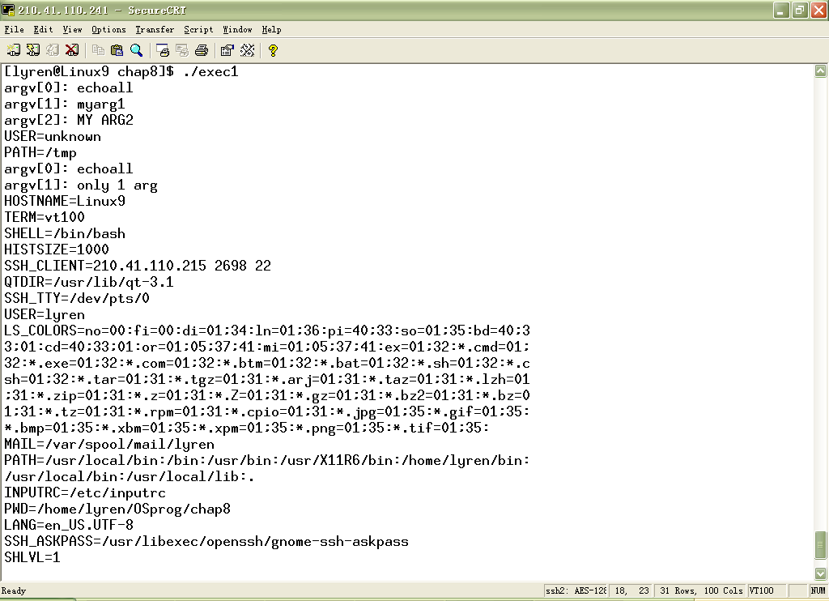
第二次调用execlp
Linux

