Slide 1
Real-time prediction of mortality, readmission, and length of stay using electronic health record data
Emory Biomedical Informatics Journal Club
Presented by: Myles McCrary
2/17/16

Slide 2
Introduction and Background
About me
Approach to choosing paper
Significance and background of the paper
Previous models
Few studies update predictions as new information about patient comes in
Many use history of health care utilization as proxies for clinical status
Few studies look at length of stay across all conditions
Most models predict only a single outcome within a given time period

Slide 3
Objectives of Dr. Cai’s Model
Predictive model for real-time predictions of length of stay, mortality, and readmission for hospitalized patients using electronic health records (EHRs)
Simultaneous estimation of sequence of future daily probabilities which are updated as more information comes in
Provide a finer-grained longitudinal forecast of patient status

Slide 4
Study Methodology
Data
Electronic health records (EHRs) from 32634 patients admitted to a Sydney metropolitan hospital via the ED over a 2.5 year time period
Data linkage between hospital EHRs and New South Wales data sets
Each patient: 1 year history, 6 month postadmission records, ED visits, deaths
32634 patients total
24625 patients for training set
8009 patients for test set
1.5 years
1 year
Time

Slide 5
Study Methodology
Variables
Static: demographics, patient history, administrative info
Dynamic: days already in hospital, ward type, lab/path reports
Wards correlated to major diagnostic categories (readily available in real time as opposed to codes)
Patient comorbidities estimated using codes from patients’ previous hospital admission → only 31%
Only cancer patients and patients with mental health conditions included
Patient outcomes
Probability of being in hospital, discharged (“at home”) or dead during each of the 7 days following an update

Slide 6
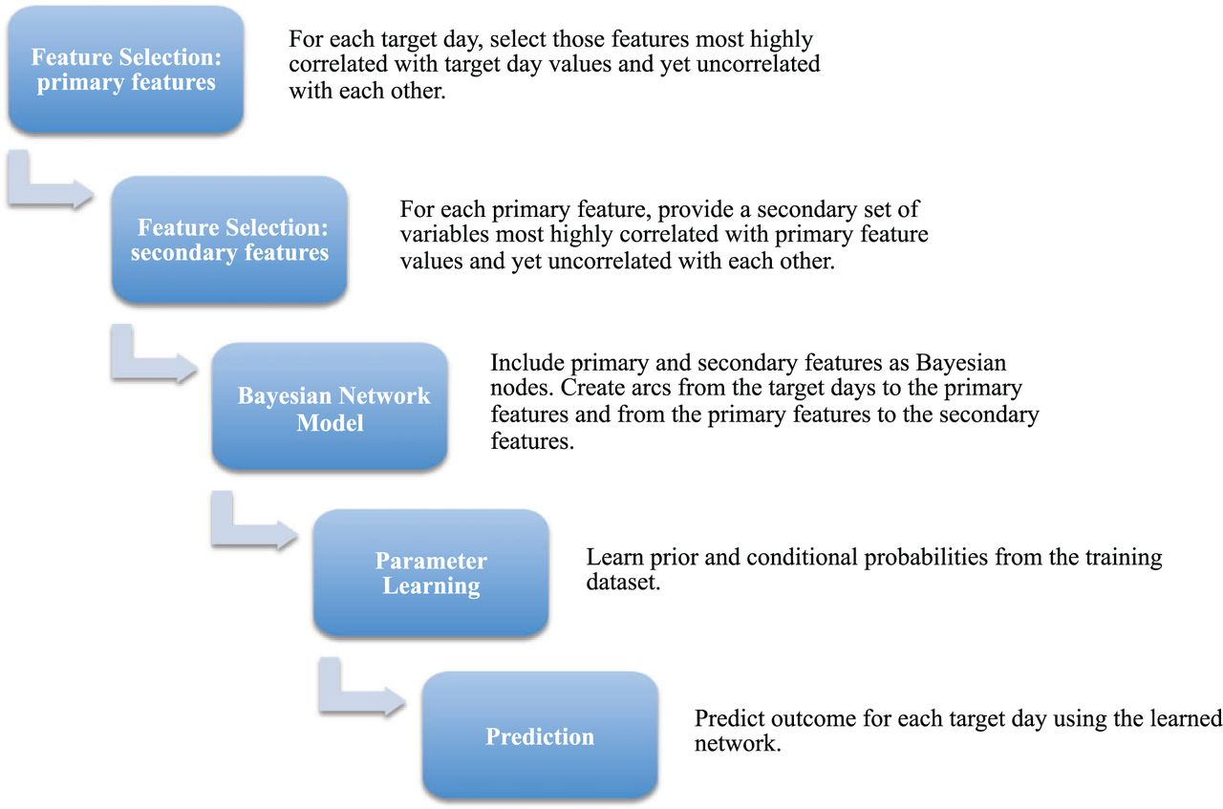
Model Generation (Figure 2)
Feature selection algorithm
Correlation-based feature selection approach and a “best-first search” algorithm
Feature subsets searched by a “greedy hill-climbing” algorithm augmented with a backtracking facility
Product: selected features most highly correlated with the output classes, but not correlated with each other
Notes:
Correlation feature selection: good feature subsets contain features highly correlated with classification, but uncorrelated to each other
Best-first search: algorithm that expands the most promising node first
Hill-climbing algorithm: iterative algorithm that starts with an arbitrary solution, then attempts to find a better solution by incrementally changing a single element→if better, repeat until no further improvements found
Greedy: find local optimal choice at each stage with hope of finding global optimum

Slide 7
Model Generation (Figure 2)
Representation of features with probability of an outcome
Nodes: 7 target days, selected primary features, selected secondary features
Arcs: created from target days to selected primary features, and from primary features to secondary features
Notes:
Bayesian network: probabilistic graphic model that represents a set of variables and their conditional dependencies in graphical form
Nodes: represent random variables
Arcs: represent direct dependencies between nodes (variables)

Slide 8
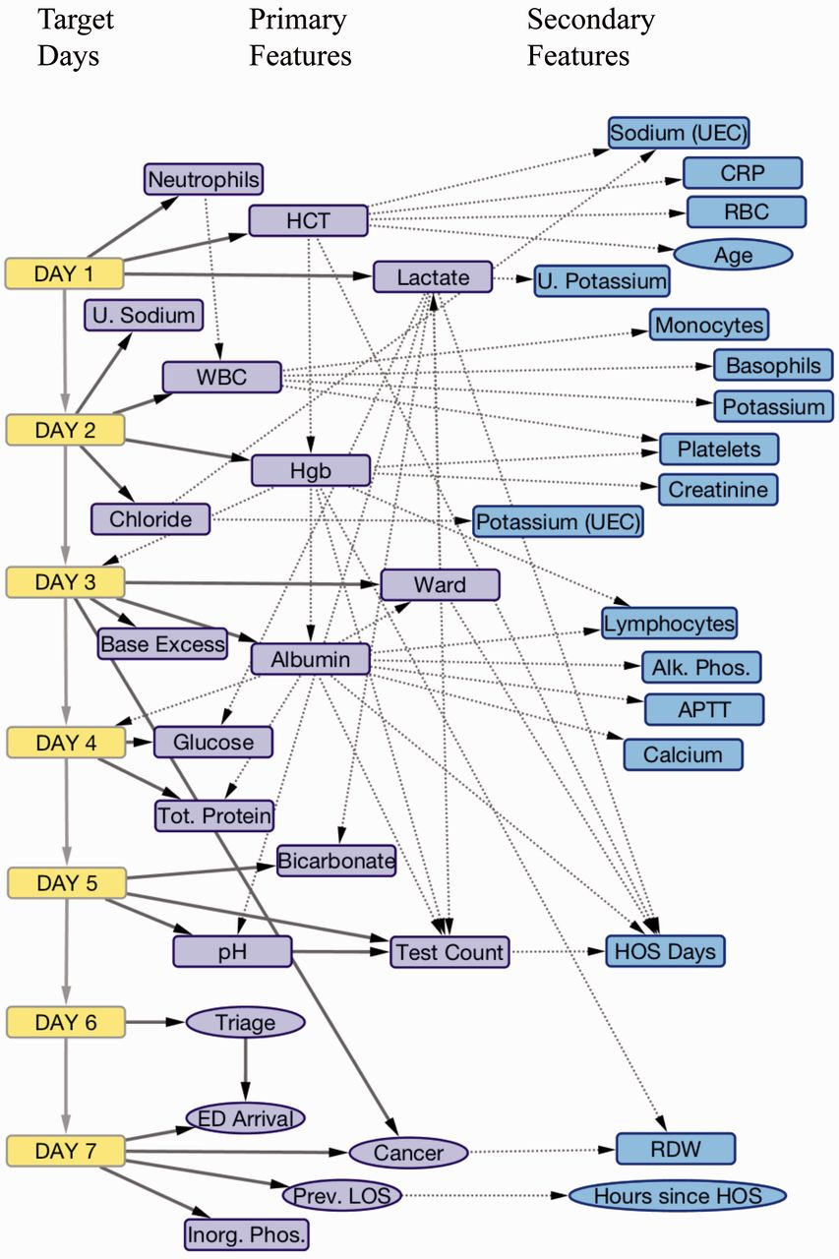
Bayesian Network

Slide 9
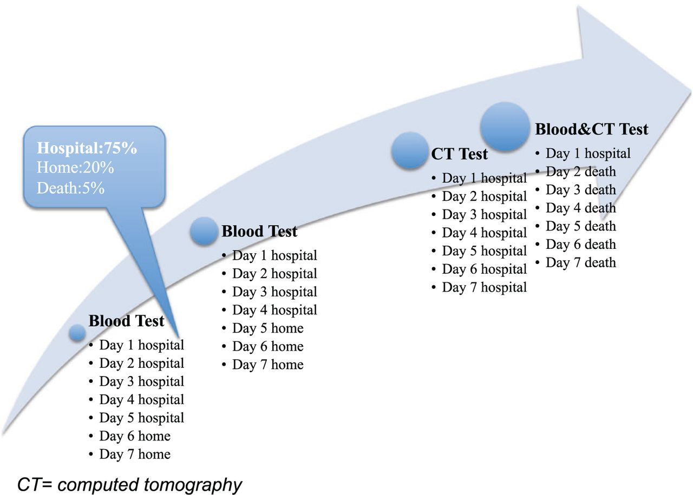
Predictive Model

Slide 10
How well does the model work?
Temporal validation to evaluate ability of model to predict events for unseen patients

Slide 11
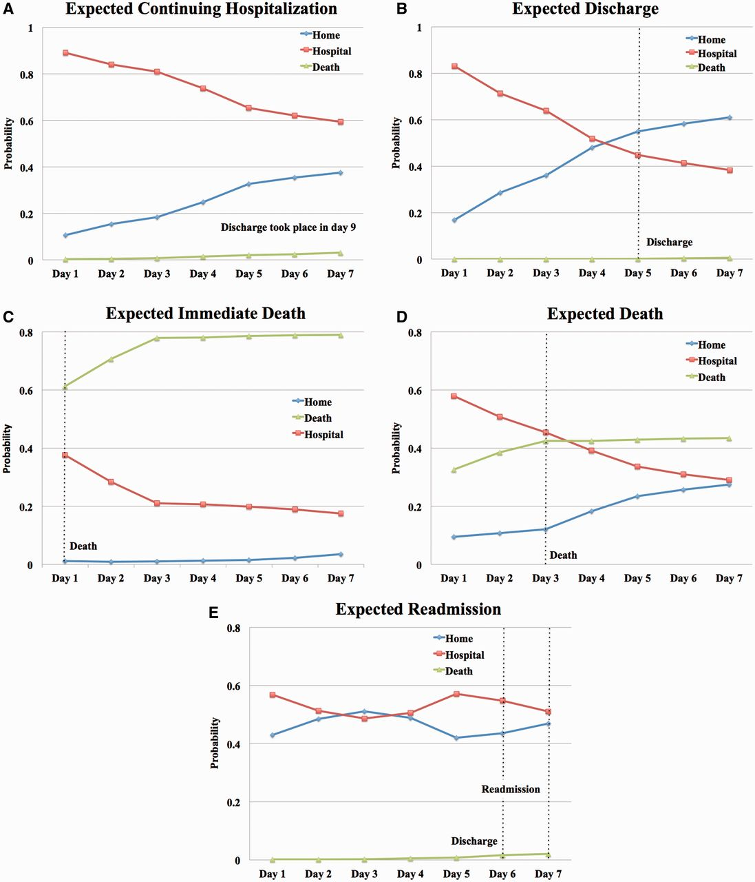
Sequences of Future Daily Probabilities
Patient outcome trajectories
Groups:
Death
Discharged alive
Continuing hospitalization
Readmitted after discharge

Slide 12
Critiques
Tradeoffs
Non-disease specific
Study design
Definition and inclusion of patient comorbidities
Math error (s?) in data table
Results
Ability to predict hospitalization was low (< 0.8)
No discussion of anomalous or unpredicted outcomes
Example: predicted to be discharged, but died
Example: predicted to die, but discharged

Slide 13
Discussion and Conclusion
This study presents a non-disease specific, validated model for estimating the probability of future patient outcomes after a new lab/path report is available
Consolidates remaining days of hospitalization, death, readmission in same outcome variable
Predicts a sequence of future daily probabilities rather than a single probability over a given time period
Has potential to be a useful tool in the clinic
Study design (i.e. inclusion criteria) and low level of predictability (hospital prediction) may be limiting factors

Slide 15
Figure 1
Notes:
Figure 1: An illustration of how the predictive model is updated following the availability of one or more pathology test results
in the EHR system. Patient outcomes comprise the probability of staying at hospital, being “at home” (ie, having been
discharged alive), or being dead during each of the 7 days following a temporal event.
Abbreviation: CT, computed tomography.

Slide 16
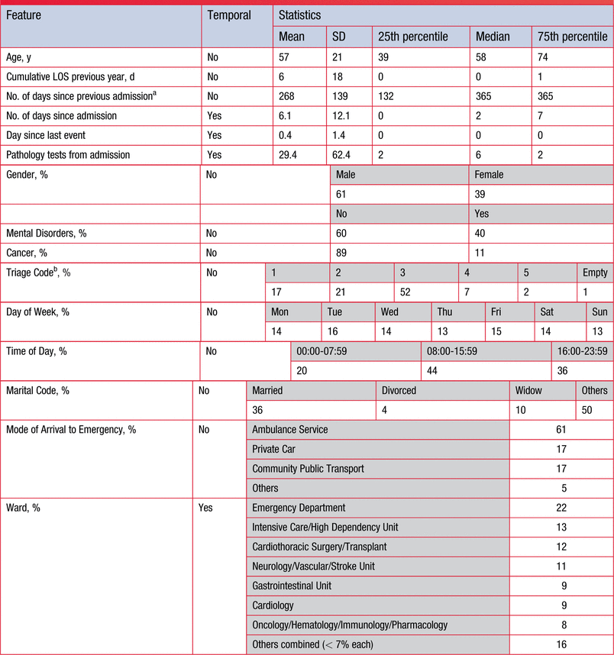
Table 1
Notes:
Table 1: Patient and admission characteristics across temporal events in the training dataset

Slide 17
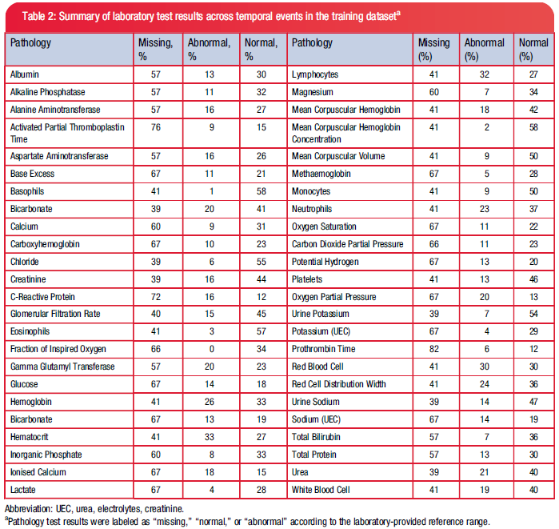
Table 2
Notes:
Table 2: Summary of laboratory test results across temporal events in the training dataseta

Slide 18
Figure 2
Notes:
Figure 2: Overview of how the predictive model was built in 5 steps.

Slide 19
Figure 3
Notes:
Figure 3: The Bayesian Network model includes 7 target days (in yellow), selected primary features (in purple), and selected
secondary features (in blue) as nodes, representing random variables. Arcs were created from each of the target
days to their corresponding selected primary features, and from these primary features to their corresponding selected
secondary features. Rectangular nodes represent dynamic variables while elliptical nodes represent static variables.
Abbreviations: U. Sodium, urine sodium; U. Potassium, urine potassium; HCT, hematocrit; WBC, white blood cell count;
Hgb, hemoglobin; UEC, urea, electrolytes, creatinine; Alk. Phos., alkaline phosphatase; pH, potential hydrogen; CRP, C-reactive
protein; RBC, red blood cell count; APTT, activated partial thromboplastin time; Tot. Protein, total protein; ED arrival,
mode of arrival to emergency department; Triage, triage category; Prev. LOS, cumulative length of stay in previous hospitalizations;
Inorg Phos, inorganic phosphate; Test Count, number of laboratory tests performed so far during hospitalization;
HOS days, days already in the hospital; Hours since HOS, hours since previous hospitalization.

Slide 20
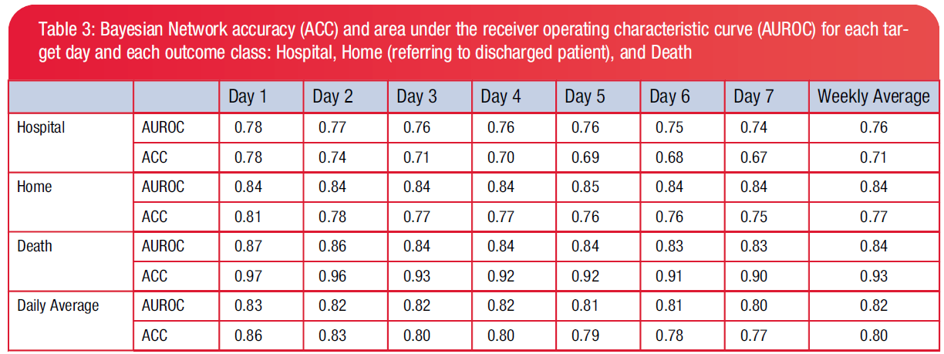
Table 3
Notes:
Table 3: Bayesian Network accuracy (ACC) and area under the receiver operating characteristic curve (AUROC) for each target
day and each outcome class: Hospital, Home (referring to discharged patient), and Death

Slide 21
Figure 4
Notes:
Figure 4: Model predictions for selected individual patients. Each line represents a future daily probability of being in the
hospital (red), “at home” (blue), or dead (green). Days 1 to 7 represent the future consecutive days relative to the time of
prediction. The dotted vertical lines indicate true events. Patients and times of prediction have been randomly selected
among examples for which the model correctly classifies patient outcomes for all, or most of, the 7 days. Panel A shows a
typical prediction of expected continuing hospitalization; Panel B illustrates a prediction of expected discharge. Panels C
and D are typical predictions of expected death, and Panel E predicts possible readmission.

