Slide 1
A clinically applicable approach to continuous prediction of future acute kidney injury

Slide 2
Clinical Background

Slide 3
Definition
Acute Kidney Injury (ARF)
Clinical syndrome denoted by decline in GFR (glomerular filtration rate)
With reduced excretion of nitrogenous waste (urea and creatinine)
Other uremic toxins
Notes:
Acute renal failure (ARF) has traditionally been defined as the abrupt loss of kidney function that results in the retention of urea and other nitrogenous waste products and in the dysregulation of extracellular volume and electrolytes

Slide 4
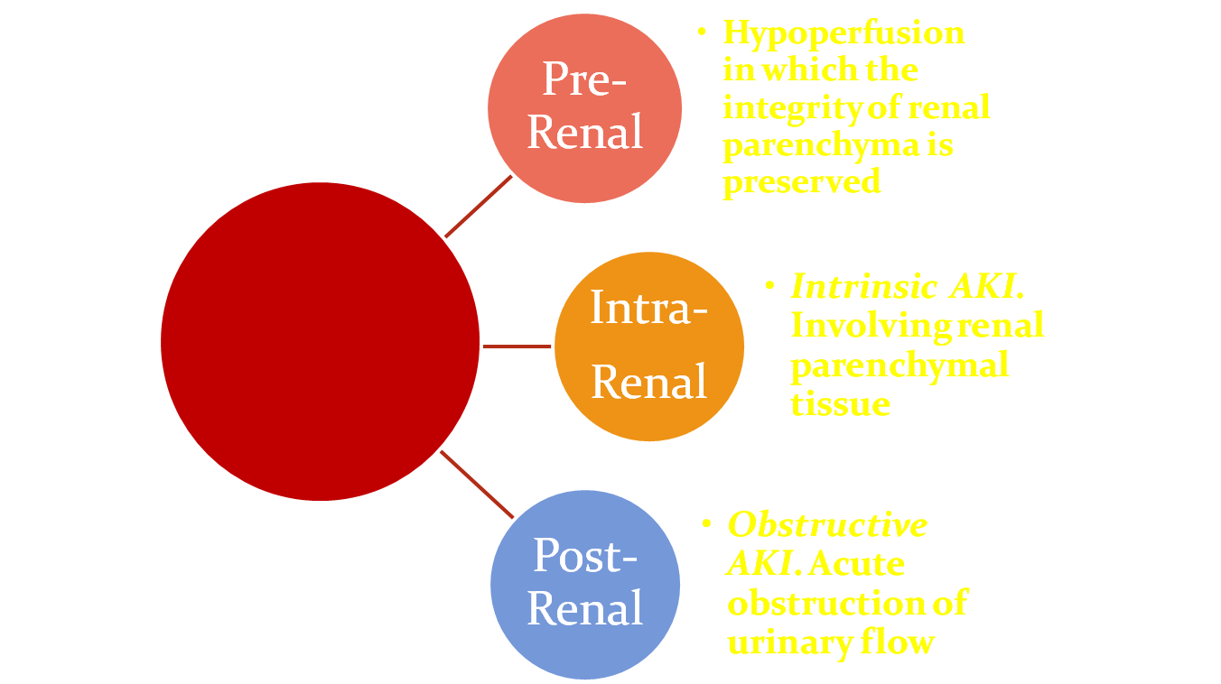
Etiology of AKI
AKI
Notes:
Categorization of the cause(s) of ARF has traditionally involved determining which general physiologic mechanism (prerenal, postrenal, or intrarenal) is responsible for the decline of glomerulan filtration. This method has the advantage of providing a well accepted diagnostic
framework that guides the clinician to comprehensively consider most potential causes of deteriorating renal function. Disease categorized by….

Slide 5
Epidemiology
AKI → 1 million hospitalized patients in the United States.
The incidence of AKI → is reported to occur in up to 5% to 7% of all hospitalized patients.
Up to two thirds of critically ill patients.
5% to 6% of patients with AKI require renal replacement therapy
Mortality rate in this population that requires renal replacement therapy is ap- proximately 50% to 70%.
AKI also significantly increases length of hospital stay
AKI survivors are still at high risk for long-term adverse outcomes such as chronic kidney disease, end-stage renal disease, and premature death, even if the serum creatinine level returns to normal.
Despite recent advances, the incidence of AKI has increased more than four-fold since 1998
Approximate incidence is 500 per 10,000 population.
Annual health cost due to AKI is more than 10 billion per year.
Notes:
AKI is increasingly common,1,2 estimated to occur annually in more than 1 million hospitalized patients in the United States.3,4 The incidence of AKI varies across clinical settings. It is reported to occur in up to 5% to 7% of all hospitalized patients and in up to two thirds of critically ill patients.5-9 Approximately 5% to 6% of patients with AKI require renal replace- ment therapy10,11 and the mortality rate in this popu- lation that requires renal replacement therapy is ap- proximately 50% to 70%.1,2,12 AKI also significantly increases length of hospital stay and is associated with a significant increase in the risk for chronic kidney disease and end-stage renal disease.11,13 Recently, studies also have identified that even small changes in serum creatinine are associated with significant in- creases in mortality.13,14 Furthermore, AKI survivors are still at high risk for long-term adverse outcomes such as chronic kidney disease, end-stage renal dis- ease, and premature death, even if the serum creatinine level returns to normal.15 Despite recent advances, the incidence of AKI has increased more than four-fol

Slide 6
Serum Creatinine
Kidney function is difficult to measure directly, requires invasive testing
Most often estimated kidney function is used
Serum creatinine the most common estimate of kidney function

Slide 7
Definitions - KDIGO
AKI is defined when
serum creatinine rises by ≥ 0.3 mg/dL within 48 hours or
serum creatinine rises ≥ 1.5X the reference value which is known or presumed to have occurred within one week or
urine output is < 0.5ml/kg/hr for >6 consecutive hours
Notes:
7

Slide 8
Methods

Slide 9
Study Population and Setting
Dept. of Veterans Affairs Health System
172 medical center, > 1000 outpatient clinics
~ 9 million patients enrolled
Dataset
703,782 patients from ~ 113 medical centers
Required that the patient be hospitalized
Data from October 2011 -> September 2015

Slide 10
Predictor Variables
29 domains
Diagnoses
Laboratory values
Vital signs
Etc.
Two primary time windows
Inpatient data (during index hospitalization)
Pre-hospitalization data

Slide 12
Outcome
Any AKI at following future timepoints 6 hours to 72 hours (by 6 hour steps)
Primary outcome discussed in the paper was AKI within 48 hours
Sub-analysis for predicting particular stage of AKI (any AKI, stage II/III)
Predicted future laboratory values (7)

Slide 13
Model
Embedding layer for historical and current timepoint features
Recurrent Neural Network layer
Prediction layer that makes predictions across the 8 future prediction windows

Slide 15
Results

