Slide 1
UNIVERSITÀ DEGLI STUDI DI SALERNO
__________________________________________
Generative Adversarial Networks (GAN)
A powerful Generative AI tool
Giovanni Messuti

Slide 2

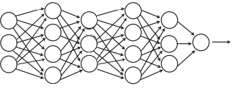






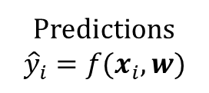
Classification problem
(Binary)
CAT
[0]
DOG
[1]
Data
Predictions
Loss
Loss Function computing
Measure of Error
Model
Weight update
$$D=(x_{i},y_{i})$$
x input
y label
Idetify the class
(Desired output)
L =
$$−log P\left(D | w\right)=$$
$$∑_{i}−y_{i}log ({\hat{y}}_{i} ) − (1 −y_{i}) log (1 −{\hat{y}}_{i})$$
Predictions
$${\hat{y}}_{i}=f(x_{i},w)$$
$$f(·,w)$$
Weights update $w$
(Loss function minimized)
Model
w parameters
New predictions computed
Results of the training process
$$f(·,w^{final})$$

Slide 3
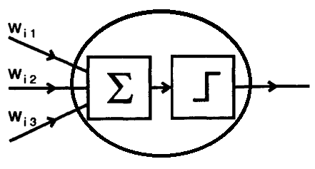
Classification problem
Neural Network
Building Block: Artificial neuron
Data
Predctions
Loss
Model
Weight update
Model
Deep Network
Loss
(Binary) Cross Entropy
Input
Output
Weights update
Gradient descent
Feed Forward

Slide 4
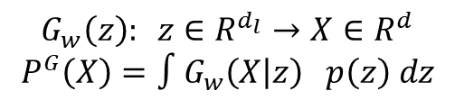
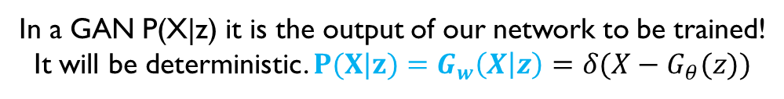

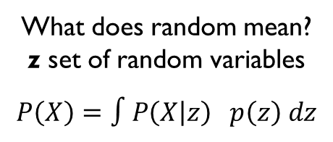

Generative Problem
Neural Network
‘Learning’ a distribution P(X)
To be able to sample (take examples) from the image space (multidimensional)
Building Block: Artificial neuron
P(X) = ‘probability that a 'random' image chosen is x’
What does random mean?
z set of random variables
$$P\left(X\right)=∫P\left(X | z\right) p\left(z\right) dz$$
_______________________________________________
Sampling
Deep Network
Generation
Input
Output
In a GAN P(X|z) it is the output of our network to be trained!
It will be deterministic. $P(X|z)=G_{w}\left(X | z\right)=δ(X−G_{θ}(z))$
$G_{w} (w=$parameters$)$
$$G_{w}\left(z\right): z∈R^{d_{l}}→X∈R^{d}$$
$$P^{G}\left(X\right)=∫G_{w}\left(X | z\right) p\left(z\right) dz$$
z
$$X$$
Feed Forward

Slide 5


Classification problem
Generative Problem
Input
Output
Input
$G_{w} (w=$parameters$)$
Output
Y
Class of the
Input image
(label)
Z
Random
numbers
X
Input
Image
$$X$$
Image
🔹 Classification (Feedforward)
Aim: assign a label to an input (e.g., image → class)
Input: real data samples
Output: class probabilities (e.g., via softmax)
Architecture: single network (Dense, CNN, etc.)
Loss function: standard supervised losses (cross-entropy)
Training: straightforward optimization with backpropagation
Evaluation: Accuracy
Typical issue: overfitting vs underfitting
🔸 Generation (GAN Framework)
Aim: generate new realistic Images
Input: random noise vector (latent space),
Output: synthetic data (Generator)
Architecture: 2 networks (Generator + Discriminator) (Dense, CNN, etc)
Loss function: adversarial loss, Unsupervised
(game between two networks, we will see)
Training: alternating optimization, often unstable. Based on backpropagation
Evaluation: indirect (visual quality of generated data)
Typical issue: training instability, mode collapse
_______________________________________________

Slide 6
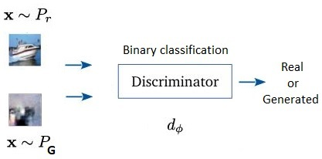
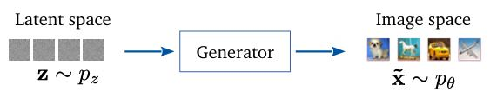
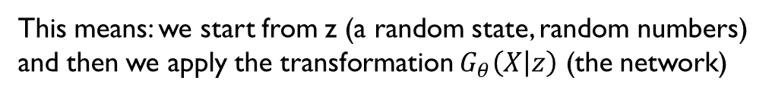


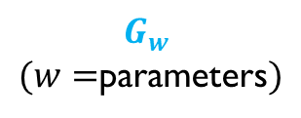
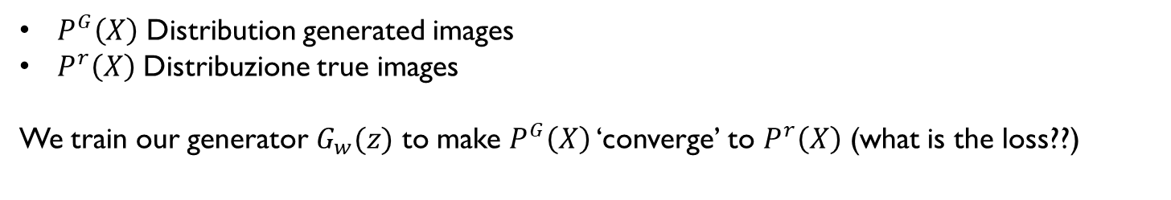
GANs: We learn $G_{θ}(X|z)$
$$P^{G}\left(X\right)=∫G_{w}\left(X | z\right) p\left(z\right) dz$$
This means: we start from z (a random state, random numbers) and then we apply the transformation $G_{θ}\left(X | z\right)$ (the network)
z
$$X$$
$$G_{w}$$
$(w=$parameters$)$
$P^{G}\left(X\right)$ Distribution generated images
$P^{r}\left(X\right)$ Distribuzione true images
We train our generator $G_{w}(z)$ to make $P^{G}\left(X\right)$ ‘converge’ to $P^{r}\left(X\right)$ (what is the loss??)
Book
Deep Learning, Bishop 2024,
Chapter 17
We need to:
Be able to ‘discriminare if X belongs to $P^{G}\left(X\right)$ or $P^{r}\left(X\right)$’ (Evaluate separation between $P^{G}$ e $P^{r}$)
Be able to train G to generate imeges that are similar to $P^{r}\left(X\right)$ (Minimize distance between $P^{G}$ e $P^{r}$)
Network
Network

Slide 7
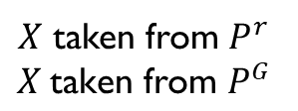
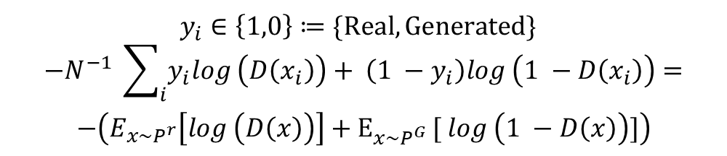
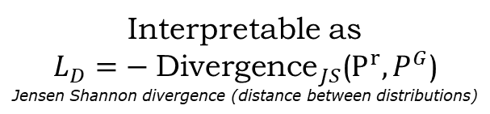


GANs: learning $G_{w}(X|z)$
We need to:
Be able to ‘discriminare if X belongs to $P^{G}\left(X\right)$ or $P^{r}\left(X\right)$’ (Evaluate separation between $P^{G}$ e $P^{r}$)
Be able to train G to generate imeges that are similar to $P^{r}\left(X\right)$ (Minimize distance between $P^{G}$ e $P^{r}$)
Evaluate difference between $P^{G}$ & $P^{r}$ → Train discriminator network
Minimize distance between $P^{G}$ & $P^{r}$ → Train generator network
Book
Deep Learning, Bishop 2024,
Chapter 17
Cross Entropy
(Like a classification problem)
$$P\left(X∈P^{r}\right)$$
$$′P\left(X∈P^{G}\right)′$$
Train discriminator network
$$y_{i}∈\left\{1,0\right\}≔\{Real,Generated\}$$
$$−N^{−1} \sum_{i}{y_{i}log \left(D\left(x_{i}\right)\right)+ \left(1 −y_{i}\right)log \left(1 −D\left(x_{i}\right)\right)}=$$
$$−\left(E_{x∼P^{r}}\left[log \left(D\left(x\right)\right)\right]+E_{x∼P^{G} }[ log \left(1 −D\left(x\right)\right)]\right)$$
Data
Predictions
LossD
$X$ taken from $P^{r}$
$$X \text{taken} \text{from} P^{G}$$
$$−\left(E_{x∼P^{r}}\left[log \left(D\left(x\right)\right)\right]+E_{z∼P_{z} }[ log \left(1 −D\left(G(z)\right)\right)]\right)$$
Weight update (discriminator)
Discriminator
Interpretable as
$$L_{D}=− {\text{D}\text{ivergence}}_{JS}\text{(}P^{r},P^{G}\text{)}$$
Jensen Shannon divergence (distance between distributions)
Data
Prediction
Loss
Model
Weight update

Slide 8
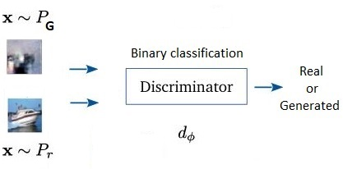
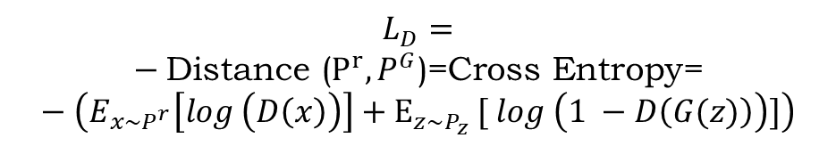

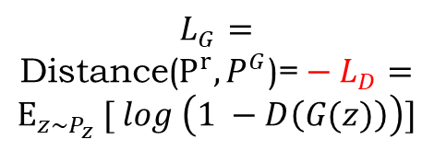





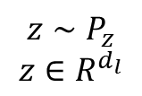

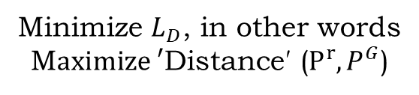
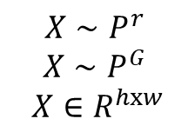
GANs: learning $G_{w}(X|z)$
Evaluate difference between $P^{G}$ & $P^{r}$ → Train discriminator network
Minimize distance between $P^{G}$ & $P^{r}$ → Train generator network
$$L_{G}=$$
$$\text{Distan}\text{ce}\text{(}P^{r},P^{G}\text{)}\text{=}−L_{D}=$$
$$E_{z∼P_{z} }[ log \left(1 −D\left(G(z)\right)\right)]$$
Valutare
$$\text{Distanza}\text{ (}P^{r},P^{G}\text{)}$$
Minimize
$$\text{Distan}\text{ce}\text{ (}P^{r},P^{G}\text{)}$$
Minimize $L_{D}$, in other words
M$aximize \text{′}\text{Distan}\text{ce}\text{′ (}P^{r},P^{G}\text{)}$
We train the generator to
Fool (to deceive, bluff) the discriminator
$$L_{D}=$$
$$− \text{Distan}\text{ce}\text{ (}P^{r},P^{G}\text{)}\text{=}\text{Cross} \text{Entropy}\text{=}−\left(E_{x∼P^{r}}\left[log \left(D\left(x\right)\right)\right]+E_{z∼P_{z} }[ log \left(1 −D\left(G(z)\right)\right)]\right)$$
$$X∼P^{r}$$
$$X∼P^{G}$$
$$X∈R^{hxw}$$
D
$$P\left(X∈P^{r}\right)$$
$$P\left(X∈P^{G}\right)$$
$$o∈[0,1]$$
Noise
sampling $P(z)$
Discriminator
Generating
Generator
Images
Predictions
LossG
G
$$z∼P_{z}$$
$$z∈R^{d_{l}}$$
$$X∼P^{G}$$
‘Sampling’ X from
$$X\sim G_{w}$$
Weight update (G!)
Sampling

Slide 9
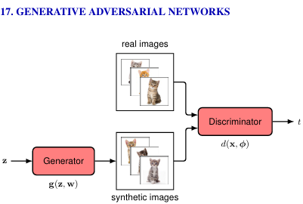





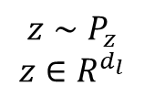


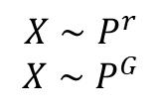
GANs Training diagrams
Models / Loss
$$X∼P^{r}$$
$$X∼P^{G}$$
$$X∈R^{hxw}$$
D
G
Output Images
Input
Images
Class
Real/Generated
Random
numbers
$$z∼P_{z}$$
$$z∈R^{d_{l}}$$
$$X∼P^{G}$$
$$o$$
Discriminator
Generator
$$P\left(X∈P^{r}\right)$$
$$′P\left(X∈P^{G}\right)′$$
Discriminator Training
$$X∼P^{r}$$
$$X∼P^{G}$$
Data
Predictions
LossD
Weight update (discriminator)
Discriminator
Generator Training
$$P\left(X∈P^{r}\right)$$
$$P\left(X∈P^{G}\right)$$
Noise
sampling $P(z)$
Discriminator
Generator
Images
Predictions
LossG
Book
Deep Learning, Bishop 2024,
Chapter 17
Weight update (G)
‘Sampling’ X from
$$X\sim P^{G}$$

Slide 10
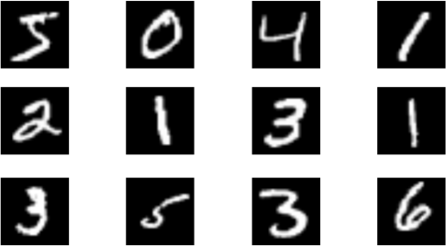
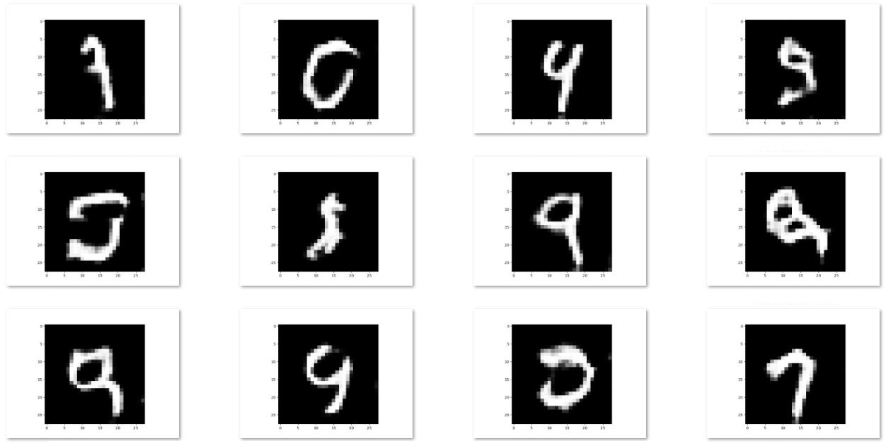

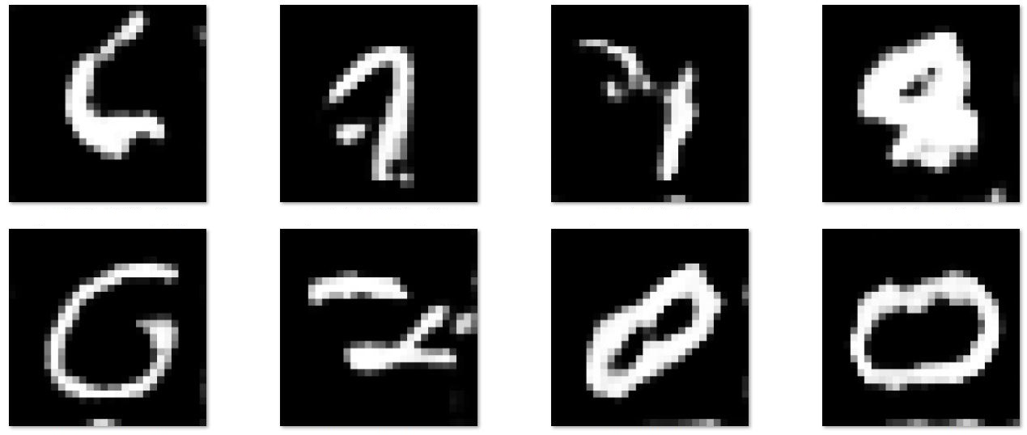
GANs: MNIST case
MNIST Dataset Examples
some Generated samples
W-GAN (Update of a GAN with another Loss) Very stable!
Samples from unstable training

Slide 11
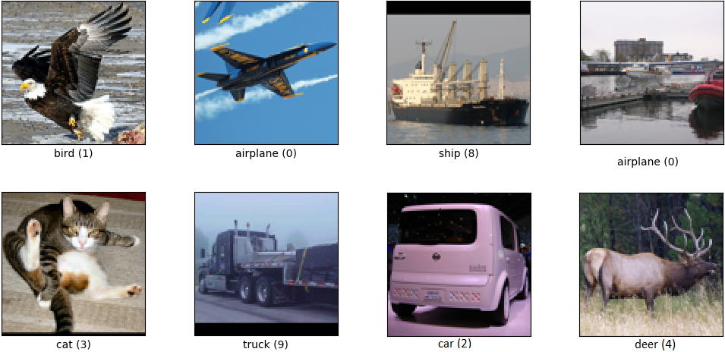
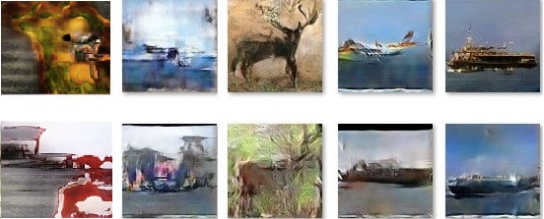
GANs: A more difficult task
Here I tried to generate other types of images, I used a different dataset, STL10 dataset
STL10 Dataset Examples
GAN. Various trained networks

Slide 12
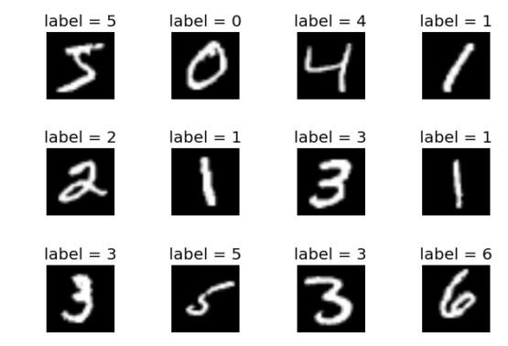
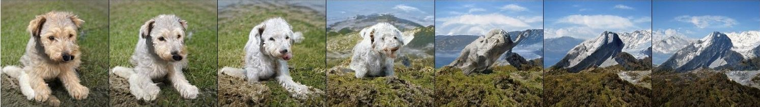
GANs - Label conditioning
How to generate responsibly
Data are not alone, we can use labels (partially supervised)
Different labels → Different images
We can use the info of the label to produce what we want!
We can also generate a mix of things. In this test, the researchers generate something 50% dog and 50% mountain! (they used the label dog or mountain or both)
Brock, A., Donahue, J., & Simonyan, K. (2019). Large scale GAN training for high fidelity natural image synthesis.

Slide 13
GANs: references
Books
Erdmann, Martin, et al. Deep Learning for Physics Research. 2021.
Generative Adversarial Networks with Python (2020) Jason Brownlee.
Papers
Goodfellow, et al. Generative adversarial nets.
Weng, L. (2019). From gan to wgan. arXiv preprint arXiv:1904.08994.
Wasserstein GAN · Depth First Learning.
Zhang, H. Towards principled methods for training generative adversarial networks.
Arjovsky, M., et.al (2017). Wasserstein generative adversarial networks.
Brock, Donahue, Simonyan (2019). Large-scale GAN training for high-fidelity natural image synthesis.
Odena, et al. Conditional image synthesis with auxiliary classifier gans.
Makhzani, Alireza, et al.(Goodfellow) Adversarial autoencoders.

