Slide 1
Python Chat Application
Hanliang Ding

Slide 2
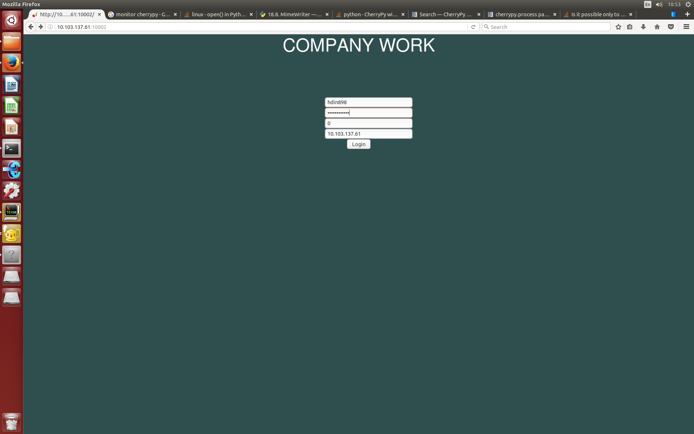
Login

Slide 3
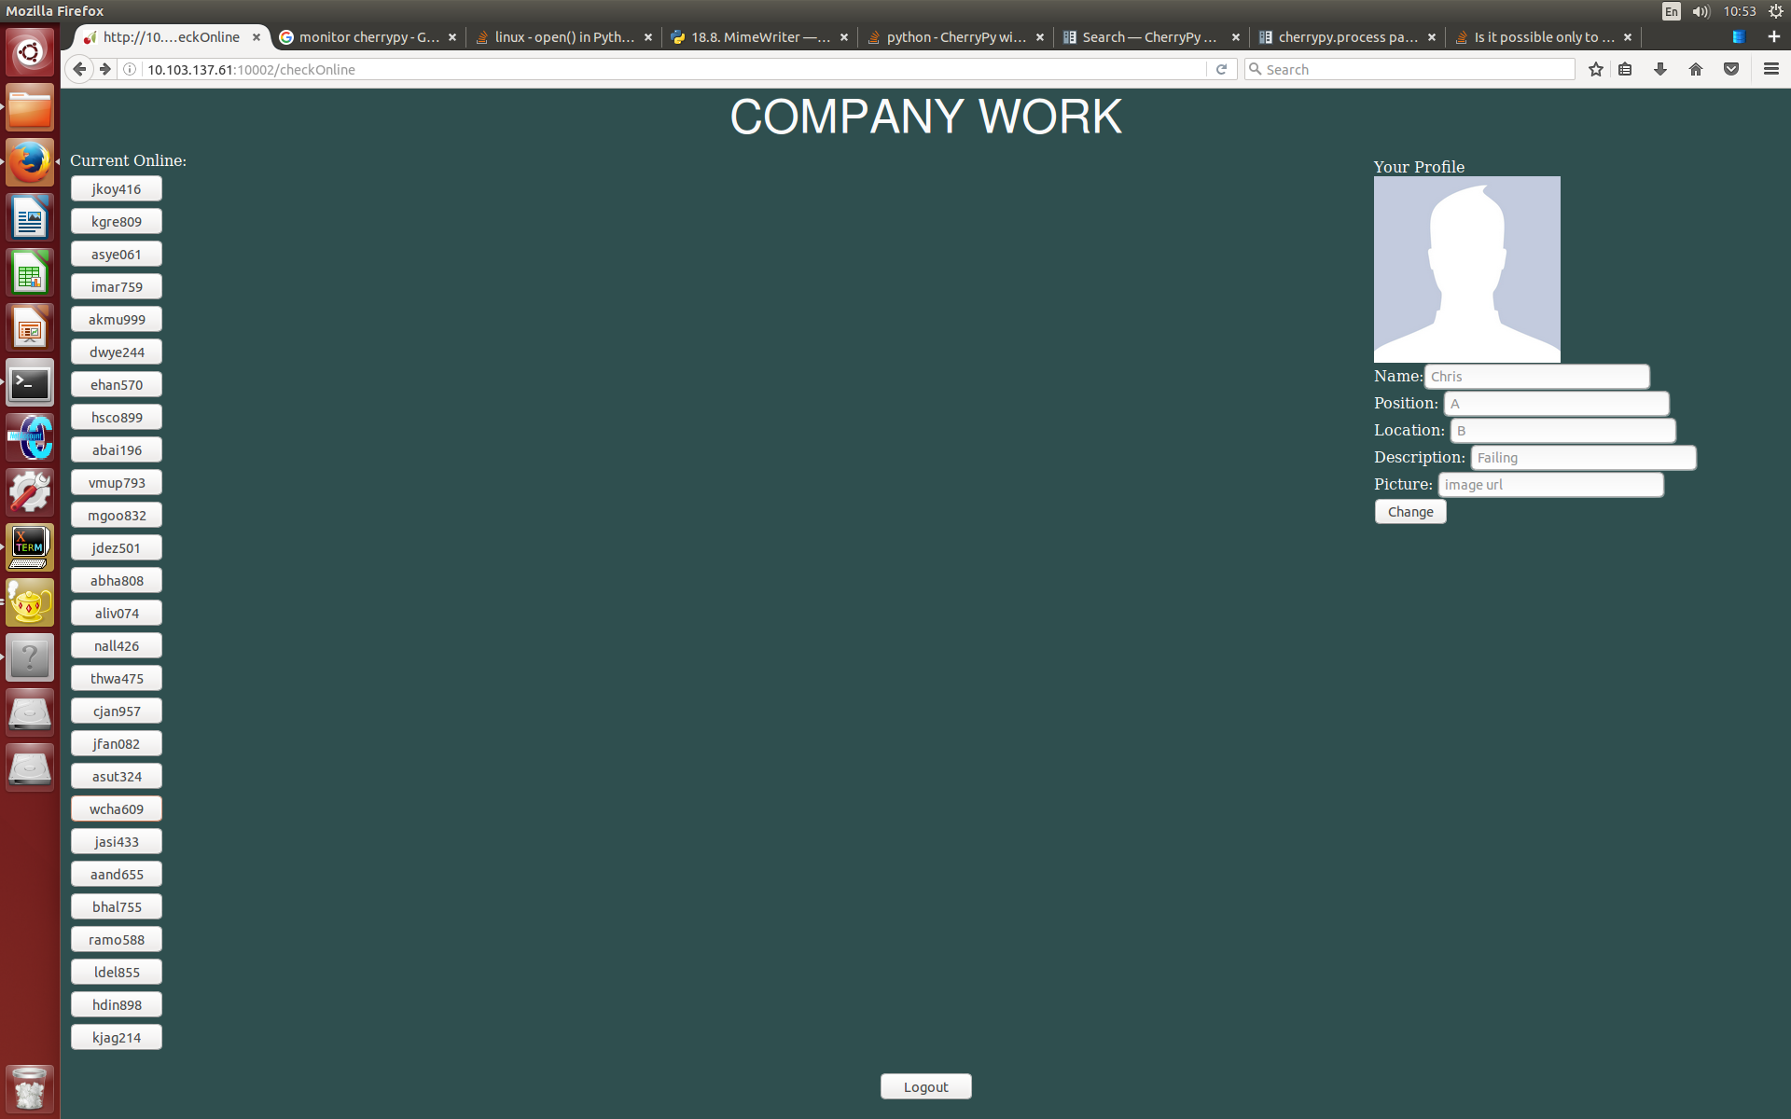
Home

Slide 4
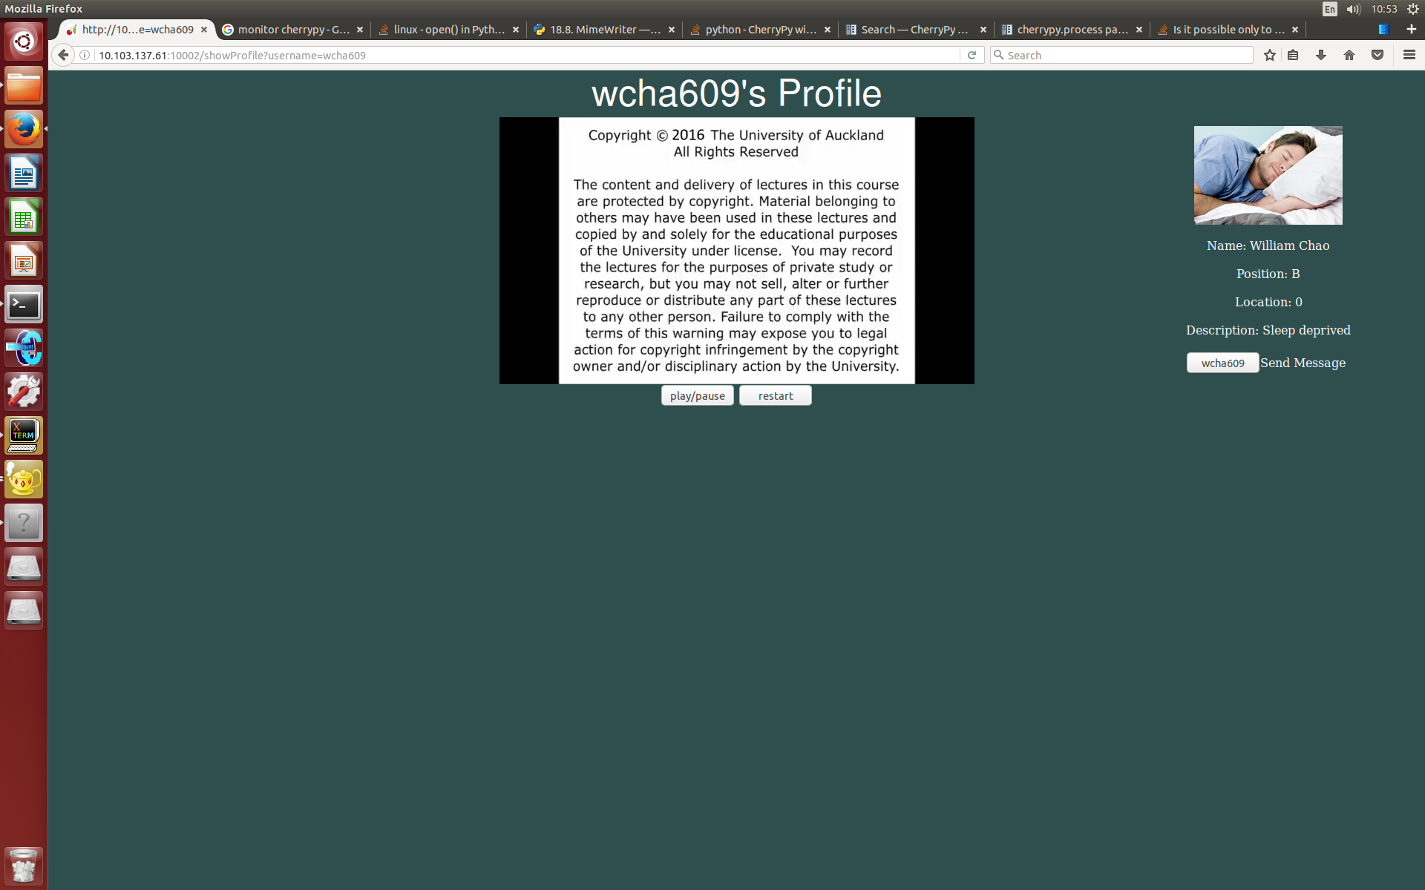
Profile

Slide 5
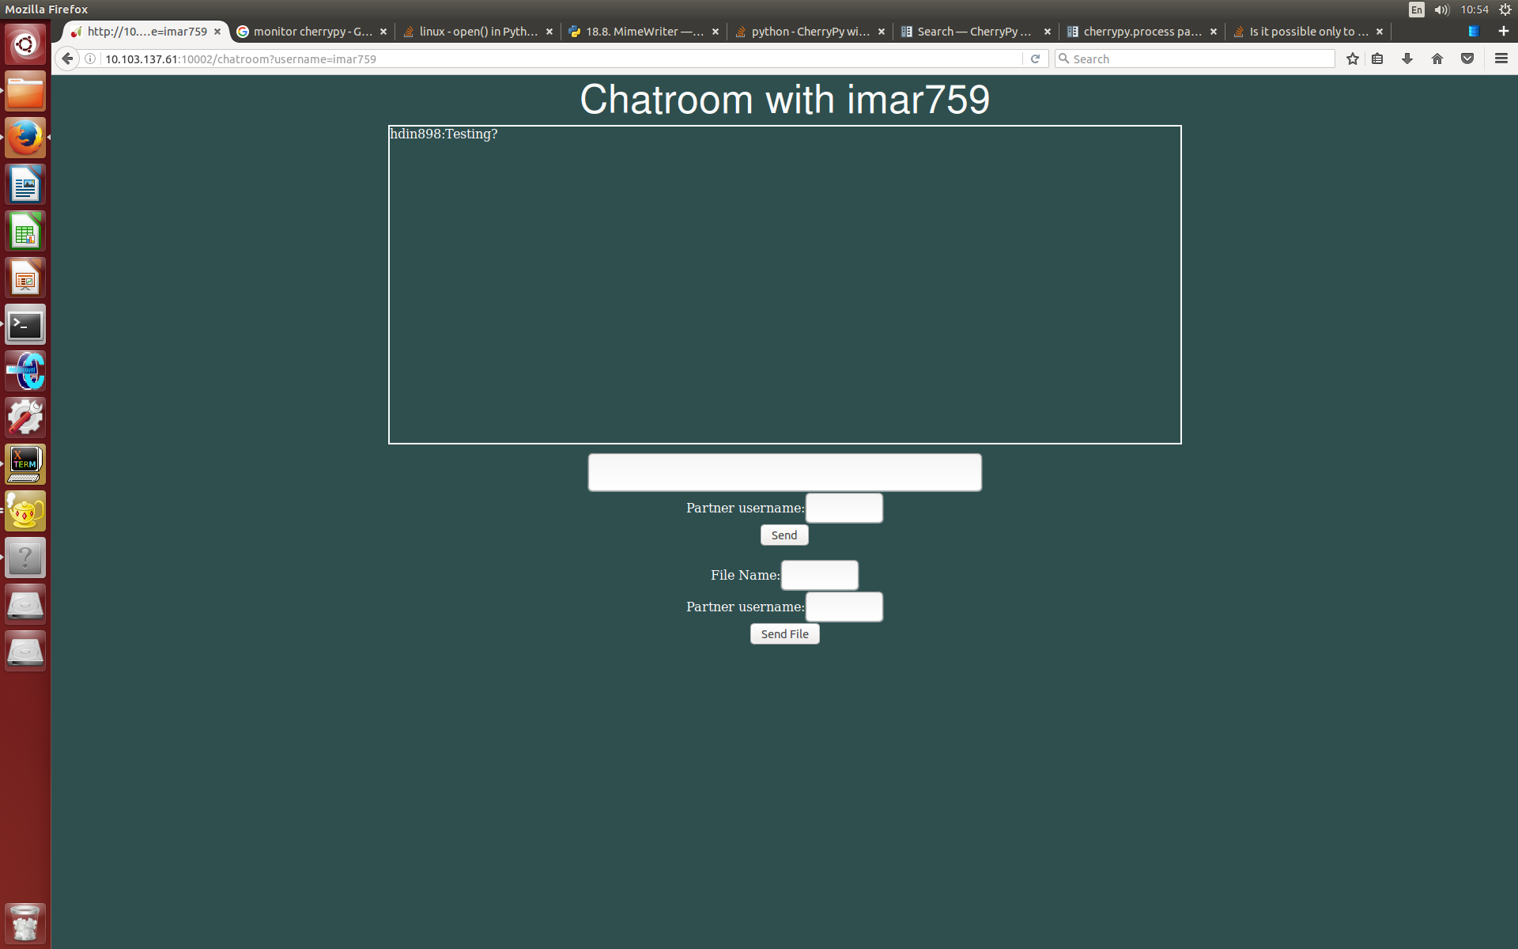
Chat room

Slide 6
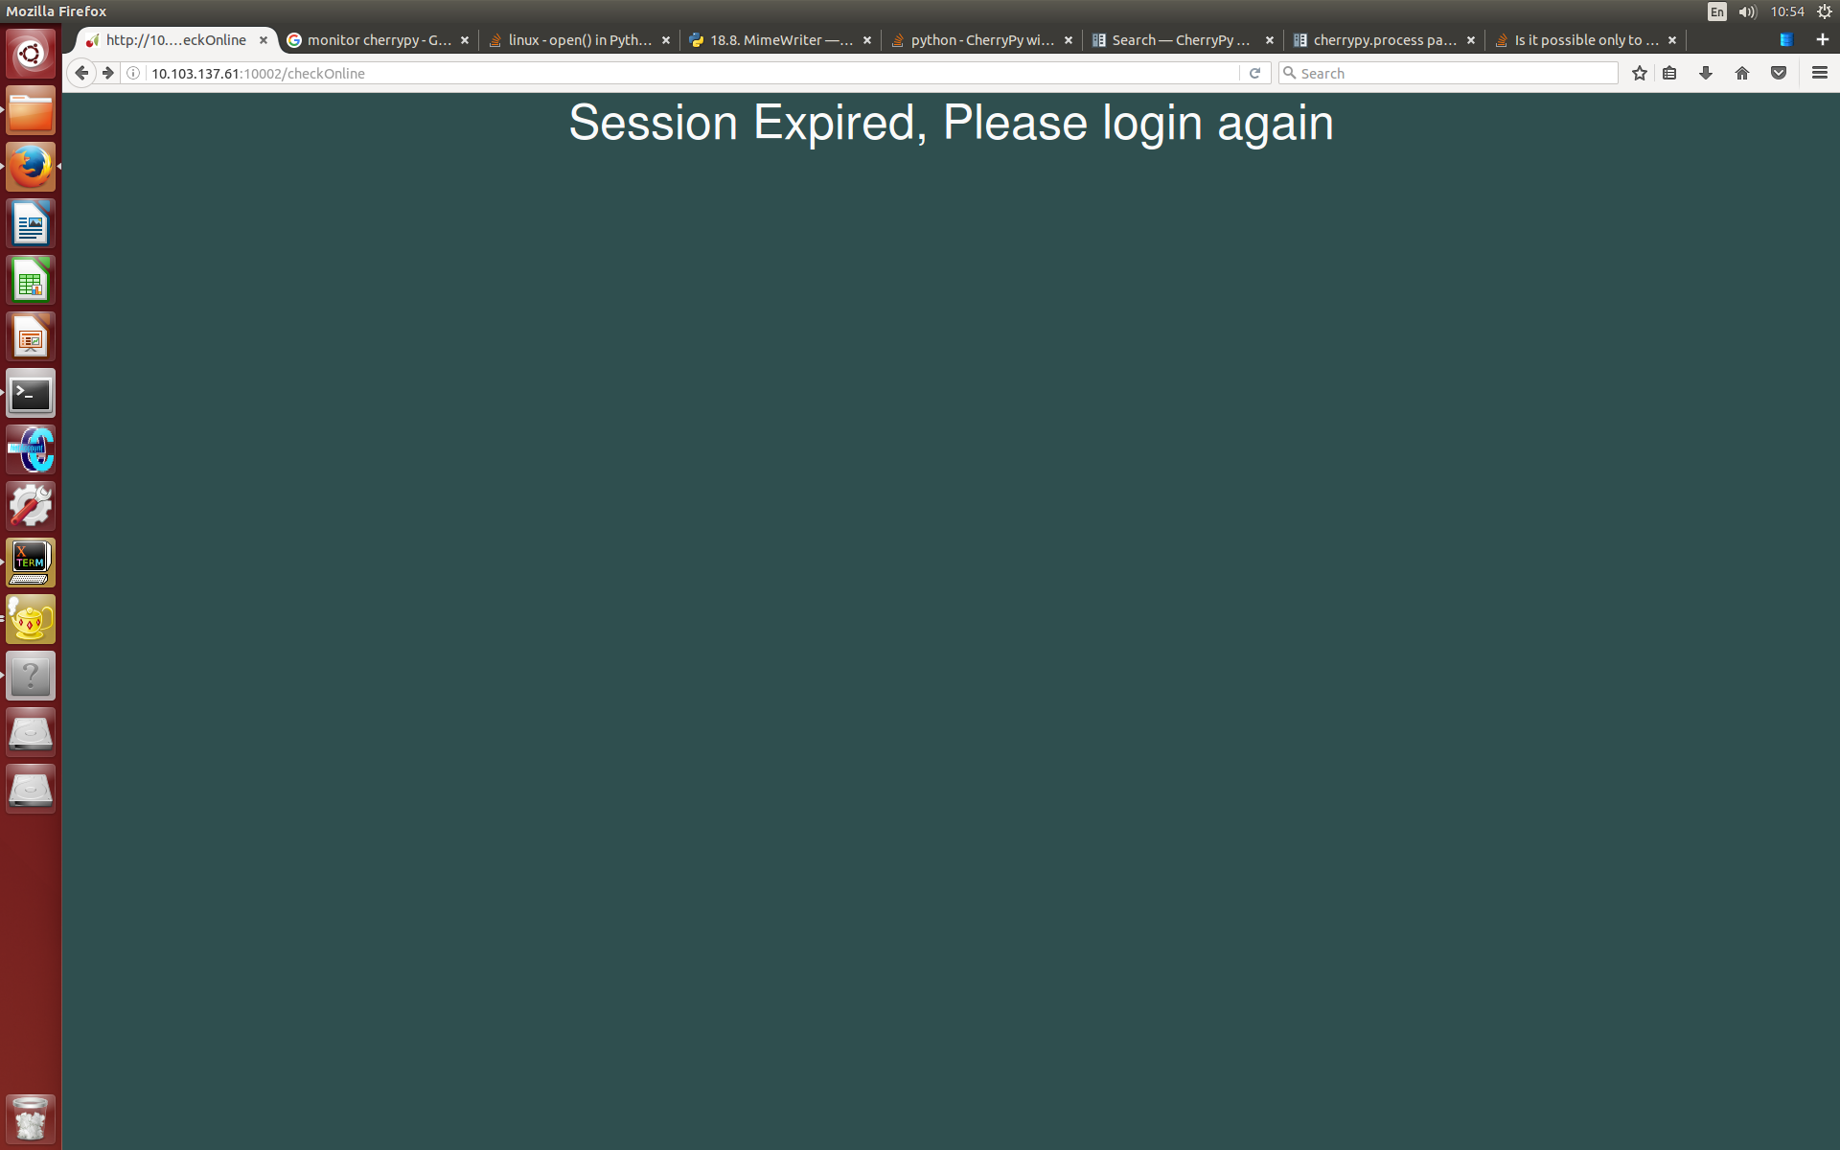
Default

Slide 7
File Structure
MainApp.py
encrypDecryp.py
Database.db
Static(folder)
Home.css
Templates(folder)
Profile.html
Home.html
Login.html
Chatroom.html
Default.html

Slide 8
Database Structure
UserKey
Username
Password
Private
Public
Profile
Username
Name
Position
Description
Location
Picture
onlineUsers
Username
Password
Private
Public
Messages
Message
Sender
Receiver
Time
Registered Users
Username

Slide 9
Future Improvements
Separate API’s and non API functions
Add group messaging
Add events
Better looking interface
More Testing

