Slide 1
WARLORDS REBORN
Developed by:
Jerry Fan
Hanliang Ding

Slide 2
Menu
Keyboard and Mouse navigation
Volume control
Sound effects and music separate mute
Game mode selections
Player selections
Bonus feature selections

Slide 3
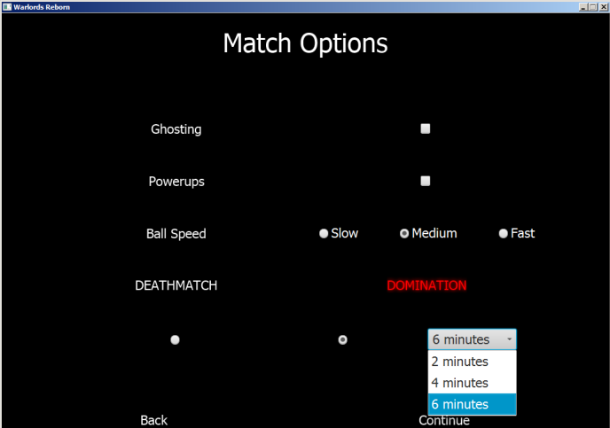
Features
Features are highly customizable and flexible so anything unwanted won’t be in the game

Slide 4
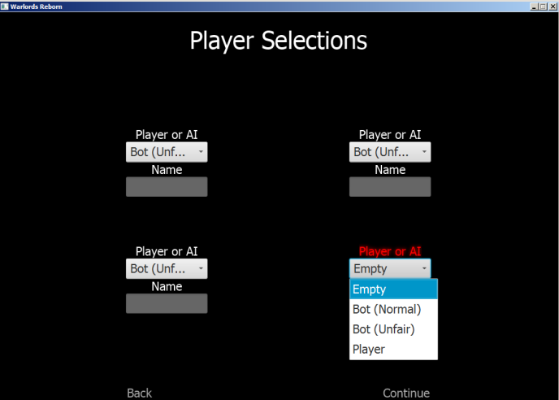
Players or AI
Each slot in the game can be chosen by the user and is not binary, more flexible than just 2 modes

Slide 5
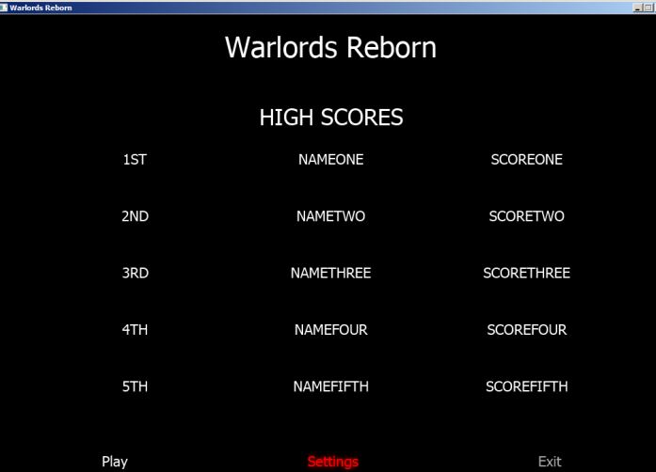
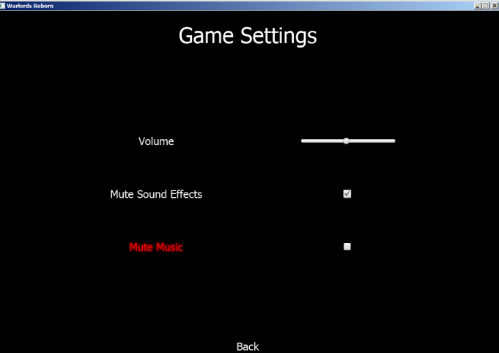
APPLICATION
START
GAME
STARTS

Slide 6
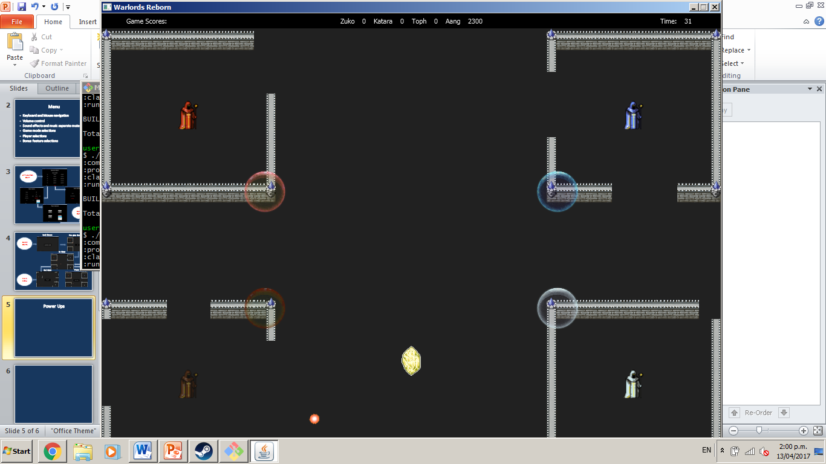
Power Ups
Makes the game more fun
Introduces randomness
Stimulating
Invisibility (make the ball invisible)
Bounty (increase score for hitter)
Double Damage (do more damage to walls)
Haste (make the ball faster)

Slide 7
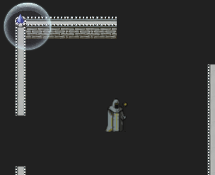
Ghosting
Dead players won’t feel bored
Discourages ganging up on one player

Slide 8
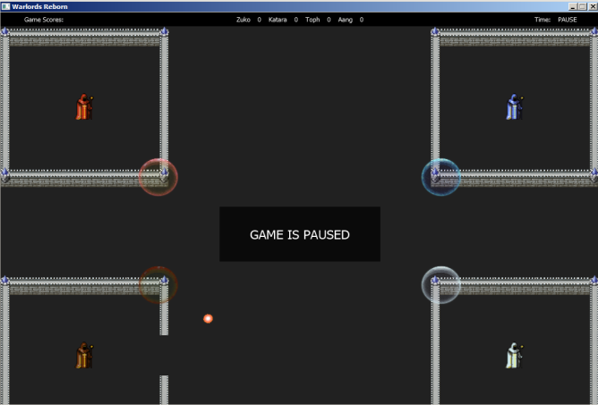
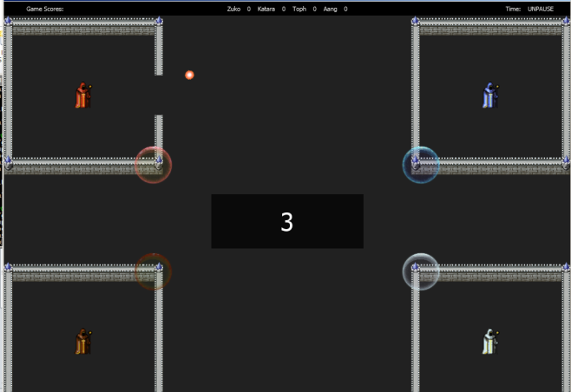
Pausing/Unpausing
Countdown from 3 before restart so players can prepare
Simple overlay for aesthetics

Slide 9
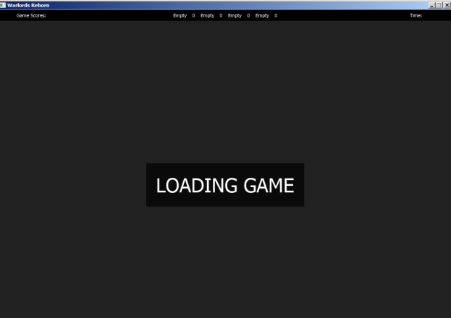
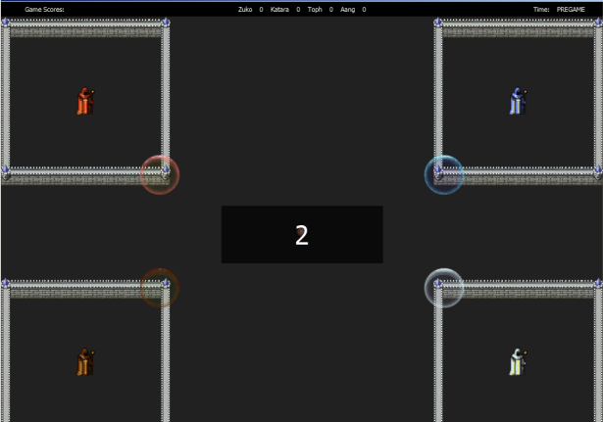
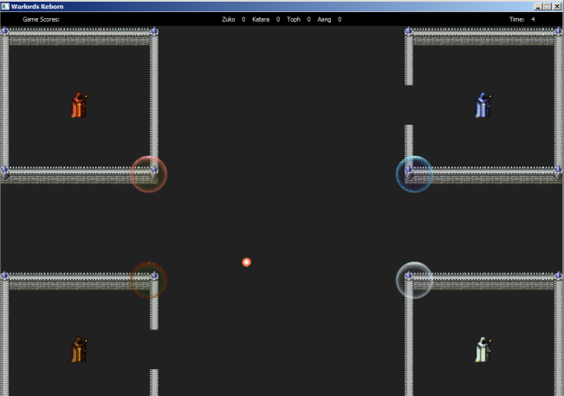
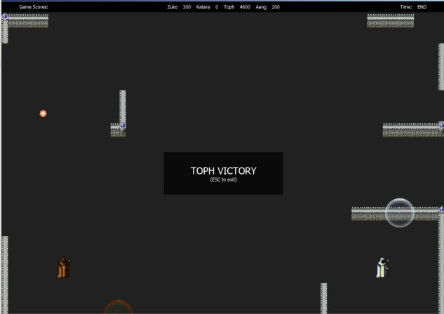

Load Screen
Pre game Countdown
GAME
STARTS
In Game
End Game
Pause
MAIN MENU

Slide 10

Minimum Requirements
Keyboard navigated main menu ✓
Single player or AI selection ✓
Starting countdown ✓
P to pause ✓
Page down key to skip game ✓
Escape key to go to main menu after game ✓
1024 x 768 window ✓
Maximum 2 minutes game mode available ✓
Collisions functional like the 1980 original ✓

Slide 11
Music/Sound Effects
Audio from creative commons so no copy right issues
Music for menu and music for game are separate
Sound effects for more ear coordination

