Slide 1
Graph neural networks for traffic modeling
Benedek Máth, Ádám Nemes
Supervisor: Dr. Varga Balázs

Slide 2
Our Goals for this semester
In real world cities only a fraction of roads have traffic volume measuring sensors (e.g.: inductive loop detectors, cameras). Our goal is to create a traffic estimator tool using Graph Neural Networks, that estimates the traffic volume on sensorless roads based on the data of the roads with sensors
Steps to achieve this:
Understanding how GNNs work, how can they be used for traffic estimation
Creating a dataset for teaching and testing using a microscopic traffic simulation tool - SUMO
Creating a GNN model for traffic estimation
Teaching the model and evaluating its performance

Slide 3
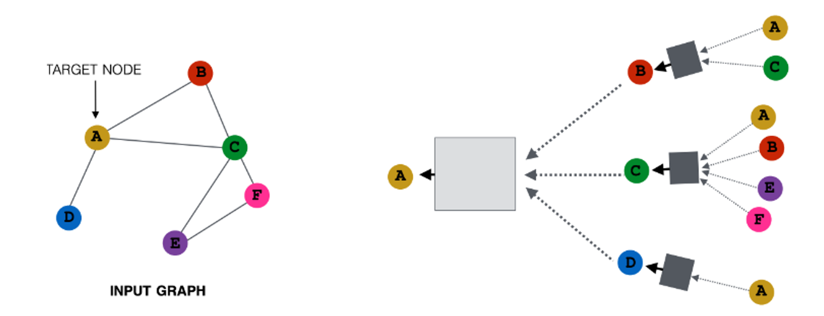
GCN Layer
Graph Neural Networks are using the adjacency matrix of the graph to capture the properties of the system.
Nodes that are connected by edges and edges connected by nodes have greater impact on each other than those which are not.
From k’th layer it will get information from edges/nodes which can reach it in exactly k steps.

Slide 4
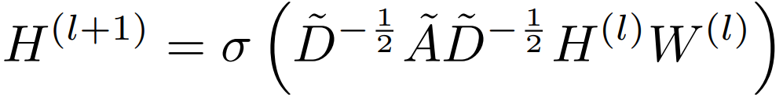
GCN Layer
We used 8 Graph Convolutional Layers(GCN) with the following formula:
Notes:
A˜ = A + IN is the adjacency matrix of the undirected graph G with added self-connections. D˜ is the degree matrix defined as D˜ ii = P j A˜ ij . σ(·) denotes an activation function, such as ReLU (ReLU(x) = max(0, x)), W(l) is a layer-specific trainable weight matrix. H(l) ∈ R N×D is the matrix of activations in the lth layer; H(0) = X. [4]

Slide 5
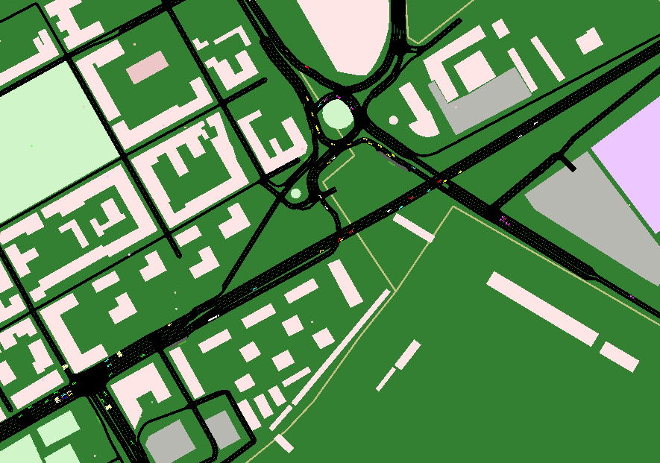
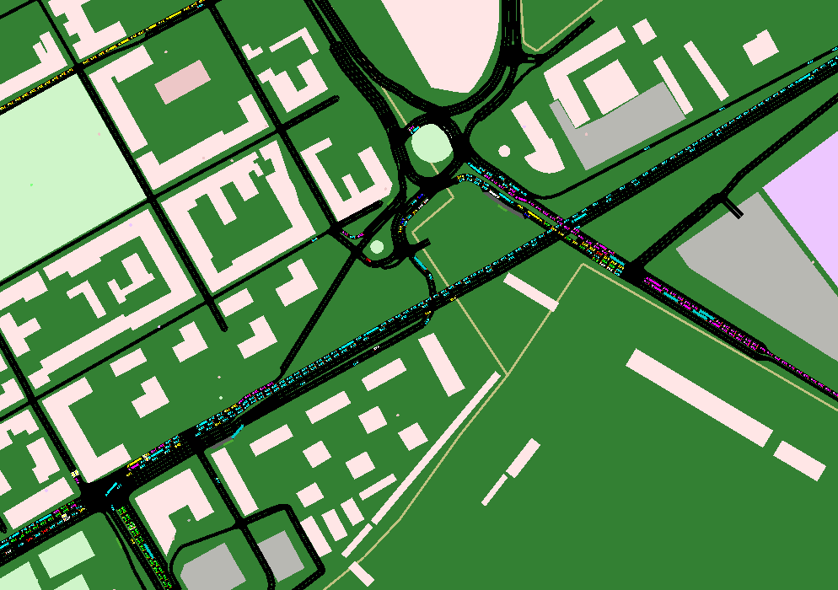
SUMO
We used sumo simulations to obtain the data for the GNN training.
To achieve a diverse training data we ran several simulations on Gyor’s roadmap with multiple changes.
We mainly modified the global seed of the simulation and the traffic’s scale.

Slide 6
SUMO
We achieved a hundred different simulations of 4 hour time period of Gyor’s traffic.
From the raw xml file generated by Sumo the collected 1358 quarter hour car counting data of each road.
We converted these road data to pytorch geometric graph data.
In the end we achieved a graph with 413 nodes (road intersections) and 504 edges(road segment) with 1 edge attribute (number of cars left the segment in the past 15 minutes)

Slide 7
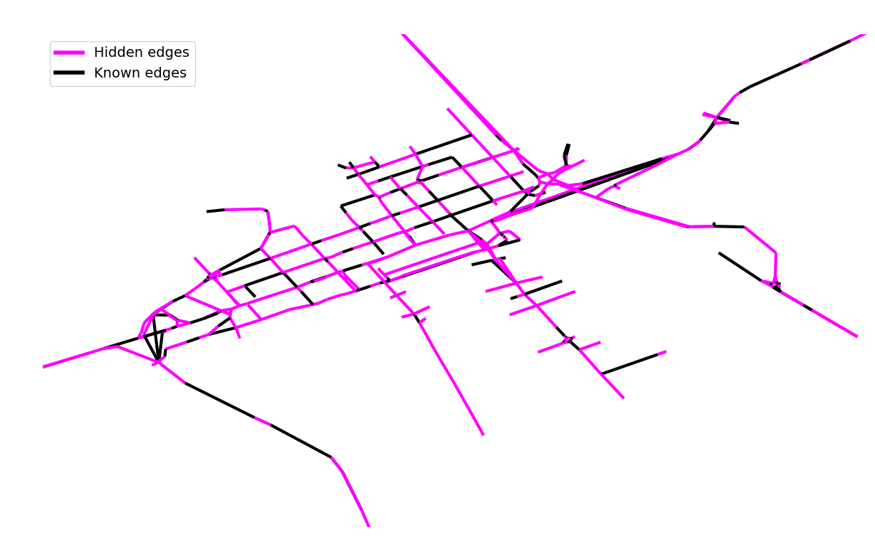
Modelling traffic
In real world cases, only about 10% of roads have traffic volume measuring sensors
We decided to aim for 30% of known roads, 70% of unknown roads as it is more within reach for one semester
We chose the known roads randomly
Our model was simple, 8 GCN and 1 dense layer

Slide 8
Data preparation and training
The traffic volume is represented as edge attributes
We normed the edge attributes with their maximum value
We set the unknown edges’ attributes to -1
We used Mean Squared Error as loss function
We tried two approaches for training the model
Choosing a data point randomly and using that for a number of epochs
Choosing a data point for each epoch randomly
For every 100 epochs, we calculated the average Mean Squared Error for all data points
In order to monitor the model’s performance we used the average Mean Squared Value of the data points as a benchmark

Slide 9
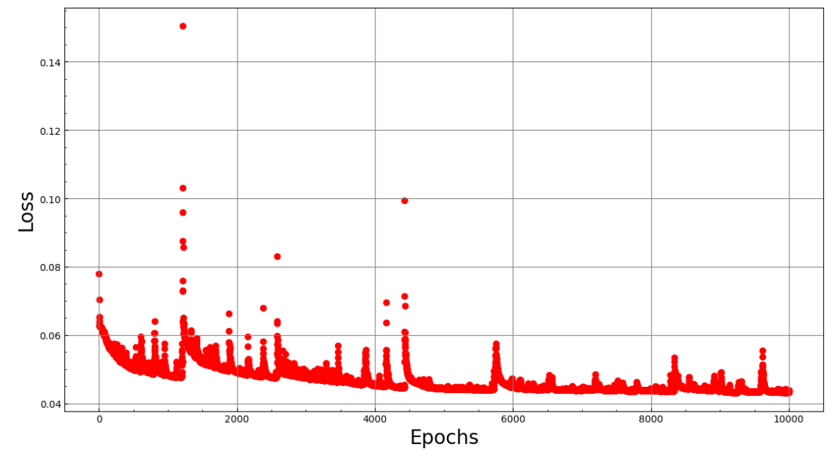

Slide 10
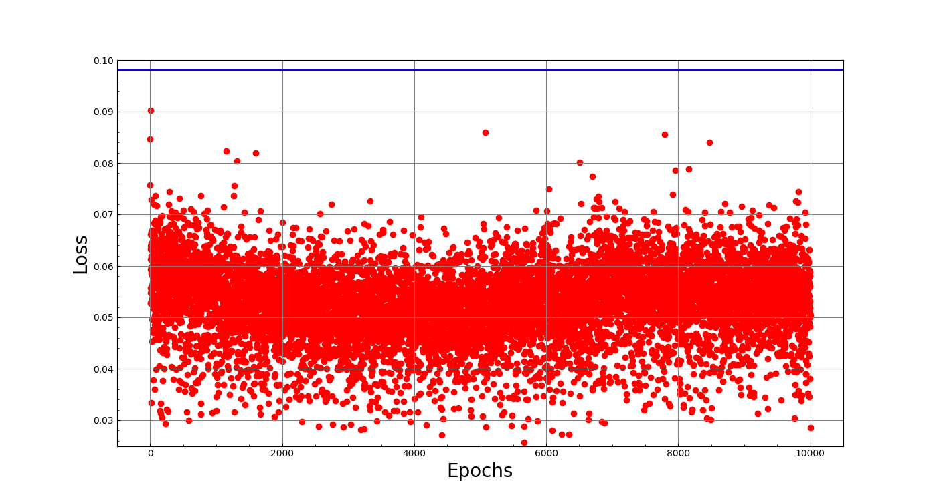

Slide 11
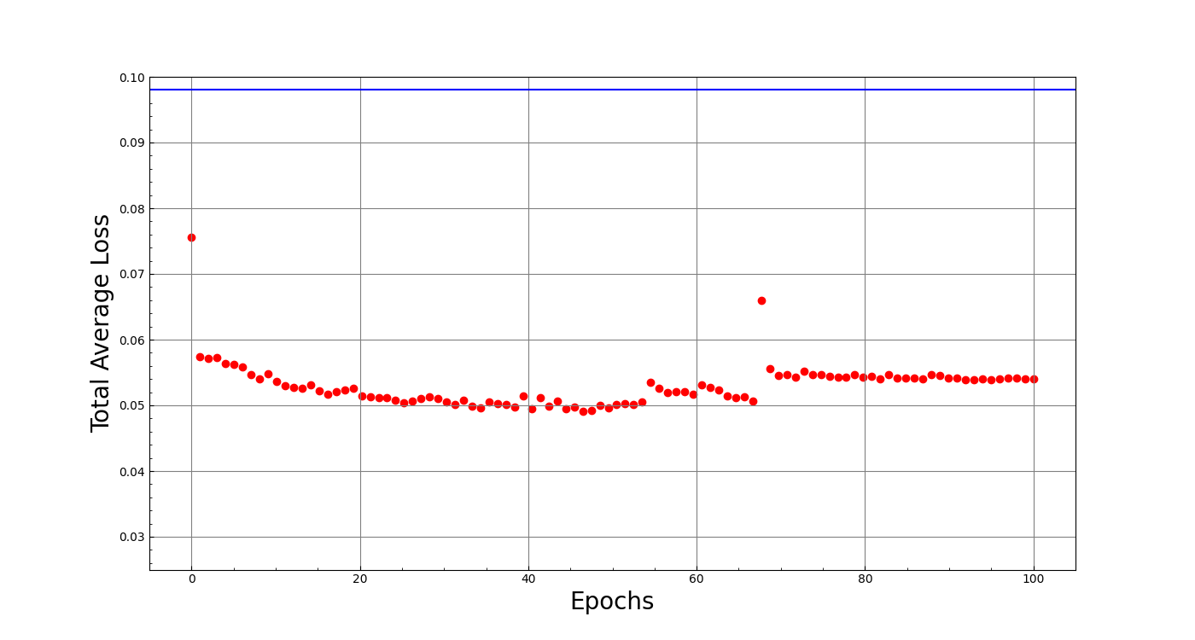

Slide 12
Evaluating our model’s performance
We compared the absolute value of the difference of the model’s output and validation data for 4 samples - 1 for each scaling
Furthermore, we analysed the spatial output of the model via graph colouring, using the same metrics
The results showed, that the model performs very similarly for each scaling and the accuracy for smaller roads is quite good, for larger roads it falls behind our expectations

Slide 13
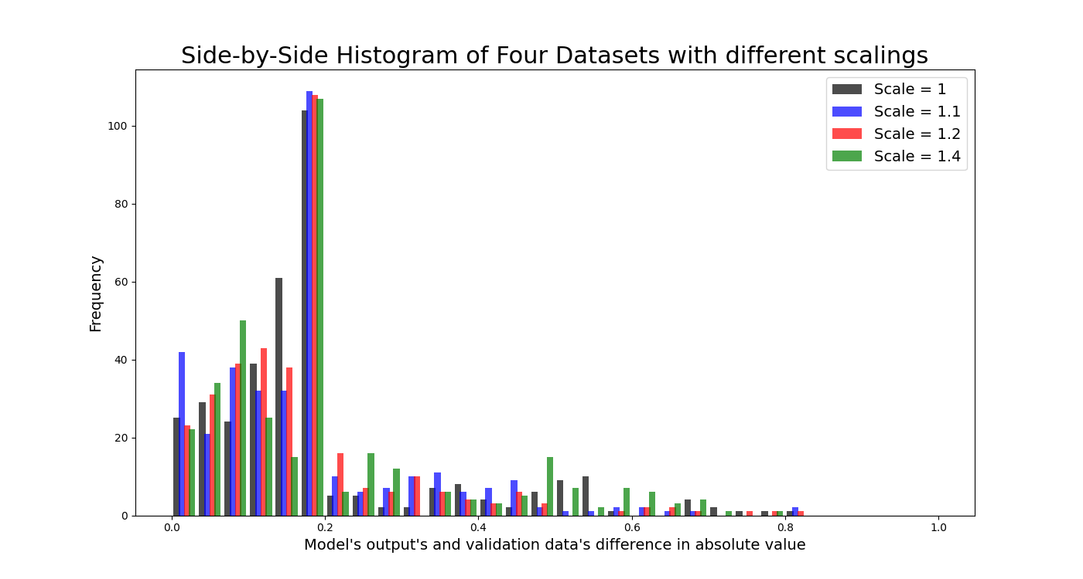

Slide 14
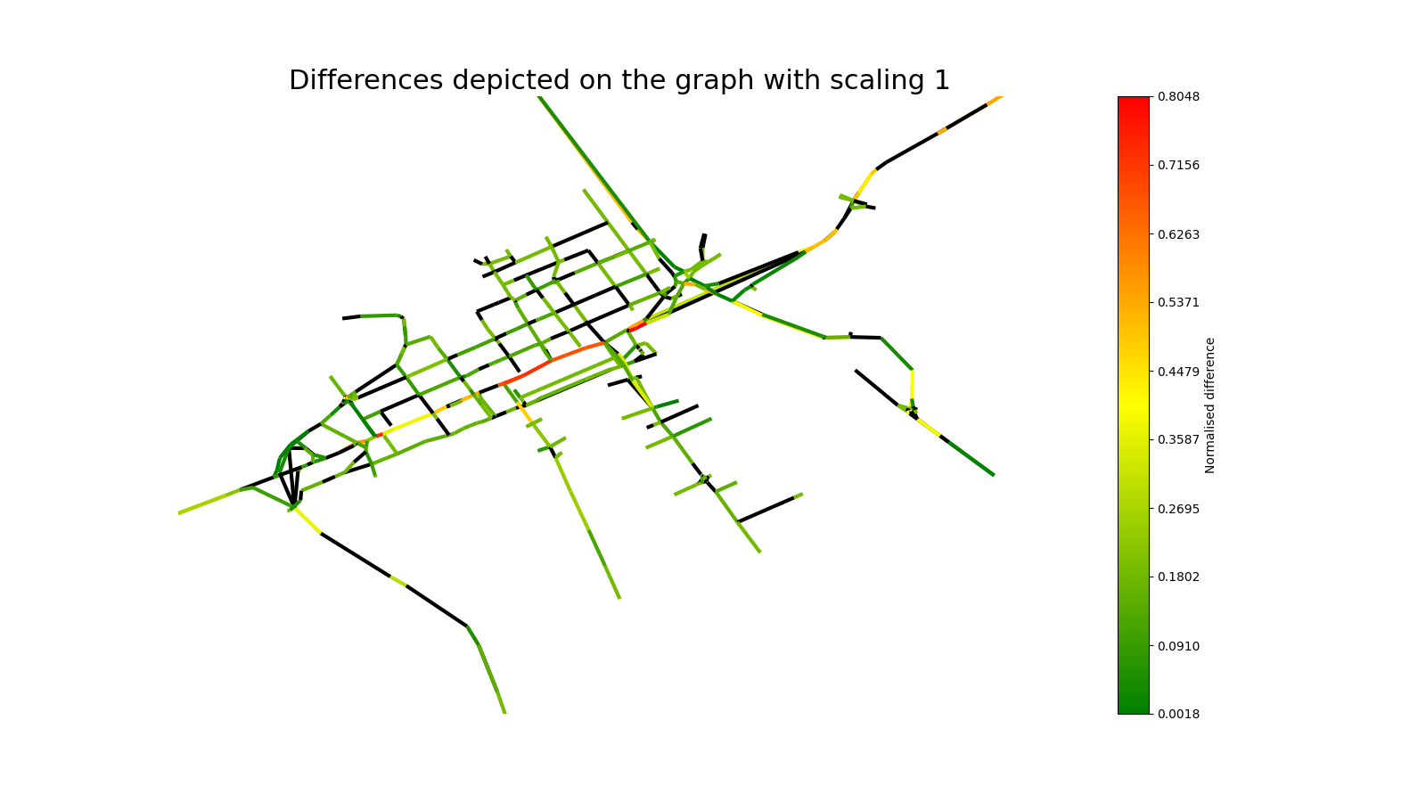

Slide 15
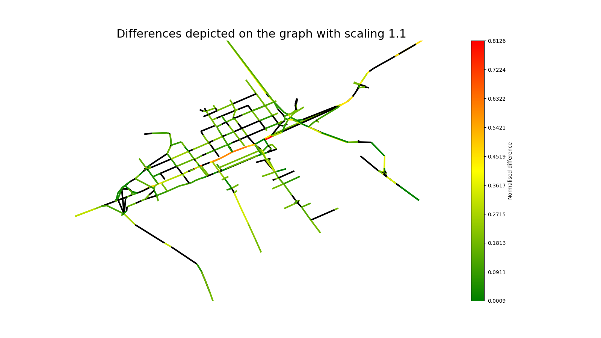

Slide 16
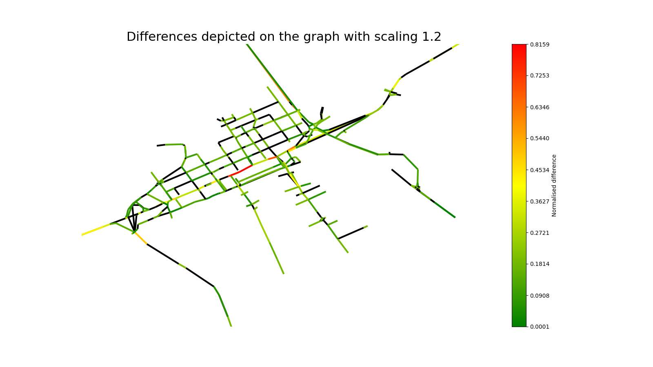

Slide 17
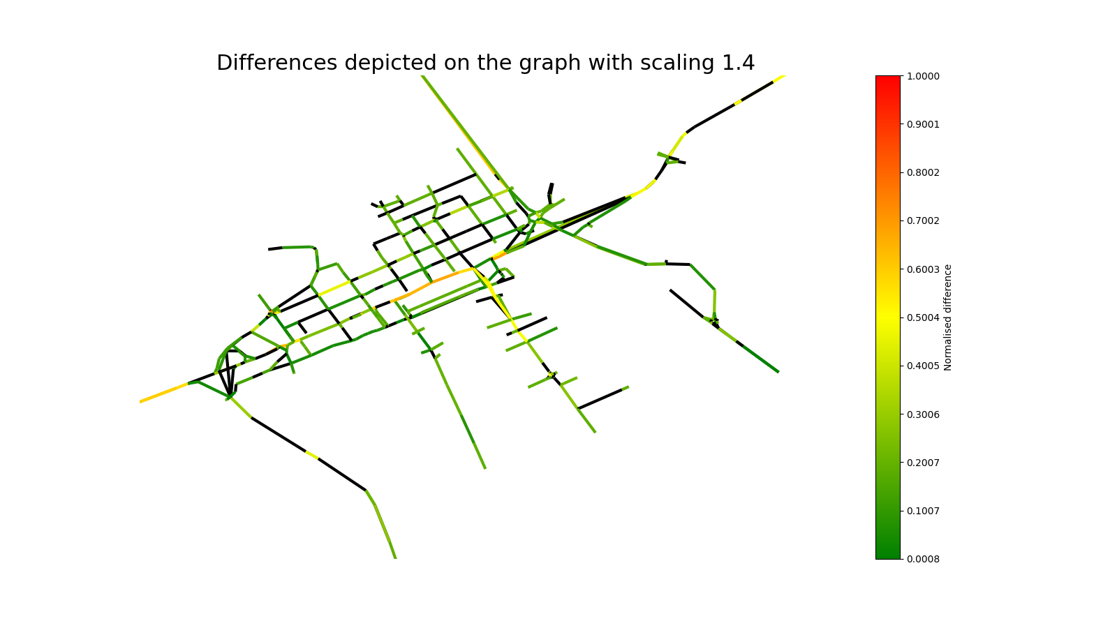

Slide 18
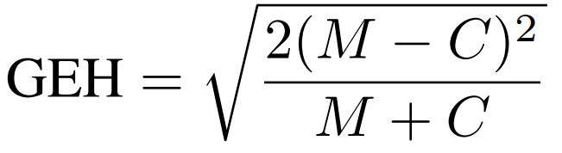
GEH metric
To further evaluate our model, we utilized the GEH metric, a widely recognized measure in the field of traffic engineering.
The aim of GEH metric highlight the roads with higher traffic volume.

Slide 19
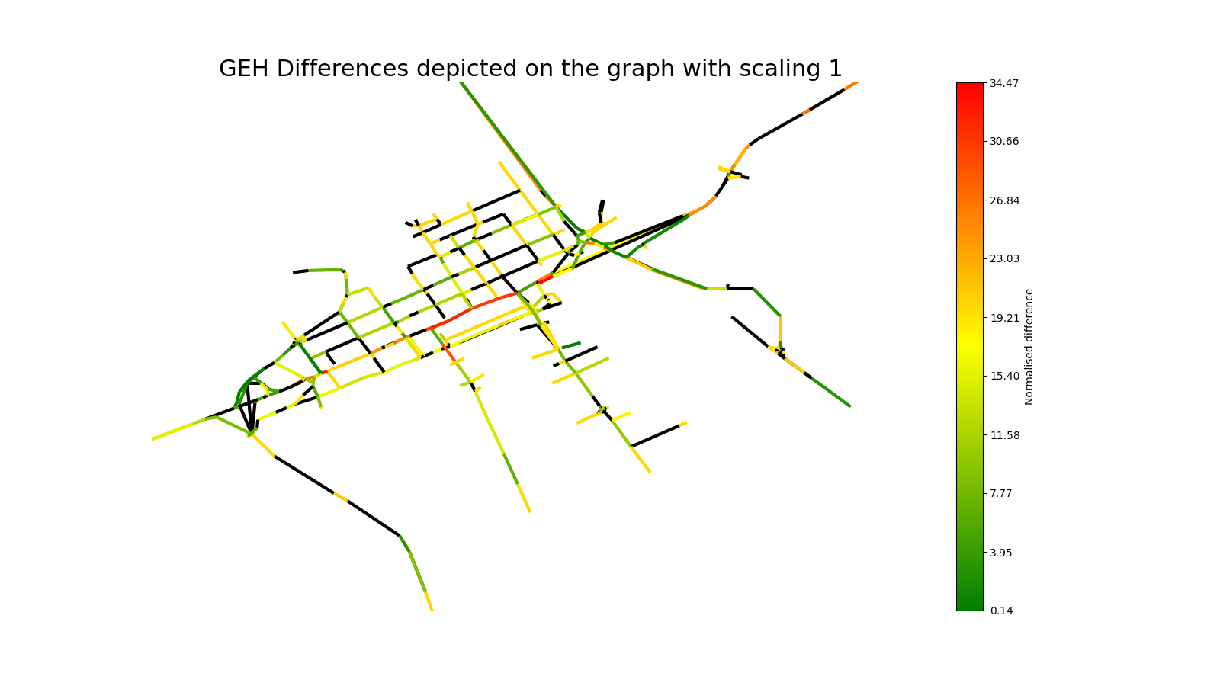

Slide 20
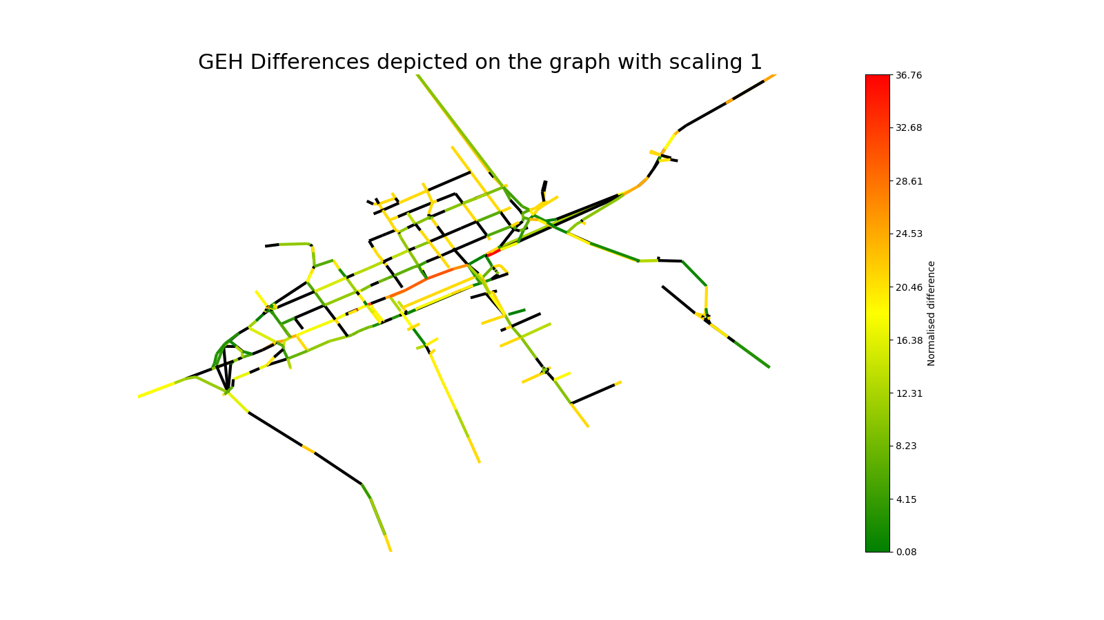
.1

Slide 21
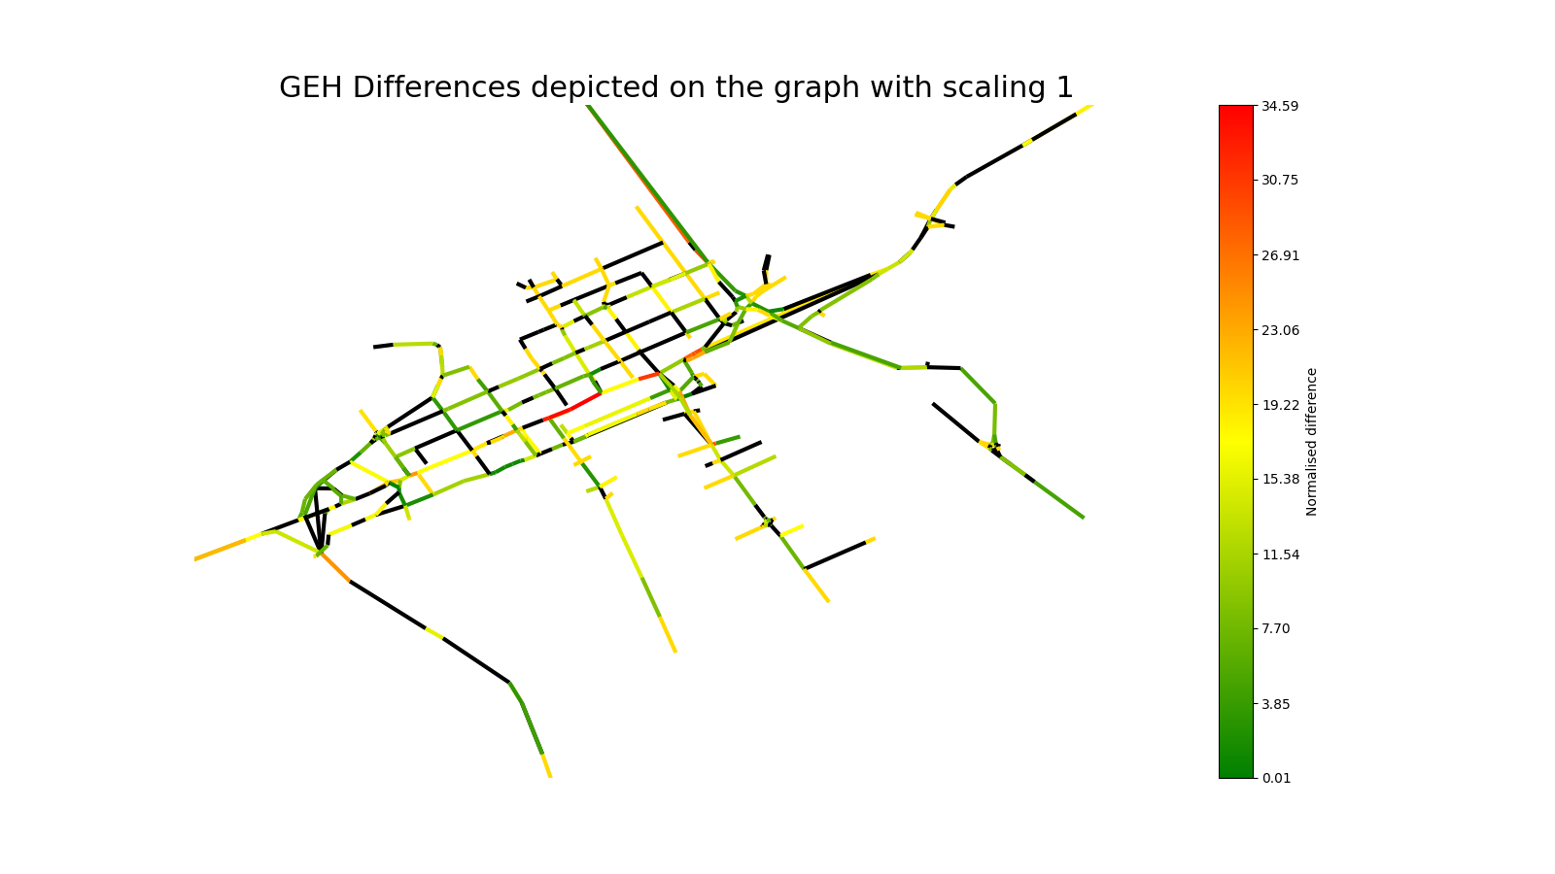
.2

Slide 22
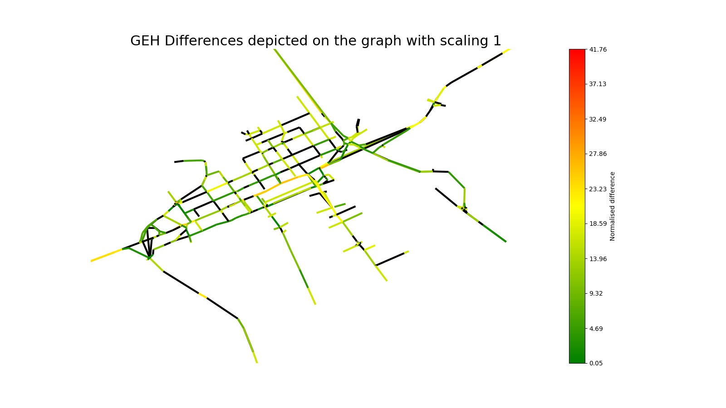
.4

Slide 23
Summary and future plans
In this semester we successfully created a traffic estimator tool using pytorch and SUMO, and showed that the model, despite its simplicity, performs fairly well
For the future we have a number of potential projects such as:
Experimenting with more complex models to achieve better performance
Working out a strategy for choosing the known roads in a more effective way, therefore achieving better results
Conduct sensitivity analysis to understand the impact of various parameters on our model’s performance and robustness
Possibly working on a traffic forecasting model
If you are interested, you can take a look at our codes at: https://github.com/Nemesaaa/Projectlab

Slide 24
Thank you for your kind attention!

