Slide 1
Snakes and Ladders
Markov chain simulation

Slide 2
Motivation
Snakes & Ladders is a trendy game that originated in India itself. People in India have played this game for centuries, and almost all the kids here have played this game once. We Indians initially gave the game a spiritual aspect, and very few have tried to view the game mathematically, even when the game has an entirely Probabilistic approach.
We wish to analyze the game using Markov Chains and draw out conclusions & computer simulations that would help understand the game's dynamics better. The study can also be further distributed to budding mathematicians, helping them understand the complex concept of probabilities in a fun manner.

Slide 3
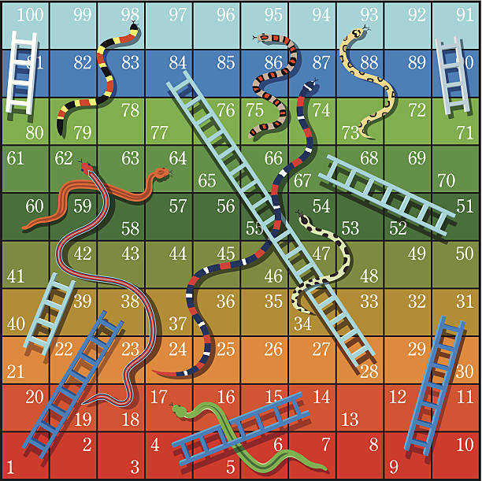
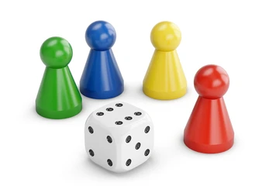
What is snakes and ladders?

Slide 4
What is snakes and ladders?
Snakes and ladders is a board game for two or more players regarded today as a worldwide classic.
A number of "ladders" and "snakes" are pictured on the board, each connecting two specific board squares. The object of the game is to navigate one's game piece, according to die rolls, from the start (bottom square) to the finish (top square), helped by climbing ladders but hindered by falling down from being bitten by snakes.

Slide 5
Gameplay and Rules
The board comprises of a 10x10 grid, with 100 tiles. Players start off start from a hypothetical zeroth square and take turns rolling the dice.
The players go along a predetermined path inscribed on the gameboard, which often follows a boustrophedon (ox-plow) track from the bottom to the top of the playing area, passing through each square once.
If a player falls on a "snake" (or chute) with a higher-numbered tile, the player slides the token down to the tile at the snake's tail. Similarly, if a player lands at the bottom of a ladder, the player climbs up to the tile at the ladder’s top.
The first player who gets their token exactly to the 100th tile on the board first wins the game.

Slide 6
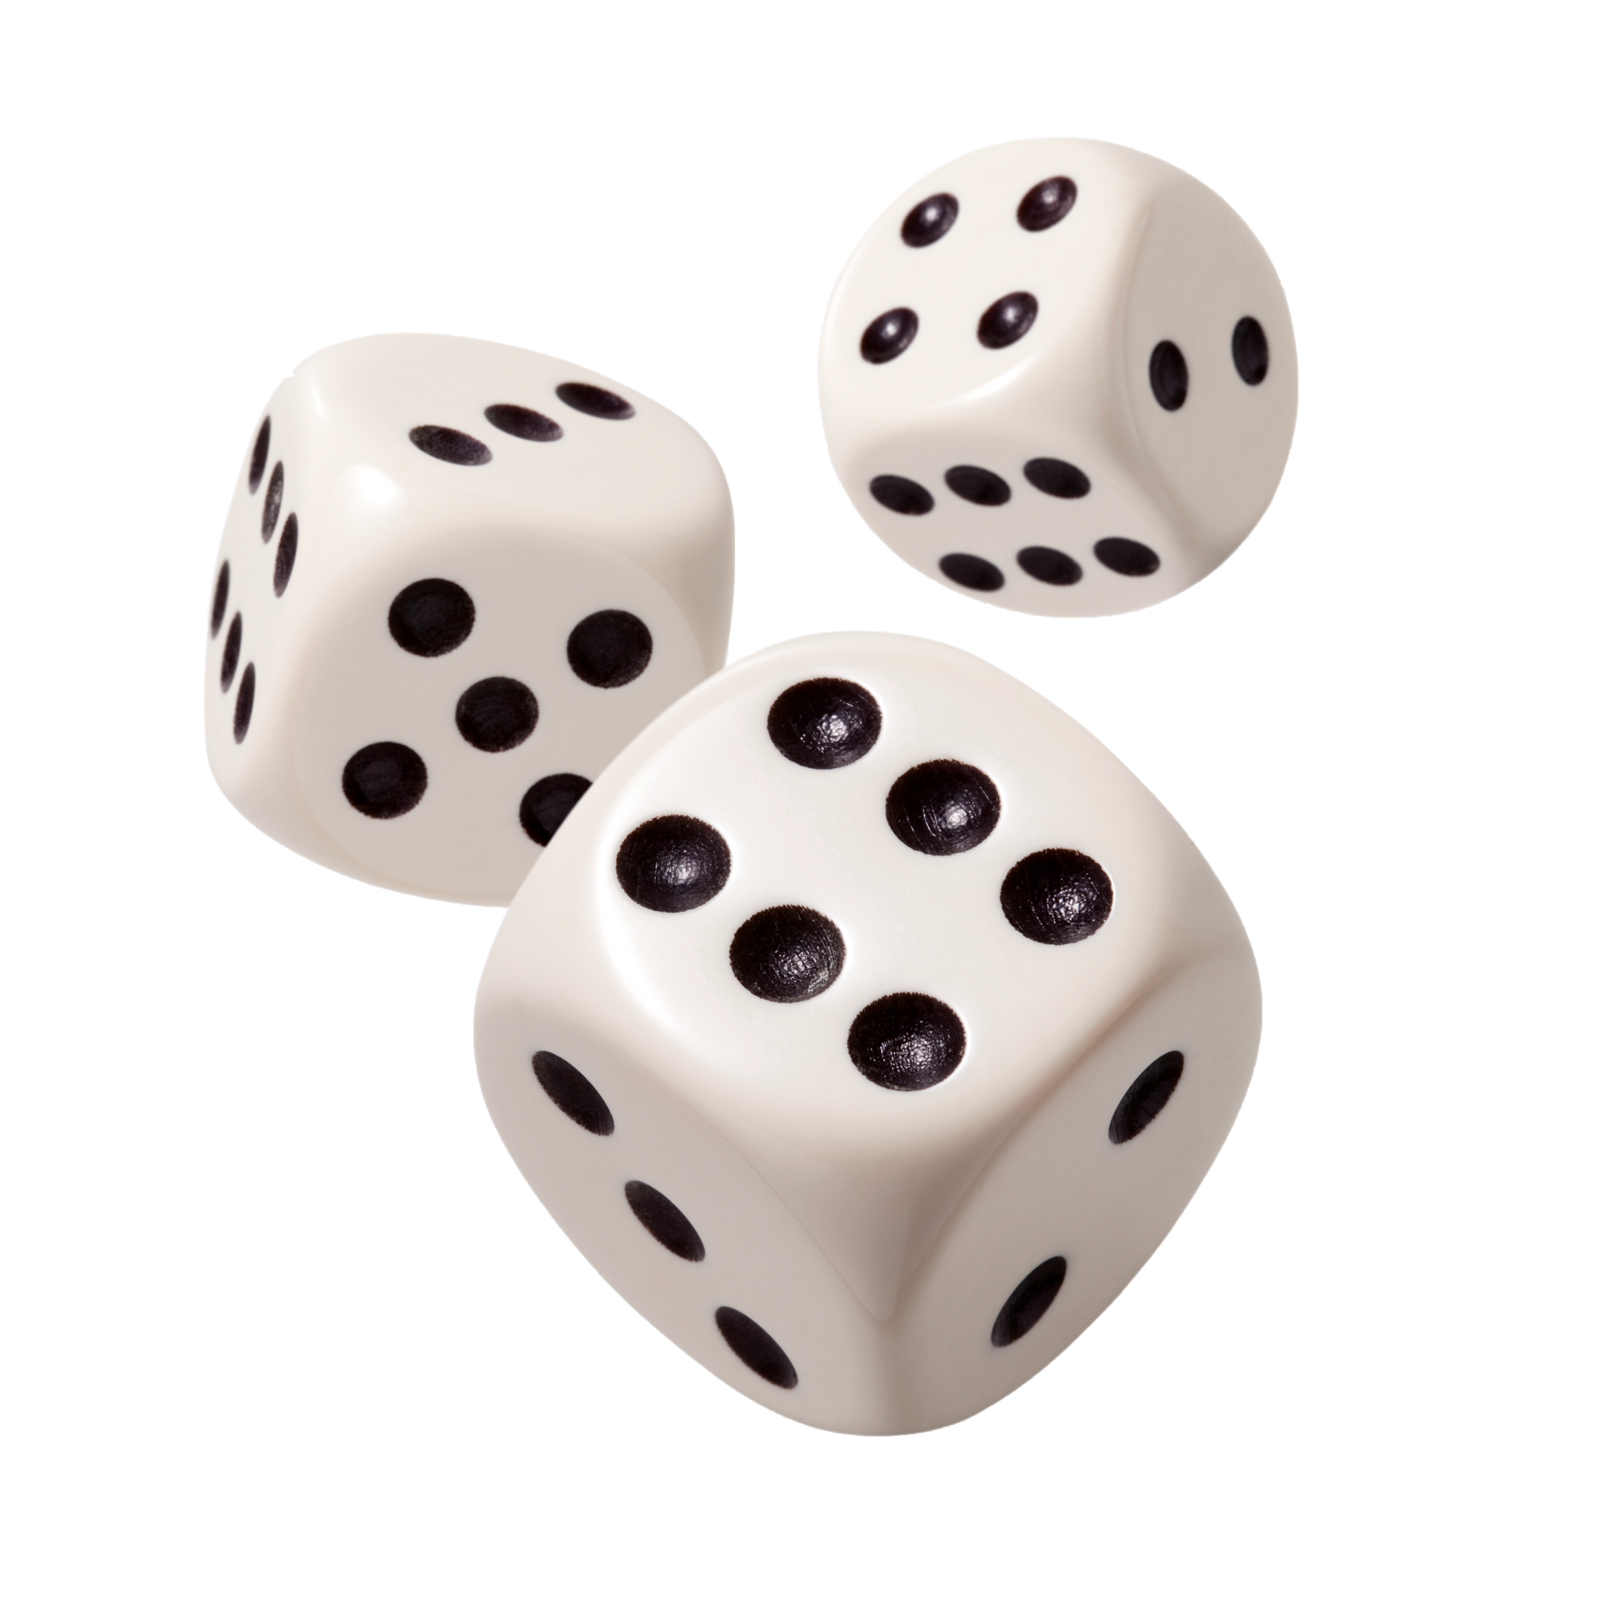
Component that introduces probability
The probabilistic component among the pieces in the game is the dice. Each roll of dice is independent of all other dice rolls. We assume that the dice is unbiased. So the chance of occurrence of any side of the dice is equally likely. Hence in a dice with n sides, the probability that the side 0>i>n+1 occurs is 1/n. A dice of side 6 has been used for most of the simulations. So this is a discrete uniform distribution.

Slide 7
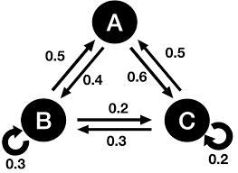
Markov Chains
A Markov chain, also known as a Markov process, is a stochastic model that describes a succession of possible occurrences.
Generally Markov chain, or the Markov Process is used for discrete time spaces (Discrete Time Markov chains).
Markov chains have many advantages like - simplicity, high predictive power
Markov Property (memoryless property) - signifies that the future evolution of the Markov process is determined solely by the current state and is unaffected by prior history. If the present state is given, the Markov process does not recall the previous state.

Slide 8
Some Terminologies.
Random Walk - A series of random transitions from an initial state x to a state y.
Path - A path is a walk where no state is repeated on transition.
Cycle - A cycle is a walk where first and last states are same and no state is repeated.
Recurrent state - A state is considered to be recurrent if, whenever we leave it, we will return to it with probability one in the future.
Absorbing state - An absorbing state is one that cannot be left once entered.
Transient state - A state is considered to be transient if, whenever we leave it, we will return to it with probability less than one in the future.

Slide 9


Real life examples of Markov chains
Search Engine Optimization
SEOs use markov chains to predict which content would be most relevant to the user thus improving the user experience. Tech giants like google use markov chain in multiple ways such as identifying key phrases belonging to a cluster, suggesting what link is user looking for, identifying hubs of relevant authorities to redirect the user.
Gambling
The amount to be won in the next bet is based on probability but doesn’t depend upon the previous results. Hence Gambling is an example of Markov chain.
Auto text completion
Markov chains are used to predict the what the next word can be, the next word depends upon the word before it and not the previous sentences.This is a memorylessness which is a markov property.

Slide 10
Real life examples of Markov chains
Prediction of Stock market trends
Stock market is based on states depicting the market to be bullish, bearish or stagnant. It is known that state of the market on next day is dependent on state of market today, and a transition matrix showing probabilities of state change can be used to find the state of market for incoming weeks.
Weather forecast
Markov chains are used for day to day weather forecasting as weather of next day has a probabilistic dependency with current weather conditions but isn’t related to previous weather records.

Slide 11
Why model snakes and ladders as a Markov Chain?
Snakes and Ladders may be represented as an finite state Markov Chain, because of the following properties:-
Memoryless property - The snake and ladder game follows the memory-less property, the probability of getting to any state with a single roll of die depends only on the previous state.When a piece is on a particular state, the next state it goes on depends only on the value obtained on rolling the dice.
Random Walk - A series of steps form the zero state to the current state of the player.
Path - A path form state i to j is when there are no repeated states in the valid moves taking the player from state i to j.
Recurrent states - Player stuck in a loop of snakes and ladders, example shown later.
Absorbing states - State 100 (this is the winning state for the game)

Slide 12
All the states except those which have a snake mouth or ladder bottom are accessible as its possible to go to all of those states from the beginning state 0.
States can communicate going forward (if i<j then it's possible to go from i to j). Also,
it's possible to go from j to i if there is a snake after or on j that takes us to i or a state before i.
This markov chain is reducible and most states are aperiodic.
So,we can model snake and ladder as a markov chain, in with each square represents a state and the final square(100) being the single absorbing state. The absorbing state is recurring, and all the other 99 states are transient states.
Given the game rules and the board layout, we can generate a transition matrix that displays the likelihood of transitioning from one transitory state to any other.

Slide 13
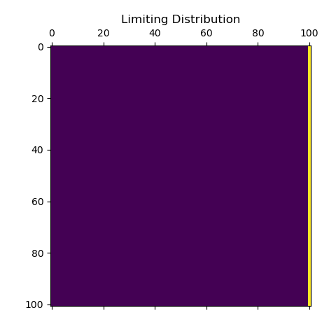
Limiting Distribution
P is raised to 165,
tol = 0.001 (max-diff norm)
P^n = P^n+1

Slide 14
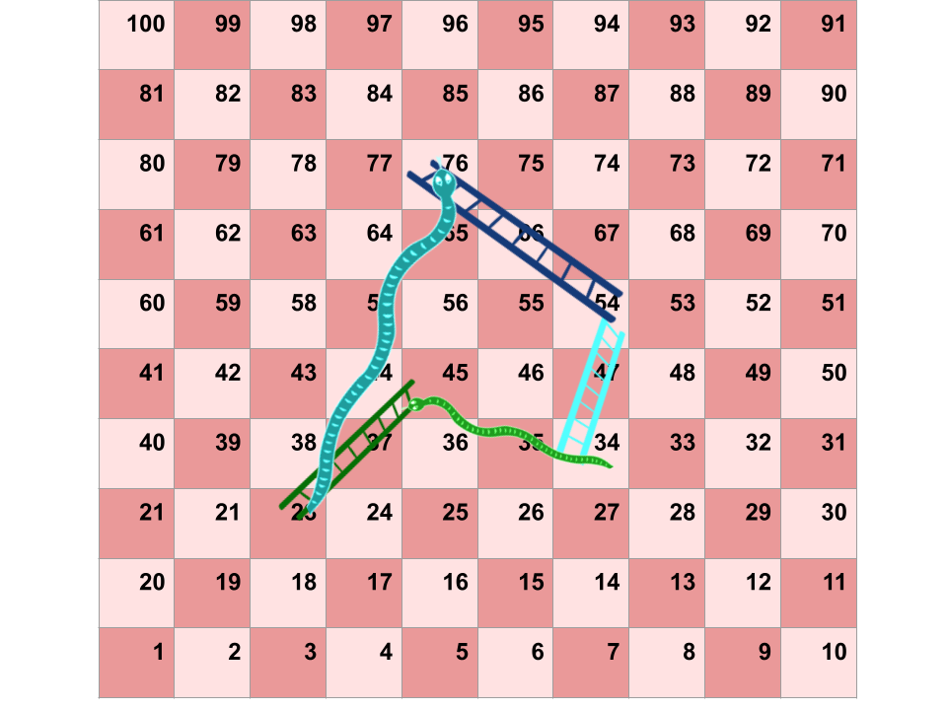
Recurrent state
A hypothetical example of recurrent state, in the snake and ladder game. Here in the image we find that the recurrent states are 23, 45, 34, 54, and 76. If the player reaches any of these states sometime, the player will never be able to get out of these states.

Slide 15
Snakes and ladder as Markov Chain
A Markov chain or Markov process is a succession of probabilistic changes from one state to another with no recollection of prior states. This Markov chain is also a regular chain with the limiting probability distribution provided by
𝜋₀ = (1, 0, … ,0) , and for states 𝑖 = 1, … , 𝑛. 𝜋_{i+1} = 𝜋_{i} * P
The standard board of the game can be denoted as R, representing all of the transitions. Specifically R= {(1, 38), (4, 14), (9, 31), (21, 42), (28, 84), (36, 44), (51, 67), (71, 91), (80, 100), (16, 6), (48, 26), (49, 11), (56, 53), (62, 19), (64, 60), (87, 24), (93, 73), (95, 75), (98, 78)}.
Stationary distribution: 𝜋 = 𝜋 * P
For our model when the piece reaches the square valued 100, it stays there and cannot move anywhere else. Thus
𝜋 = (0, 0, … ,1) for the final distribution once game is over.

Slide 16
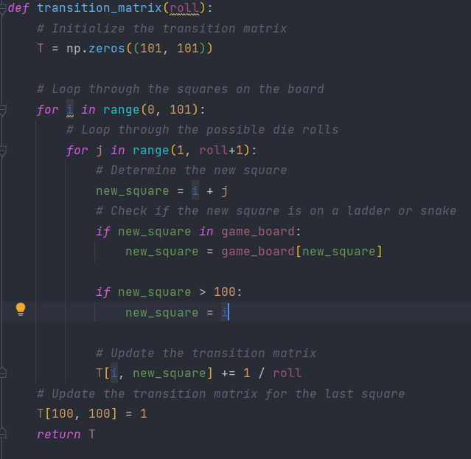
SIMULATION OF THE GAME AND MARKOV CHAIN

Slide 17
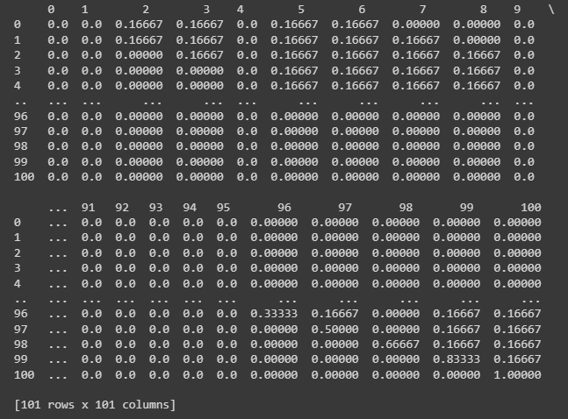
Constructing the Transition Probability Matrix
A single roll of die places a player from state (cell) i to exactly 6 distinct states (cells) with probability ⅙.
It is different in the case i >= 95.
Example: For i = 98, P _{i,98} = ⅔ , P _{i,99} = ⅙ , P _{i,100} = ⅙.
Similarly, P_{100,100} = 1

Slide 18
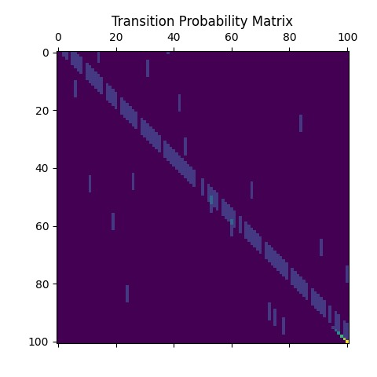
Transition matrix for normal snakes and ladder
This is the transition matrix, of a general snakes and ladder game, calculated for the game that was used for simulation. Each of the blue bars is for representing the probability ⅙ wrt positions.

Slide 19
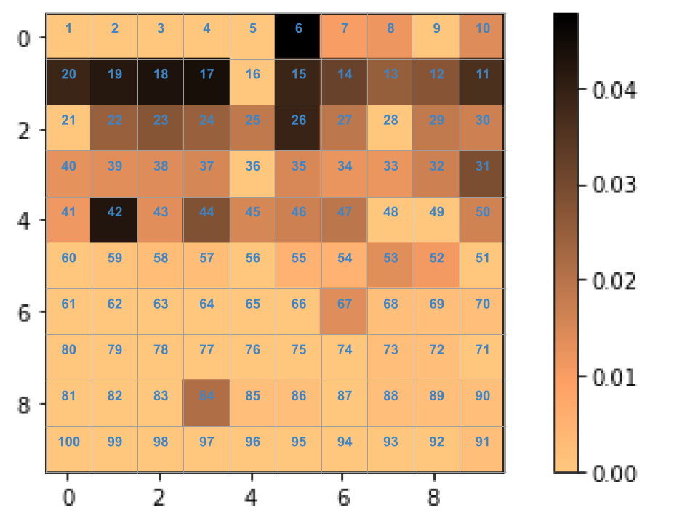
Probability
Distribution
For position of player after
5 moves
This image shows the probability that the player can be at some state in the game after 5 states, the snakes and ladders are the same as the one used for the simulation above.

Slide 20
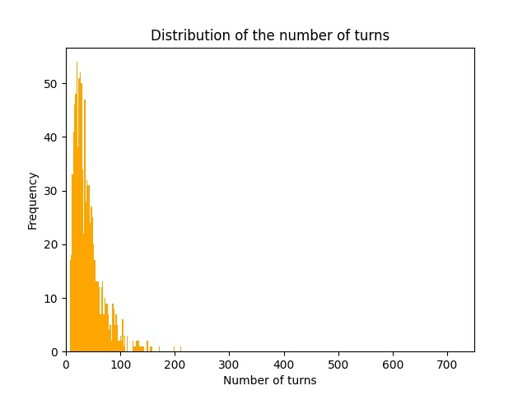
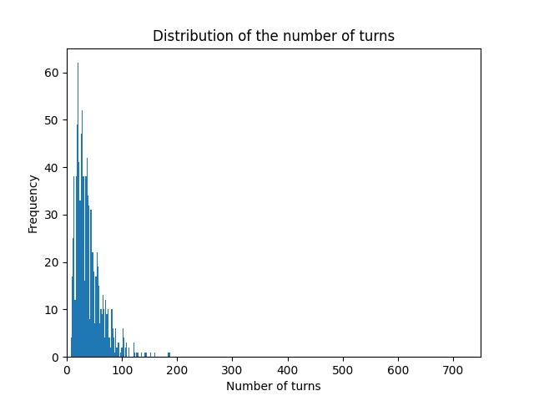
Simulations on Classic Board
From markov chain simulation
From snakes and ladder game simulation

Slide 21
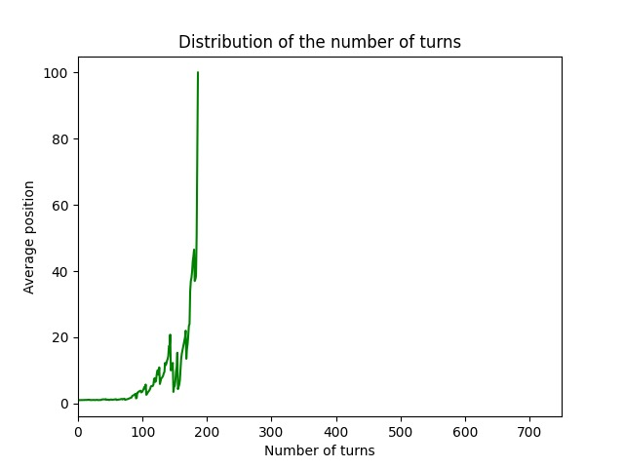
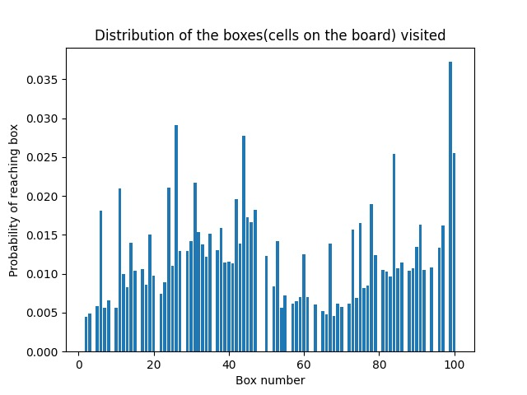
Graph for position of the player vs the turn number in a normal board
The probability of reaching a state in a normal board(some states have a zero probability because from those states the player is either climbing the ladder or is bitten by a snake)

Slide 22
Effects of changing number of snakes and ladders on finish time
Intuitively, adding more snakes might increase the finish time since the players drop down to lower-numbered tiles more frequently. In the same manner, adding more ladders should decrease finish time.We have analysed the graphs shown previously and as the number of snakes and ladders change, the transition probability matrix changes and the movement of the piece along the board changes along with that similar to how markov chain walk for the given transition probability matrix.

Slide 23
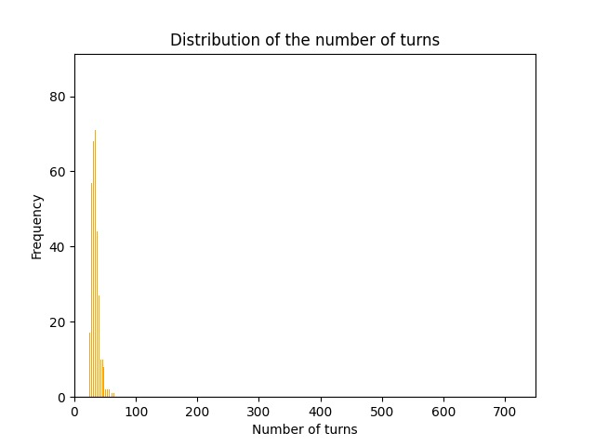
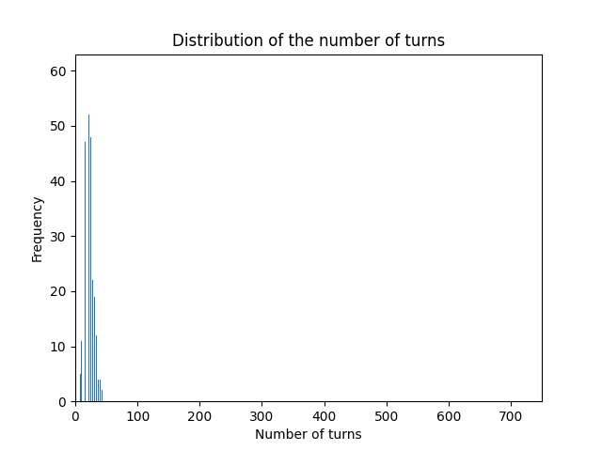
Simulation on board without snakes
From markov chain simulation
From snakes and ladder game simulation

Slide 24
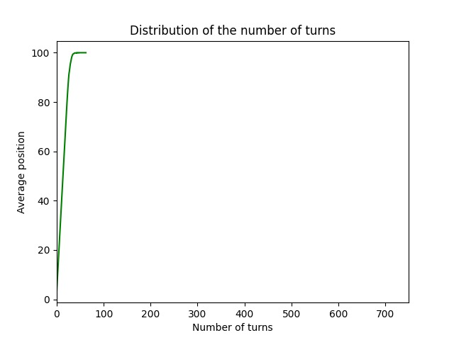
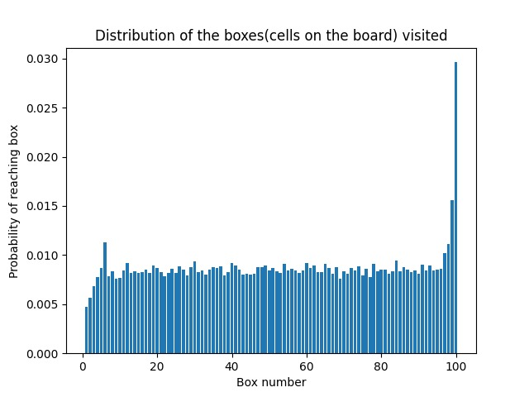
Graph for position of the player vs the turn number in a board without snakes and ladder.
The probability of reaching a state in a normal board(here none of the states have a zero probability as there are no snakes or ladders)

Slide 25


Transition probability matrix
With no snakes
With no ladders
With both snakes and ladder

Slide 26
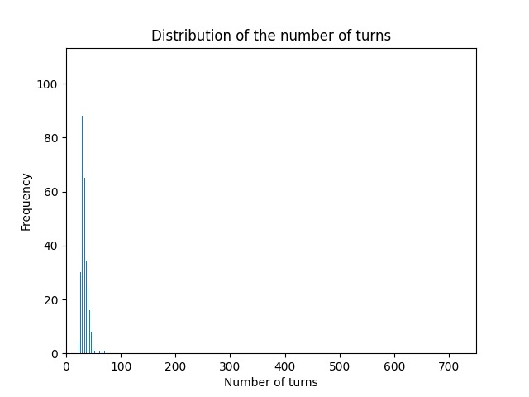
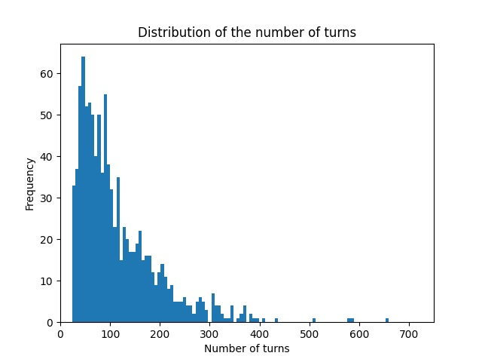
We are modeling our game as a markov process and we can see for different graphs how behavior changes when number of snakes and ladder changes. These changes are reflected in the transition probability matrix and changes the behavior of the markov chain and when it reaches its final absorbing state.
Normal board
Without both
Without snakes
Without ladders

Slide 27
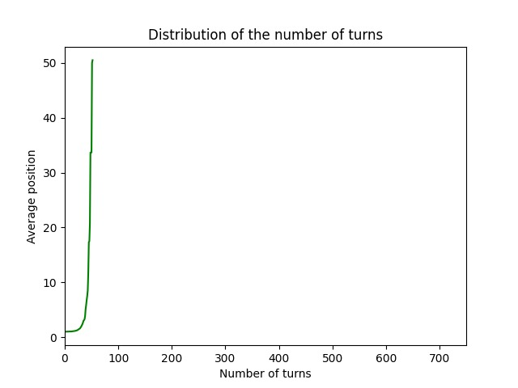
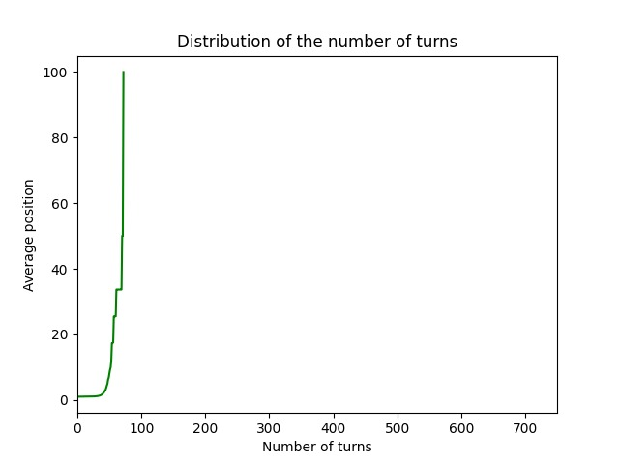
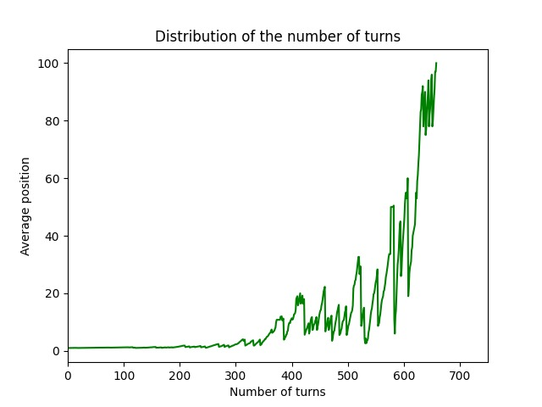
The following graphs show the situation of average position of a player on the board with respect to the number of turns. We can clearly see the difference in distribution as the board type changes (as mentioned). These modifications are represented in the transition probability matrix, which alters the behaviour of the markov chain and the time it takes to reach its final absorbing state.
Classic board
Ladders only
No snakes or ladders
Snakes only

Slide 28
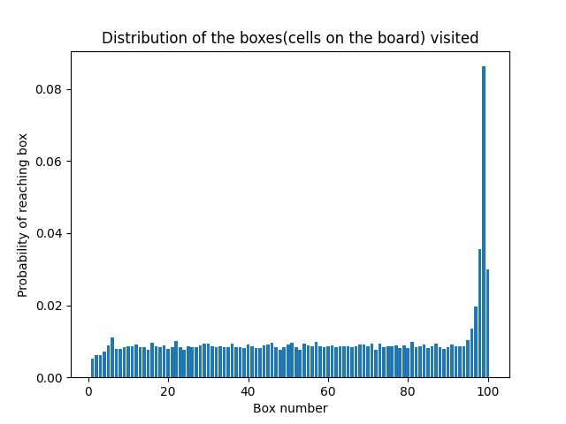
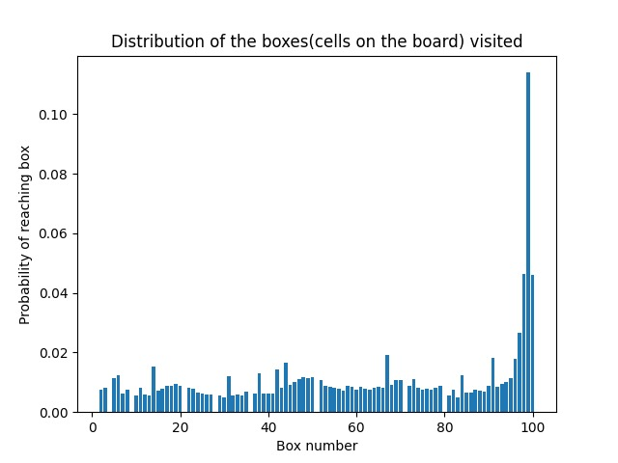
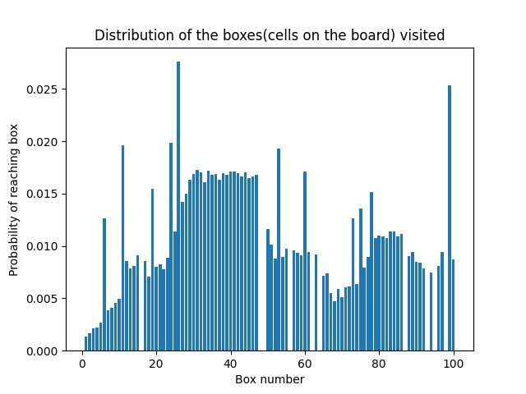
The following graphs show the distribution of probabilities of reaching each state/box from 0 to 100. We can clearly see the difference in probability distribution as the board type changes (as mentioned). These modifications are represented in the transition probability matrix, which alters the behaviour of the markov chain and the time it takes to reach its final absorbing state.
Normal board
Without both
Without snakes
Without ladders

Slide 29
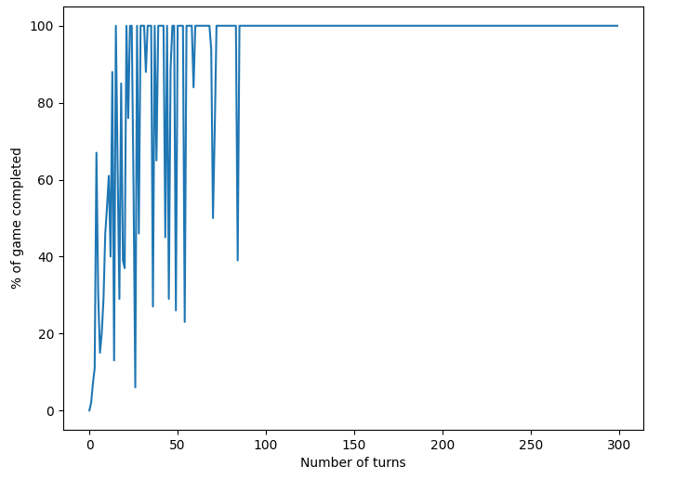
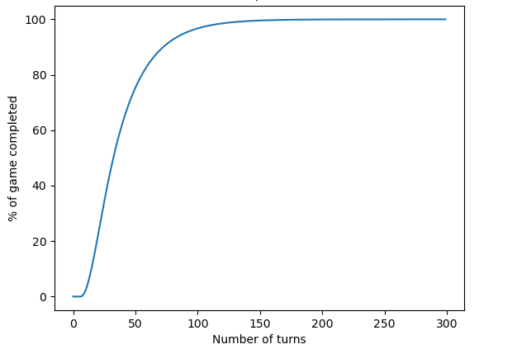
Typical game length
Simulating the game 1000 times yields a number around 38-39 as the average number of turns required to finish the game.
It can be clearly seen from both the following methods of analyzing the game that game finishes after apx 100 turns.
Through simulation
(b) After modelling as Markov process

Slide 30
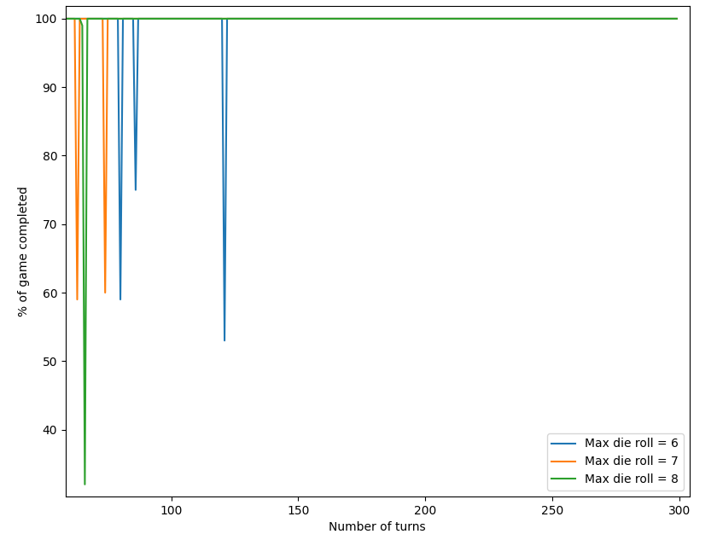
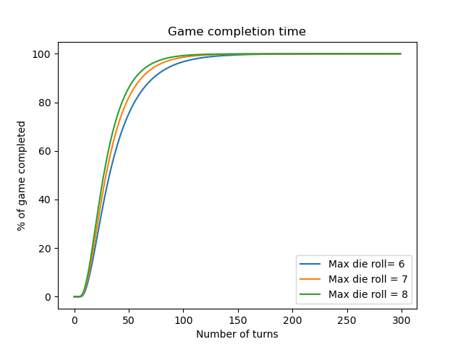
Effects of adding more sides to the dice wrt finish time
As the number of sides of the die increases, the number of turns it takes to complete the game decreases.
Through simulation
(b) After modelling as Markov process

Slide 31
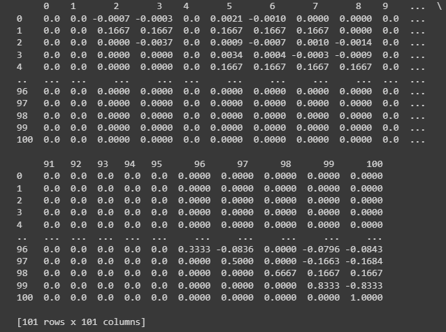
Verifying the correctness of theoretically computed TPM
We simulated the game 1000 times and constructed a transition probability matrix from the data obtained.
It was found to be very close to the theoretically computed one.
The difference of the two matrices consists of negligible values.

Slide 32
Conclusion
We have successfully coded and compiled both the game and its simulation as a Markov Chain.
We have found that Snakes & Ladders follows Markov Property, with 1 absorbing (100) and other transient states.
We have obtained results for many scenarios in graphical format for both cases, and the graphs obtained seemed to coincide further justifying our claim.
Thus, we have successfully modeled the game as a Markov Chain.

Slide 33
References
https://people.sc.fsu.edu/~jburkardt/presentations/snakes_2014_fsu.pdf
https://scipython.com/book/chapter-6-numpy/additional-problems/analysing-snakes-and-ladders-as-a-markov-chain/
https://web.mit.edu/18.06/www/Spring17/Chutes-and-Ladders.pdf
https://math.uchicago.edu/~may/REU2014/REUPapers/Hochman.pdf
https://math.uchicago.edu/~may/REU2014/REUPapers/Hochman.pdf
https://jaketae.github.io/study/markov-chain/

Slide 34
THANK YOU
Adarsh Raj Shivam - 2020274
Aman Kumar - 2020279
Aniket Goel - 2020281
Arya Sinha - 2020498
Ishita Sindhwani- 2020305
Keshav Rajput - 2020308
Satyam Arora - 2020330

