Slide 1
Customer Attrition in Telecom Sector
ML Group 6

Slide 2
Motivation
Customer Attrition is defined as the loss of customers by a business.
Predicting the churn/attrition rate is very useful because a low attrition rate implies customers are happy with the service provided. And also for every customer that churns, you are losing potential profits.
In contrast, high attrition rate implies dissatisfaction of customers with the service, causing them to leave. High attrition is a clear sign of losing foothold and rival rising as the customers who leave would mostly turn up to some other service provider.

Slide 3
Motivation
According to Forbes, it costs 5 times more to acquire a new customer than it does to retain one.
Companies lose about $1.6 trillion per year due to customer attrition.
Moreover, the Harvard Business School report claims that on average, a 5% increase in customer retention rates results in 25% – 95% increase of profits.
We aim to analyze the factors on which attrition depends along with predicting customer attrition in order to sustain the company.

Slide 4
Literature Review
Customer churn prediction in telecom (Bingquan Huang, Mohand Tahar Kechadi, Brian Buckley, Jan 2012)
Different features of Datasets are introduced: 2 six-month Henley segmentation(divides customers and potential customers into different groups or levels according to characteristics, needs, and commercial values), precise 4-month call details, line information, bill and payment information, account information, etc.
Results: feature subset of call details is more effective for churn prediction, most useful type of call detail is information of local calls, feature of the 6-bill with payment is the best for the SVM and C4.5, results from SVM and C4.5 are the best. AUC values from DMEL are the lowest for any feature set, prediction rates obtained by Naive Bayes modelling technique are very bad (large number of features, not transformed into low dimension).
Churn prediction in telecom. using big data (Abdelrahim K. Ahmad, Assef Jafar, Kadan Aljoumaa, Mar 2019)
Model developed in this work uses machine learning techniques on big data platform and builds a new way of feature engineering and selection. In order to measure the performance of the model, the Area Under Curve (AUC) standard measure is adopted, and the AUC value obtained is 93.3%.
Another main contribution is to use customer social network in the prediction model by extracting Social Network Analysis (SNA) features. The use of SNA enhanced the performance of the model from 84 to 93.3% against AUC standard. The model experimented four algorithms: Decision Tree, Random Forest, Gradient Boosted Machine Tree “GBM” and Extreme Gradient Boosting “XGBOOST”. Best results were obtained by applying XGBOOST algorithm.

Slide 5
Literature Review
Model of Customer Churn Prediction on Support Vector Machine (XIA Guo-en, JIN Wei-dong, Sept 2008)
Current machine learning models are of 2 types, Classification(good for small scale, uncertain at large scale) & AI based(more complex, low generalization ability). This paper uses SVM on structural risk minimization to improve the prediction. On comparing it proved to be the best in accuracy rate, hit rate, covering rate, and lift coefficient. 2 datasets are used (UCI database of University of California and home telecommunication carry. Results using SVM model are superior to the other methods except that ANN in the hit rate and decision tree C4.5 in the coverage rate
Final Outcome Analysis: Customer with big churn rate have the following traits: strong charge willingness, long mobile service, and considerable customer care. Large scale, high dimension, nonlinearity, nonnormality, time series, and rare class, SVM can also be developed in the bank industries using similar customer churn data.
Churn Prediction using Improved Random Forest (Yaya Xie, Xiu Li, E.W.T. Ngai, Weiyun Ying, Apr 2009)
In this paper, a novel learning method, called improved balanced random forests (IBRF) is used. Using the effectiveness of the standard random forests approach in predicting customer churn, while also integrating sampling techniques and cost-sensitive learning into the approach to achieve a better performance than most existing algorithms. In it, best features are iteratively learned by altering the class distribution and by putting higher penalties on misclassification of the minority class.
It is found to improve prediction accuracy significantly compared with other algorithms, such as artificial neural networks, decision trees, and class-weighted core support vector machines (CWC-SVM). Moreover, IBRF also produces better prediction results than other random forests algorithms such as balanced random forests and weighted random forests.

Slide 6
Dataset Description
Data Source: The public dataset is completely available on the Maven Analytics website platform where it stores and consolidates all available datasets for analysis in the Data Playground. The specific telecom customer churn dataset at hand can be obtained in this link below: https://www.mavenanalytics.io/blog/maven-churn-challenge
After downloading the dataset, we can access the telecom_customer_churn.csv file.

Slide 7
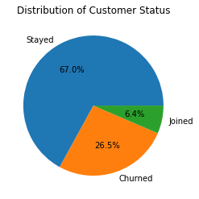
Dataset Description
Data has 7043 rows and 38 columns(23 categorical and 15 numerical)
Target Variable is Customer Status
14 columns have null-values with missing value percentage ranging from 10-70 %
61% of Categorical variables have 2 categories and 87% of Categorical variables have less than 5 categories(excluding nan)
60% of Numeric variables have more than 1000 unique values.

Slide 8
Data Preprocessing
Data Cleaning:This involved the removal of Customer ID column(index column).
Filling missing values: Majority of the columns had 20% NULL values. Missing Values are filled using KNN imputer(categorical) and Mean(numerical).
Encoding Categorical Data: Label encoding was performed for all categorical features as well as the class we are going to try to predict(Customer Status).
Feature Selection: pairwise relation > 0.85 then one of the feature was removed , numerical features with variance threshold less than 0.05 were removed , chi-square testing for categorical features was also done
Standardization and Normalization: The dataset was normalized using sklearn's implementation called Standard Scaler, it normalizes as well as standardizes the data, this helps improving model accuracy for different models.
For rows with Customer Status , Joined was converted into Stayed.
Dimensionality Reduction: We performed Principal Component Analysis to reduce some of the dimensions down to 8 (from 31) since it helps with reducing the time it takes for models like logistic regression to converge. We determined 8 to be the best using trial and error method.
Train test split: Splitting the dataset into training and testing dataset of size 75:25 respectively.
Separability of data: We performed TSNE to check whether the classes are separable or not. We observed that the data is indeed separable.

Slide 9
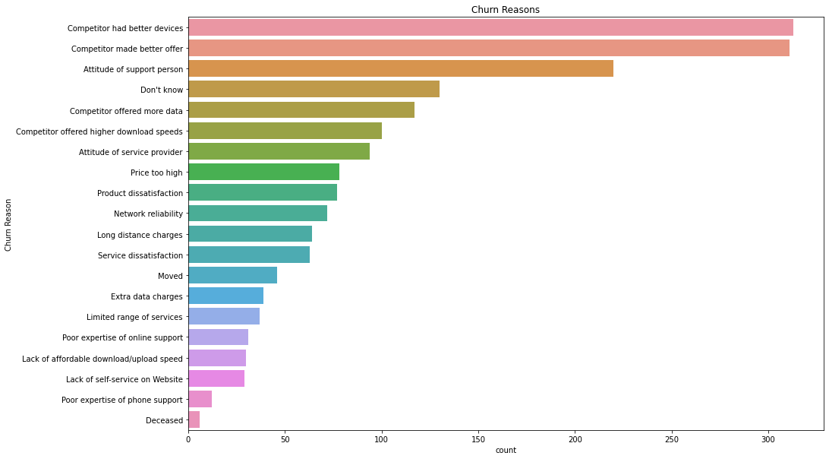
Some EDA
Around 16% of the Customers Churned because competitor provided them with better offers and devices.
Around 13% of attrition was because of bad attitude of support person.

Slide 10
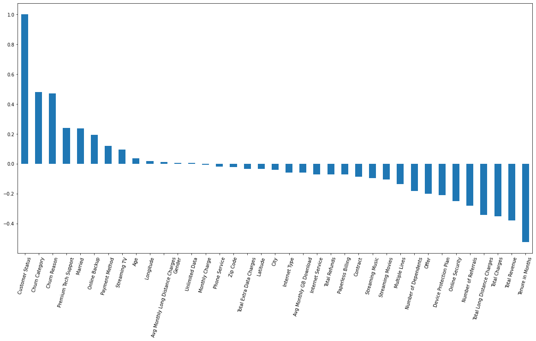
Some EDA
Correlation of different attributes with Customer Status
Churn rate is positively correlated with Churn category,Churn reason,Tech Support and negatively correlated with Tenure,Revenue,Charges

Slide 11
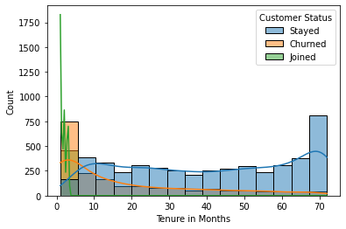
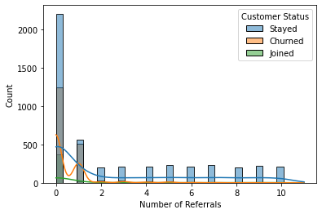
Some EDA
Customers who referred to 0 persons churned more as compared to those who stayed.
Customer who referred to more than one person never churned.
Churn rate is highest in first 5 months
Churn rate decreases as tenure increases

Slide 12
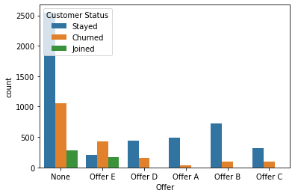
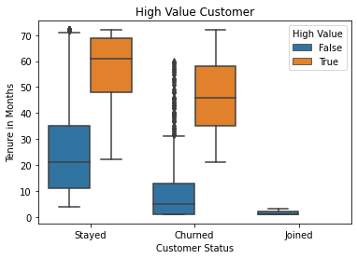
Some EDA
Majority took no offers
High churn rate associated with offer E
high retention rate with offer A and B
High Valued Customer Subscribed for greater tenure .
For customers who stayed , 75% of Non High Value customers subscribed for less than 35 month whereas more than 75% of High value customers subscribed for more than (around)50 months.
Similar pattern can be observed for churned customers.

Slide 13
Methodology
Six models have been used for the classification task along with validation and evaluating performance of each.
Logistic Regression using the default values as given by sklearn's implementation.
Naive Bayes using Gaussian and Bernoulli apriori distributions with default values via sklearn's implementation.
Support Vector Machines using linear, radial basis,polynomial and sigmoid kernels.
Random Forest using sklearn's implementation with the different parameters i.e. estimators from 2 to 20, depth from 5 to 20, and criteria as gini and entropy and obtaining the best parameters using grid search i.e. estimators = 20, depth = 10 and criteria = gini.

Slide 14
Methodology
Boosting Techniques on random forests such as AdaBoost and XGBoost , using sklearn's implementation and applying grid for searching for optimal parameters .The parameters obtained are AdaBoost were estimator = 20,depth = 10,criteria = gini and for XGBoost .
Artificial Neural Networks, the parameters were found using grid search, the activation function 'relu' , learning rate as adaptive, learning rate initialized using 0.001 and having solver as 'adam'. The hidden layer sizes were (256,32),
The valuation metrics used are accuracy score,f1 and recall.
The Kfold cross validation method is used for calculating all the metrics with 5 folds.
ROC-AUC curves are plotted for identifying the performance because they are the most appropriate for a classifier.

Slide 15
SVM
Kernel | Accuracy Score | Precision | Recall | F1 score
Linear | 96.38 | 96.8 | 89.30 | 92.89
rbf | 96.72 | 98.42 | 89.08 | 93.51
poly | 85.83 | 91.18 | 51.64 | 65.91
sigmoid | 91.84 | 85.52 | 83.81 | 84.50
Best accuracy is achieved with rbf kernel.

Slide 16
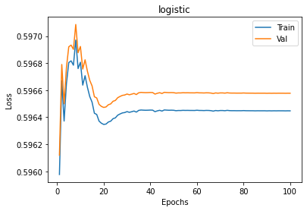
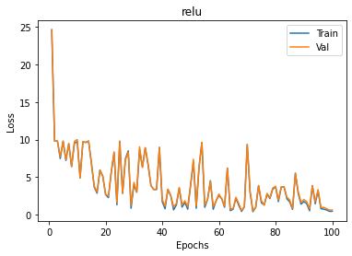
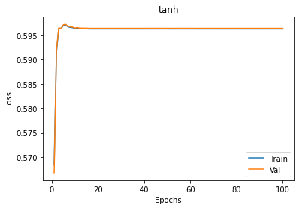
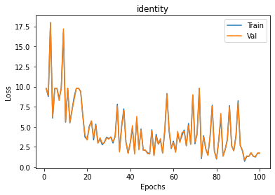
ANN (Best parameters {'activation': 'relu', 'learning_rate': 'adaptive', 'learning_rate_init': 0.001, 'solver': 'adam'})

Slide 17
Some results on ANN
Activation function | Accuracy Score | Training Loss | Testing Loss
Sigmoid | 91.65 | 0.5964 | 0.5965
ReLu | 94.38 | 0.4638 | 0.6304
tanh | 87.93 | 0.5963 | 0.5964
Identity | 91.80 | 1.7064 | 1.7335

Slide 18
Results And Conclusion
Model Name | Accuracy Score | Precision | Recall | F1 | ROC-AUC Score
Logistic | 95.79 | 94.84 | 89.01 | 91.82 | 98.1
Naive Bayes(Gaussian) | 93.16 | 97.18 | 76.4 | 85.56 | 97.3
Naive Bayes(Bernoulli) | 87.03 | 85.91 | 61.20 | 71.44 | 93.4
SVM(kernel=rbf) | 96.72 | 98.42 | 89.08 | 93.515 | 98.8
Random forest (estimator=20,depth=10,criteria=gini) | 94.51 | 95.63 | 83.95 | 89.00 | 98.8
AdaBoost(estimator=20,depth=10,criteria=gini) | 95.23 | 94.20 | 87.45 | 90.31 | 99.7
XGboost(estimator=20,depth=8,objective=’binary:logistic) | 95.47 | 94.34 | 88.23 | 91.11 | 99.8
ANN | 94.38 | 80.48 | 99.66 | 89.05 | 97.8

Slide 19
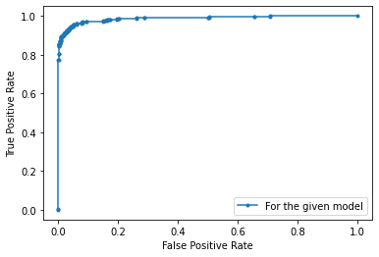
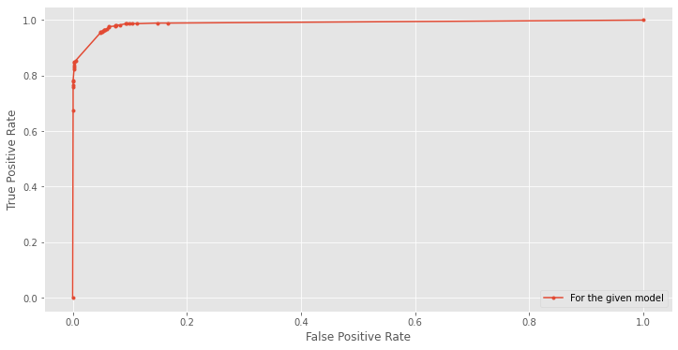
Conclusion ( AUC-ROC of TOP 4)
SVM
Random Forest

Slide 20
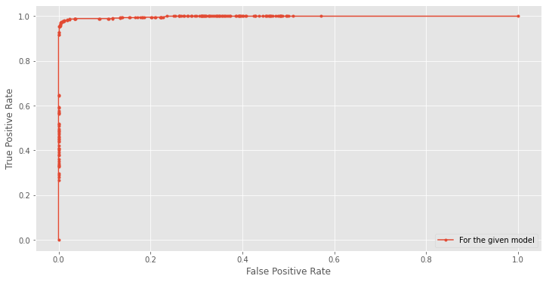
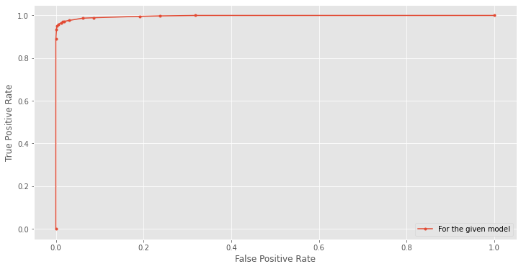
Conclusion ( AUC-ROC of TOP 4)
XGBoost
ADABoost

Slide 21
Conclusion (Category Wise Best Performance)
Accuracy: SVM (kernel=rbf) [96.72] > XGBoost (estimator=20, depth=8, objective=’binary:logistic’) [95.47] > ADABoost (estimator=20, depth=10, criteria=’gini’) [95.23]
Precision: SVM [98.42] > Naive Bayes(Gaussian) [97.18] > Random Forest (estimator=20, depth=10, criteria=’gini’) [95.63]
Recall: ANN [99.66] > SVM [89.08] > Logistic [89.01]
F1: SVM [93.51] > Logistic [91.82] > XGBoost [91.11]
AUC-ROC Score: XGBoost [99.8] > ADABoost [99.7] > SVM [98.8]
OVERALL: SVM is best, followed by XGBoost with small margin

Slide 22
Timeline
Followed:
Week 3- Data Exploration, Data pre-processing and Data Visualization
Week 4-5- Feature Selection
Week 6- Logistic Regression, Naive Bayes
Week 7- Support Vector Machines,Decision Trees and Random Forest
Week 8- Artificial Neural Network
Week 9- Performance Analysis of Models
Week 10- Model Testing and Improvement(Bias, Variance, Hyperparameter Tuning)
Week 11- Final Report Writing

Slide 23
Contribution
All Members had equal contributions. There distributed work is given below:
Ishit Bajpai - EDA, Data Cleaning, Naive Bayes, Logistic Regression, ANN
Keshav Rajput - Debugging , Result Analysis and Report(TSNE,PCA) splits etc, Dataset
Prachi - Random Forest, KFold Cross validation, EDA, SVM, ADABoost
Satyam - Literature Review, Report, Presentation, EDA, Result Analysis, PCA, XGBoost

