Slide 1
Scribe
The modern platform for bloggers and content creators
MLSA Fullstack Web Development Project
Akshat Shukla

Slide 2
Overview
Full-stack blogging platform with React frontend and Supabase backend for seamless hosting and authentication.
Styled using DaisyUI for a clean, modern user experience and scalable deployment.
Key features: user authentication, blog management, profile management, and blog feed.

Slide 3
Tech Stack
Frontend: React, DaisyUI
Backend: Supabase (serverless hosting, database, authentication)
Styling: DaisyUI (with custom color schemes)
Database: Supabase(Postgres)
Icons: Lucide, Simple Icons
Misc: react-markdown

Slide 4
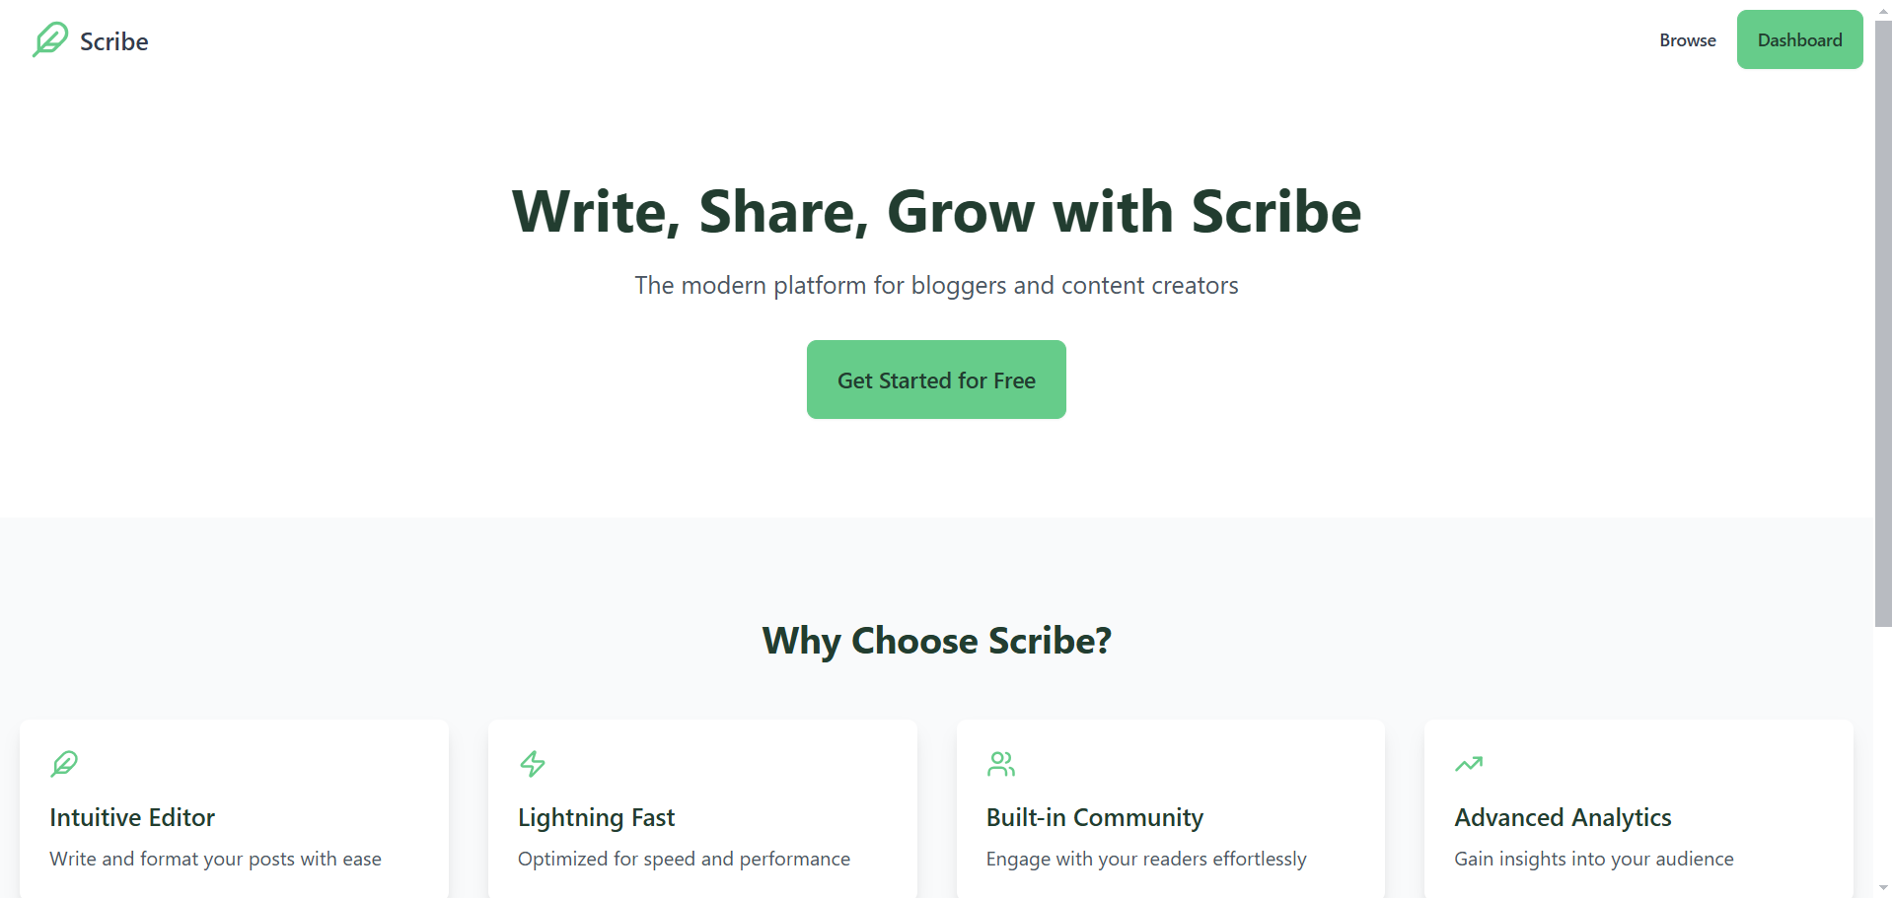
Images

Slide 5
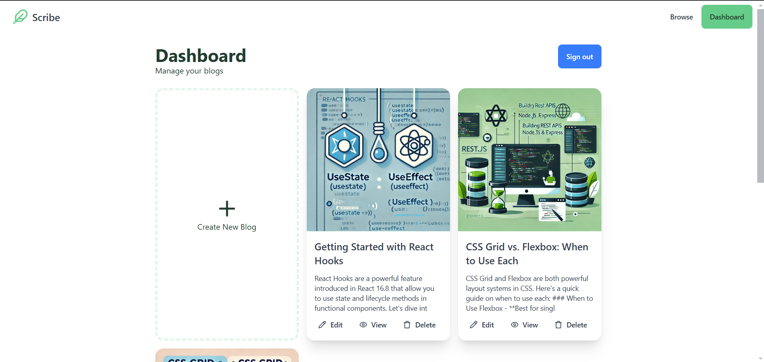

Slide 6
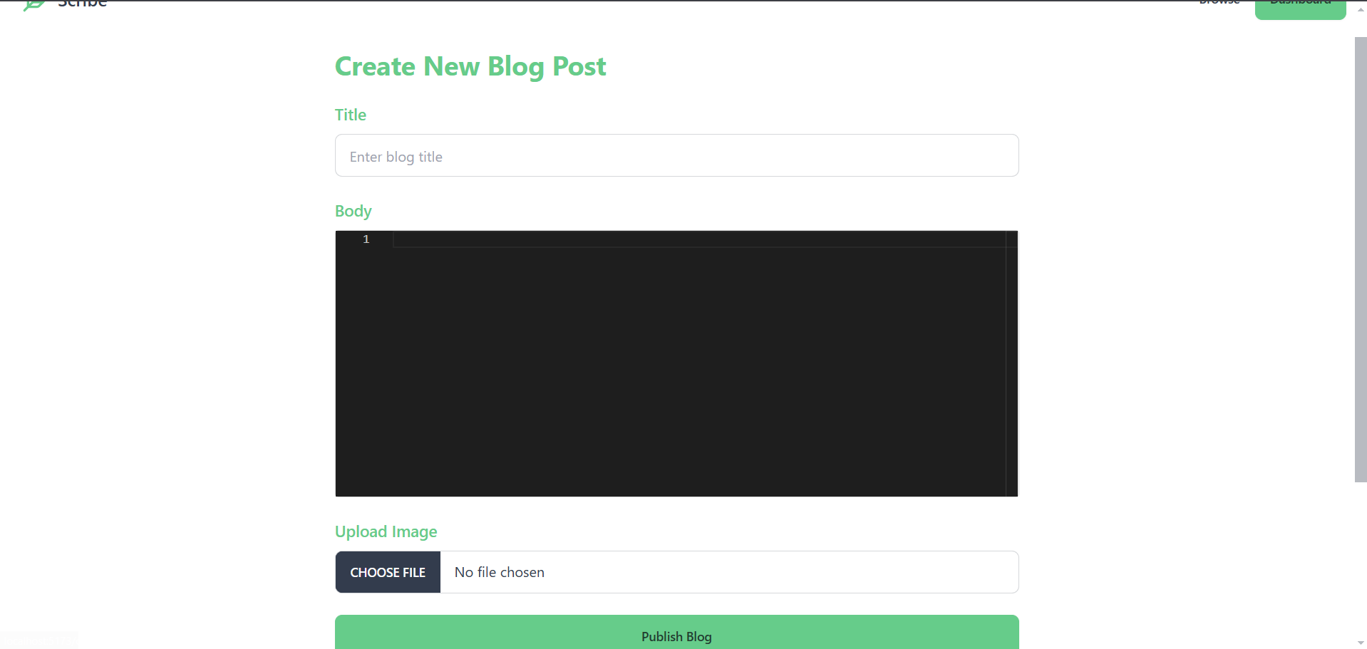

Slide 7
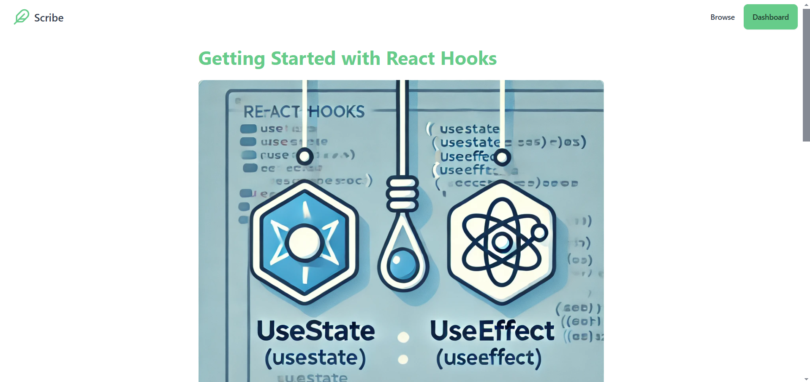

Slide 8
Future Enhancements
Rich Text Editor – Upgrade the blog editor to support rich text and image uploads for a more dynamic content experience.
Social Sharing & Reactions – Add social sharing buttons, likes, and reactions to blogs for increased engagement.
Comment System – Integrate a comment system for users to interact with blog posts.
Notifications – Implement email or in-app notifications for new comments, likes, or when followed authors publish new posts.
Draft and Publish Scheduling – Enable users to save drafts and schedule posts for future publishing.

