Slide 1
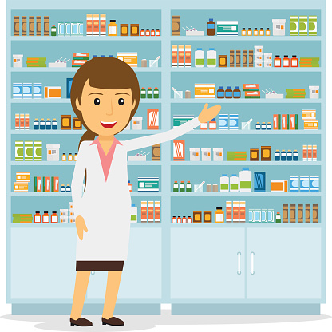
Pocket Pharmacist
A Drug-to-Drug Interaction App

Slide 2
Table of Contents
Overview
Brainstorming
How it was Made
API’s
Problems/Complications
Plans for Growth
Terms of Service
Contributors

Slide 3
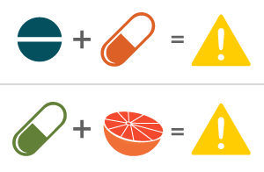
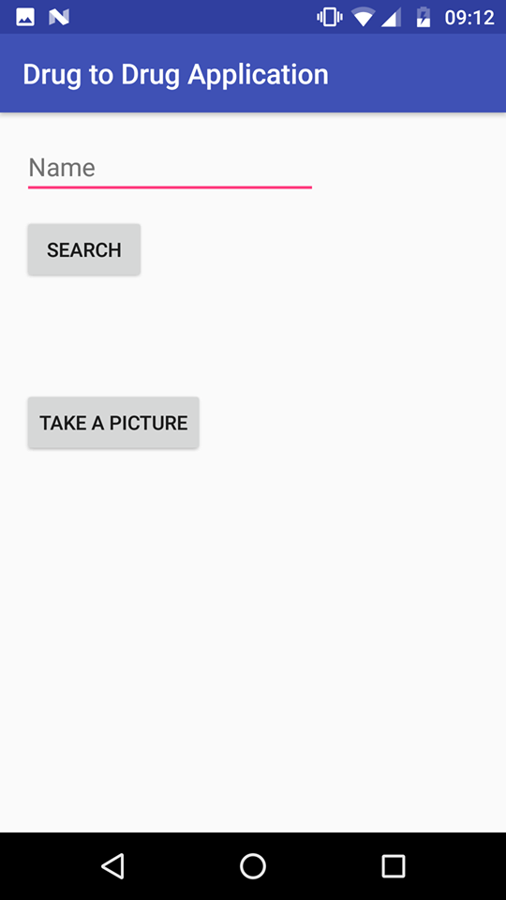
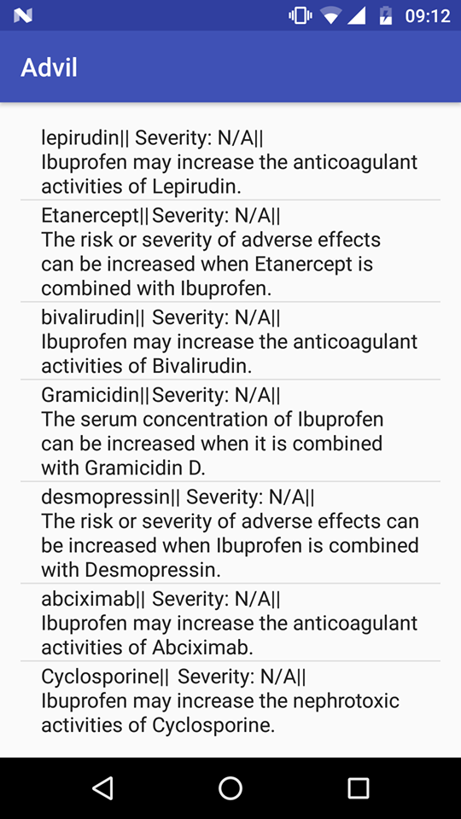

Overview
The idea – to make people aware of the adverse effects of drug-to-drug interactions
Advil

Slide 4
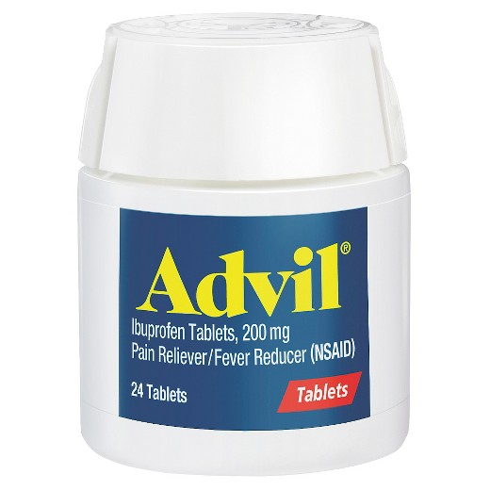
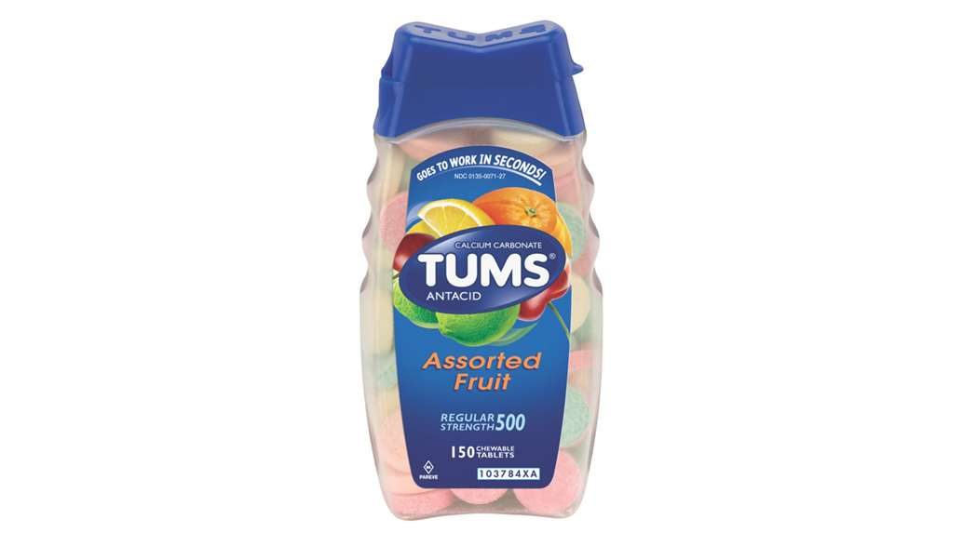



Brainstorming
Anagh’s story – Advil and Tums

Slide 5
How it was Made
IDE – android studio
Programming Languages – Java
Data Formatting – JSON, XML
Design Patterns – Model View Controller (MVC)

Slide 6
API’s
RXNorm API
Drug Interaction API
Microsoft’s Computer Vision API

Slide 7

Problems and Complications
Revert to Jasper

Slide 8
Plans for Growth
Make the app compatible for all iOS devices.
Added functionality – on the basis of dosage and strength of drug, calculate consumption, and return a more specific level of severity and describes adverse effects more accurately
Ability for user to upload a prescription image from their phone gallery

Slide 9
Terms of Service
"This product uses publicly available data from the U.S. National Library of Medicine (NLM), National Institutes of Health, Department of Health and Human Services; NLM is not responsible for the product and does not endorse or recommend this or any other product."

Slide 10
Contributors
Anagh Telluri
Jasper Bae
Rushabh Jhaveri
Samanvitha Medam

