Slide 1
Predictive Analytics in Supply Chain Management: A Classification Model for Assessing Delivery Timeliness
Presented by:
Nemi Makadia Yash Doshi Aneri Patel Nihar Domala

Slide 2
INTRODUCTION
The efficiency and resilience of supply chain operations are vital for any business's success. In a rapidly evolving business landscape, where data is an invaluable asset, leveraging advanced analytics becomes imperative. Our project embarks on a journey to unravel the untapped potential within supply chain data.
Why delve into supply chain data? Because optimizing it goes beyond cost-cutting; it boosts customer satisfaction, ensures punctual deliveries, and minimizes risks. Our project focuses on modeling this complex data for transformative impacts on business outcomes.

Slide 3
OBJECTIVE
This project seeks to optimize supply chain management by leveraging data-driven insights extracted from a comprehensive dataset. Our primary objectives include identifying patterns in payment methods, understanding market and regional sales dynamics, and analyzing on-time delivery patterns of the supply chain system.

Slide 4
DATA PRE-PROCESSING
Feature Engineering:
Created a new feature, Customer.Full.Name, by combining first and last names.
Handling Missing Values:
Applied na.omit(data) to remove rows with missing values.
Column Removal for Streamlining:
Eliminated unnecessary columns (Customer.Email, Customer.Password, etc.) for simplicity.
Target Variable Transformation:
Transformed Late_delivery_risk into a tabular format using table(data$Late_delivery_risk).
Identified and removed redundant columns (Order.Item.Product.Price, etc.) for optimization.

Slide 5
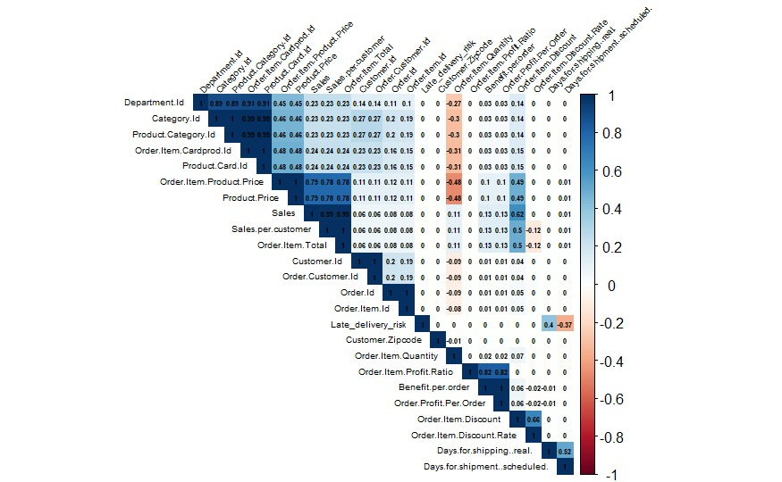
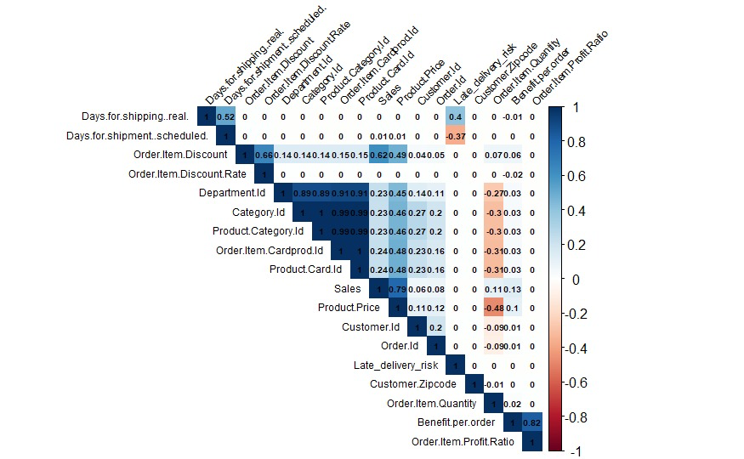
Correlation Analysis
Before pre-processing
After removing redundant columns

Slide 6
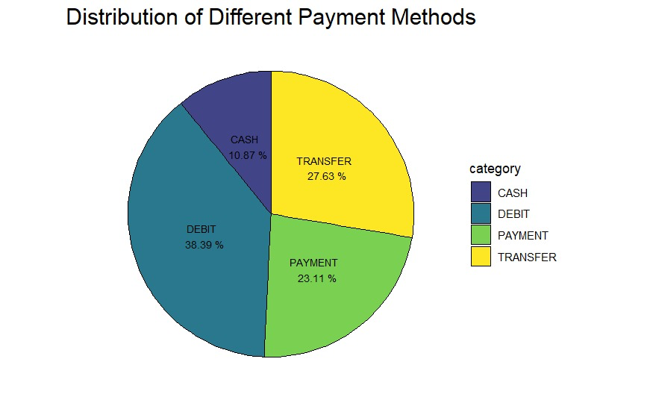
Exploratory Data Analysis (EDA)
Analysis of Payment Method Trends
1. Distribution of Payment Methods
Debit payments emerge as the primary transaction method, constituting more than one-third of all transactions.
Electronic transfers represent a substantial share, signifying a prevailing inclination toward cashless transactions.
Cash payments, although still utilized, occupy the smallest portion, implying a diminished role in the current payment landscape.
Pie chart showing the distribution

Slide 7
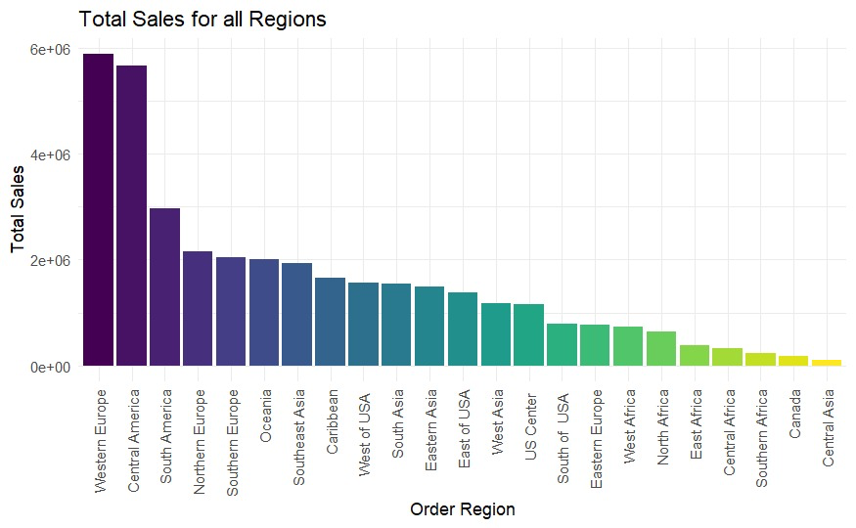
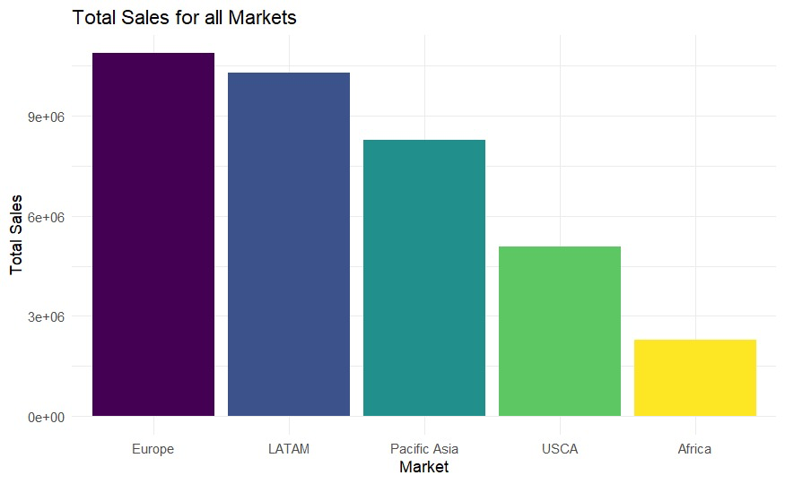
Total Sales Analysis
Total Sales across Regions
Total Sales across Markets
Europe has the highest overall sales, while Africa shows the lowest total sales.
Western Europe and Central America top the list in terms of total sales by region, while Southern Africa, Canada, and the Central Asia region display the lowest sales.

Slide 8
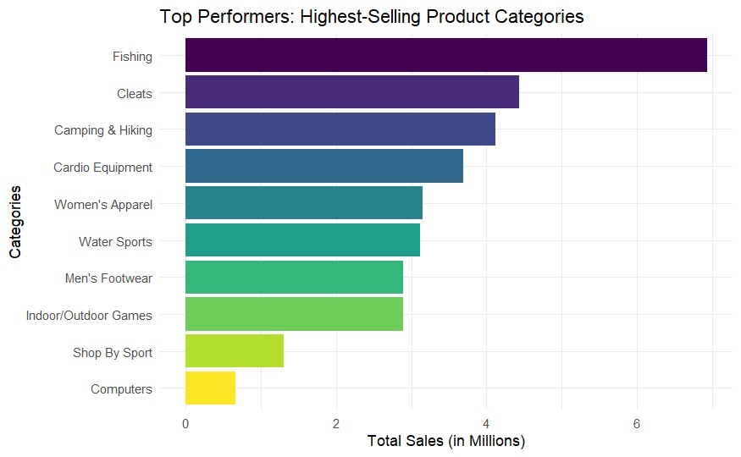
Highest selling product categories
Strong market preference for outdoor and fitness-related products
Computers category shows minimal sales

Slide 9
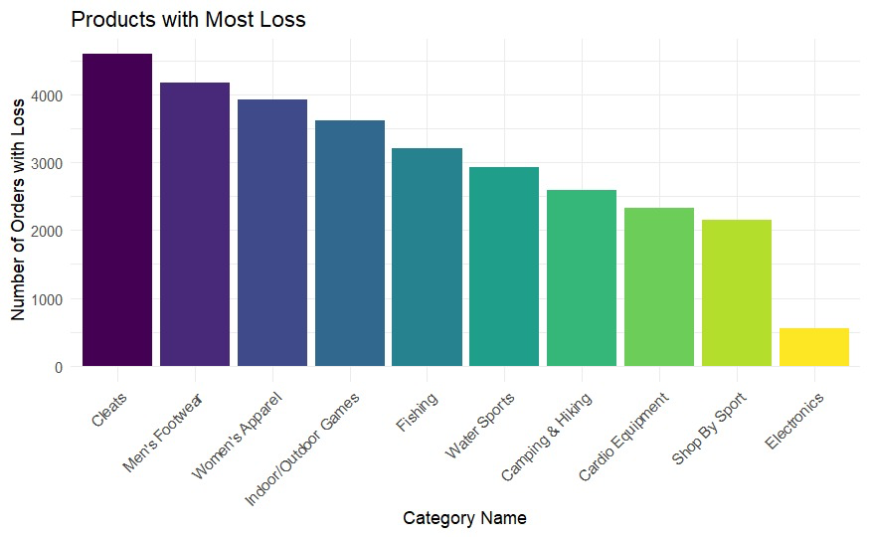
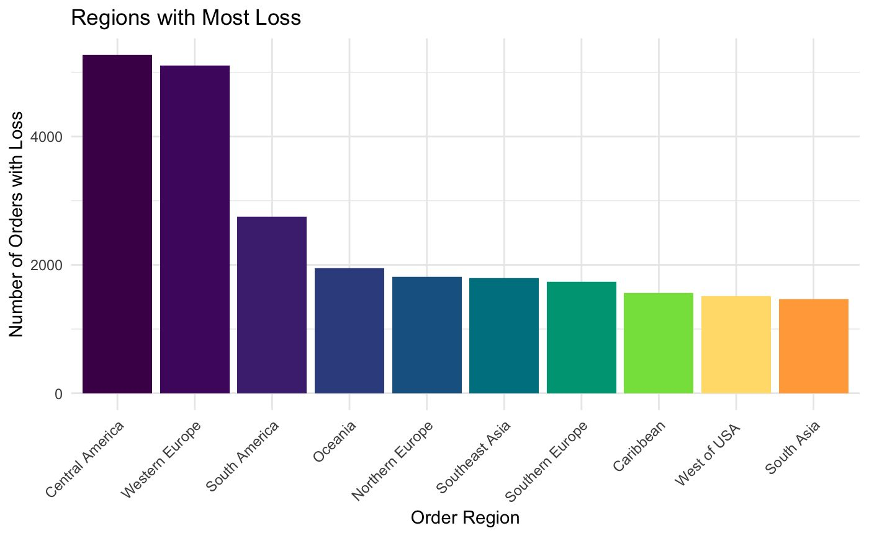
Loss Analysis
Products with Most Loss
Regions with Most Loss
Product categories related to clothing and footwear, specifically Cleats, Men's Footwear, and Women's Apparel
Electronics category has the smallest number of loss-making orders

Slide 10
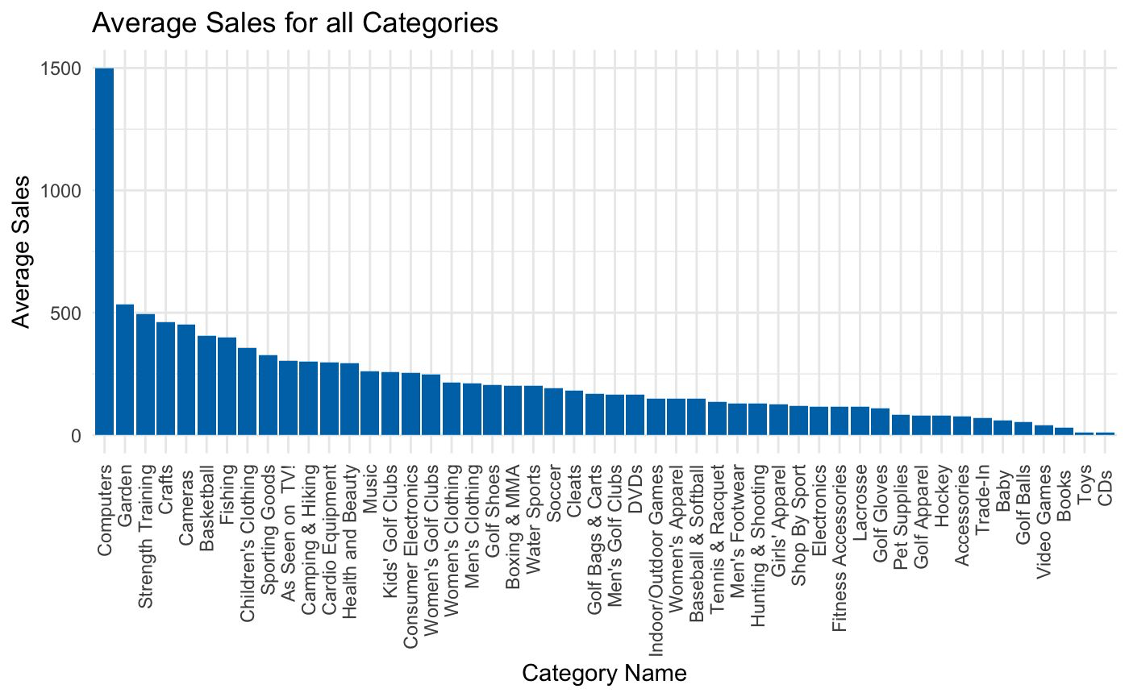
Average sales across all categories
Computers tops the list in terms of average sales, demonstrating a notable lead over other categories
Toys and CDs appear to have lower average sales compared to the leading category

Slide 11
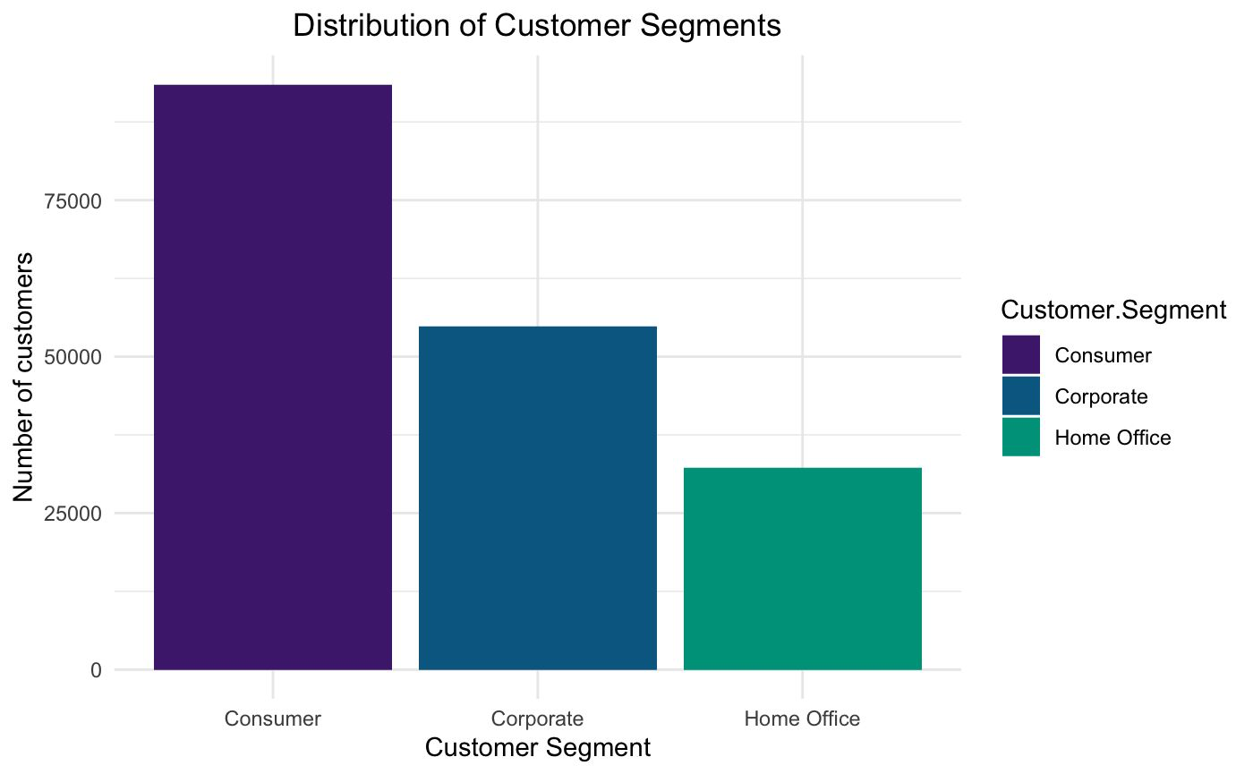
Distribution of Customer Segments
The chart highlights a significant presence in the "Consumer" segment, outpacing "Corporate" and "Home Office." This emphasizes a consumer-centric market, providing insights for targeted strategies and informed business decisions.

Slide 12
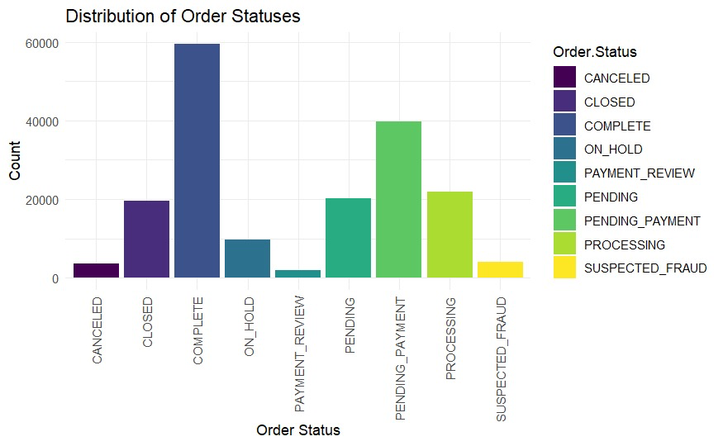
Distribution of Order Status
The graph shows the distribution of order in terms of statuses.
The order statuses with COMPLETE has the highest distribution followed by PENDING_PAYMENT.
Whereas CANCELLED,PAYMENT_REVIEW, and SUSPECTED_FRAUD has the least amount of distribution.

Slide 13
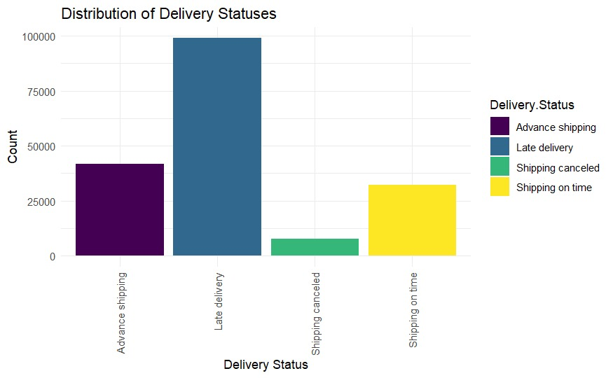
Distribution of Delivery Status
The following graph shows the distribution of delivery status , i.e. , either the product is shipped in advance, on time, late or is it cancelled.
Orders being delivered late has the highest amount of distribution, followed by orders shipped in advance. Orders that are cancelled has the least distribution.

Slide 14
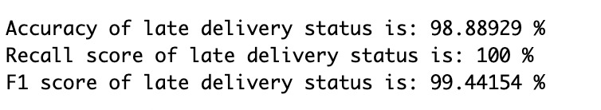
Model Building
Logistic Regression Model
The model shows exceptional performance in predicting late delivery status, and achieved a high accuracy of 98.89%
With recall score of 100%, it successfully captured all actual late delivery instances
F1 score of 99.44% further underscores its precision and reliability

Slide 15
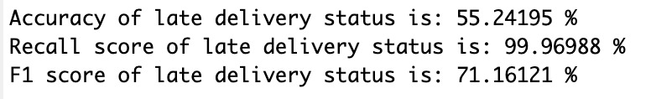
Naive Bayes Model
The model achieved an exceptionally high recall score of 99.97%, indicating it almost perfectly identified all actual late deliveries
Overall accuracy stands at a much lower 55.24%, which suggests a significant number of false positives
F1 score, at 71.16%, reflects a better balance between precision and recall than the accuracy suggests

Slide 16
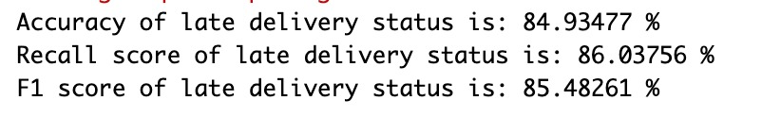
K-Nearest Neighbors (KNN) Model
Achieved an accuracy of 84.93%, indicating a high level of correctness in its predictions.
The recall score of 86.04% demonstrates its effectiveness in identifying a majority of actual late deliveries.
The F1 score, at 85.48%, indicates a good balance between precision and recall

Slide 17
Conclusion
In conclusion, the Logistic Regression model stands out as the most reliable and effective choice for predicting late delivery status, offering unparalleled accuracy, recall, and F1 score.

Slide 18
THANK YOU!

