Slide 1

ECE 4501 AI Hardware Final Project
SignScribe - Real Time American Sign Language Translator
Team Members: Nemo Kim (kyj5ra) | Bryan Tang (nfs7xc) | Davis Wang (bqe6ue)

Slide 2
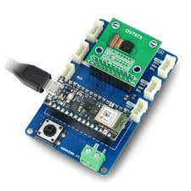
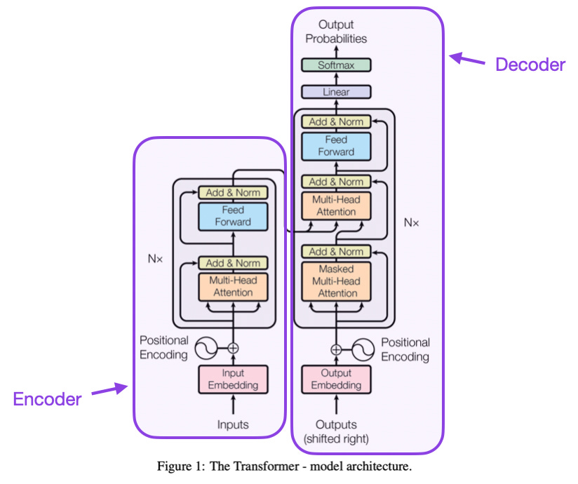
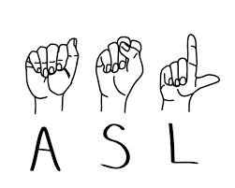
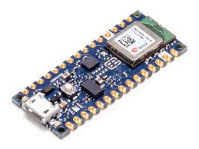
Introduction
SignScribe
Serial Image Capture on a Custom Interface
ASL Gesture Recognition Training on Edge Impulse
Contextual Interpretation via Large Language Model
Arduino TinyML Kit
GroqCloud LLM
Arduino 33 BLE
Notes:
The SignScribe project aims to develop a real-time, AI-driven sign language translation system to bridge communication gaps for individuals who use American Sign Language (ASL).
To make SignScribe a reality, we needed a combination of cutting-edge technology that is not only powerful but also portable, efficient, and capable of real-time performance. This is why we chose to integrate three key components: the Arduino TinyML Kit, the Arduino Nano 33 BLE, and the GroqCloud Large Language Model (LLM). The selection of these tools were based on decisions to target efficiency, portability, and low latency through a strategic combination of hardware and AI to meet the technical demands of our project, as well as to provide a user-friendly solution for sign language translation.

Slide 3
Motivations and Goals
Motivations:
Empowering users through inclusivity and accessibility
Bring communities together by providing communication tools
Creating smoother interactions between sign language users and non-signers
Goals:
Train a deep learning model for accurate gesture recognition
Achieve real-time translation
Deliver an interface with practical accessibility for users
Utilize AI to address social barriers
Notes:
the core idea behind the project is driven by the vision of empowering users through inclusivity and accessibility, enabling individuals who rely on American Sign Language (ASL) to communicate seamlessly with non-signers. By training a deep learning model for accurate gesture recognition and combining it with real-time translation, the system aims to create smoother and more natural interactions, reducing friction in conversations with those with hearing and speech disabilities. Our ultimate goal is to deliver a practical, user-friendly interface that bridges communities and fosters understanding through cutting-edge technology, which also means that we must ensure the system remains scalable and adaptable, allowing it to grow alongside users' needs, whether by expanding its gesture vocabulary or integrating additional languages and dialects.

Slide 4
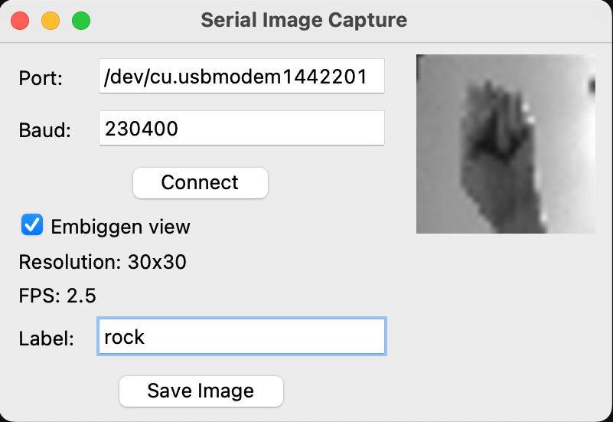
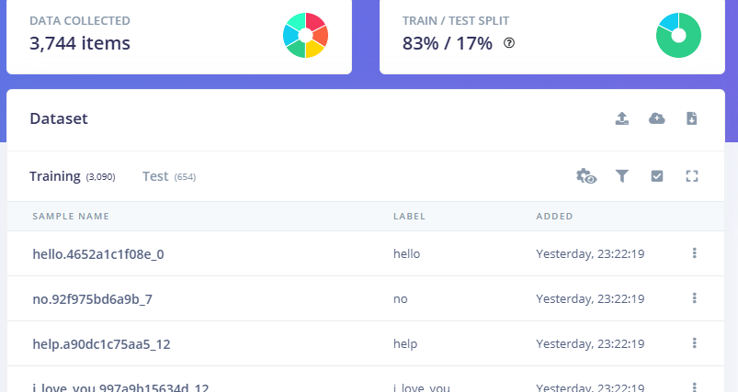
Project Methodology
Image Capture + Collect Dataset
Image Transforms
train model
Deployment
Used OV7675 to take images of signs to synthesize dataset using VS Code GUI
50 Pictures per sign + 50 for background = 300 individual images
Run Jupyter notebook code to do multiple transforms to each image
Zoom in and out
+
Translations
Self Classified specific training and testing images
Uploaded all images to model trainer
Edge Impulse + TFLite Extension + CNN (model)
Con: runtime limit → epochs < 90
The edge impulse deployed to Arduino file extension
Results of live imaging were displayed as inference percentage on serial monitor
COM7
Notes:
Our system relies on two advanced models to achieve real-time speech-to-sentiment analysis.
Starting with Speech Recognition, we chose OpenAI’s Whisper for its state-of-the-art performance. Whisper offers multilingual support and excels at handling different accents, making it suitable for diverse user bases.
For Sentiment Analysis, we use DistilRoBERTa, specifically the emotion-english-distilroberta-base model. This lightweight version of RoBERTa strikes an excellent balance between speed and accuracy, making it well-suited for real-time applications. It’s pre-trained on emotion detection tasks and supports simultaneous identification of multiple emotions, allowing us to analyze complex emotional expressions efficiently.

Slide 5






Analysis Process
Hello | Yes | No | Help | I love you | Background
https://streamable.com/44mb3c?src=player-page-share
Notes:
For our evaluation, we explored different datasets and ultimately chose the RAVDESS dataset over the MOSEI dataset. The RAVDESS dataset provided us with high-quality audio recordings from professional actors speaking with clear and well-defined emotional expressions. This clarity allowed us to effectively align our system’s classifications with human-labeled ground truths.
In our experiment settings, we focused on real-time processing of 5-second audio segments.
We also implemented two analysis modes to enhance user insights:
Current Segment Mode: This mode provides immediate emotion detection for the most recent recording, making it ideal for real-time feedback.
Full Transcript Mode: This mode aggregates emotions across the entire session, giving a holistic view of the emotional dynamics over time.
These evaluation methods and modes helped us measure both the accuracy and practicality of our system in real-time scenarios.

Slide 6
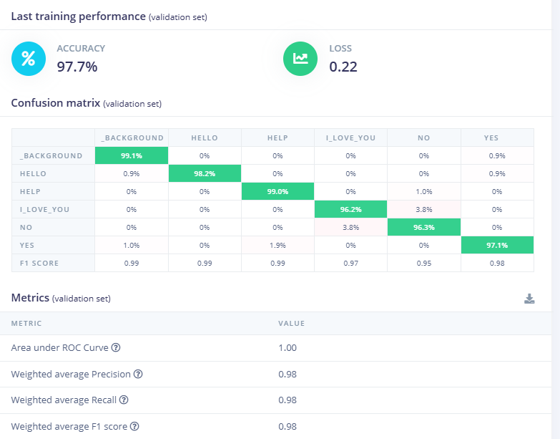
Accuracy and Loss Metrics
Notes:
1. Categorical Cross-Entropy Loss (for Classification Tasks)

Slide 7
hello
background: 0.00
hello: 0.906
help: 0.00
i love you: 0.00
no: 0.00
yes: 0.094
help
background: 0.00
hello: 0.00
help: 0.977
i love you: 0.00
no: 0.023
yes: 0.00
i love you
background: 0.00
hello: 0.00
help: 0.00
i love you: 0.000001
no: 0.997
yes: 0.00
yes
background: 0.00
hello: 0.00
help: 0.047
i love you: 0.000001
no: 0.00
yes: 0.953
no
background: 0.00
hello: 0.00
help: 0.320
i love you: 0.00
no: 0.680
yes: 0.00

Slide 8
Limitations
Hardware Limitations: Resolution quality issues
Small Dataset: Overfitting
80 epochs for less than 50 images per individual gesture
lack of data variety
Light but Weak

Slide 9
Thank You

