Slide 1
LAB 6 TA 鄭紹雄 巫佶翰

Slide 2
Deadline: 2021/8/31(Tue) 12:00 No Demo

Slide 3
Must use sample code, otherwise no credit.
In this lab,

Slide 4
Outline
1. Solve LunarLander-v2 using DQN
2. Solve LunarLanderContinuous-v2 using DDPG
3. Modify and Run Sample Code
4. Scoring Criteria
5. Reminders

Slide 5
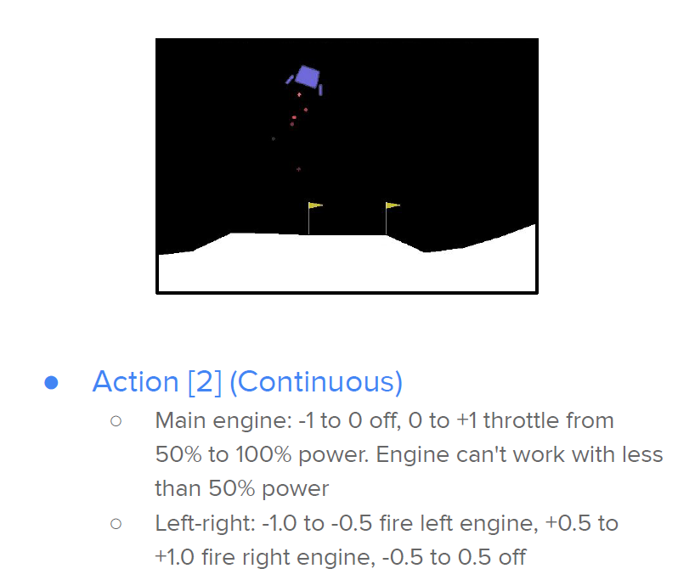
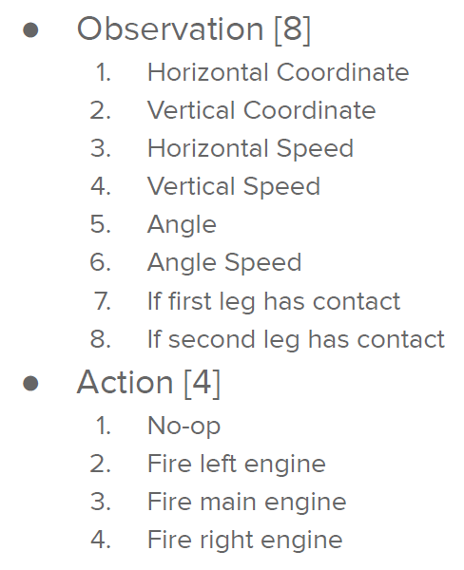
LunarLander-v2

Slide 6
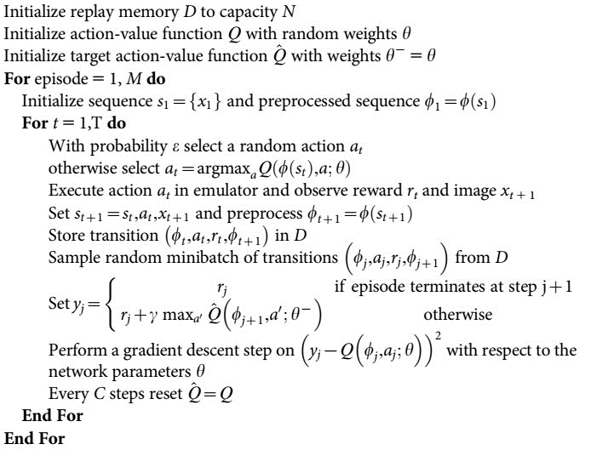
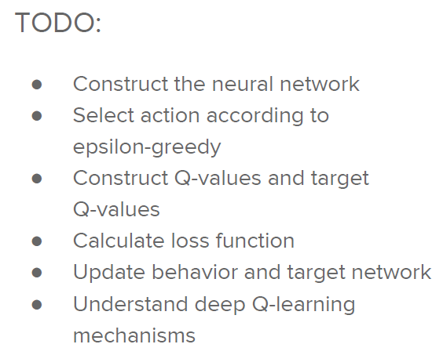
Deep Q-Network (DQN)
Algorithm 1 – Deep Q-learning with experience replay:

Slide 7
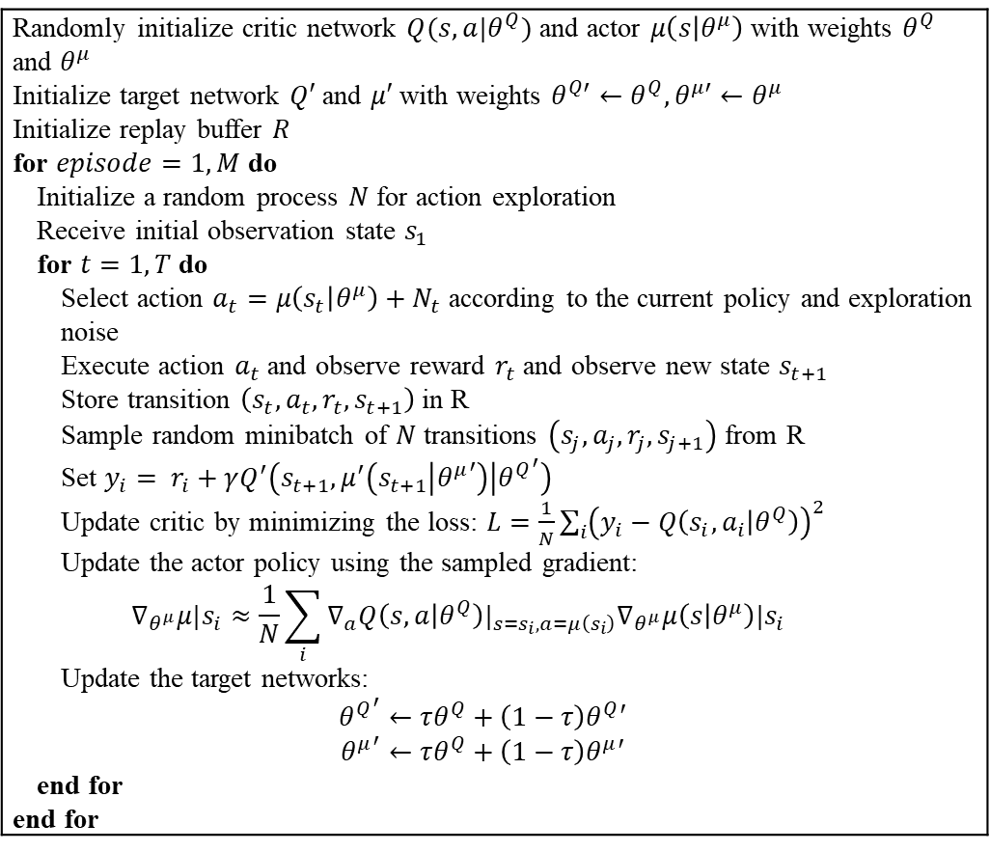
Deep Deterministic Policy Gradient (DDPG)
Algorithm 1 – Deep Q-learning with experience replay:
Randomly initialize critic network $Q(s,a|θ^{Q})$ and actor $μ\left(s | θ^{μ}\right)$ with weights $θ^{Q}$ and $θ^{μ}$ Initialize target network $Q′$ and $μ′$ with weights $θ^{Q′}←θ^{Q}, θ^{μ′}←θ^{μ}$ Initialize replay buffer $R$ for $episode=1,M$ do Initialize a random process $N$ for action exploration Receive initial observation state $s_{1}$ for $t=1,T$ do Select action $a_{t}=μ\left(s_{t} | θ^{μ}\right)+N_{t}$ according to the current policy and exploration noise Execute action $a_{t}$ and observe reward $r_{t}$ and observe new state $s_{t+1}$ Store transition $\left(s_{t},a_{t}, r_{t},s_{t+1}\right)$ in R Sample random minibatch of $N$ transitions $\left(s_{j},a_{j}, r_{j},s_{j+1}\right)$ from R Set $y_{i}= r_{i}+γQ^{′}\left(s_{t+1},μ^{′}\left(s_{t+1} | {θ^{μ}}^{′}\right) | {θ^{Q}}^{′}\right)$ Update critic by minimizing the loss: $L=\frac{1}{N}\sum_{i}{{\left(y_{i}−Q\left(s_{i},a_{i} | θ^{Q}\right)\right)}^{2}}$ Update the actor policy using the sampled gradient: $$∇_{θ^{μ}}μ|s_{i}≈\frac{1}{N}\sum_{i}{∇_{a}Q\left(s,a | θ^{Q}\right)|_{s=s_{i},a=μ\left(s_{i}\right)}∇_{θ^{μ}}μ\left(s | θ^{μ}\right)|s_{i}}$$ Update the target networks: $${θ^{Q}}^{′}←τθ^{Q}+\left(1−τ\right)θ^{Q}′$$ $${θ^{μ}}^{′}←τθ^{Q}+\left(1−τ\right)θ^{μ}′$$ end for end for

Slide 8
3. Modify Sample Code
1. Find a #TODO comment with hints
2. remove the raise NotImplementedError

Slide 9
3. Run Sample Code
Simply train and test: python dqn.py
Only test and render: python dqn.py --test_only --render
Help message: python dqn.py --help

Slide 10
4. Scoring Criteria
Show your work, otherwise no credit will be granted.
Report (80%)
(DO explain; do not only copy and paste your codes.)
Report Bonus (20%)
Implement and Experiment on Double-DQN (10%)
Extra hyperparameter tuning, e.g., Population Based Training. (10%)
Performance (20%)
[LunarLander-v2] Average reward of 10 testing episodes: Average ÷ 30
[LunarLanderContinuous-v2] Average reward of 10 testing episodes: Average ÷ 30

Slide 11
5. Reminders
Your network architecture and hyper-parameters can differ from the defaults.
Ensure the shape of tensors all the time especially when calculating the loss.
with no_grad() : scope is the same as xxx.detach()
Be aware of the indentation of hints.
When testing DDPG, action selection need NOT include the noise.

Slide 12
References
Mnih, Volodymyr et al. “Playing Atari with Deep Reinforcement Learning.” ArXiv abs/1312.5602 (2013).
Mnih, Volodymyr et al. “Human-level control through deep reinforcement learning.” Nature 518 (2015):529-533.
Van Hasselt, Hado, Arthur Guez, and David Silver. “Deep Reinforcement Learning with DoubleQ-Learning.” AAAI. 2016.
Lillicrap, Timothy P. et al. “Continuous control with deep reinforcement learning.” CoRRabs/1509.02971 (2015).
Silver, David et al. “Deterministic Policy Gradient Algorithms.” ICML (2014).
OpenAI. “OpenAI Gym Documentation.” Retrieved from Getting Started with Gym: https://gym.openai.com/docs/ .
OpenAI. “OpenAI Wiki for Pendulum v0.” Retrieved from Github: https://github.com/openai/gym/wiki/Pendulum-v0 .
PyTorch. “Reinforcement Learning (DQN) Tutorial.” Retrieved from PyTorch Tutorials: https://pytorch.org/tutorials/intermediate/reinforcement_q_learning.html .

